Slide 1
Features-Enriched
Radiation Model
Extending the Radiation Model with exogenous location features
for large-scale human mobility prediction
Application to international migration · Vittoria Bettio · Robustness meeting 15-04-2026

Slide 2
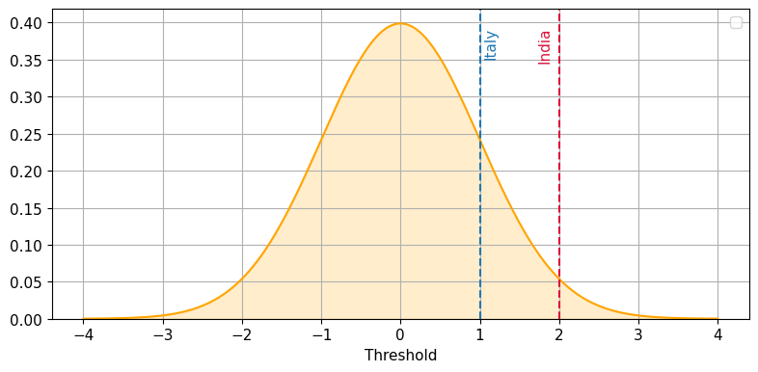
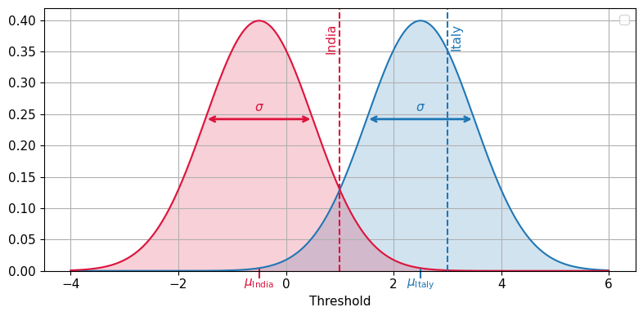
Motivation
Standard Radiation Model
Features-Enriched RM (FERM)
Only population as input
Parameter-free & analytically tractable
Works well at national/regional scale
Cannot incorporate economic, climatic, or cultural features
All locations share the same benefit distribution
Population + exogenous feature (niche) as input
Same physical absorption process as RM
Each location gets its own benefit distribution
Attractive destinations draw migrants from further away
→

Slide 3
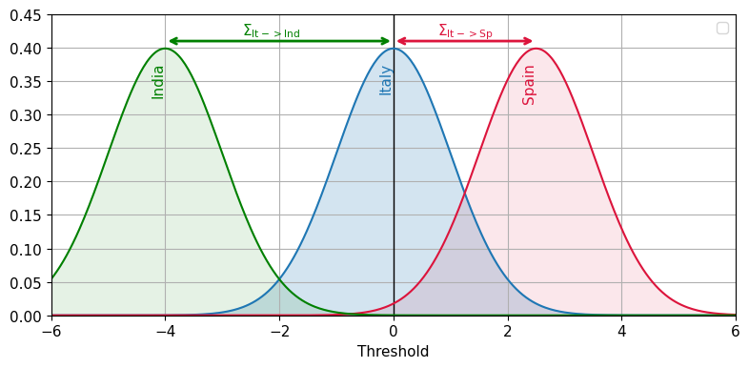
Motivation
Features-Enriched RM (FERM)
Relational FERM
Population + exogenous feature (niche) as input
Same absorption process as RM
Each location gets its own benefit distribution
Attractive destinations draw migrants from further away
Population + relational feature Σᵢⱼ as input
Same absorption process as RM / FERM
Attractiveness becomes corridor-specific, not only destination-specific
Destination j can look different from different origins i
→

Slide 4


Motivation
Features-Enriched RM (FERM)
Relational FERM
→

Slide 5


Σᵢⱼ corridor-specific attractiveness
Let C be a set of countries indexed by i and j. Define the corridor attractiveness matrix
- Σᵢⱼ > 0: destination j is attractive from origin i (visa openness, language similarity, diaspora networks)
- Σᵢⱼ < 0: destination j is repulsive from origin i (political tension, closed borders, historical conflict)
- Σᵢⱼ = 0: neutral corridor.
The three model variants differ only in how Σᵢⱼ
is specified

Slide 6
Motivation
Features-Enriched RM (FERM)
→
Relational FERM

Slide 7
How FERM Works: The Simulation
1
Fix thresholds
2
Sort destinations
For each origin, we simulate n_particles migrant-particles. Each particle draws one absorption threshold as the max-of-mᵢ origin-specific distributions, e.g. N(μᵢ, σ).
Higher origin niche → higher thresholds on average
(migrants from attractive places are harder to satisfy)
Destinations ranked by distance from origin, nearest first.
Each particle travels outward and stops at the first destination that beats its threshold.
3
Offer absorbance
4
Count & normalize
At each stop j, a new absorbance offer is drawn.
Offer > threshold → absorbed here, journey ends.
Offer ≤ threshold → particle moves on.
After all n_particles have been assigned, we count how many are absorbed by each destination j.
The fraction absorbed by j gives the probability P(i → j).
Repeating this for every origin builds the full OD probability matrix.
Efficiency trick: for Gaussians instead of drawing mᵢ samples and taking max, use the inverse-CDF shortcut:
z = μ + σ · Φ⁻¹(U^(1/n))

Slide 8
The Niche: Encoding Location Attractiveness
What is the niche?
GDP per capita 2018
The niche is the normalized country-level feature that modulates the benefit distribution μᵢ in FERM. A higher niche value shifts the Gaussian to the right, making a location more likely to offer a winning absorbance.
Economic output per person. Strong proxy for job opportunities and wages. [245.66, 188 298.32]
Social Connectedness Index 2021
[48, 37 967 668]
Diplomatic Disagreement
Measures political/diplomatic disagreement between countries. Higher values mean more disagreement. [0, 4.617]
Common Religion
Abel Migrant Stock 2005-2010
Measures religious similarity between origin i and destination j. Higher values mean stronger common religious composition. [0, 0.997]
Measures historical corridor strength using migrant stocks. [0, 6 825 626]

Slide 9
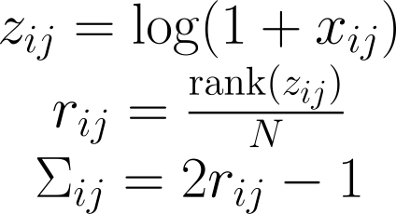
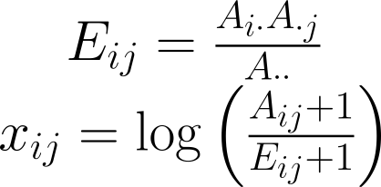
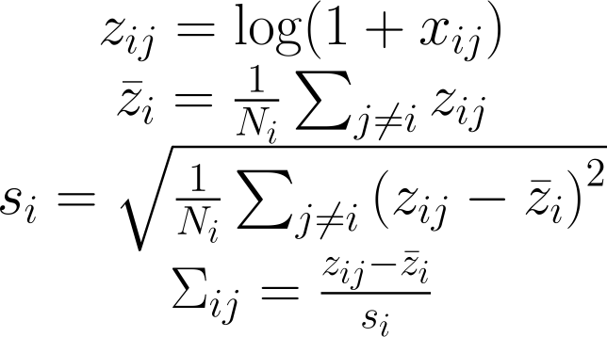
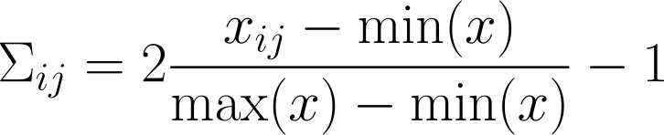
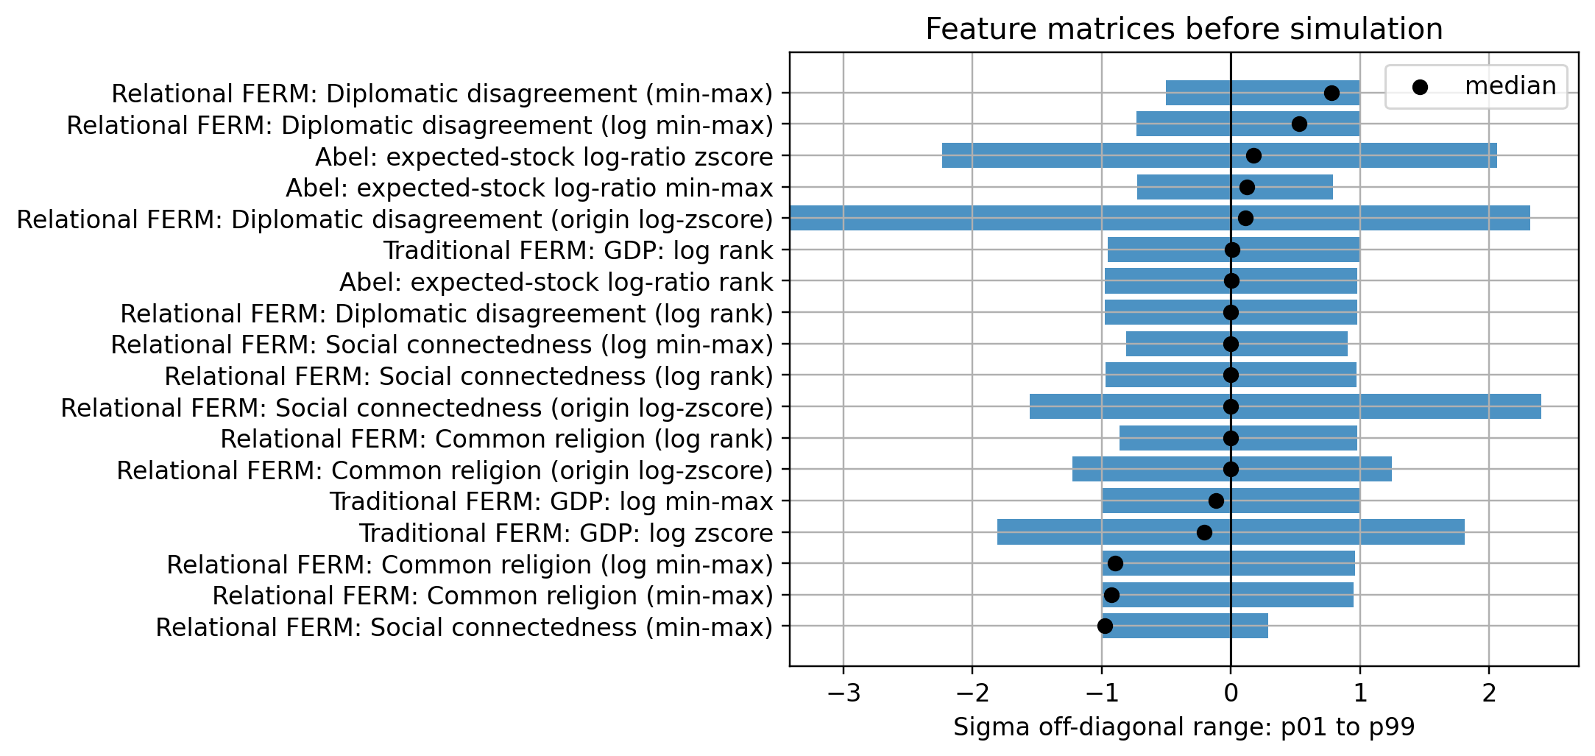
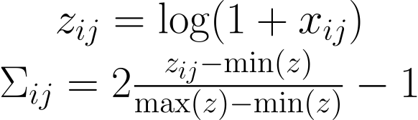
The Niche: Encoding Location Attractiveness
How to normalize?
log-zscore
Log rank
Abel expected-stock log ratio
Min max
Log Min max

Slide 10
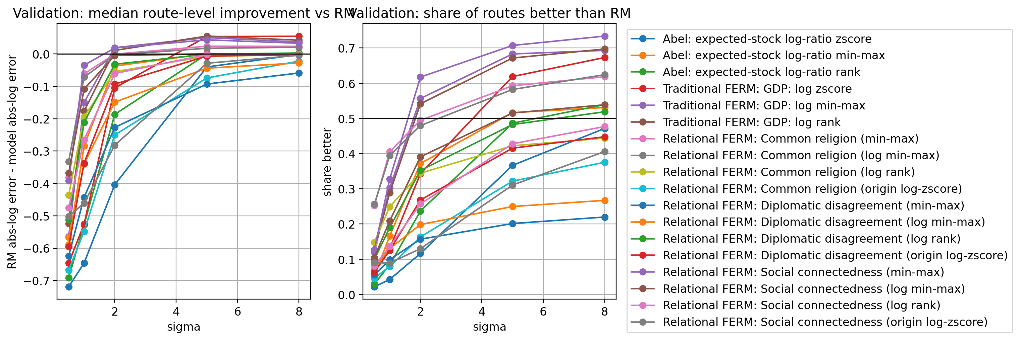
The Niche: Encoding Location Attractiveness
How to normalize?

Slide 11
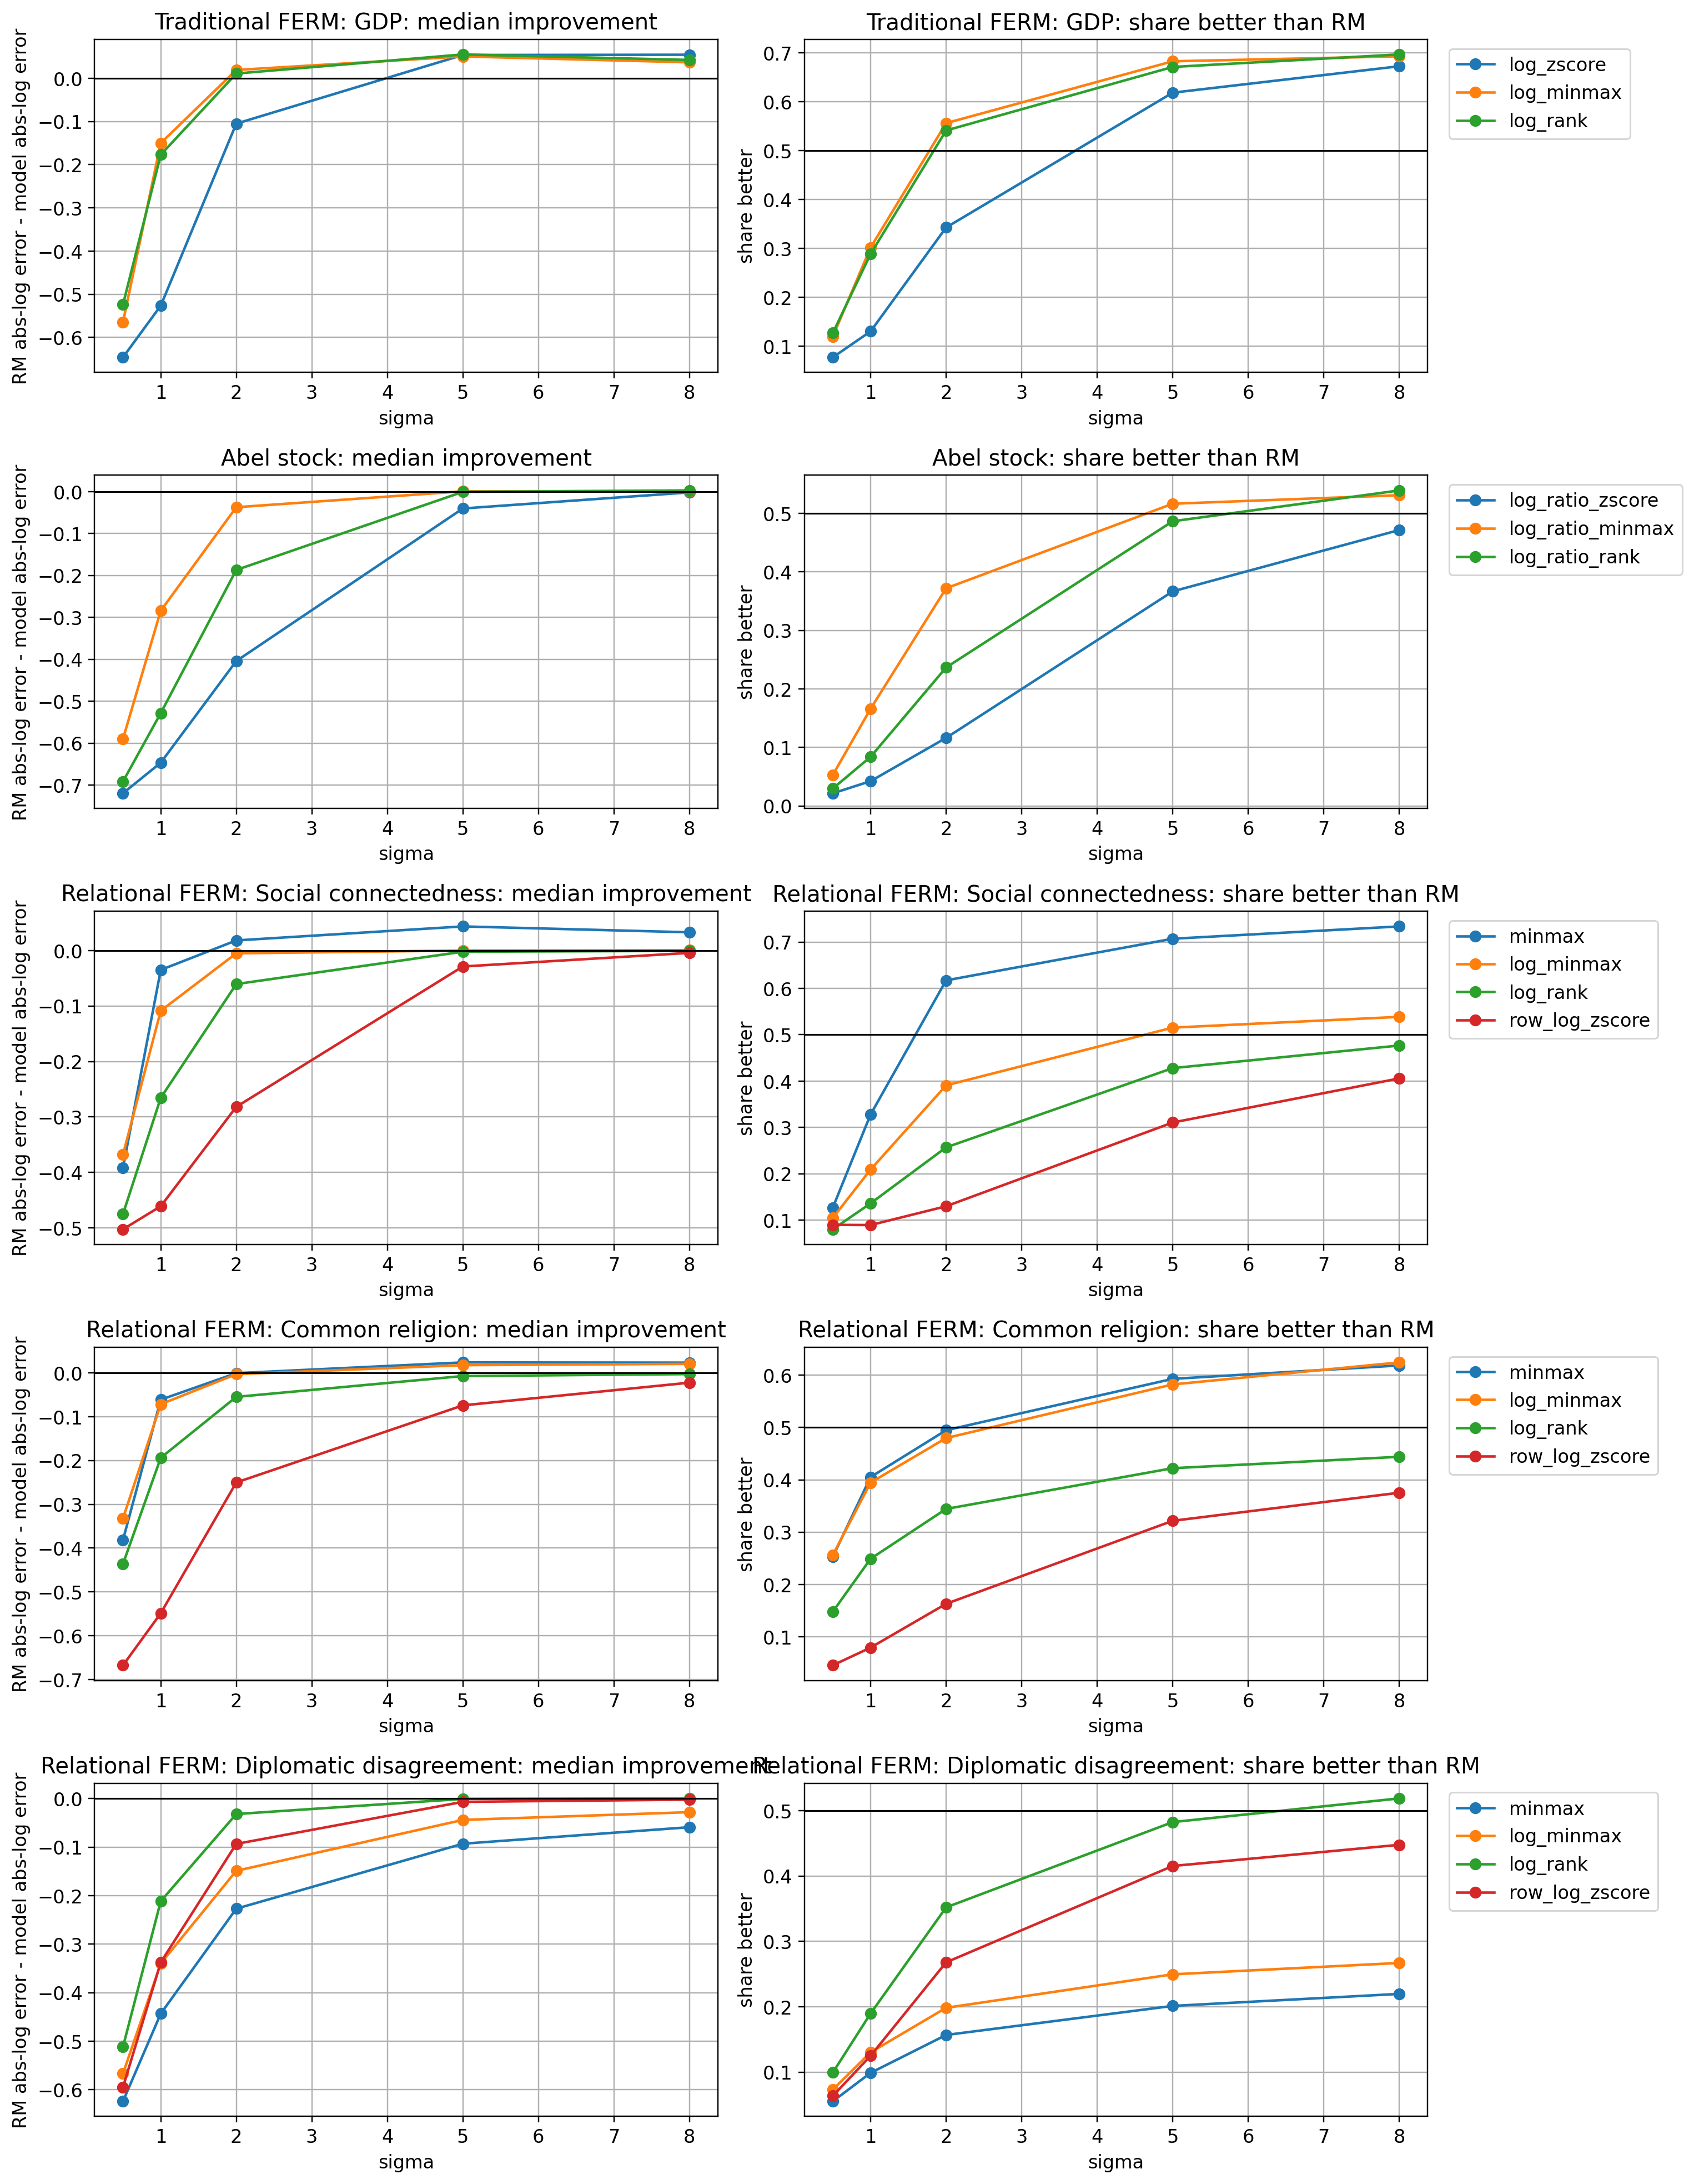
The Niche: Encoding Location Attractiveness
How to normalize?

Slide 12
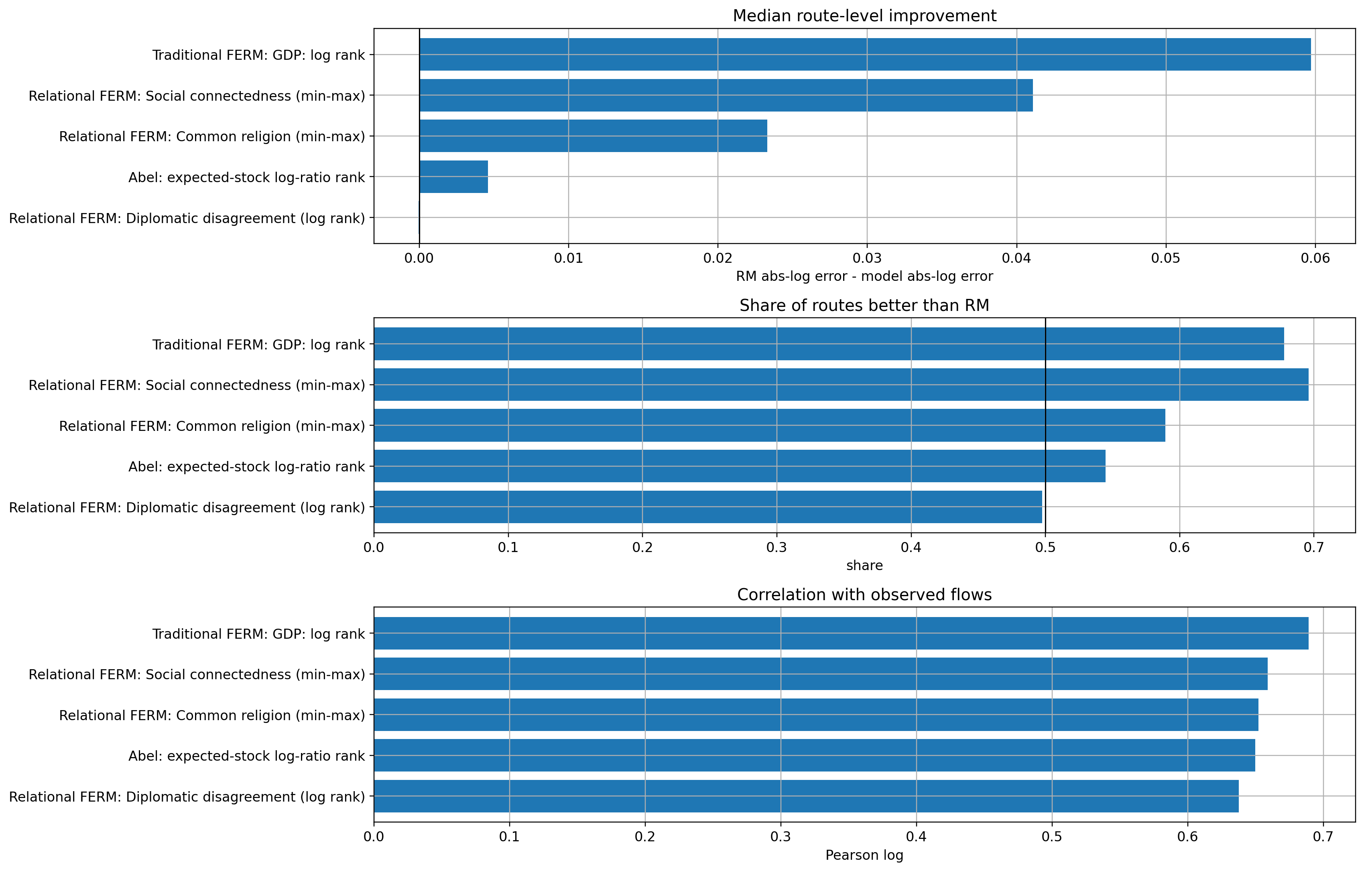
The Niche: Encoding Location Attractiveness
Which features are working better?

Slide 13
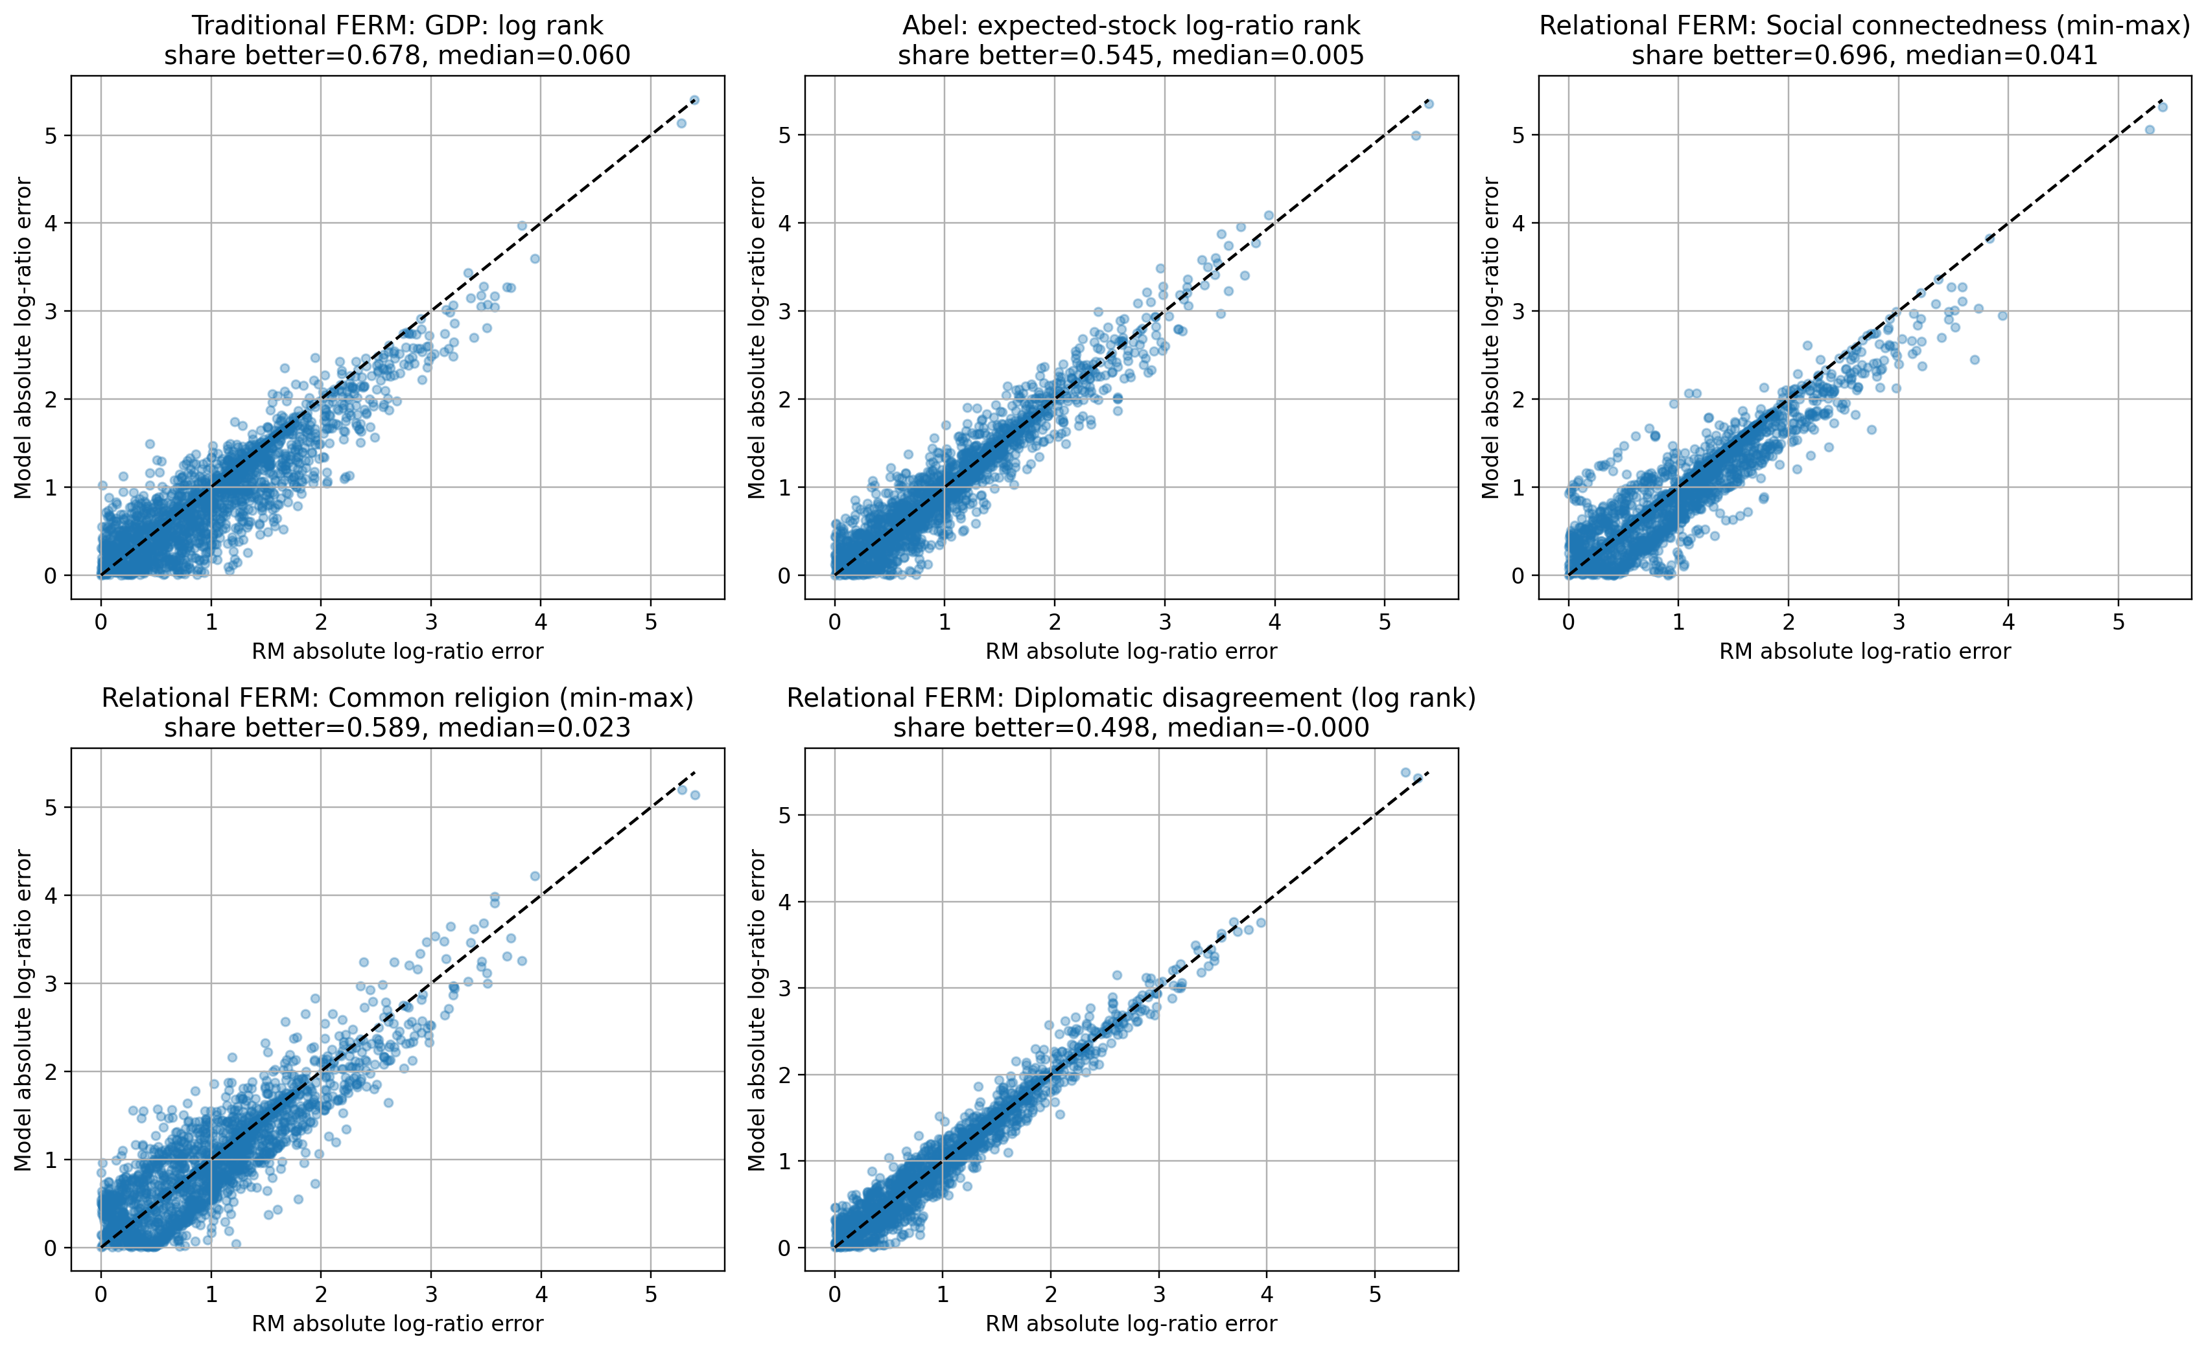
Which features are working better?

Slide 14
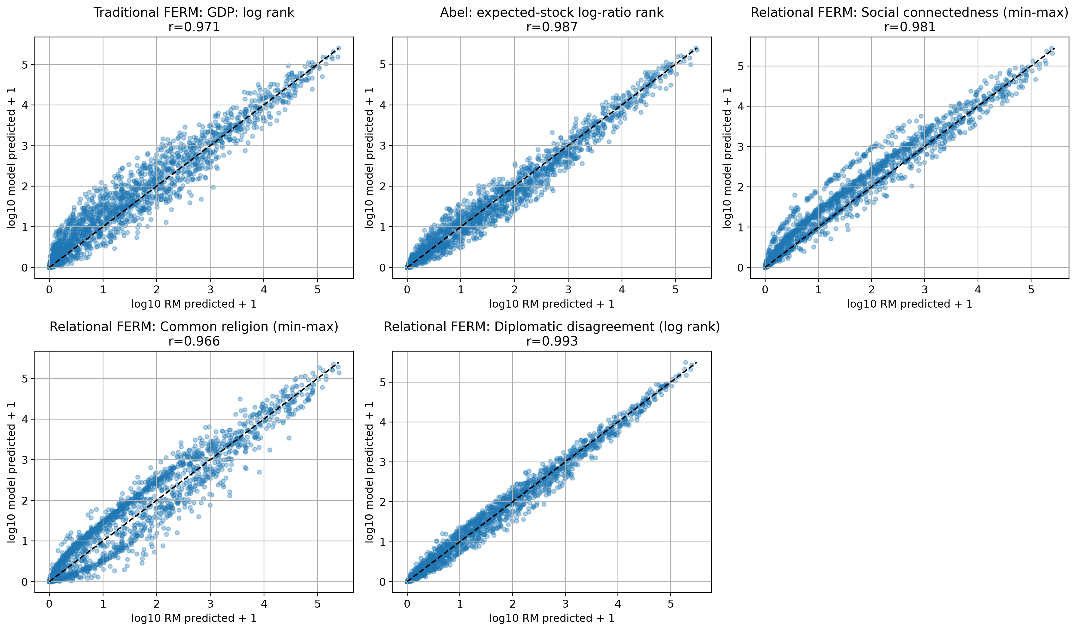
Which features are working better?

Slide 15
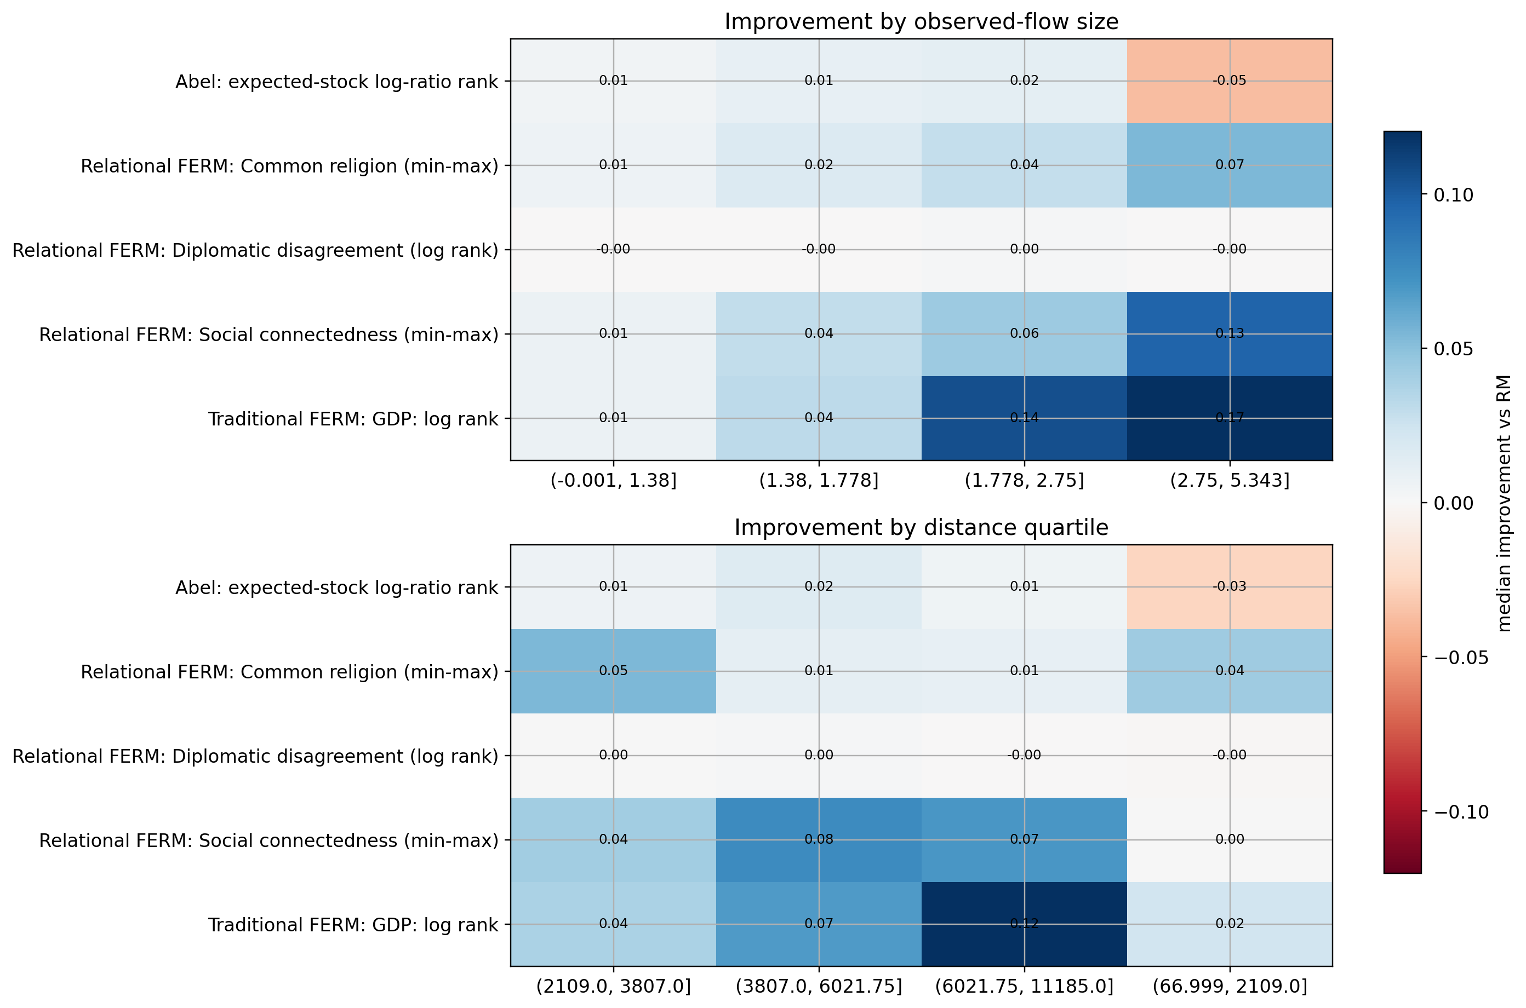
Which features are working better?
The gains are not uniform across routes.

Slide 16
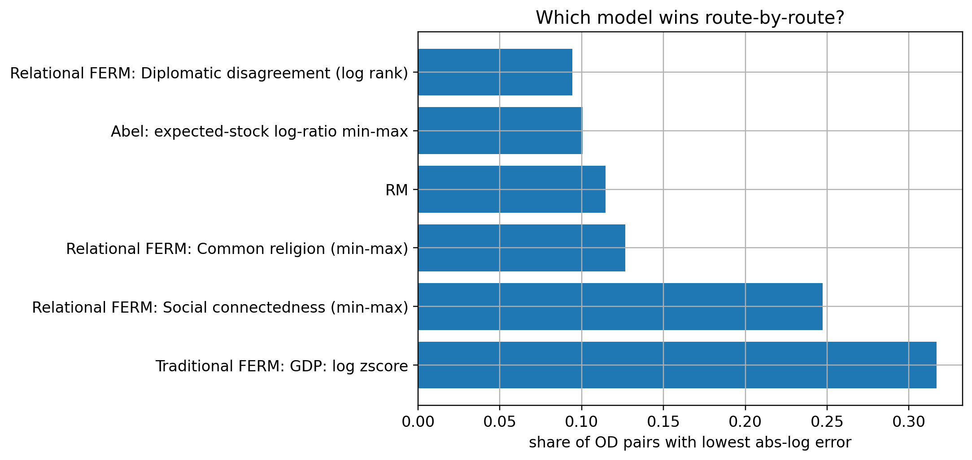
Which features are working better?

Slide 17
Which features are working better?
Working great!

Slide 18
Which features are working better?
What if we combine the best working features??

Slide 19
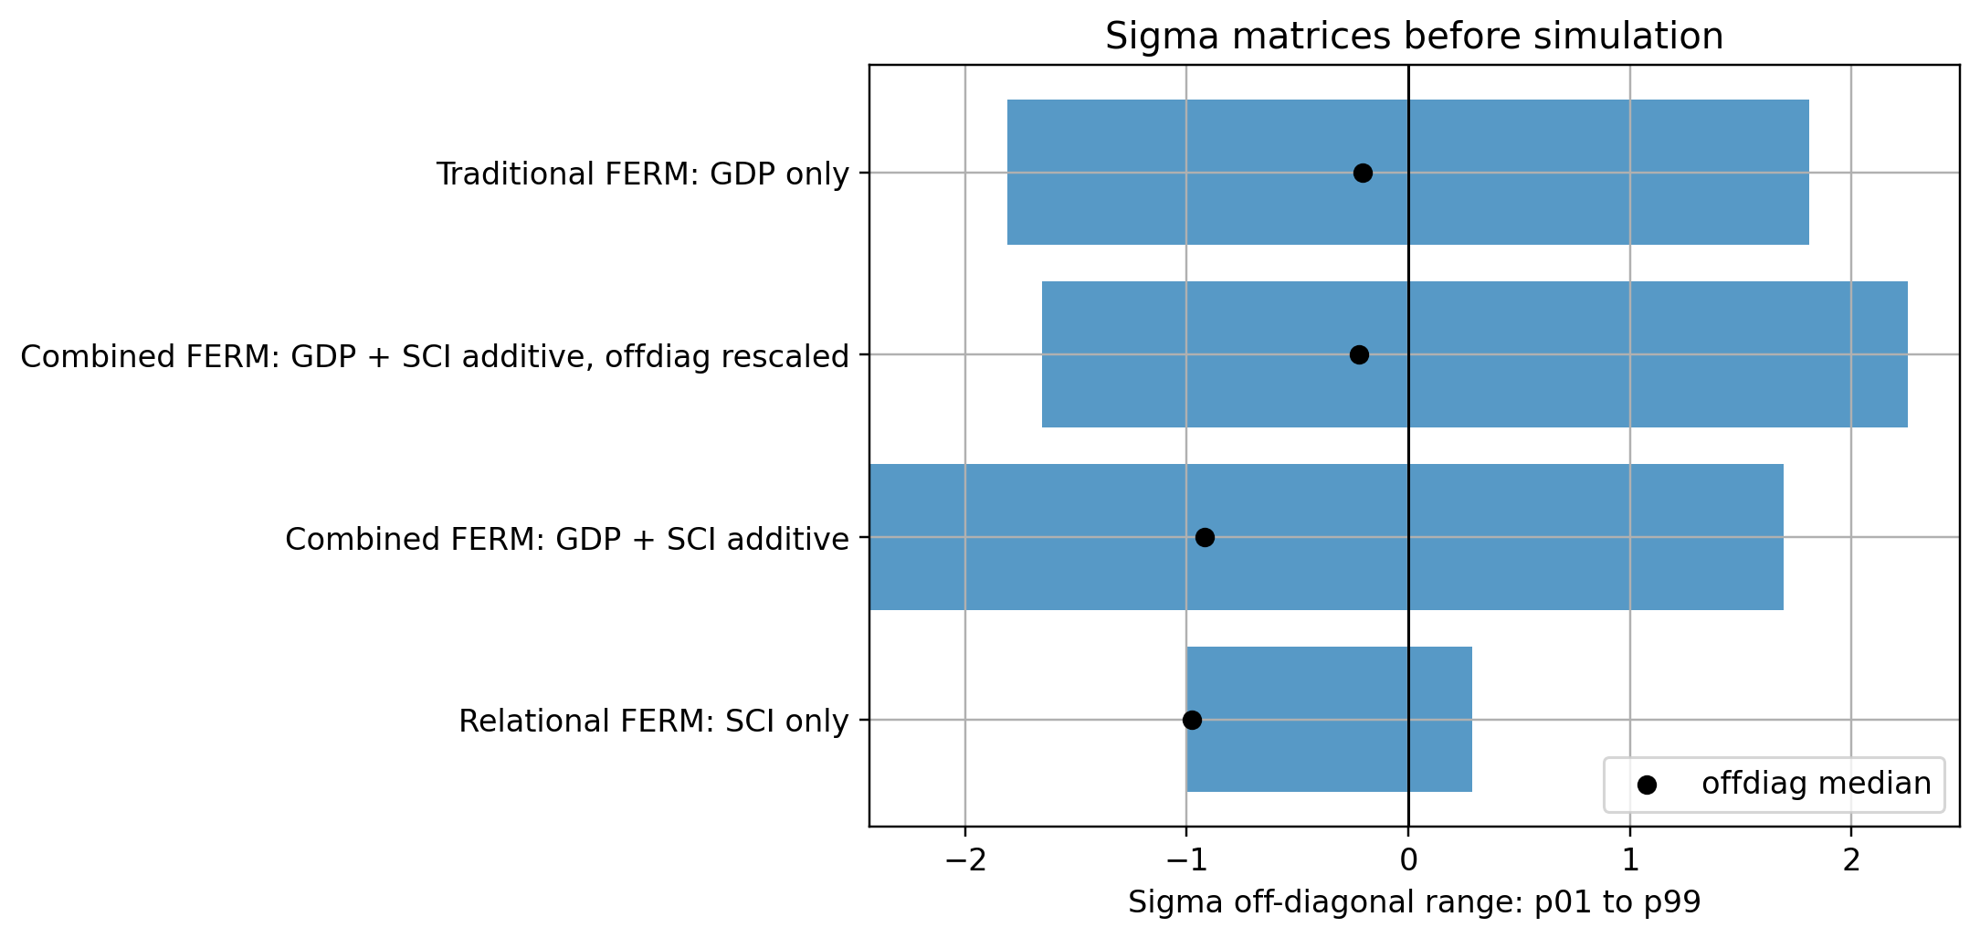
Combining GDP per capita and SCI

Slide 20
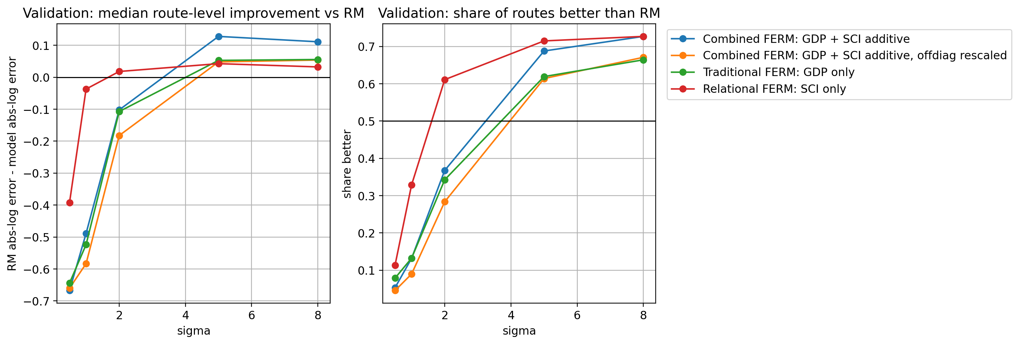
Combining GDP per capita and SCI

Slide 21
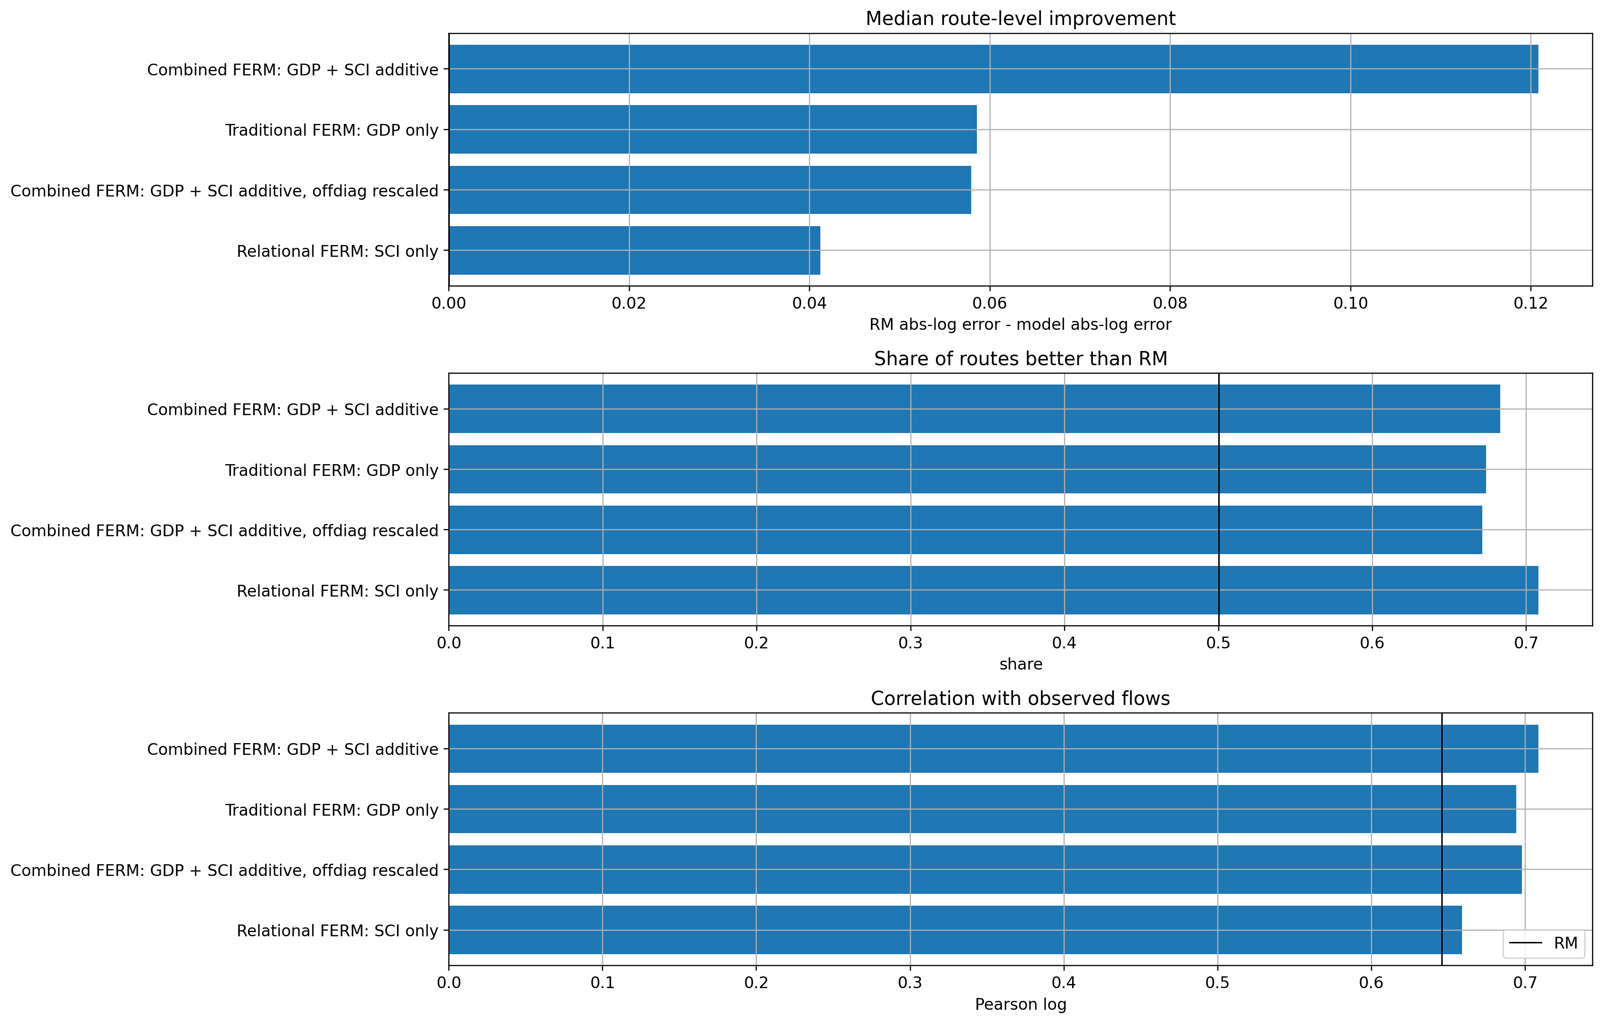
Combining GDP per capita and SCI

Slide 22
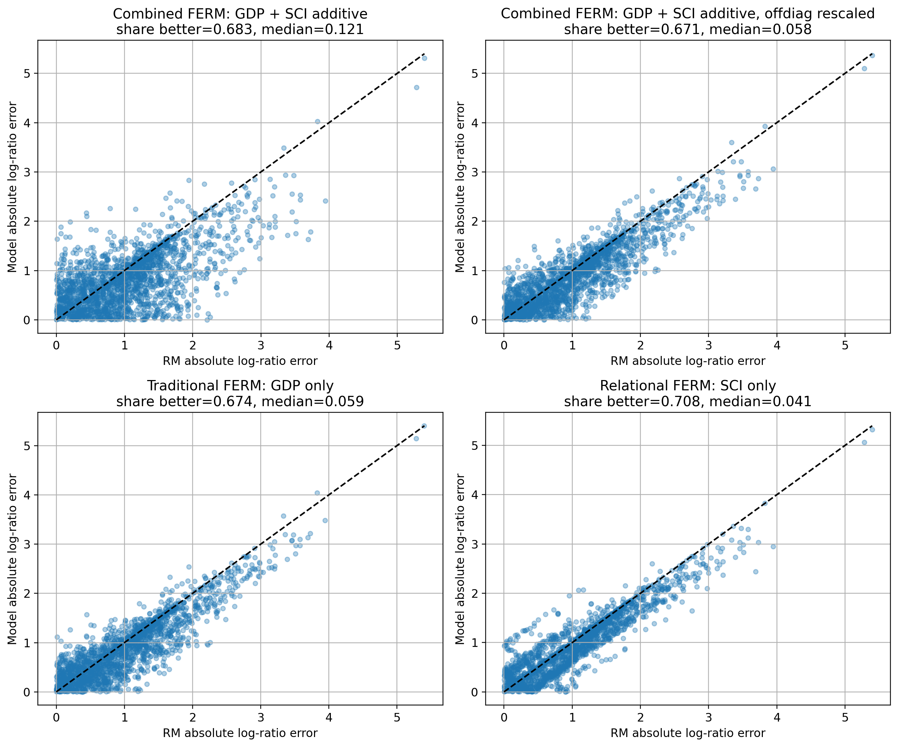
Combining GDP per capita and SCI

Slide 23
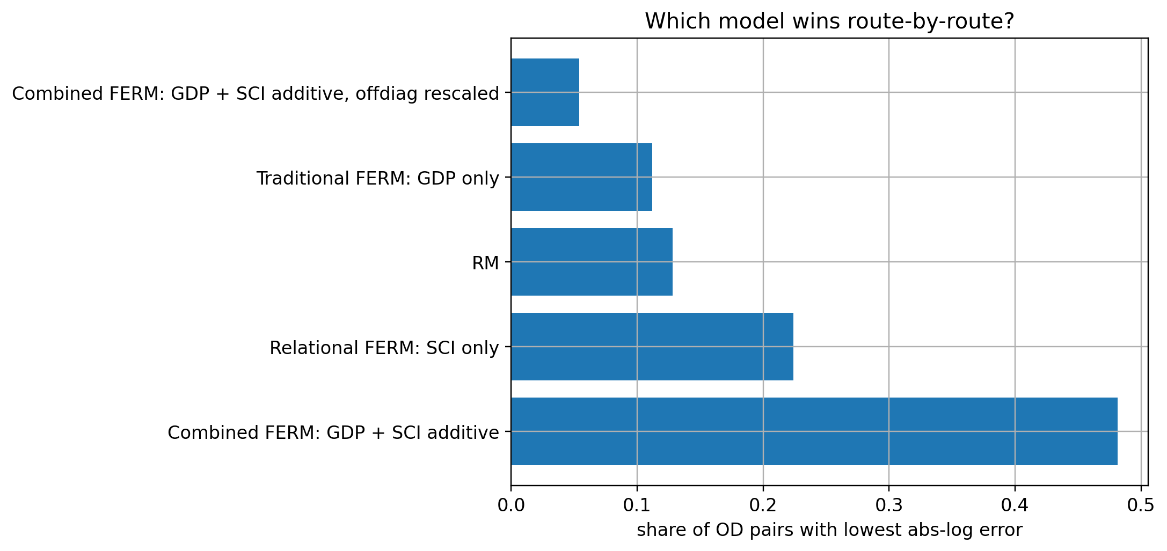
Combining GDP per capita and SCI

Slide 24
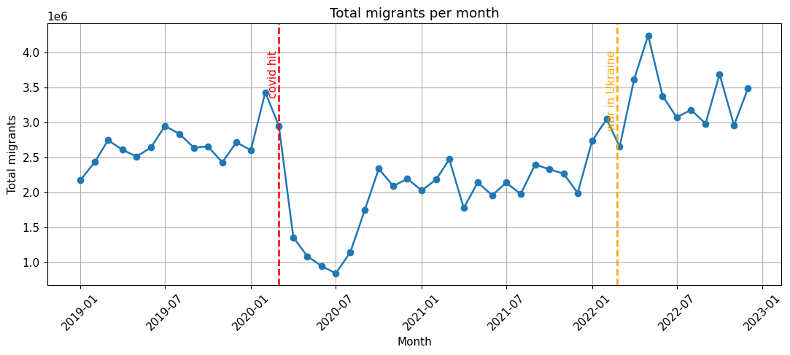
Data Sources
Migration flows
Geometry
Facebook / Meta bilateral country-level flows (pre-COVID period)
Country centroids for distance matrix
Population
Niche features
Country-level population estimates from the World Bank
HDI 2020(UN), GDP per capita 2018(WB), Migrant stock 2019(UN)

Slide 25
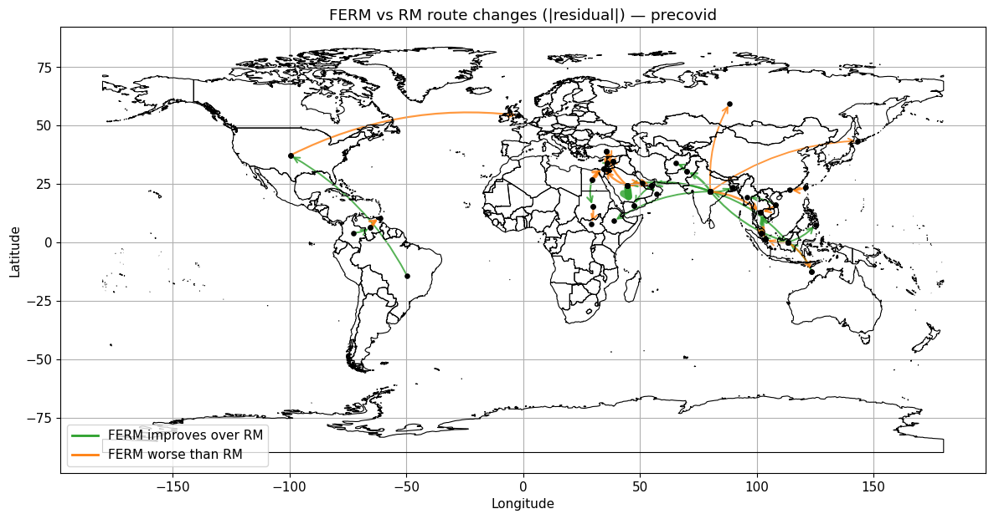
Global Snapshot
σ=5.0, n=500k
GDP per capita 2018

Slide 26
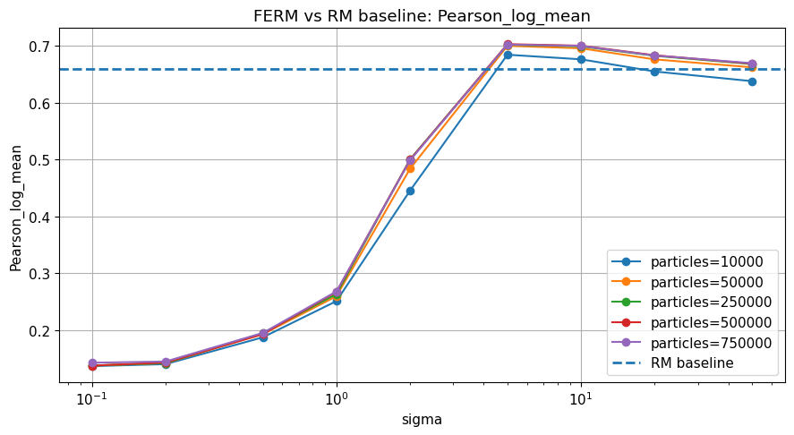
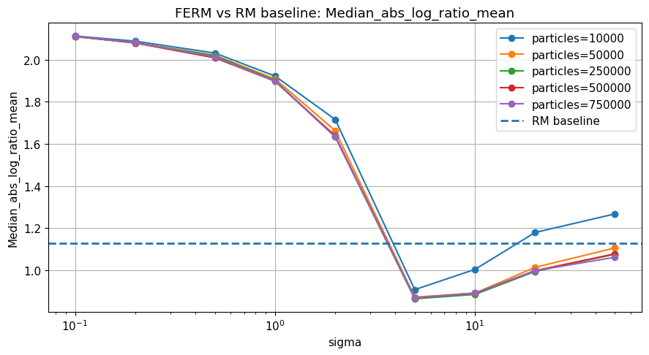
Calibration Strategy: Asia
Two free parameters are tuned via grid search on pre-COVID flows:
σ
n_particles
Grid: 0.1, 0.2, 0.5, 1, 2, 5, 10, 20, 50
Grid: 10k · 50k · 250k · 500k · 750k
Controls sharpness of niche contrast. Large σ → FERM collapses toward RM.
Monte Carlo sample size. More = more accurate but slower.
Best: 5.0 (all niches)
Best: 500k – 750k
Migration stock 2019

Slide 27
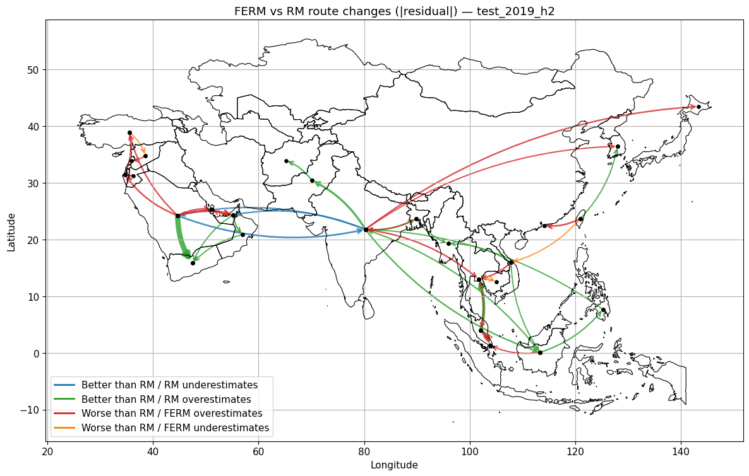
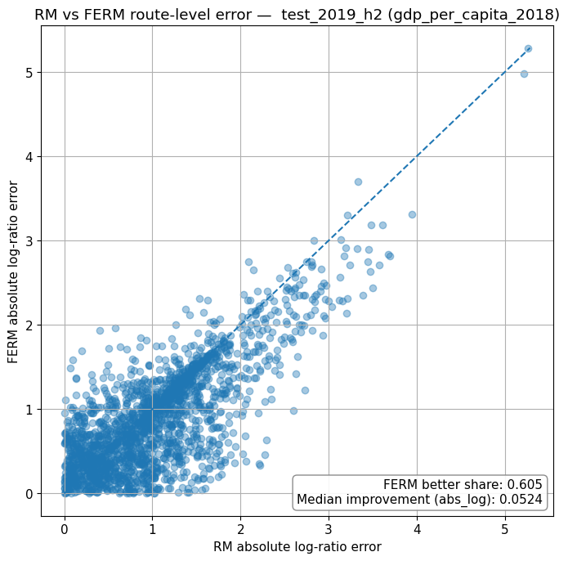
Results: Asia
HDI 2020
GDP per capita
σ=5.0, n=500k
Strong gains on wealthy destination routes
Closely correlated with HDI in Asia
Saudi Arabia → India: large flow, well predicted

Slide 28
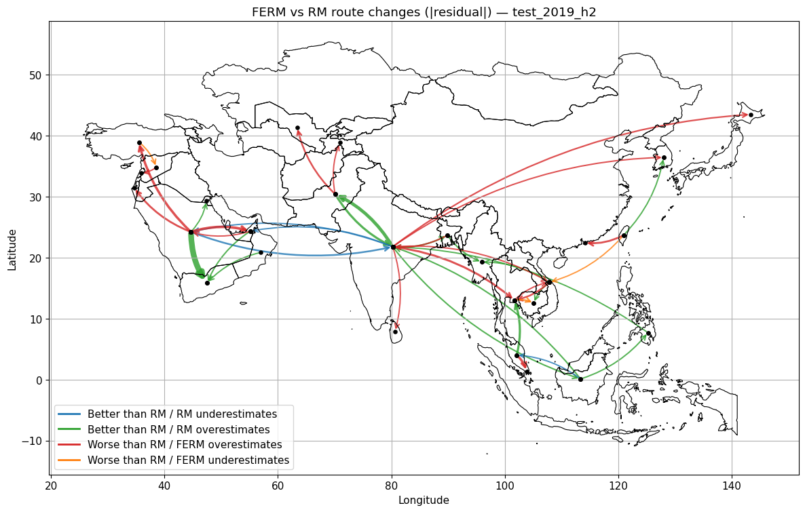
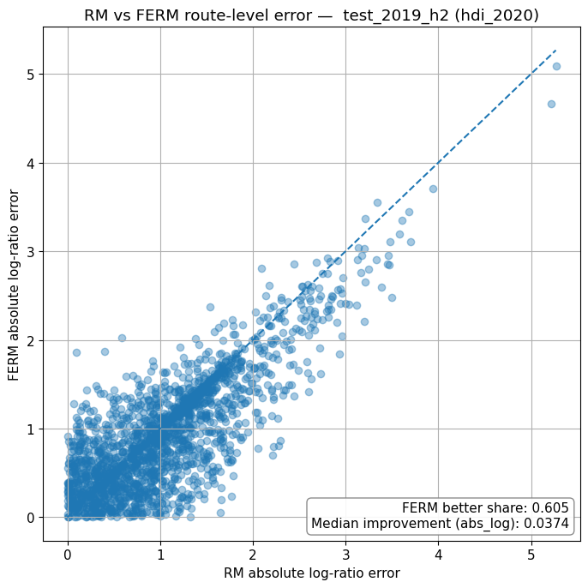
Results: Asia
HDI 2020
σ=5.0, n=750k
Clear improvement over RM on high-HDI corridors
Saudi Arabia → Yemen: correctly downweighted
India → UAE: boosted by UAE high HDI

Slide 29
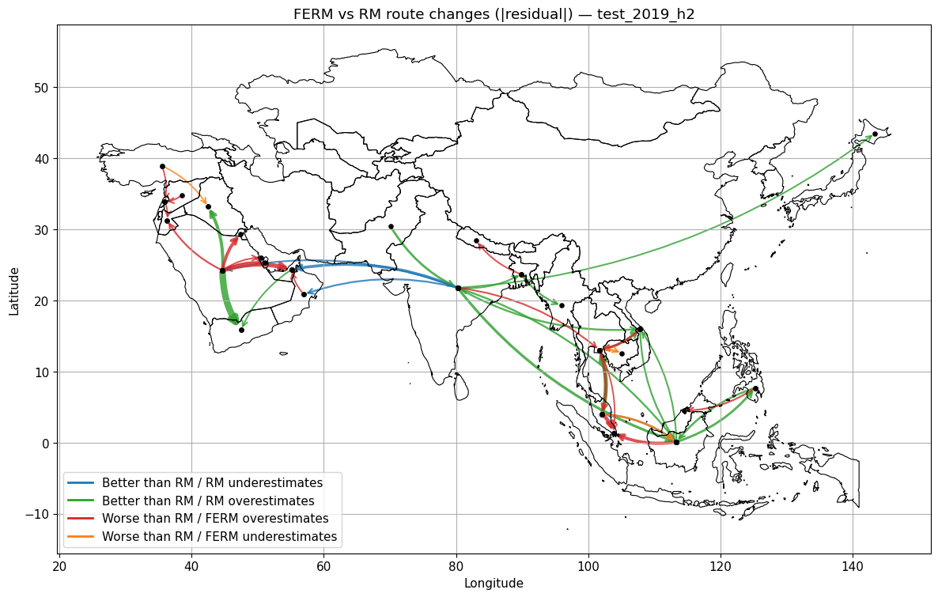
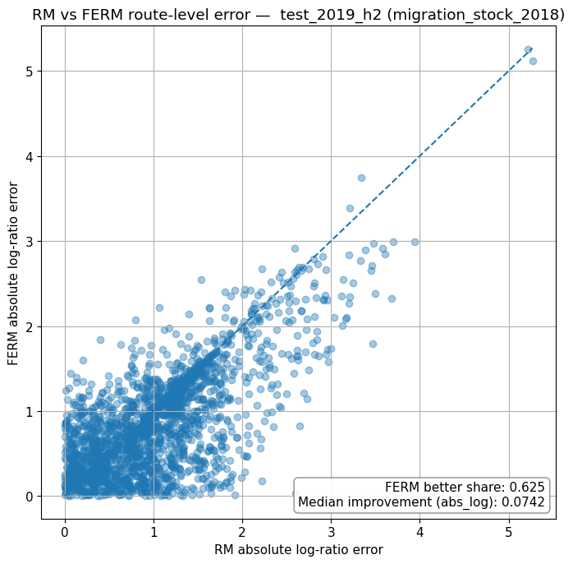
Results: Asia
Migrant stock 2018
σ=5.0, n=500k
Captures network effects (diaspora pull)
Saudi Arabia → Iraq: improved route
India → Japan/Korea: improved route

Slide 30
Results: Asia, why the outliers?
Geopolitical problems!
Origin | Destination | Observed flow | Predicted flow
India | Pakistan | 0 | 361 393
Pakistan | India | 0 | 303 882
Turkey | Cyprus | 0 | 11 698
Syria | Israel | 0 | 5 303
Israel | Syria | 0 | 1 483
Cyprus | Turkey | 0 | 420

Slide 31
What FERM Corrects Over RM
Why Asia is informative
Where FERM Still Struggles
Asian countries are highly heterogeneous in income, development, openness, and migration appeal
Nearby countries are not necessarily the most attractive destinations
Population, distance, and attractiveness are often misaligned
FERM cannot fully correct cases where geography and population dominate the flow structure.
Corridors shaped by political constraints, conflict or diaspora networks may not be captured by a simple niche variable.
When countries are relatively homogeneous, as in Europe, RM may already perform well because distance, population and attractiveness are more aligned.
A single niche variable cannot explain all route types simultaneously.

Slide 32
Takeaways & Next Steps
Key takeaways
Next steps
The niche redirects flows while population still controls scale. the two sources of information are balanced
σ = 5 (log z-score) is a robust calibration across all three niches tested
HDI, GDP and migrant percentage each give complementary signals, migration seems like a slightly better indicator
FERM gains most on corridors where wealth gap is large and population alone misleads RM
Combine multiple niches (multi-feature FERM)
Extend to other regions: Africa, Americas??
Improve feature normalization technics
Define a corridor-based approach?
Vittoria Bettio· Features-Enriched Radiation Model · Robustness meeting

