Slide 1
FERM RESULTS
GDP wins globally; SCI is the relational signal worth taking seriously.
Feature normalization, relational FERM, and out-of-sample route-level evidence
0.037
0.568
0.562
24.7%
GDP median improvement
GDP share better
SCI share better
routes won by SCI
Thesis
The relational extension is informative, but feature-dependent. GDP captures the dominant global destination-attractiveness gradient; SCI is the most promising bilateral feature.
Generated from presentation_ferm_results.ipynb outputs.
01

Slide 2
SETUP
The experiment compares one benchmark with two ways of injecting attractiveness.
Distance is not a feature here: it is already part of the RM/FERM mechanism through the distance matrix.
Model | Sigma structure | Interpretation
RM | All Sigma = 0 | Neutral benchmark: population and distance only.
Traditional FERM | Sigma_ij = destination attractiveness | Tests broad destination absorption, here proxied by GDP.
Relational FERM | Off-diagonal Sigma_ij from bilateral feature | Tests whether corridor-specific affinity improves routes.
What changes
Evaluation
Only Sigma changes across FERM variants. RM keeps Sigma neutral; traditional FERM makes destinations attractive; relational FERM makes specific OD corridors attractive or unattractive.
Tune normalization and sigma on validation_2019_h1. Report final results on test_2019_h2.
Source: presentation_ferm_results.ipynb; test split = 2019 H2.
02

Slide 3
NORMALIZATION
Normalization is a specification choice, so it is selected on validation.
Build Sigma variants
Every feature has a different scale and skew; the final test carries forward one selected version per feature group.
1
Feature group | Selected normalization | sigma
GDP | log zscore | 8
Abel stock | expected-stock log-ratio min-max | 8
Social connectedness | min-max | 5
Common religion | min-max | 8
Diplomatic disagreement | log rank | 8
GDP, Abel, SCI, religion, diplomacy
2
Tune sigma on validation
Same sigma grid for each variant
3
Select one per feature group
Median improvement, then share better, then Pearson
4
Freeze and test
Report only the selected feature specifications
Validation selection uses median route-level improvement as the primary criterion.
03

Slide 4
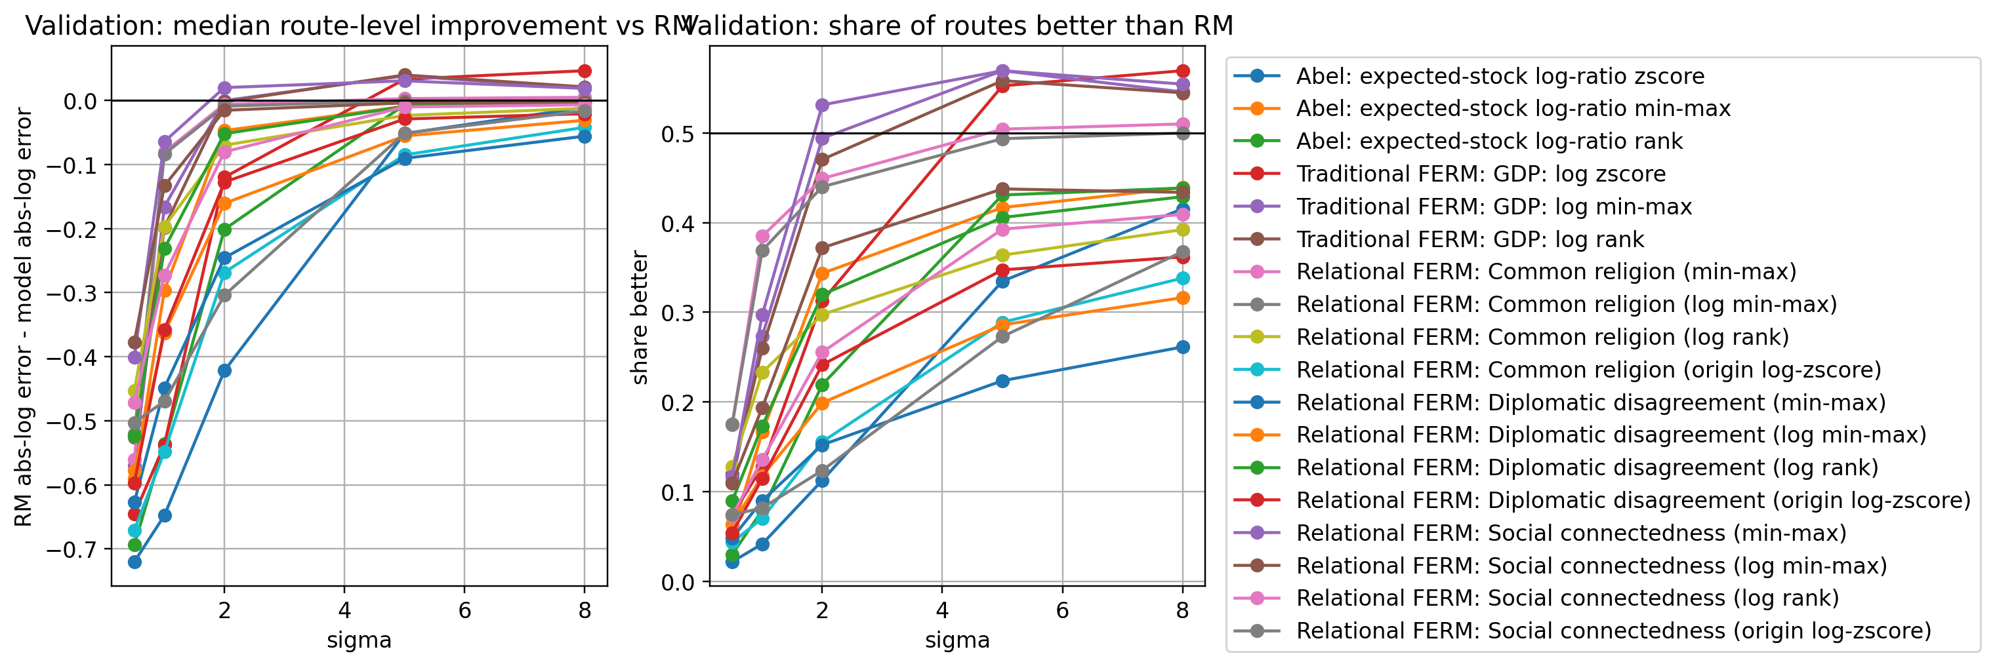
VALIDATION
Validation says GDP is strongest, while SCI is the relational feature worth carrying forward.
High selected sigma means dilution toward RM-like behavior, not stronger feature influence.
Validation split: 2019 H1.
04

Slide 5
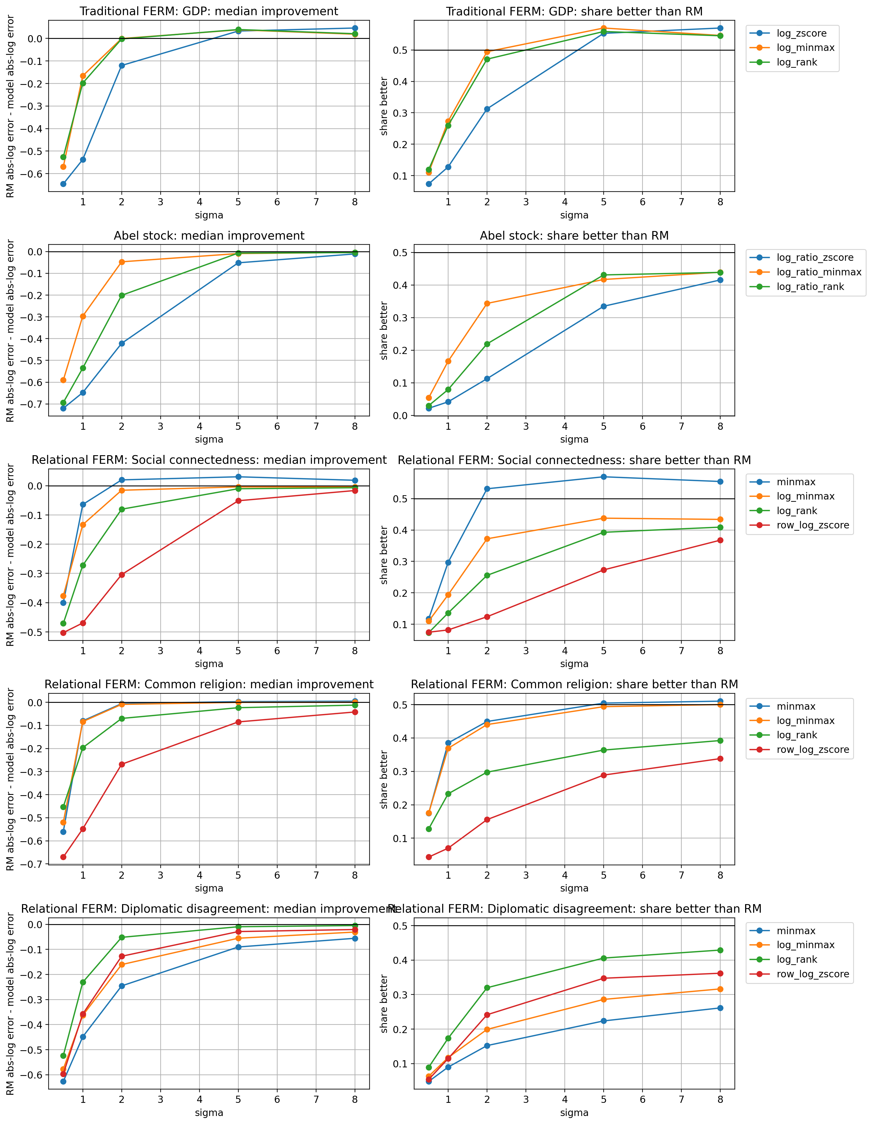
NORMALIZATION CHECK
Across normalization variants, GDP remains the clearest global winner.
The normalization sensitivity figure is the robustness story: each feature group is tested fairly before final test evaluation.
Each row is one feature group; each line is one normalization variant.
05

Slide 6
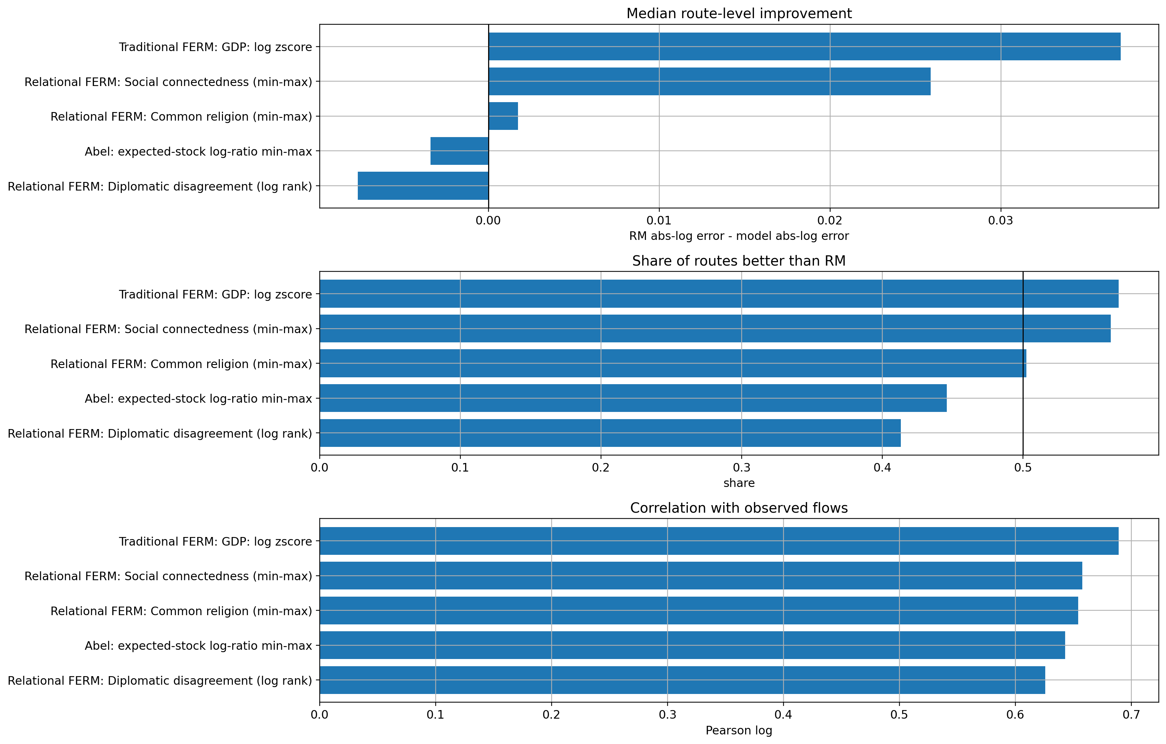
TEST RESULT
Out of sample, GDP leads every main metric; SCI is second and meaningfully positive.
Common religion is marginal; Abel and diplomatic disagreement underperform RM on median route-level error.
Test split: 2019 H2.
06

Slide 7
EXACT METRICS
The ranking is not subtle: GDP is globally best; SCI is the only strong relational candidate.
Positive median improvement means the model reduced RM's absolute log-ratio error.
Model | Median improvement | Share better | Pearson log | Zero pred.
Traditional FERM: GDP | 0.037 | 0.568 | 0.689 | 0.152
Relational FERM: Social connectedness | 0.026 | 0.562 | 0.658 | 0.157
Relational FERM: Common religion | 0.002 | 0.502 | 0.654 | 0.197
Abel stock | -0.003 | 0.446 | 0.643 | 0.207
Relational FERM: Diplomatic disagreement | -0.008 | 0.413 | 0.626 | 0.228
RM | baseline | baseline | 0.646 | 0.000
Reading rule
Median improvement is RM absolute log error minus model absolute log error. Positive values mean the model improves on RM.
Source: presentation_ferm_results.ipynb; test split = 2019 H2.
07

Slide 8
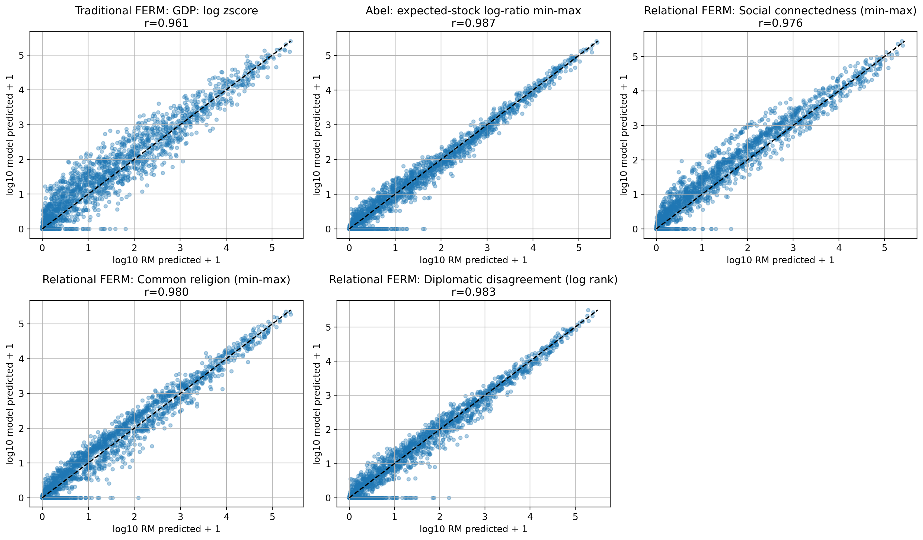
PREDICTION STRUCTURE
All variants remain close to RM, but GDP and SCI make useful route-level shifts.
This matters because high sigma values push the model back toward RM-like distributions.
Source: presentation_ferm_results.ipynb; test split = 2019 H2.
08

Slide 9
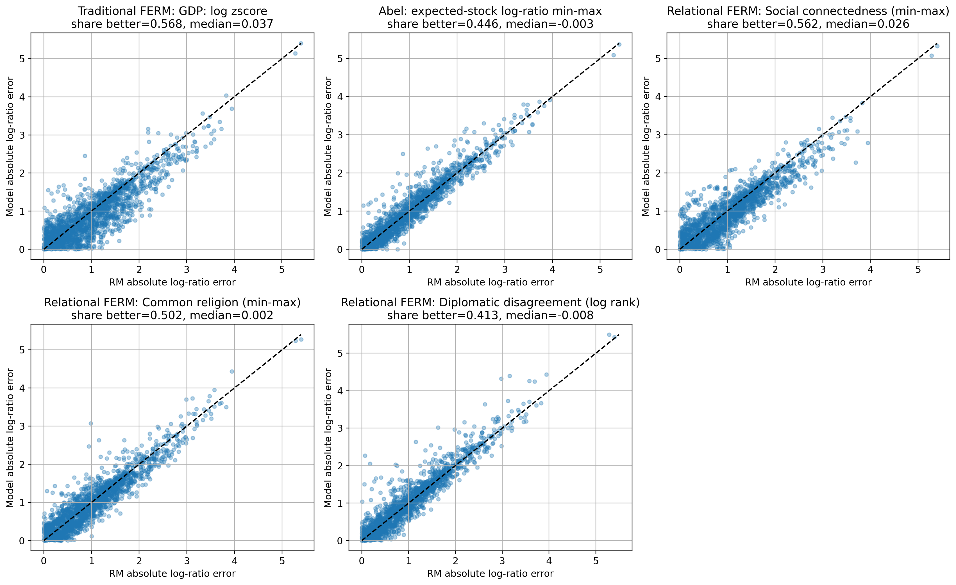
ROUTE ERRORS
GDP and SCI improve many routes, but GDP shifts errors more consistently below the diagonal.
Points below the diagonal mean the FERM variant has lower absolute log-ratio error than RM.
Source: presentation_ferm_results.ipynb; test split = 2019 H2.
09

Slide 10
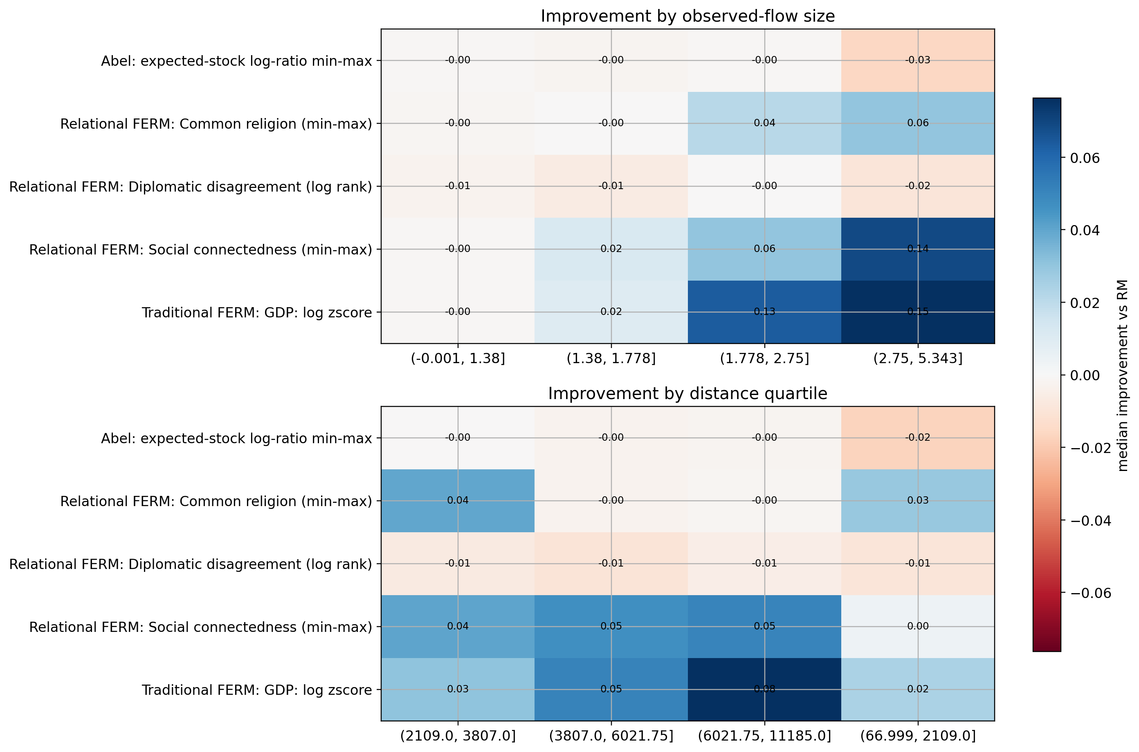
HETEROGENEITY
The gains are not uniform: GDP and SCI help most on larger observed-flow routes.
This is the strongest argument against a single headline metric: different features win different OD pairs.
Read
Blue/positive cells indicate median route-level improvement over RM within each observed-flow or distance bin.
Source: presentation_ferm_results.ipynb; test split = 2019 H2.
10

Slide 11
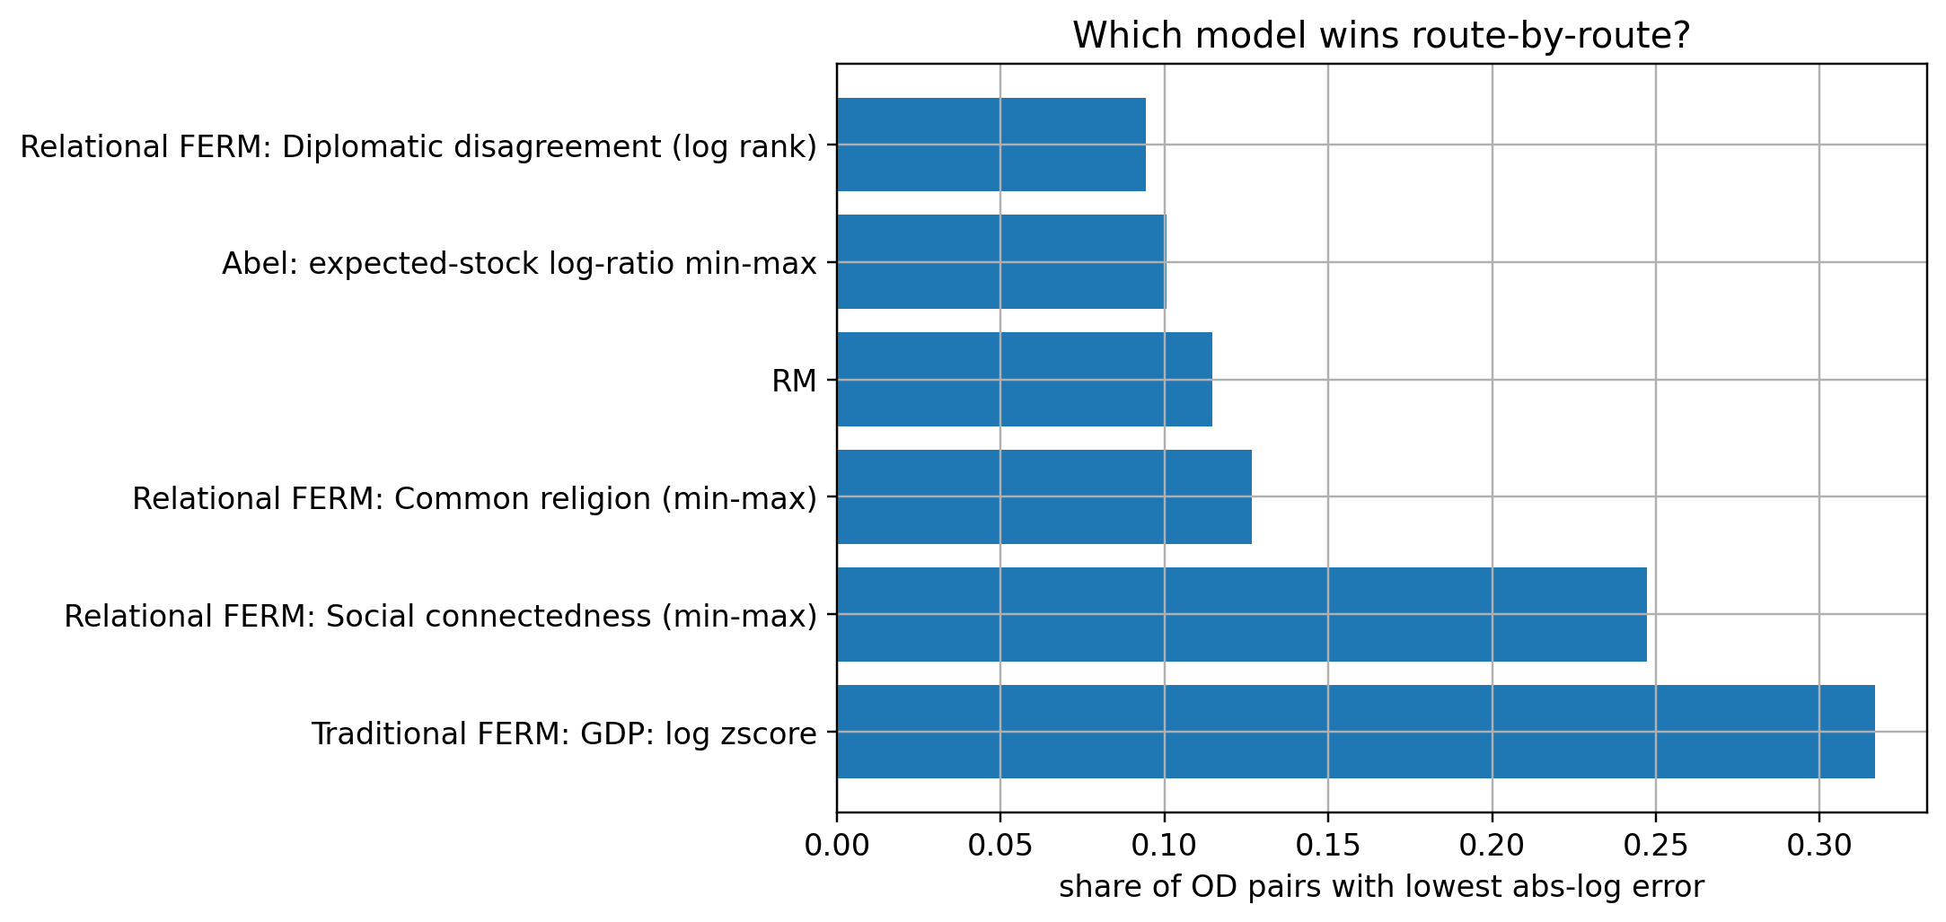
ROUTE WINNERS
GDP wins the largest route share, but SCI wins a substantial subset of OD pairs.
This is the cleanest evidence that relational information has value, even if it does not dominate globally.
Winner shares
GDP wins 31.7% of routes. SCI wins 24.7%. RM still wins 11.4%, mostly lower-observed-flow routes.
Interpretation
The model extension is feature-dependent: social connectedness contains useful bilateral signal, but GDP captures a broader absorption gradient.
Source: presentation_ferm_results.ipynb; test split = 2019 H2.
11

Slide 12
ABEL DIAGNOSTIC
Abel is conceptually appealing, but this specification zero-predicts too many real routes.
The zero routes are not only tiny flows; several large Gulf/South Asia corridors are set to zero.
20.7%
57,919
7,424
Abel zero-prediction share
observed migrants on zero routes
largest observed zero route
Route | Observed | Prediction
Sri Lanka -> Qatar | 7,424 | 0
Qatar -> Sri Lanka | 6,239 | 0
Bahrain -> Philippines | 6,137 | 0
Sri Lanka -> Kuwait | 4,500 | 0
Nepal -> Cyprus | 2,815 | 0
Takeaway
Abel may still be useful, but not as currently normalized and simulated. The immediate evidence is instability, not improvement.
Source: presentation_ferm_results.ipynb; test split = 2019 H2.
12

Slide 13
CONCLUSION
The relational model is viable, but not every relational feature deserves the same confidence.
GDP is the strongest global feature because it captures destination absorption.
SCI is the only relational feature with a meaningful positive out-of-sample signal.
Common religion is marginal; Abel and diplo are weak in this specification.
Normalization matters, but it does not create signal where the feature is misaligned.
The natural next model is combined: destination attractiveness plus relational corridor structure.
Presentation sentence
I would not claim that relational FERM failed. I would claim that the current relational features are uneven, and SCI is the most promising one.
Next step
Estimate or tune a combined Sigma with destination and relational components, then validate out of sample.
Source: presentation_ferm_results.ipynb; test split = 2019 H2.
13

