Slide 1
RELATIONAL FERM
Relational FERM keeps the radiation mechanism and changes the attractiveness matrix.
Model formulation, Sigma construction, normalization, and out-of-sample evidence
Sigma_ij
0.037
0.562
24.7%
corridor attractiveness
GDP median improvement
SCI share better
routes won by SCI
Core claim
The relational extension is not a different mobility process. It is a different parameterization of attractiveness within the same radiation-style absorption framework.
Sources: FERM model note and presentation_ferm_results.ipynb.
01

Slide 2
MOTIVATION
Migration attractiveness is not only destination-specific.
The same destination can be more or less attractive depending on the origin corridor.
Destination-level attractiveness
mu_j
Corridor-specific attractiveness
delta_ij
Examples of bilateral signals
social connectedness, common language or religion, visa openness, diaspora networks, diplomatic relations, historical ties
Destination j looks the same
from every origin
Destination j can look different
from origin i versus origin k
Research question
Can corridor-specific attractiveness improve route-level predictions without changing the radiation mechanism?
Sources: FERM model note; src/ferm/model.py; presentation_ferm_results.ipynb.
02

Slide 3
MECHANISM
The radiation-style mechanism is sequential absorption by distance.
Particles leave an origin, inspect destinations in increasing distance order, and stop at the first successful offer.
Origin i
particle emitted
nearest k1
offer B_i1
k2
offer B_i2
destination j
offer B_i3
farther k3
offer B_i4
Threshold T_i
P(i -> j) = p_ij × product over closer k of (1 - p_ik)
Important
Traditional FERM and relational FERM do not change this scanning process. They change the centers of the latent threshold and offer distributions.
Sources: FERM model note; src/ferm/model.py; presentation_ferm_results.ipynb.
03

Slide 4
LATENT VARIABLES
Thresholds and offers are latent maxima centered by Sigma.
Population enters through the maximum over many Gaussian draws; attractiveness shifts the mean of those draws.
Threshold side
T_i ~ max over m_i draws
N(Sigma_ii, sigma^2)
Offer side
B_ij ~ max over n_j draws
N(Sigma_ij, sigma^2)
Population
Shared sigma
m_i and n_j affect the distributions through maxima: larger populations generate more extreme thresholds/offers.
The model uses one sigma as the shared spread of the Gaussian sampling kernel. Larger sigma dilutes the effect of Sigma centers.
Sources: FERM model note; src/ferm/model.py; presentation_ferm_results.ipynb.
04

Slide 5
SIGMA MATRIX
One attractiveness matrix unifies RM, traditional FERM, and relational FERM.
A
B
C
D
E
The diagonal controls origin thresholds; off-diagonal entries control origin-destination offers.
A
Σii
Σij
Σij
Σij
Σij
Diagonal
Off-diagonal
Sigma_ii centers the threshold distribution at origin i.
Sigma_ij centers the offer distribution for corridor i -> j.
B
Σij
Σii
Σij
Σij
Σij
C
Σij
Σij
Σii
Σij
Σij
D
Relational view
Σij
Σij
Σij
Σii
Σij
A destination is not intrinsically attractive in the same way from every origin. The row matters.
E
Σij
Σij
Σij
Σij
Σii
Sources: FERM model note; src/ferm/model.py; presentation_ferm_results.ipynb.
05

Slide 6
MODEL FAMILY
The variants differ only by the structure imposed on Sigma.
This is the conceptual clarity of the matrix formulation.
Variant | Sigma structure | Interpretation
RM | Sigma_ii = 0, Sigma_ij = 0 | No feature-based attractiveness.
Traditional FERM | Sigma_ii = mu_i, Sigma_ij = mu_j | Destination-specific attractiveness; rows are identical.
Relational FERM | Sigma_ii = 0, Sigma_ij = delta_ij | Thresholds neutral; offers become corridor-specific.
Combined model | Sigma_ii = mu_i, Sigma_ij = f(mu_j, delta_ij) | Destination and corridor information together.
Takeaway
Relational FERM is the corridor-specific case: Sigma_ii is kept neutral and Sigma_ij encodes bilateral attraction or repulsion.
Sources: FERM model note; src/ferm/model.py; presentation_ferm_results.ipynb.
06

Slide 7
RELATIONAL FERM
In the relational specification, all bilateral information lives on the offer side.
Thresholds are neutral; corridors shift destination offers.
Negative corridor
Sigma_ij < 0
Interpretation
A positive corridor shifts the offer distribution upward and increases the chance of absorption before farther destinations are reached.
Origin threshold
Sigma_ii = 0
Neutral corridor
Sigma_ij = 0
Mechanism unchanged
The particle still scans destinations in distance order. Relational FERM only changes the mean of B_ij.
Positive corridor
Sigma_ij > 0
Sources: FERM model note; src/ferm/model.py; presentation_ferm_results.ipynb.
07

Slide 8
INTERPRETATION
Sigma controls direction; sigma controls how sharply the feature matters.
This distinction is crucial for interpreting validation curves.
Sigma_ij > 0
more attractive than neutral
Low sigma
High sigma
Centers matter strongly; Sigma has a stronger effect on absorption.
Gaussian spread dominates center differences; the model moves closer to RM-like behavior.
Sigma_ij = 0
neutral corridor
small sigma
large sigma
Sigma_ij < 0
more repulsive than neutral
feature influence
RM-like dilution
Sources: FERM model note; src/ferm/model.py; presentation_ferm_results.ipynb.
08

Slide 9
EMPIRICAL SIGMA
The empirical task is to build a meaningful Sigma matrix.
The model is only as good as the feature and normalization used to construct Sigma.
GDP
destination-level
traditional FERM
Distance
Abel stock
historical corridor stock
relational FERM
Distance is not a feature in this comparison. It is already used to order destinations in the radiation mechanism.
Social connectedness
bilateral social tie
relational FERM
Common religion
bilateral similarity
relational FERM
Diplo disagreement
bilateral friction
relational FERM
Sources: FERM model note; src/ferm/model.py; presentation_ferm_results.ipynb.
09

Slide 10
NORMALIZATION
Bilateral features cannot be inserted raw into Sigma.
Zero should mean neutral; signs should mean attraction versus repulsion; heavy tails need compression.
sign orientation: high values can mean attraction or repulsion
centering: Sigma > 0 attractive, Sigma = 0 neutral, Sigma < 0 repulsive
heavy tails: log compression can stop extreme corridors dominating
missing values: zero is a substantive neutrality assumption
split comparability: validation and test must use consistent transformations
Feature | Selected normalization | sigma
GDP | log zscore | 8
Abel stock | expected-stock log-ratio min-max | 8
Social connectedness | min-max | 5
Common religion | min-max | 8
Diplomatic disagreement | log rank | 8
Validation rule
The notebook tests normalizations within each feature group and carries forward one selected version per group into the test split.
Sources: FERM model note; src/ferm/model.py; presentation_ferm_results.ipynb.
10

Slide 11
PIPELINE
The empirical workflow separates tuning from reporting.
The final comparison is out-of-sample on test_2019_h2.
1
2
3
4
5
Build nodes and flows
Build distance matrix
Construct Sigma variants
Tune sigma on validation
Freeze and test
Asia, 2019 validation/test periods
gravity dist used for scanning order
GDP, Abel, SCI, religion, diplomacy
same grid, same metric hierarchy
one selected model per feature group
Metric hierarchy
Primary: median route-level improvement over RM. Tie-breakers: share of routes better than RM, then Pearson correlation in log space.
Sources: FERM model note; src/ferm/model.py; presentation_ferm_results.ipynb.
11

Slide 12
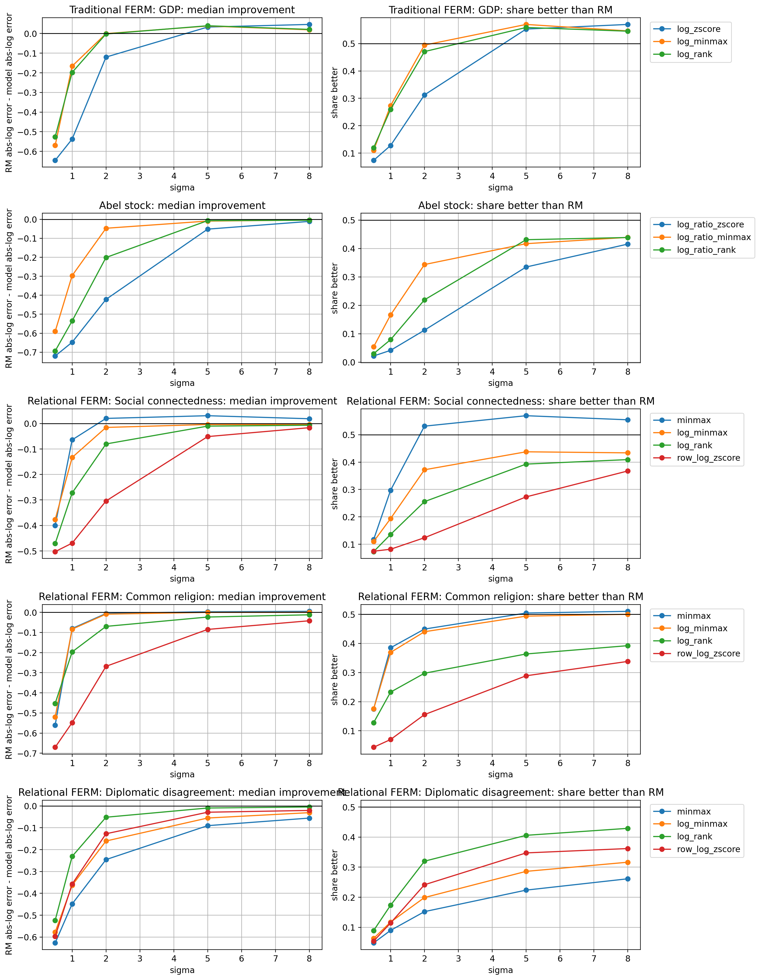
NORMALIZATION RESULTS
Normalization changes results, so the selected specification is chosen feature-by-feature.
This is a robustness step, not an extra model parameter.
Validation split: 2019 H1. Each row is one feature group; each line is one normalization.
12

Slide 13
TEST RESULTS
GDP is strongest globally; SCI is the strongest relational feature.
The relational extension shows value, but only when the bilateral feature contains useful signal.
Model | Median improvement | Share better | Pearson log
Traditional FERM: GDP | 0.037 | 0.568 | 0.689
Relational FERM: SCI | 0.026 | 0.562 | 0.658
Relational FERM: Common religion | 0.002 | 0.502 | 0.654
Abel stock | -0.003 | 0.446 | 0.643
Relational FERM: Diplo disagreement | -0.008 | 0.413 | 0.626
RM | baseline | baseline | 0.646
Main result
GDP leads on median improvement, share better than RM, and Pearson log correlation.
Relational result
SCI is meaningfully positive: median improvement 0.026 and share better 0.562.
Weak features
Abel and diplomatic disagreement underperform RM on median route-level error.
Test split: 2019 H2.
13

Slide 14
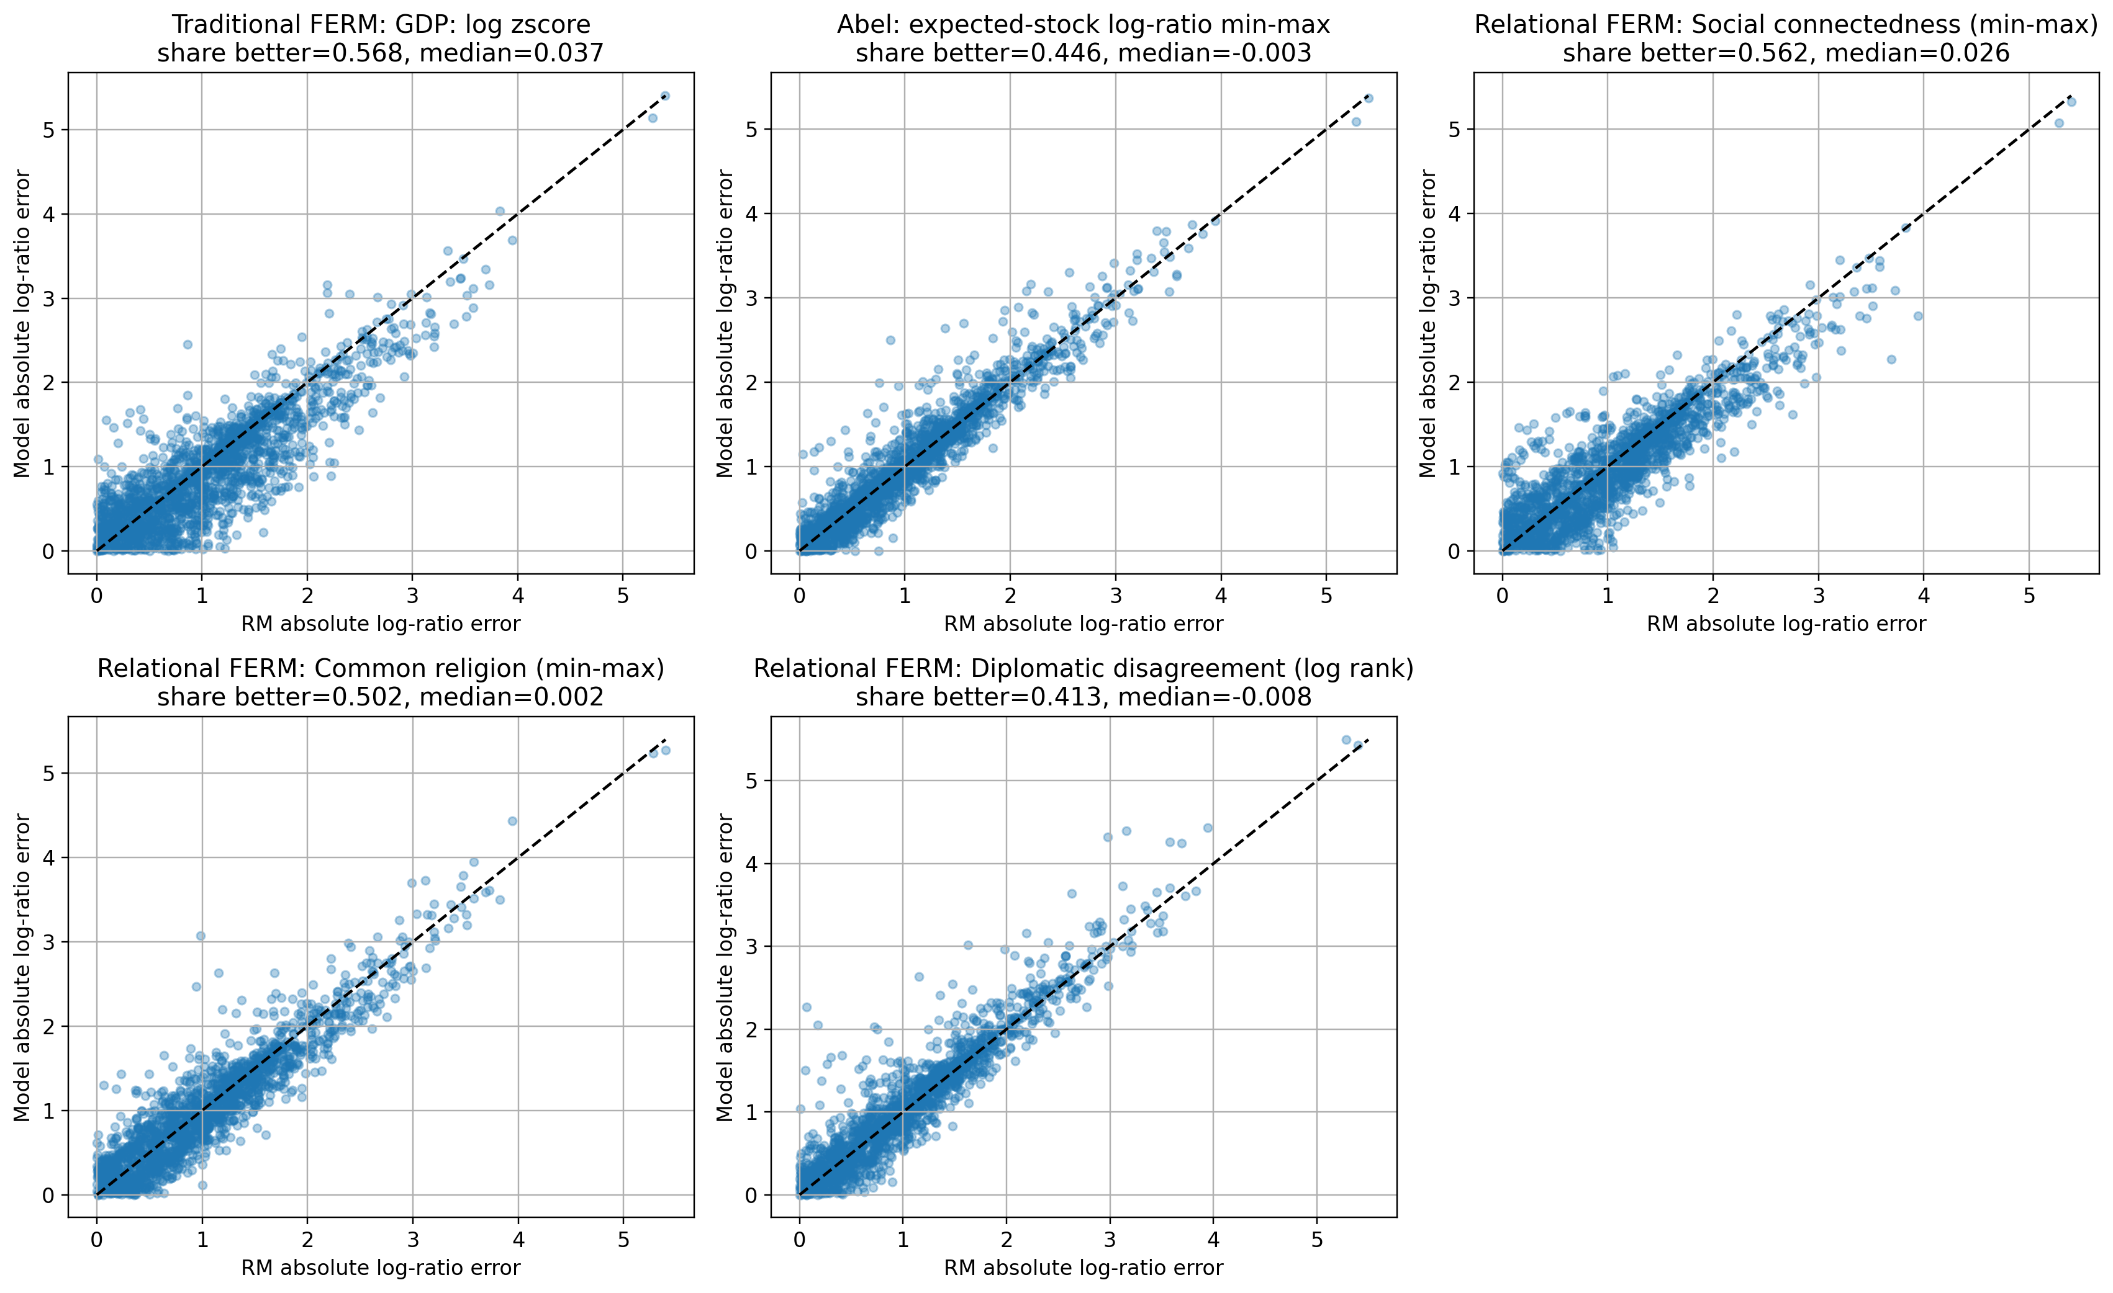
ROUTE EVIDENCE
Route-level plots show GDP and SCI improve many OD pairs, but GDP is more stable.
Below the diagonal means the model has lower absolute log-ratio error than RM.
Sources: FERM model note; src/ferm/model.py; presentation_ferm_results.ipynb.
14

Slide 15
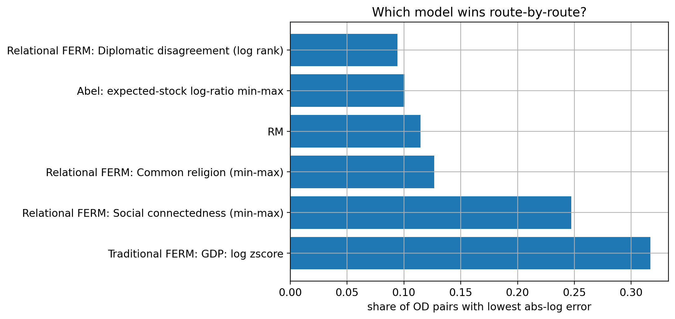
HETEROGENEITY
Relational information helps specific routes, not the whole system uniformly.
SCI wins almost a quarter of all OD pairs, even though GDP is the best global model.
Route winners
GDP wins 31.7% of OD pairs. SCI wins 24.7%. RM still wins 11.4%.
Interpretation
This supports a feature-dependent relational extension rather than a universal relational improvement.
Sources: FERM model note; src/ferm/model.py; presentation_ferm_results.ipynb.
15

Slide 16
ABEL DIAGNOSTIC
Abel stock is unstable here because it zero-predicts too many real corridors.
The problem is not only tiny routes; some large South Asia-Gulf corridors receive zero predictions.
20.7%
57,919
7,424
zero-prediction share
observed migrants on zero routes
largest observed zero route
Zero-predicted route | Observed
Sri Lanka -> Qatar | 7,424
Qatar -> Sri Lanka | 6,239
Bahrain -> Philippines | 6,137
Sri Lanka -> Kuwait | 4,500
Nepal -> Cyprus | 2,815
Takeaway
Abel remains conceptually relevant, but this construction is empirically too punitive or too sparse for important labor-migration corridors.
Sources: FERM model note; src/ferm/model.py; presentation_ferm_results.ipynb.
16

Slide 17
CONCLUSION
Relational FERM is viable, but the empirical Sigma must be built carefully.
The model contribution is conceptual clarity; the empirical contribution is identifying which bilateral features actually carry signal.
The radiation mechanism is unchanged across RM, traditional FERM, and relational FERM.
Relational FERM moves attractiveness from destination-only to corridor-specific offers.
Normalization is part of the model specification because Sigma has sign and scale semantics.
Out of sample, GDP is strongest globally; SCI is the most promising relational feature.
The next natural step is a combined destination-plus-relational Sigma.
Suggested final sentence
The relational extension does not fail; it tells us that route-specific attractiveness matters only when the bilateral feature is strong enough and normalized coherently.
Next model
Sigma_ii = mu_i and Sigma_ij combines destination attractiveness with corridor-specific relational structure.
Sources: FERM model note; src/ferm/model.py; presentation_ferm_results.ipynb.
17

