Slide 1
Output Presentation
John Doe

Slide 2
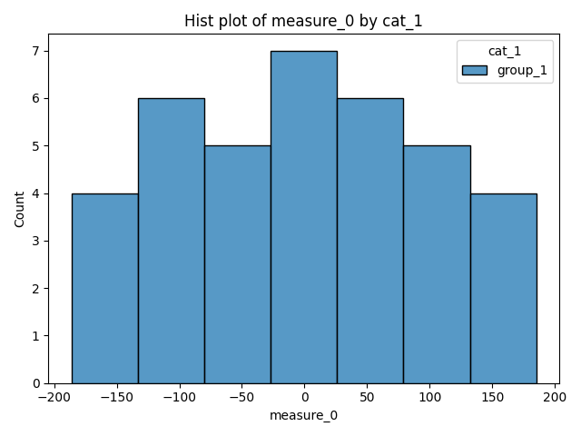
Testing Slide

Slide 3
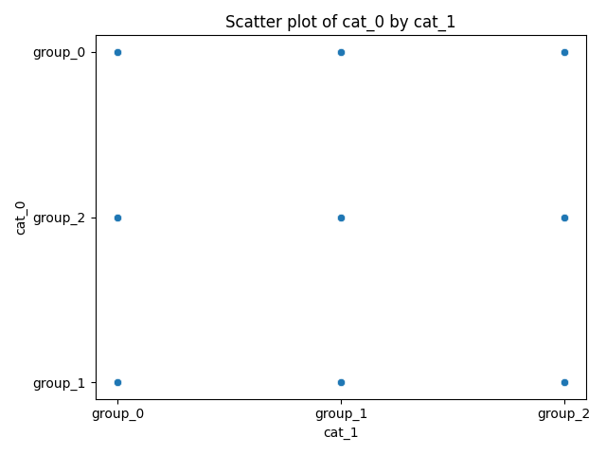
testing 2

