Slide 1
2016 US News and World Reports Data Exploration
Thomas M. Seeber
thomasmseeeber@gmail.com
https://www.linkedin.com/in/thomasseeber

Slide 2







Technologies Used for Analysis
This Photo by Unknown Author is licensed under CC BY-NC
Geopandas

Slide 3

Complete Source Code and Project files Available at
https://github.com/tomseeber/college_data_analysis

Slide 4
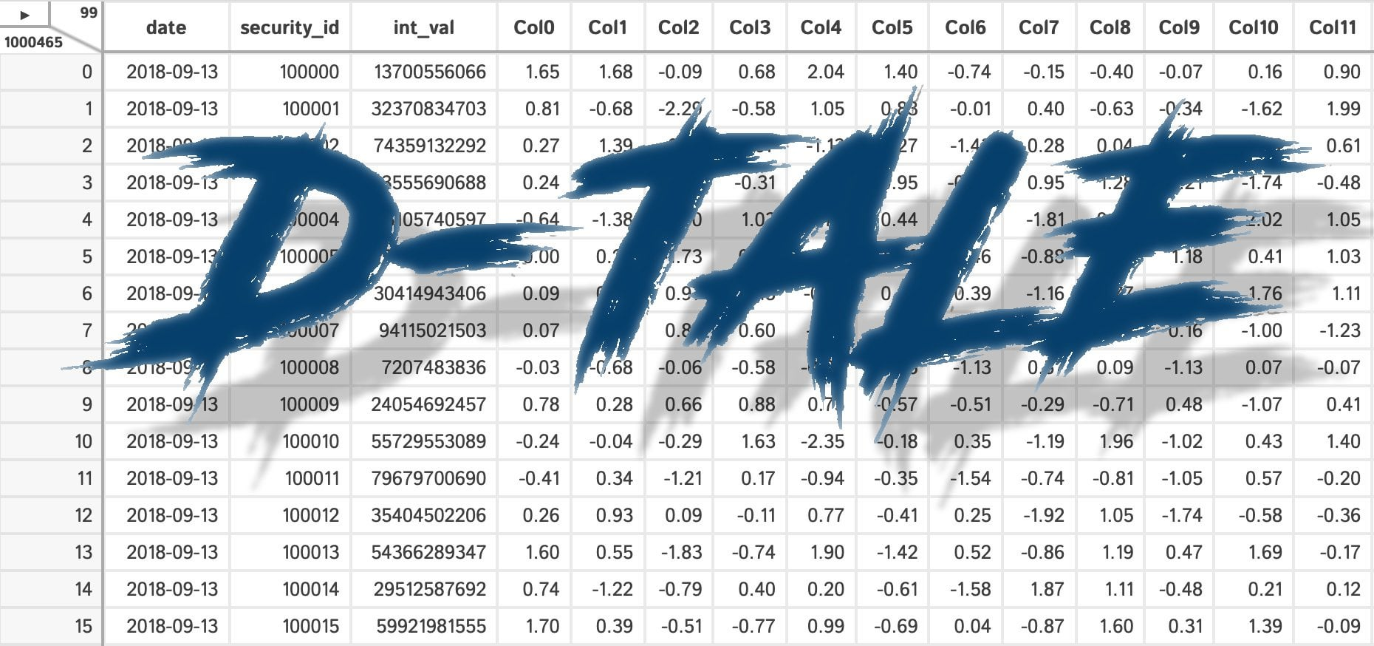

Exploratory Data Analysis (EDA): New Tools Implemented
Some basic EDA was created using Automated tools. Jupyter notebooks are provided.
Exploratory
PandasAI
https://github.com/tomseeber/college_data_analysis/tree/main/notebooks

Slide 5
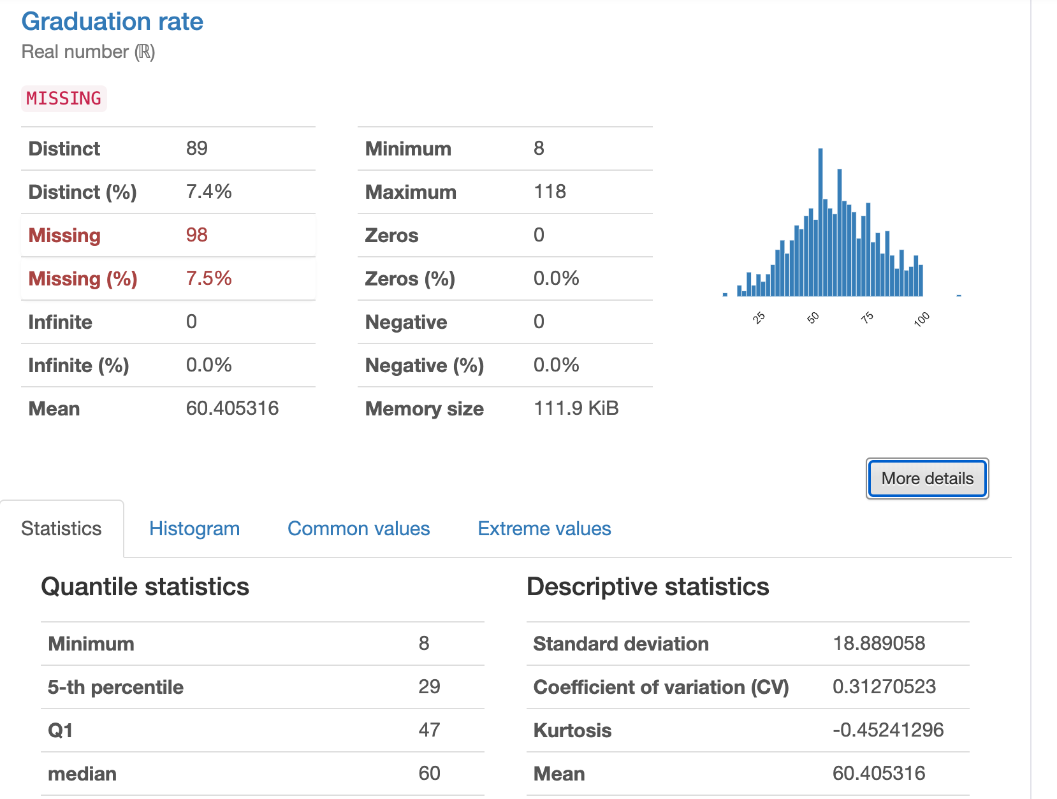
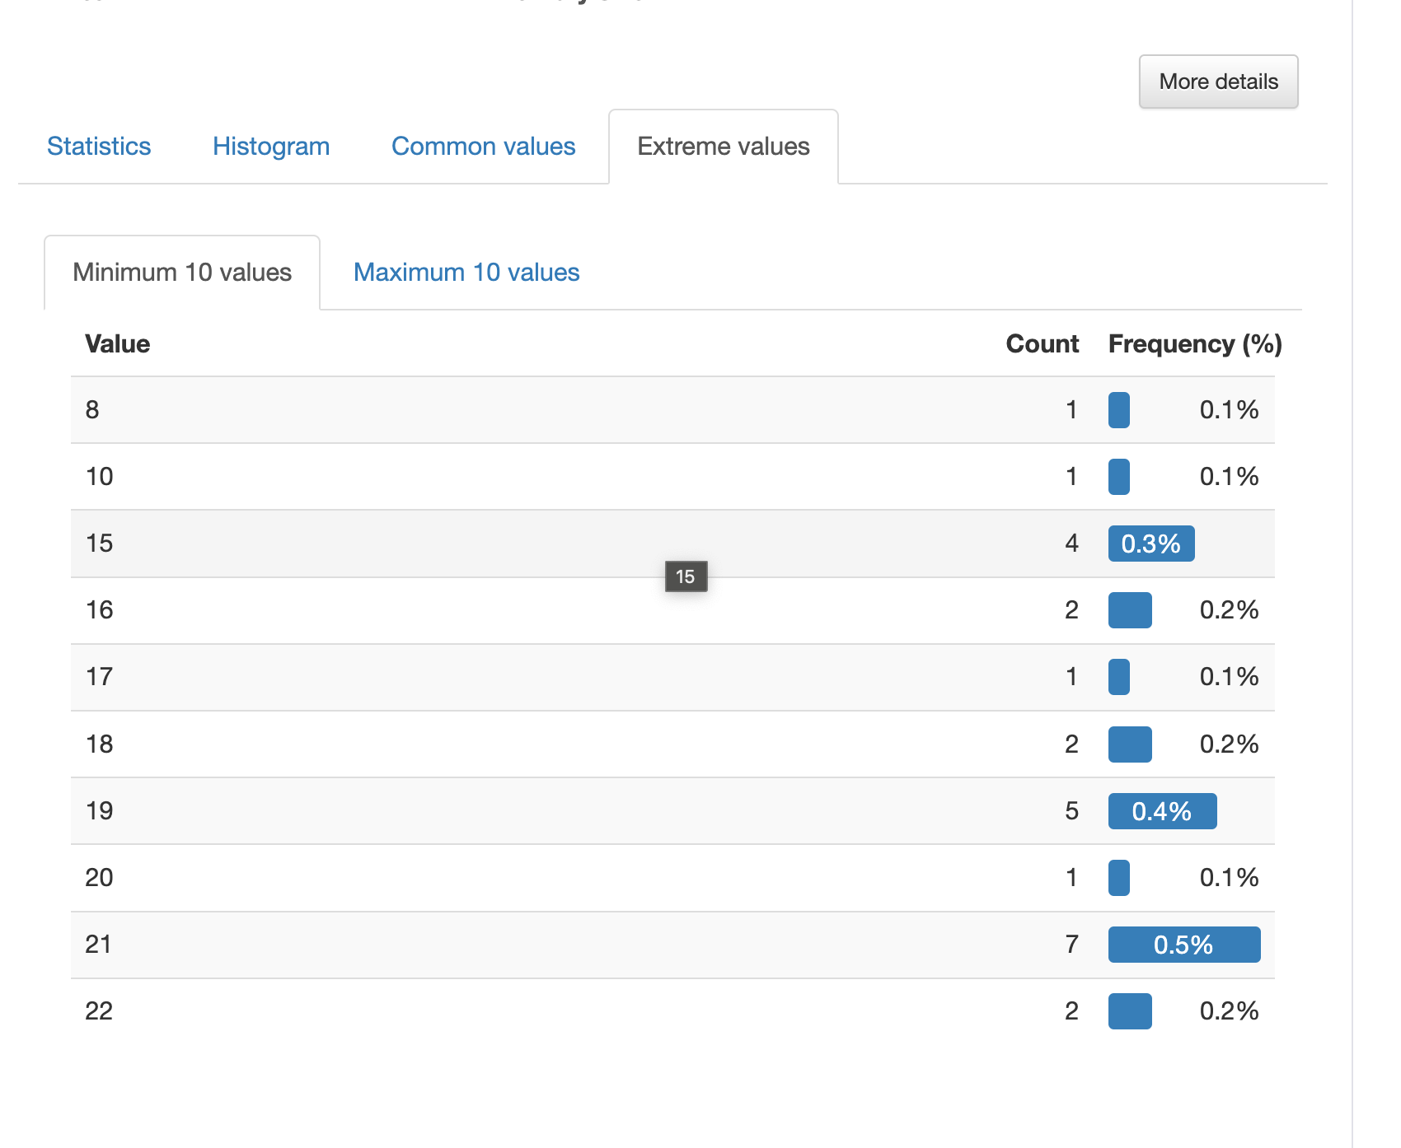
EDA: Panda Profiling ( New Tools)
Panda Profiling lets you derive all basic statistics, outliers, correlations, and basic EDA information in one interface.
https://pypi.org/project/pandas-profiling/

Slide 6
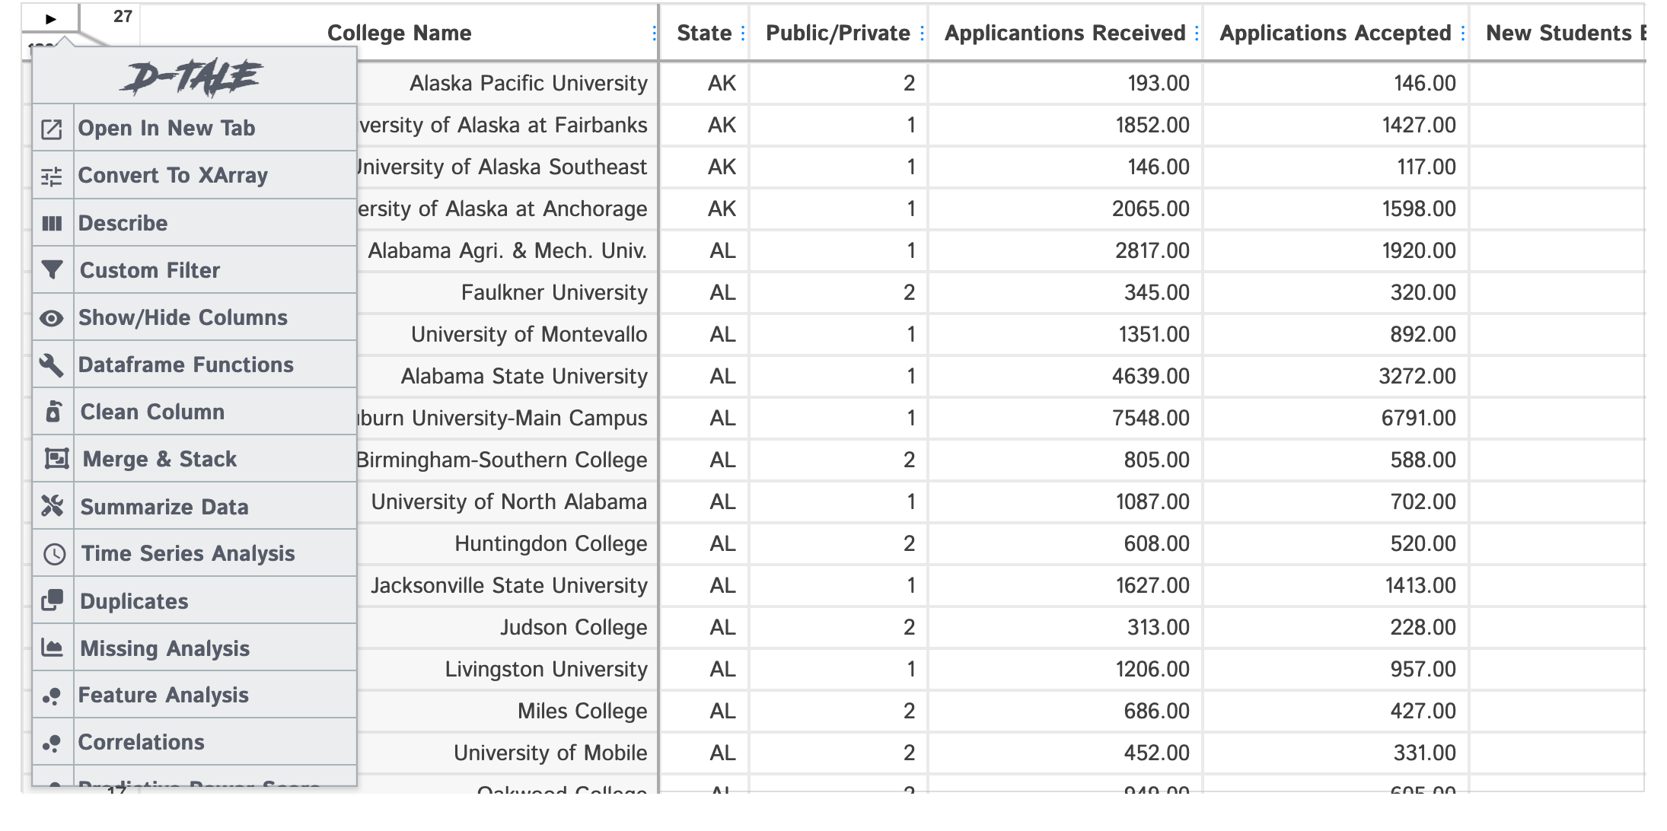
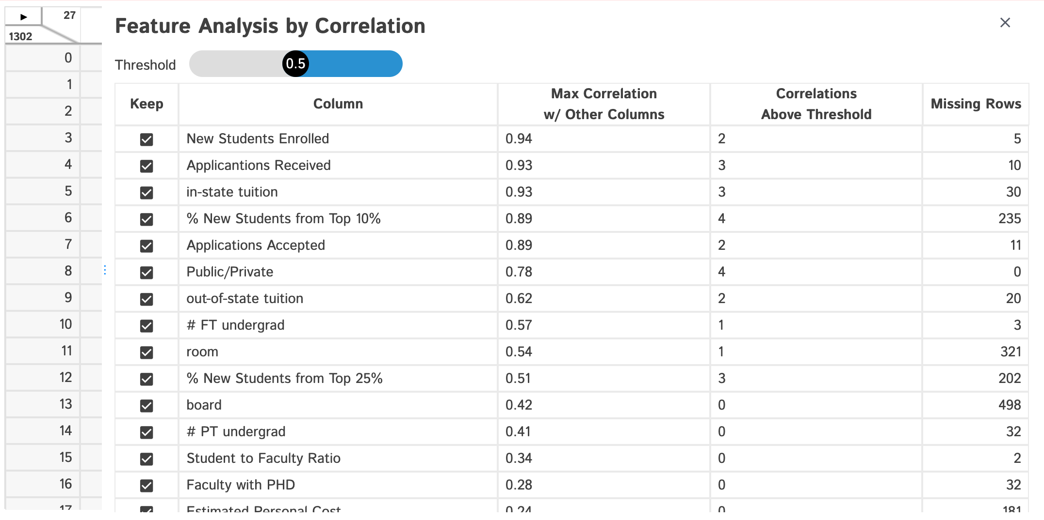
EDA: D-Tale ( New Tools)
D-Tale lets you derive all basic statistics, outliers, correlations, and basic EDA information in one interface as well, but also does feature analysis, and on the fly graphing with GUI
https://pypi.org/project/dtale/

Slide 7
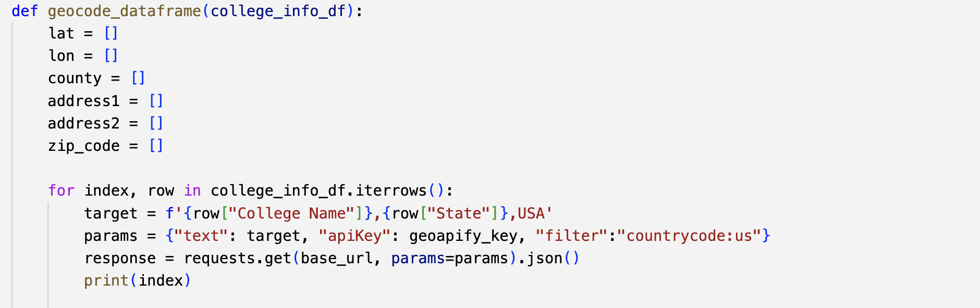
ETL Processes: Adding In Additional Data - Geocoding
Added Latitude and Longitude to Address Data ( Geocoding ) through the Geofy
Allows for direct mapping and geospatial analysis
Maps
Connection to US Census and demographic data

Slide 8
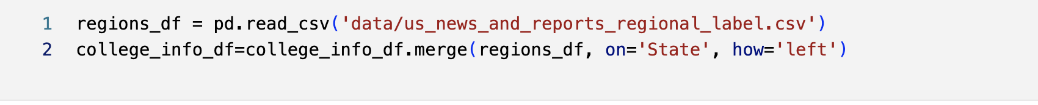
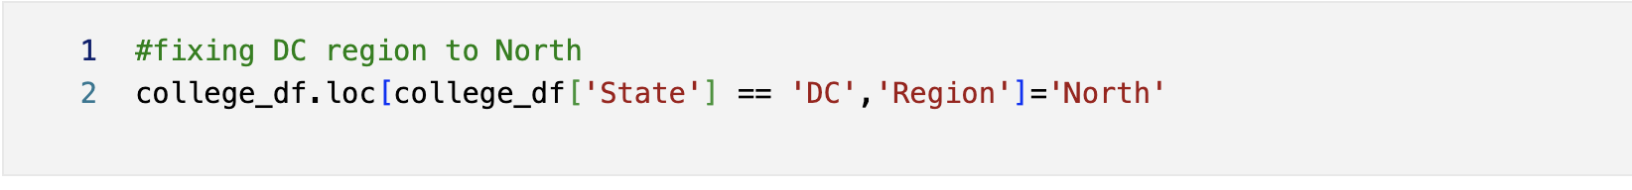
ETL Processes: Adding In Additional Data - US Reports Regions
Added Regional Data from the US and News and Reports
Original States per Region in US News and Reporting
Extracted from 2016 Information from ChatGPT
Cross-Region comparisons
Adding Regional Information for DC, since DC was not included in the State extraction

Slide 9
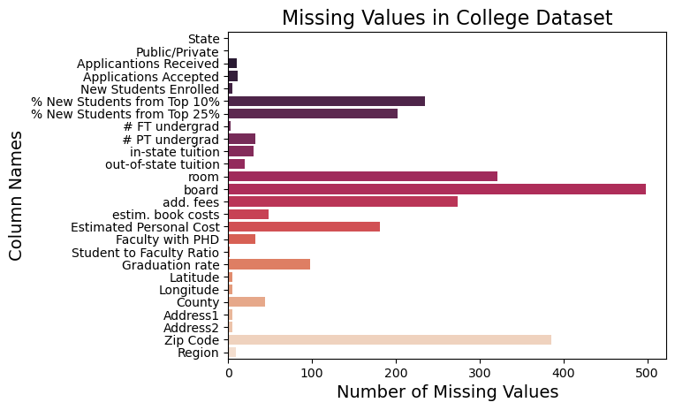
Data Cleaning: Missing Data: No drop_na
Using the Pandas Method Drop_na takes our record count from 1302 to 471 with a 63.82% reduction in data.
We can’t use such a blunt tool.
Case-by-case dropping using dropna with a subset on specific columns

Slide 10

Data Cleaning: Correcting Types
Converted string columns to numeric (Float or INT) in Pandas
Corrected any typos or mistakes that would prevent this conversion via Pandas and Loc.
Kept data in Excel using Pandas Excel functionality conversions to avoid unneeded string-to-number conversions.
No Data Time functionality was needed.

Slide 11
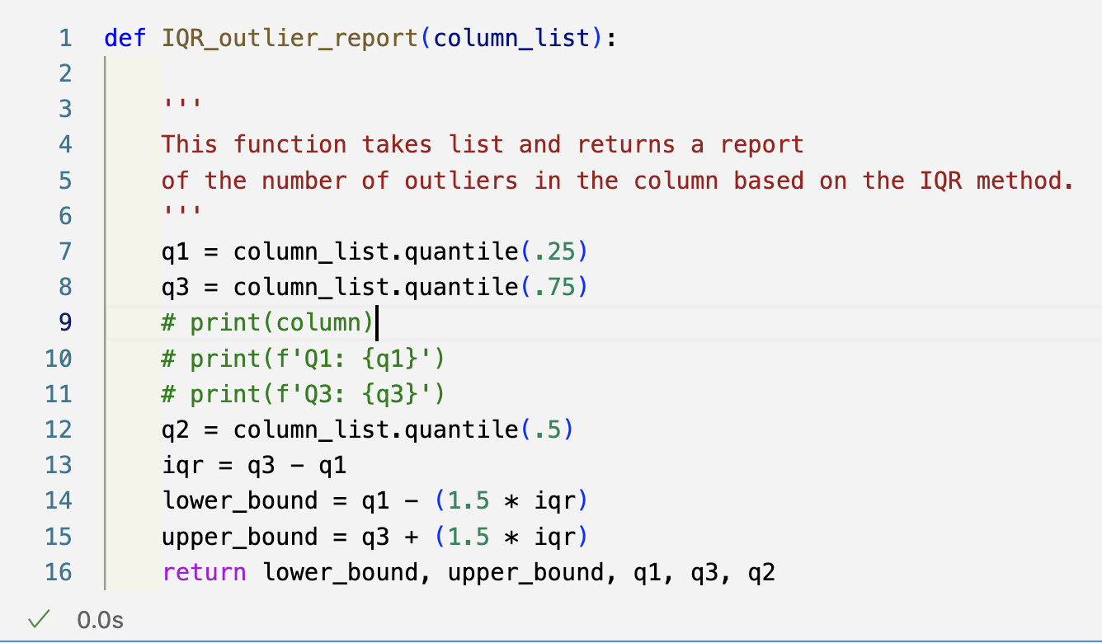
Outliers: Detection
The IQR method uses the quartiles +- 1.5 ( Code is on the right).
Easy to deal with outliers:
120 for the Graduation Rate is impossible; manually fixed this with correct data. ( Fixing these )
Case Western Reserve University does not have a 2.9 Student to Faculty Ratio, and most lower than Q1-IQR*1.5 are probably incorrect data
Harder to Dismiss
~48000 applications for Rutgers University in 2016 are correct.
Similarly, in and out-of-state tuitions, some schools are correctly expensive outliers. Can we drop MIT from a college report?

Slide 12
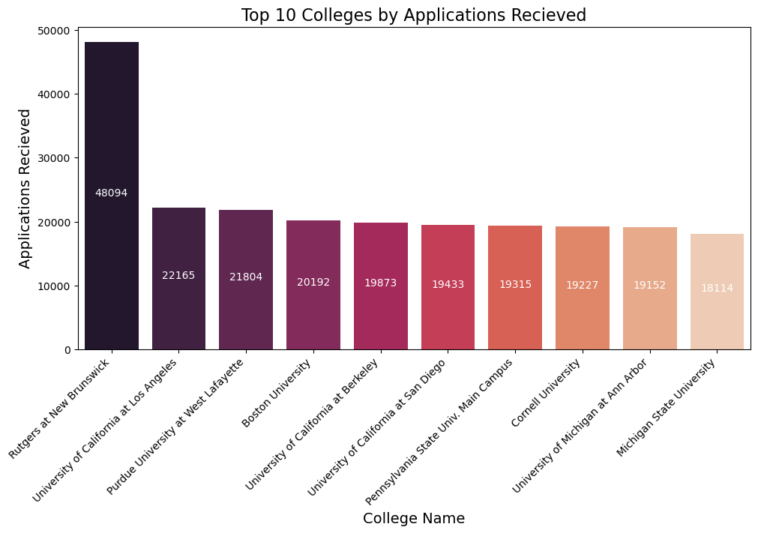
Data Cleaning: Most Outliers
Most columns in the data have higher variability.
Outliers tend to look like the top 10 colleges by Applications Received.
All items are outliers in this chart, and all are relevant.
Outliers in this data can not be summarily dismissed.
All of these are outliers and all 100% correct

Slide 13
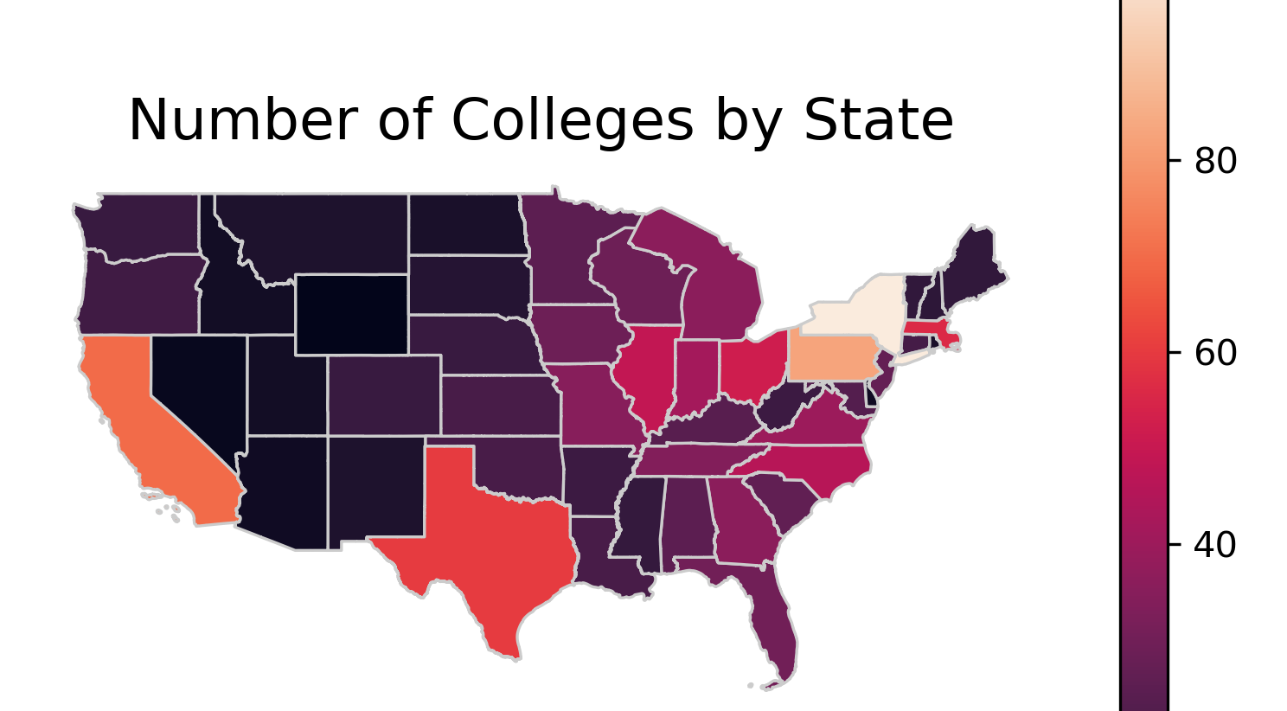
Created with Geopandas, US Census Shape Files, and MatPlotlib

Slide 14
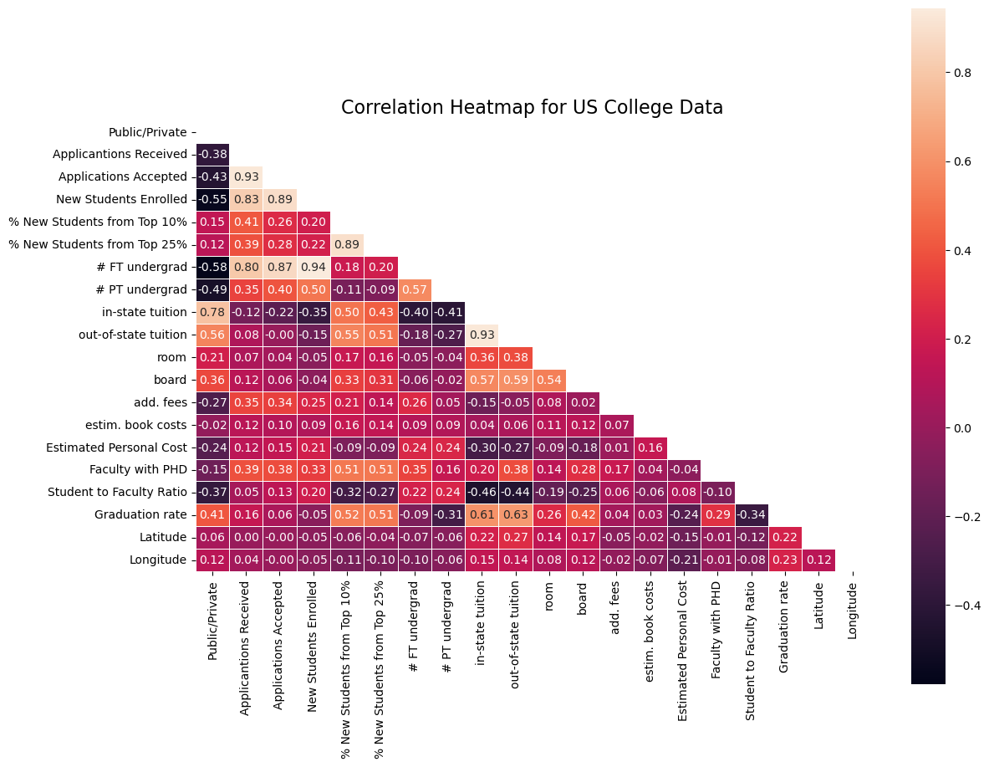
General Correlations
Applications Received, Applications Accepted, and New Students Received are all highly correlated. More enrollment can take more students and get more applications.
Part-time student status moderately negatively relates to Graduation Rates
(Correlation: - 0.31 )
Additional Fees and Estimated Personal costs negatively correlate to Public/Private schools. At the same time, room and board are moderately correlated with public/private, meaning Private schools tend to bundle more components into the room and board, and public schools tend to itemize costs and pass them to students.

Slide 15
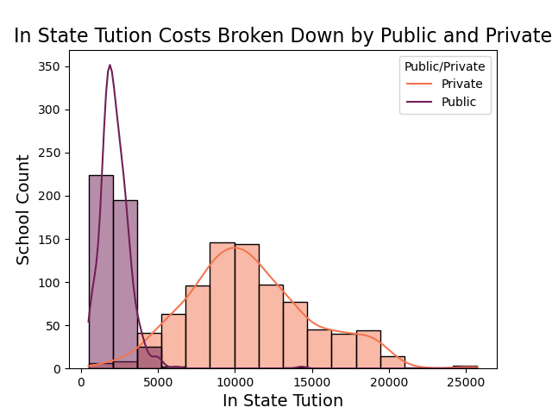
Cost: In-State Tuition
2208
Mean In-State Tuition for Public.
11008
Mean for In-State Tuition for Private Schools (2-tailed ttest p-value = 0.0, Statistic=58.6)
Schools over 20K a year in order of highest to lowest
Middlebury College
Bates College
Franklin and Marshall College Bennington College
Hampshire College
Massachusetts Institute of Technology

Slide 16
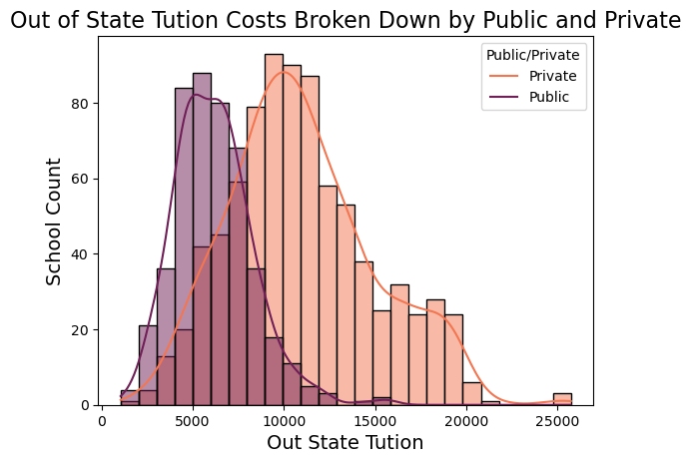
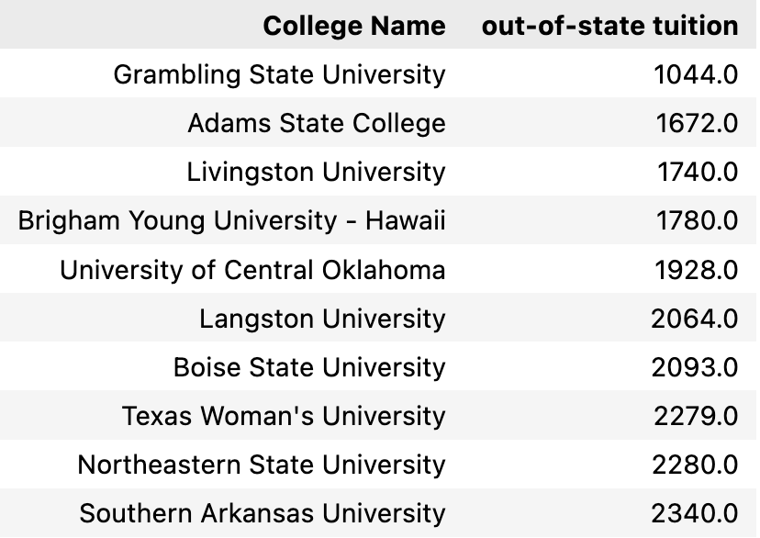
Cost: Out-State Tuition
6152
Mean Out-of-State Tuition for Public.
11008
Mean for Out-of-State Tuition for Private Schools (2-tailed ttest p-value = 0.0, Statistic=58.6)
Lowest Cost for Out-of-State Colleges

Slide 17
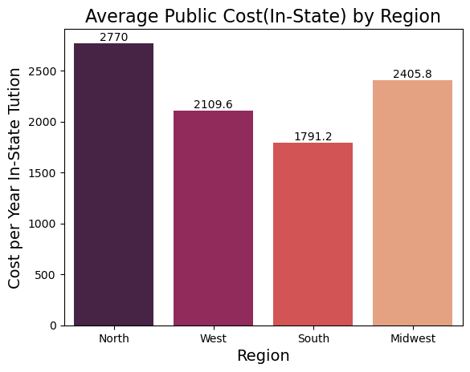
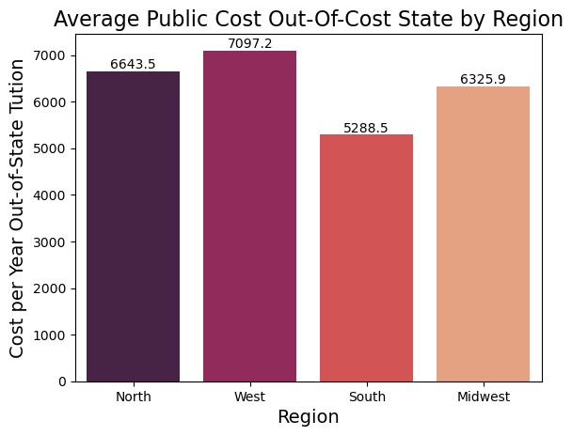
Public to Public Regions Charge Differently for In and Out of State
Significant Differences Between the Average Cost In State For Different Regions ( ANOVA fvalue=22.97054536966959, pvalue=7.732162944526283e-14)
Significant Differences Between the Average Cost In State For Different Regions (AMOVA fvalue=18.14586886782207, pvalue=3.897390493224823e-11 )

Slide 18
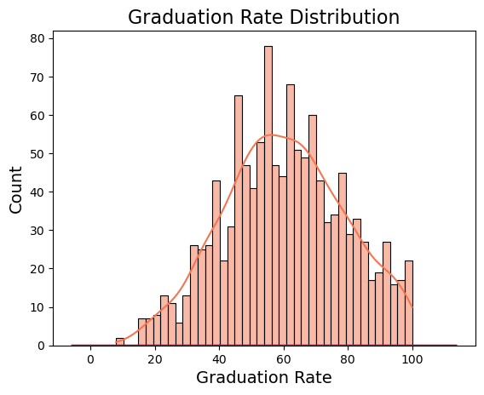
mean 60.343023
std 18.822515
min 8.000000
Max 100
25% 47.000000
50% 60.000000
75% 74.000000
THE BEST AT 100% GRADUATION RATE
Harvey Mudd College
Santa Clara University
Amherst College
Harvard University
Lindenwood College
Missouri Southern State College
Siena College College of Mount St. Joseph Grove City College
University of Richmond Goddard College
Heritage College
THE WORST AT 8% GRADUATION RATE
UNIVERSITY OF HOUSTON DOWNTOWN

Slide 19
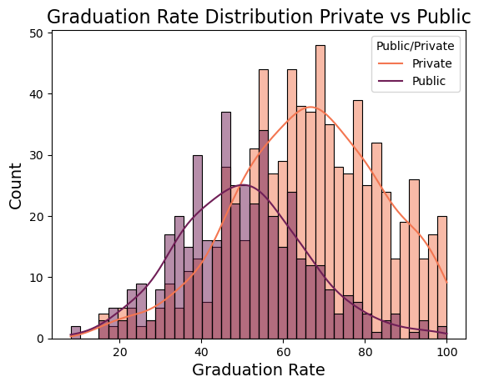
Graduation Rates: Private Schools Do Better
Private Average Graduation Rate
66.07
Public Average Graduation Rate
50.18
2-tailed t-test ( p-value: 0.0, Statistic = 15.03*)
Statistically Significant Difference
We must reject the null hypnosis that private and public school graduation rates are the same.
* p-values are exceedingly small

Slide 20
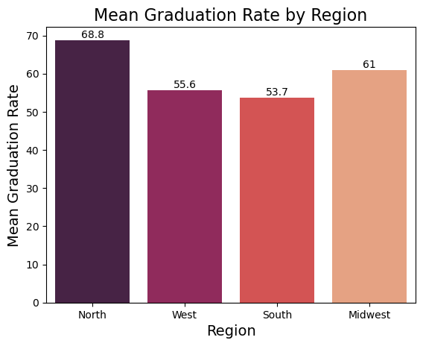
Graduation Rates: Regional Differences Exist
Different US News and World Report Best College Regions 2016 have different graduation rates
( ANOVA p-value= 0.0, fvalue=47.13* )
The North Region does significantly better then even the next highest Midwest Region
( t-test p-value=0.0, statistic=5.8 *)
The West and South Region are not significantly better than each other
( t-test p-value=0.29, statistic=1.05 *)
The Midwest does better than the West and South
( t-test p-value=0.002, statistic=3.02 *)
If you must graduate, attend North Region schools.
* p-values are exceedingly small

Slide 21
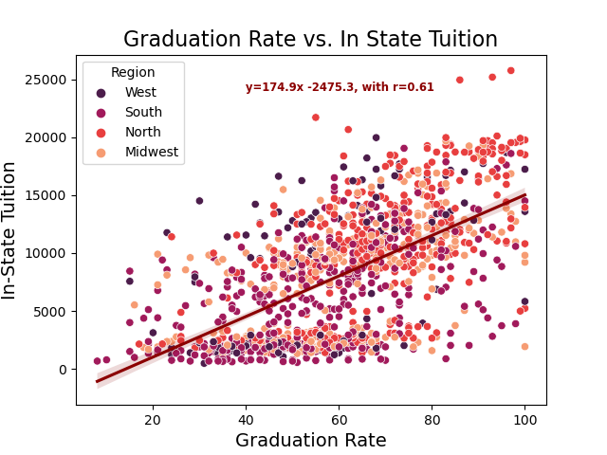
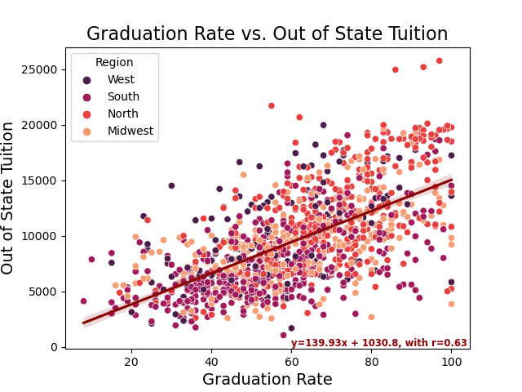
Graduation Rates: Tuition Up, Graduation Rate Up
Spend More to get more? Graduation rates suggest yes.

Slide 22
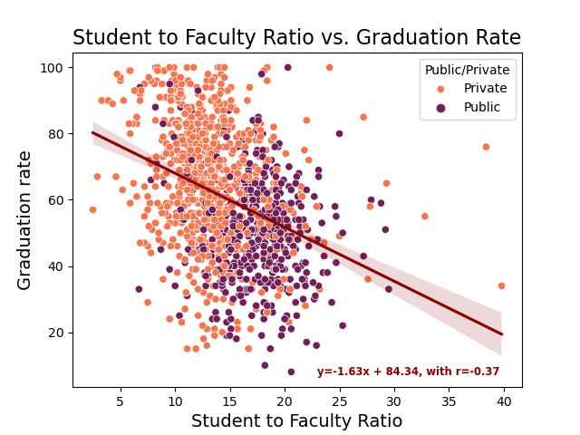
Graduation vs. Faculty to Student Ratio
A lower student-to-faculty ratio does help with higher graduation rates, but it is only moderate.
(Correlation: -0.34)
Most Schools have a ratio of student to faculty ratio between 14-15
(mean: 14.9, median: 14.3 )
Private Schools have statistically significantly smaller Student to Faculty Ratios.
( 2 tailed t-test p-value = 0.0*., Public student to faculty ratio = 17.4, Private student to faculty ratio = 13.1 )

Slide 23

Next Steps In Analysis
Separate Public and Private fully and analyze each separately. In many of the graphs and analyses, the two categories acted like they came from different populations.
Much of the outlier ( but valuable data) problem will be helped with that split.
More Geopandas with Regional Tests and Regional Visualizations.
Clean Github and Clean-Up Jupyter notebooks
Would like to do an Unsupervised K-Means as I suspect there is a public-private and small-medium-large clustering in the data.
Would like to test the PCA reductions against Random Forest.

Slide 24
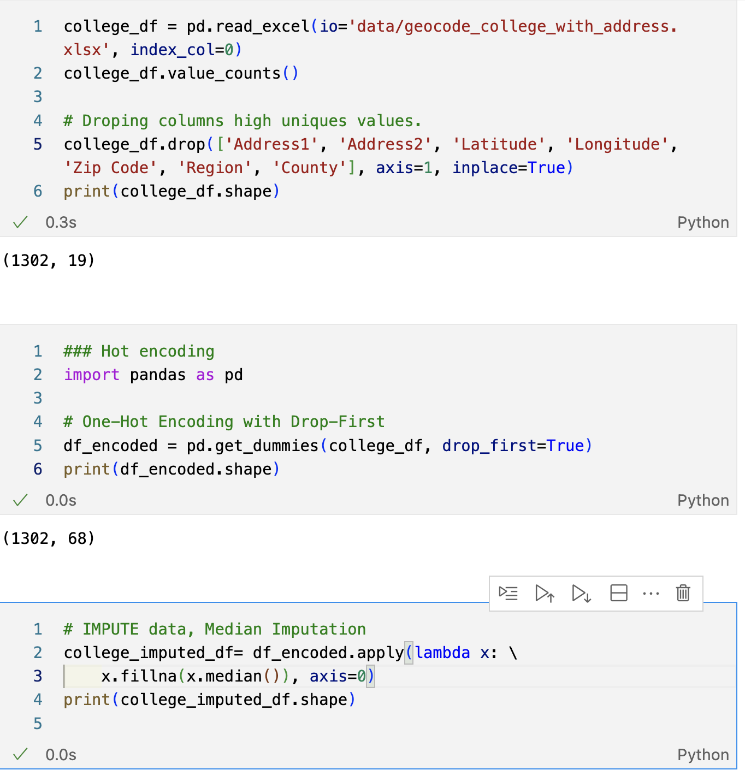
PCA Dimension Reduction The step before machine learning.
Preparation Work
Dropped Columns that were too unique
Address1, Address2, Latitude, Longitude, Zip Code, County. Dropping Region as it was not part of the original data.
Reduction from over 3000 columns hot-encoded to just 68
Hot-Encoding data VIA Pandas pd.get_dummies.
Imputing missing data via Median Strategy.
Scaling via Standard Scalar Modules

Slide 25
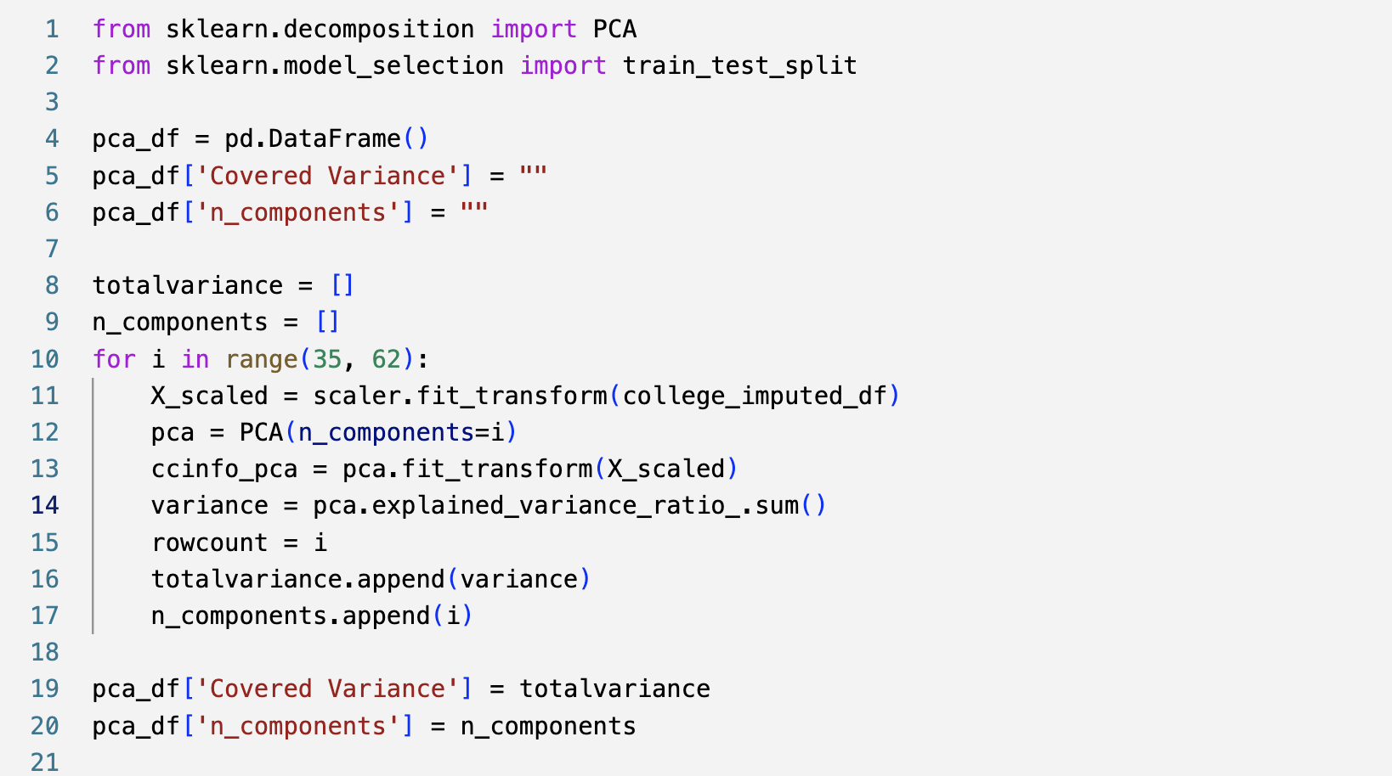
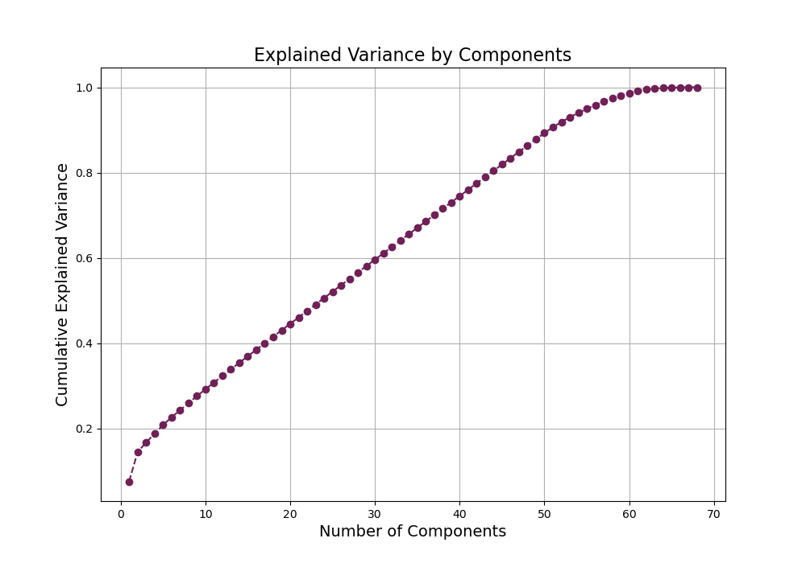
Scree Analysis for PCA
Based on Scree, Ran PCA with n-Components between 35-62 to capture 75% -> 95% of the variability
Scree graph stables around 58, checking for the best coverage at the lowest level of n_components.

Slide 26
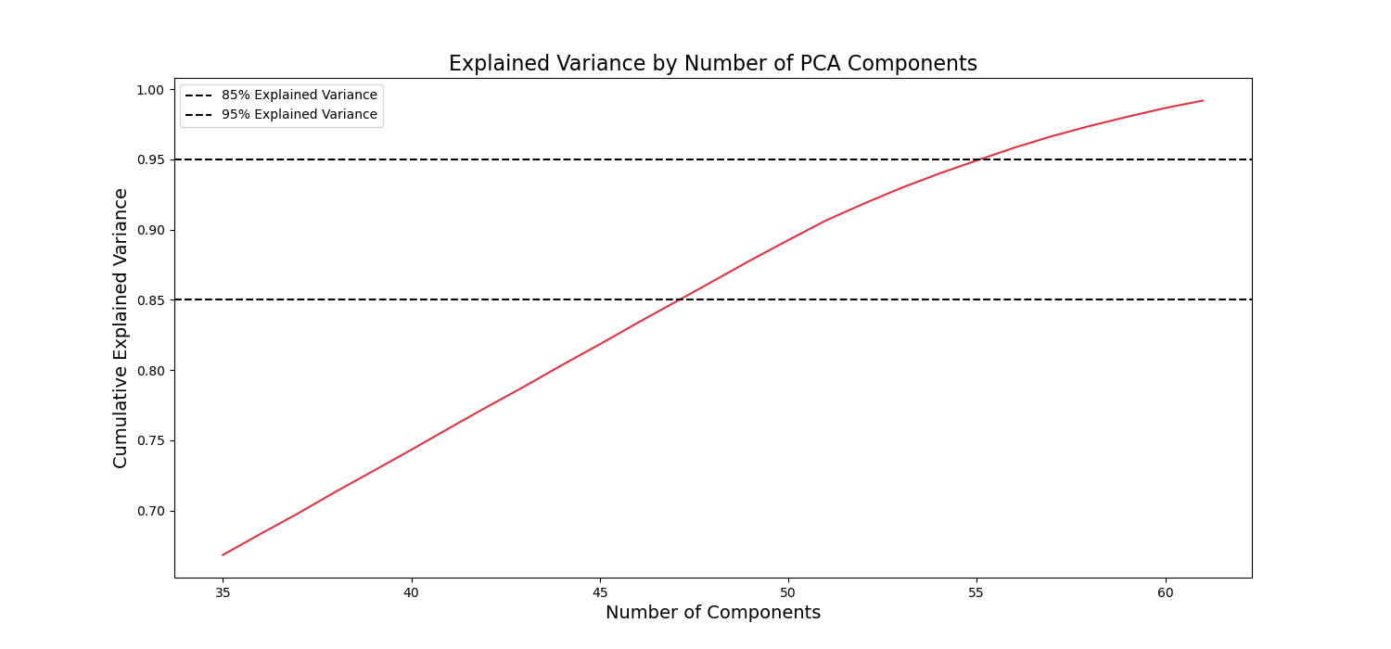
Outcome of Multiple PCA Dimension Reduction
55 PCA components to have 95% of the summed variance covered.
47 PCA components to have 85% of summed variance covered.

