Slide 1
OK Cupid
Codecademy Machine Learning Project

Slide 2
Project Scoping
I was keen to build a predictive model using the data in the dataset
One of the features that I thought would be interesting to investigate was whether or not a person smoked
I started of using age, income and height variables but there was little or pattern in these as to whether people smoked or not
So my next approach was to see if other similar facts, diet, alcohol and drug consumption might be more effective

Slide 3
Data cleaning and manipulation
I simplified the data to help my work by turning smokes into a binary Yes/No and by making the other variables more concise
I used pd.getdummies to get the feature data ready for the model

Slide 4
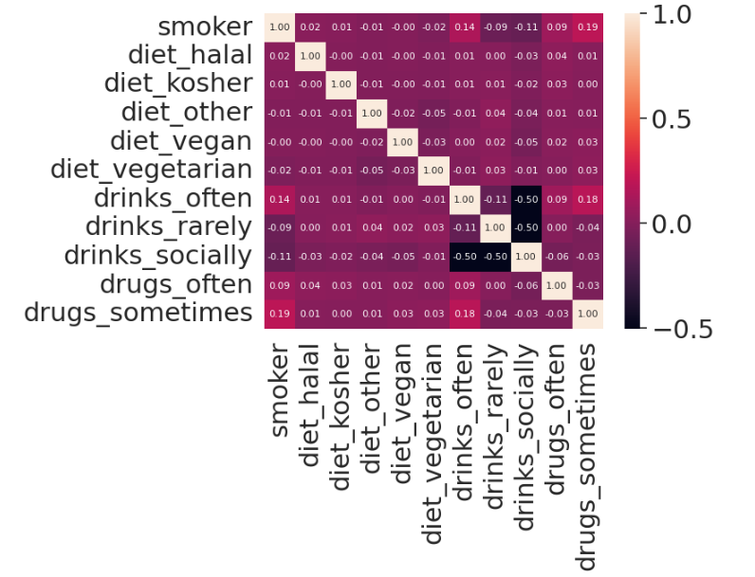
Explore and explain the data
I created this heatmap to understand the effect of each of the features. The data shows that other addictive traits in people ie drinking often and taking drugs had some correlation with whether or not someone smoked

Slide 5
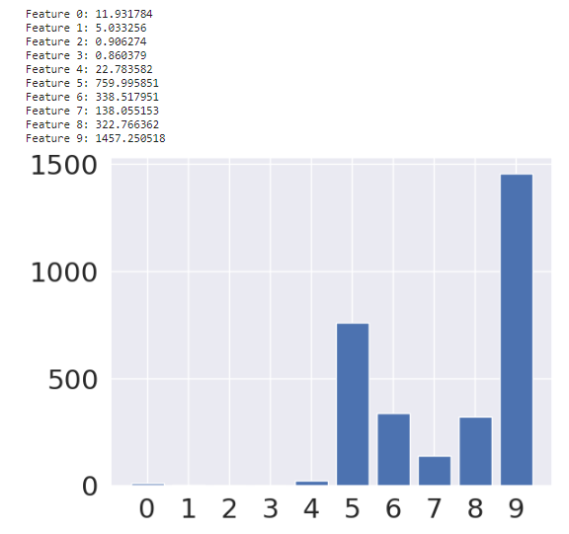
Explore and explain the data
I ran a Chi test on the correlation between the different features and whether or not a person smoked or not.
It backed up the heatmap in showing that the drinking and drug features were the best to use in a model

Slide 6


Model results
After fitting the model with the drinking and drug features it turned out to be have a fair accruacy and precision score but tended to under predict the people who smoked
This was almost certainly due to the quality of the data but it was certainly a project I found interested and improved my model making and machine learning skills

