Slide 1

HypPo Data Tool User’s Guide
HypPo is a customizable graphical user
interface (GUI) for analyzing spectroscopic
data developed in Matlab 2012a

Slide 2
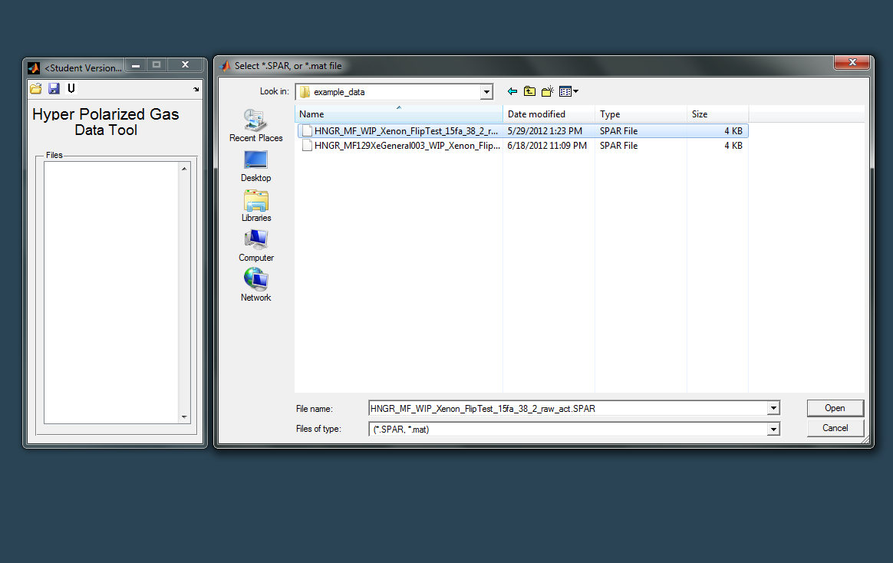

Slide 3
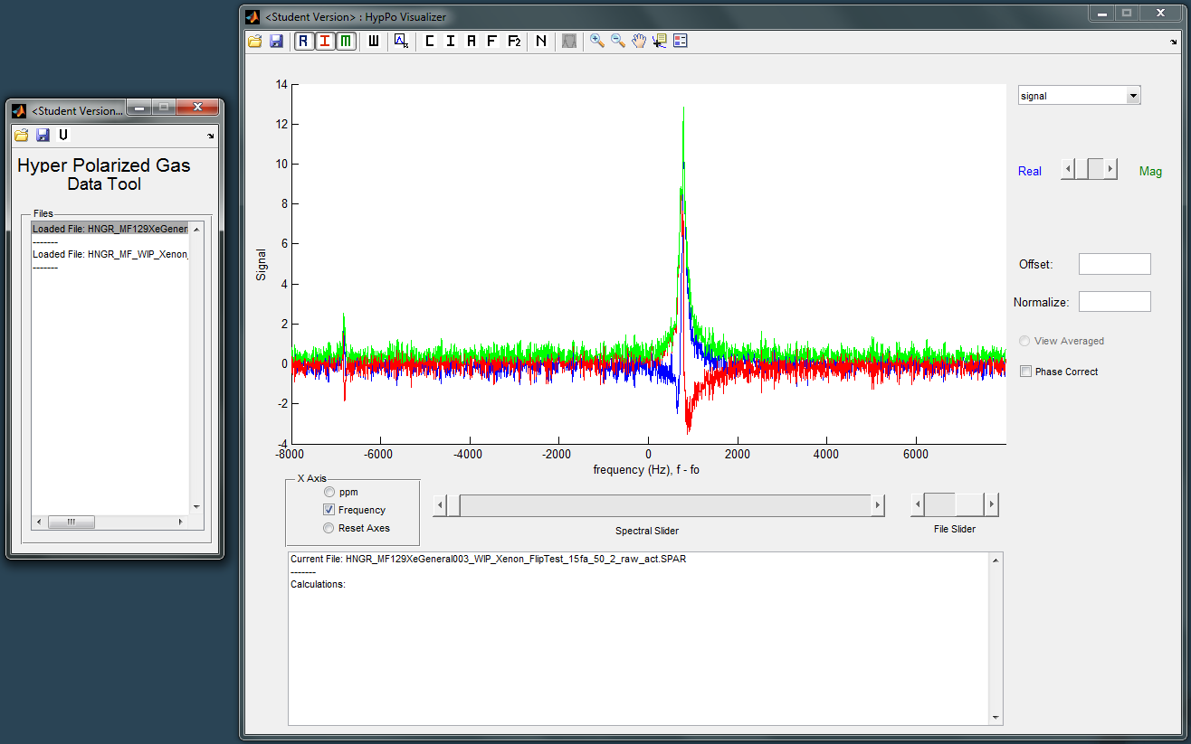
Click on visualizer button

Slide 4
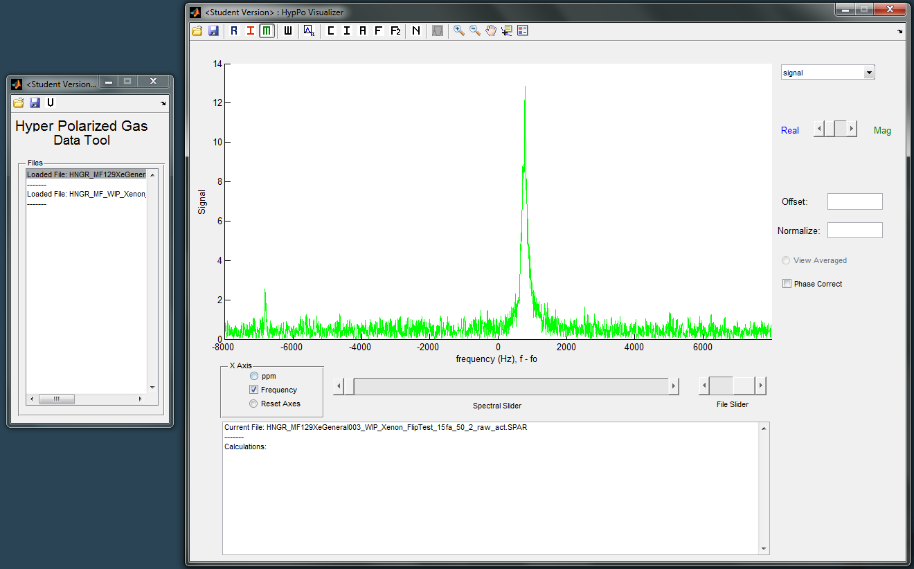
Select which part of spectrum to display

Slide 5
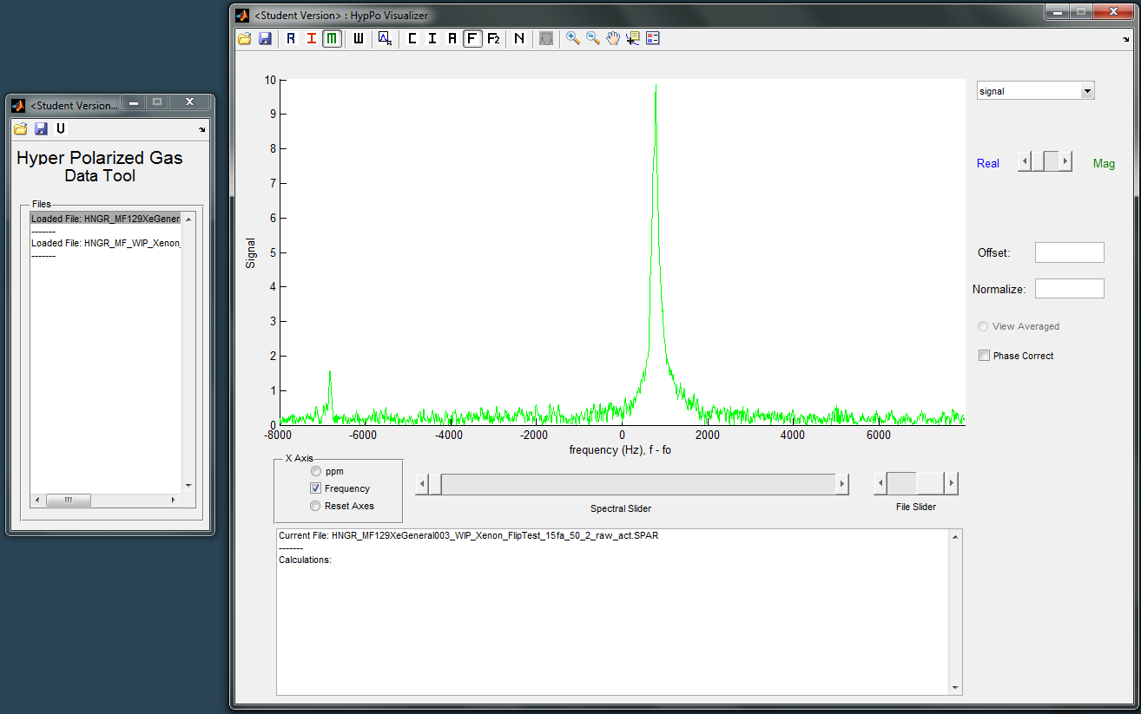
Apply low-pass filter

Slide 6
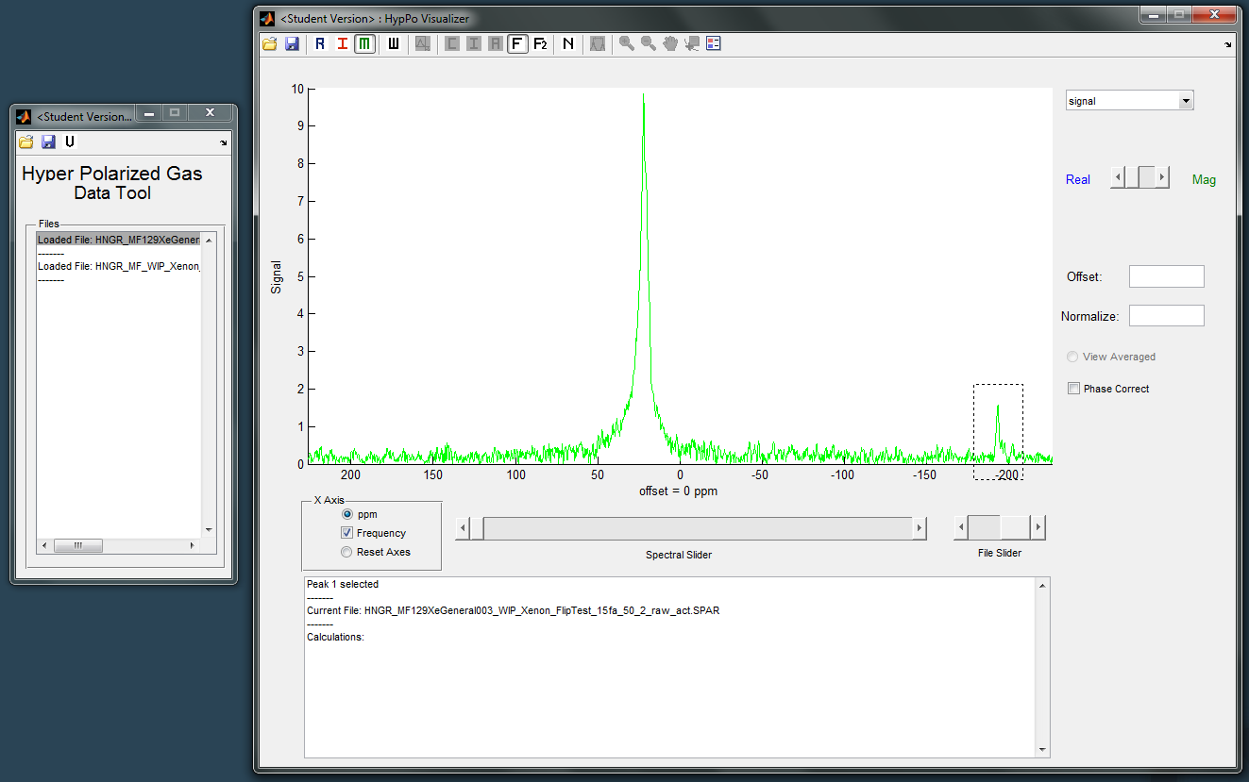
Calculate
chemical shift
Change x-axis into ppm

Slide 7
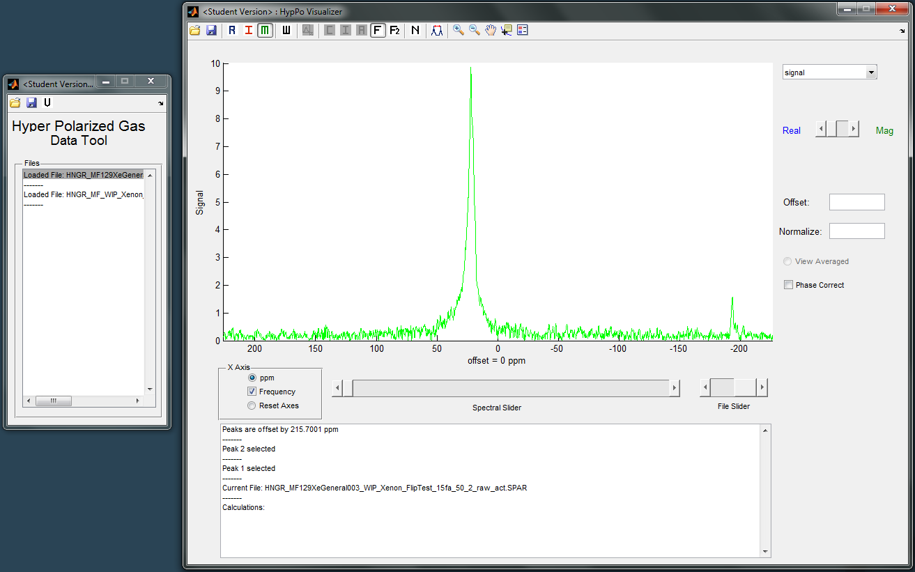

Slide 8

Switch to other file

Slide 9
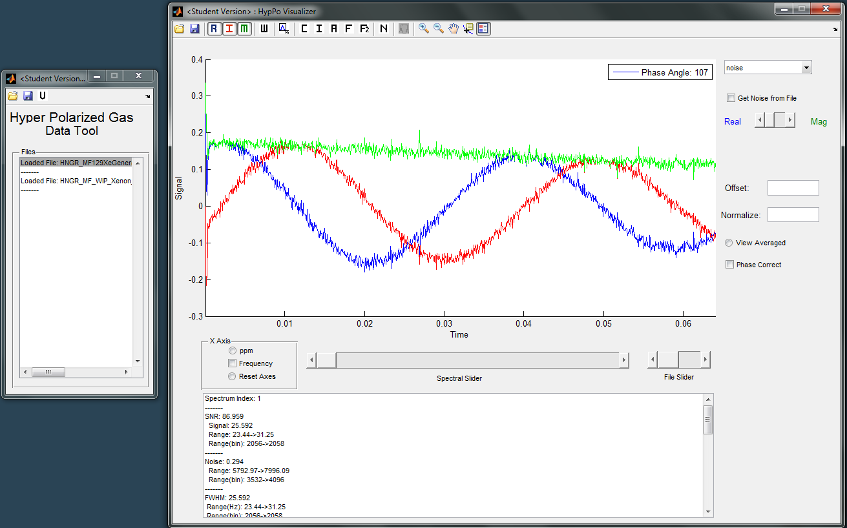
Change domain
of spectrum

Slide 10
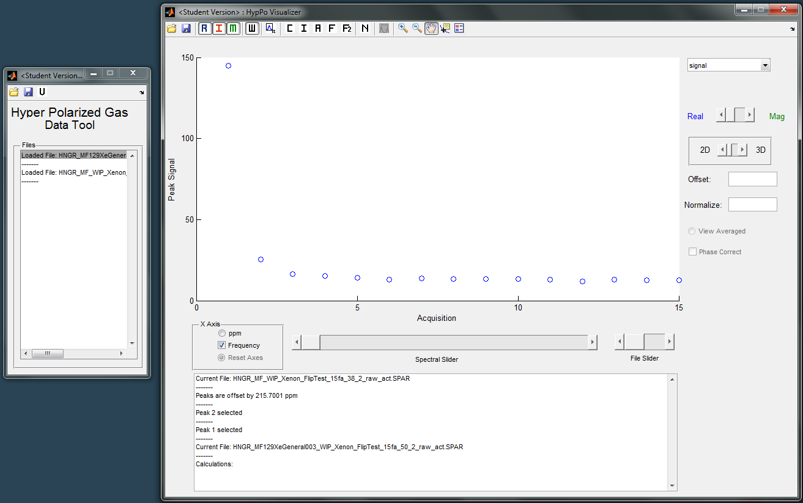
View max signal
for all acquisitions

Slide 11
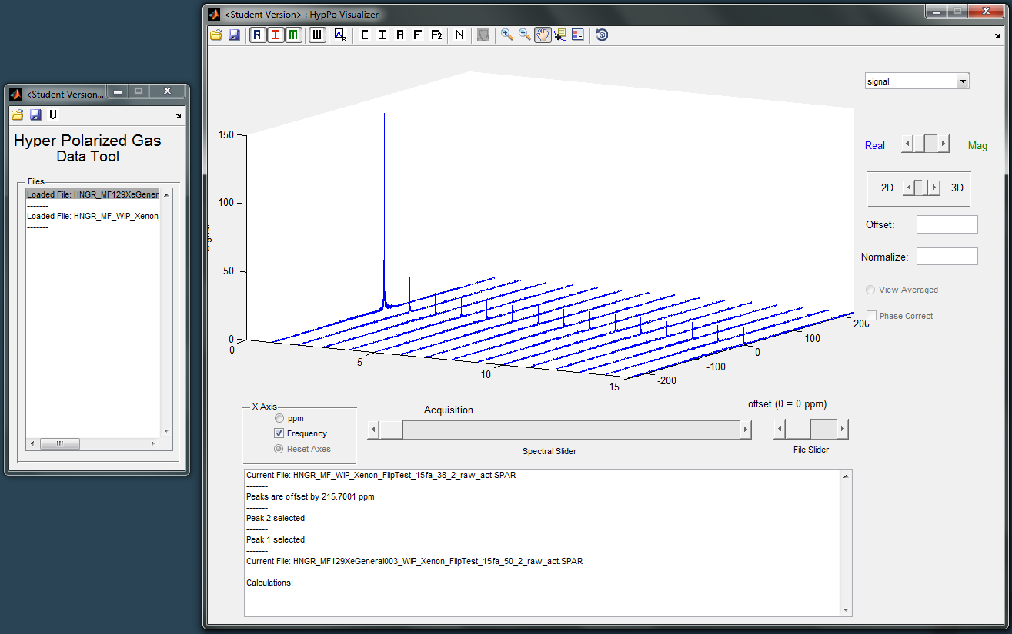
View all spectra

Slide 12


Slide 13
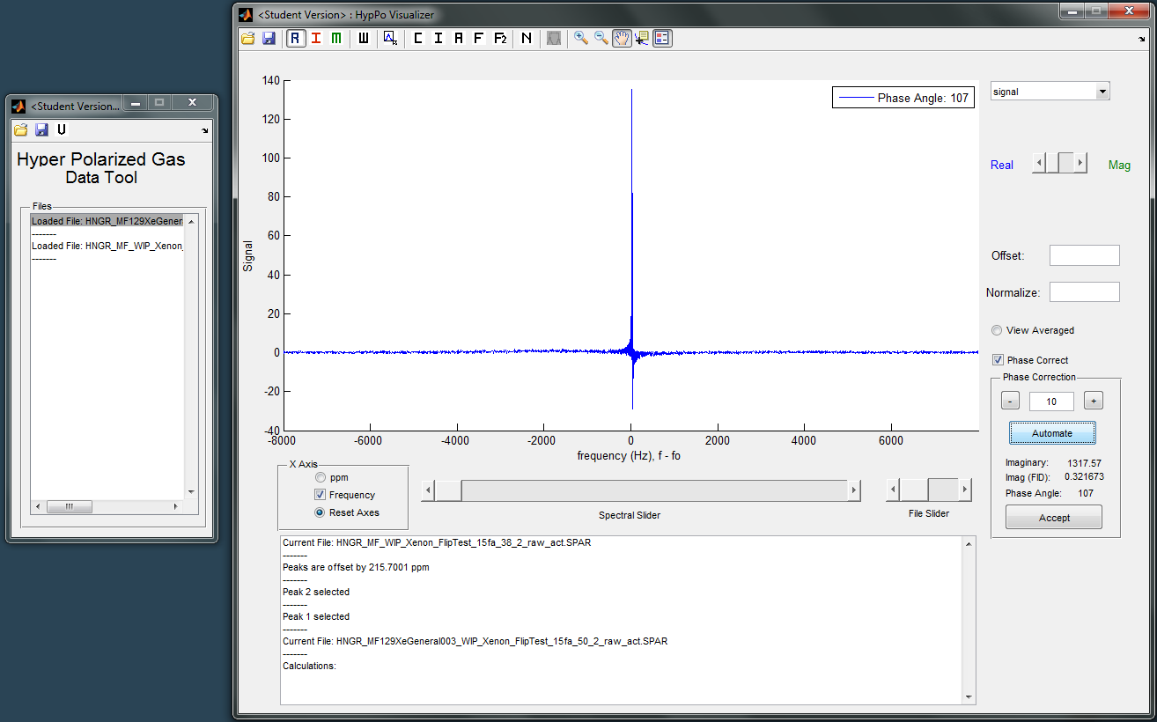
Perform phase correction, begin by attempting automation

Slide 14

Modify phase angle until data appears phased

Slide 15
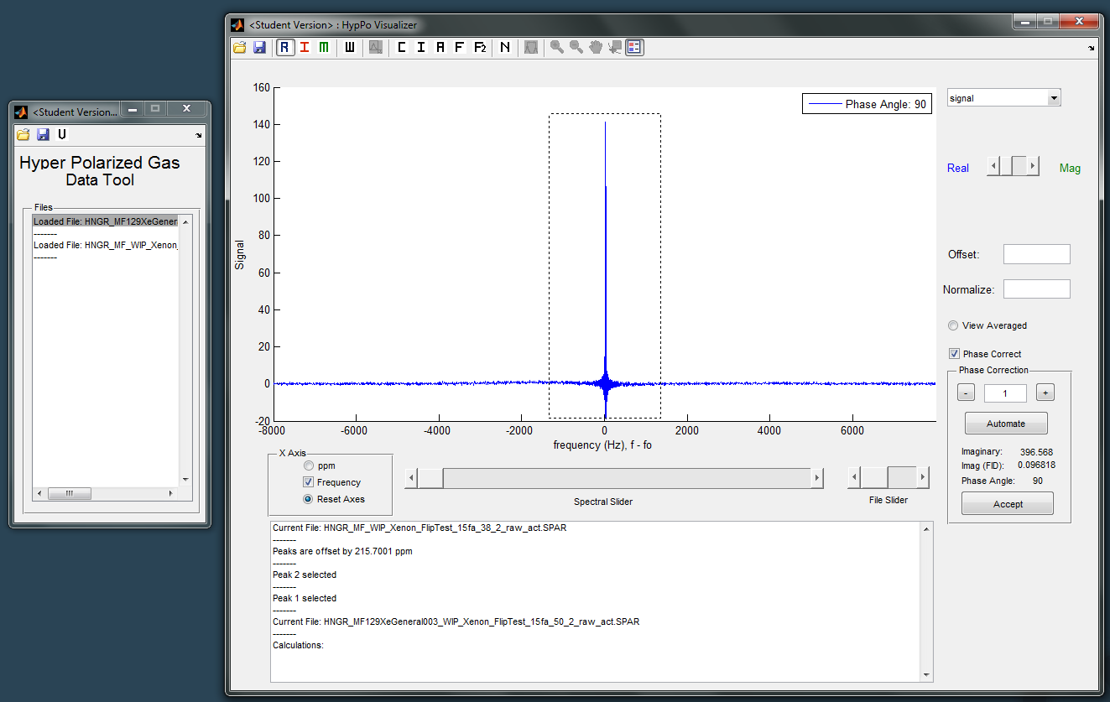
Select regions of signal and a region of noise

Slide 16
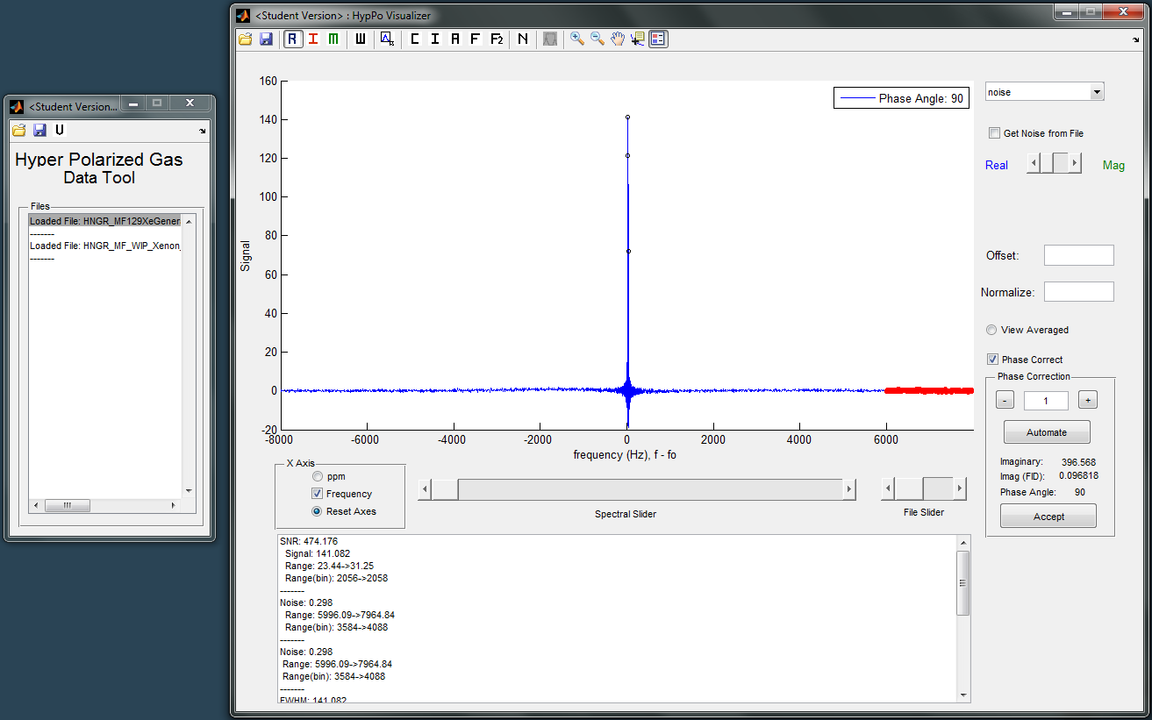
Display information about selection

Slide 17
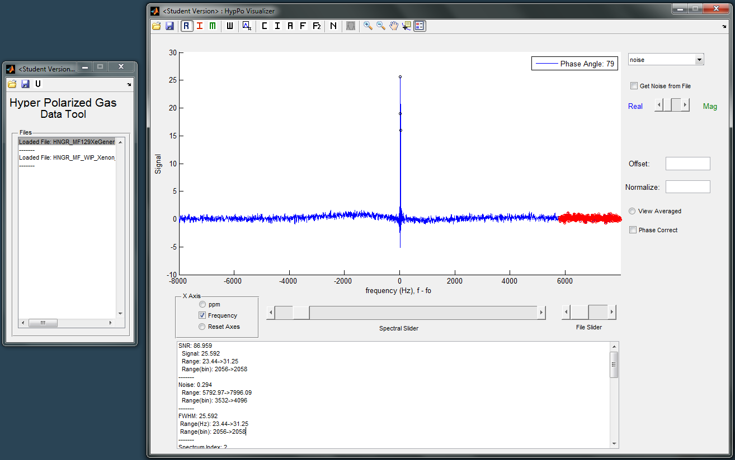

Slide 18
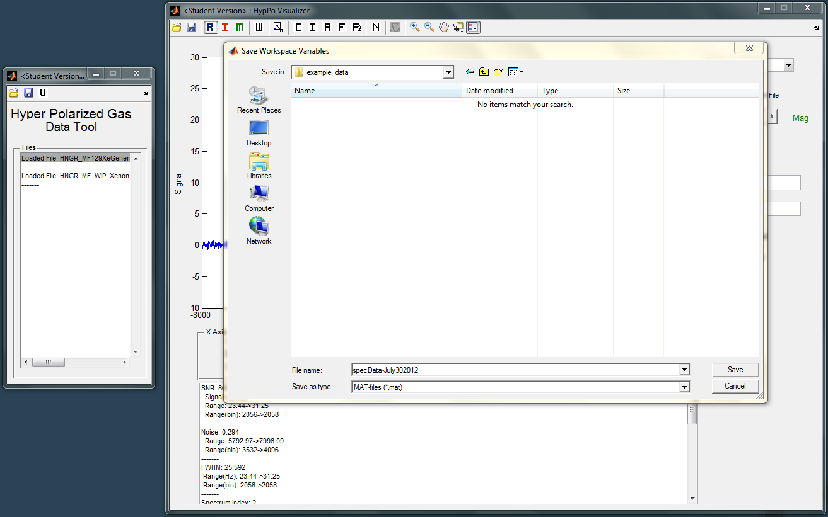
Save all data to a file

Slide 19
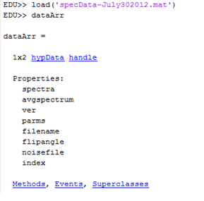

Slide 20
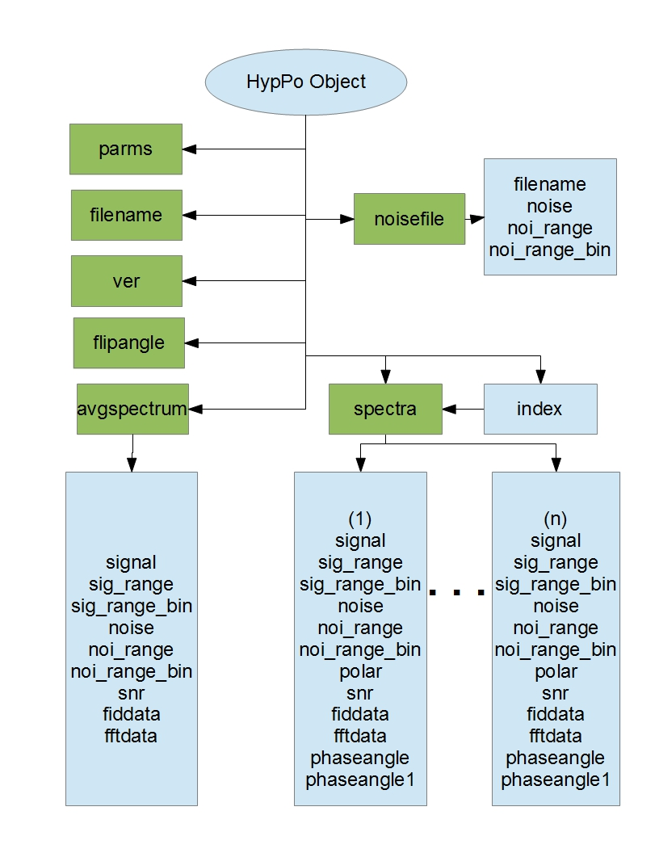

Slide 21
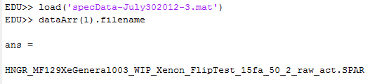
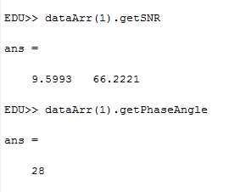
Data is stored as an object which
can be interacted with in the
matlab workspace.
Built in functions are provided
for ease of access.

Slide 22
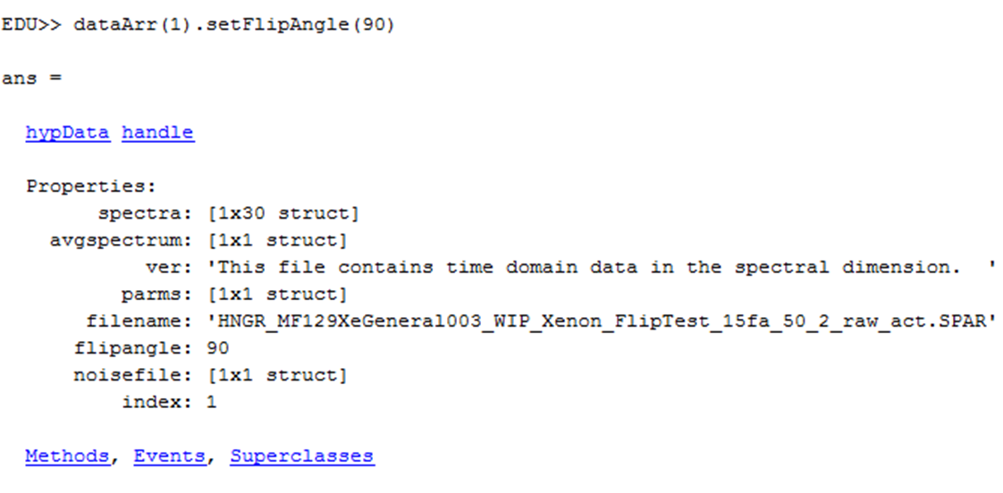

Slide 23
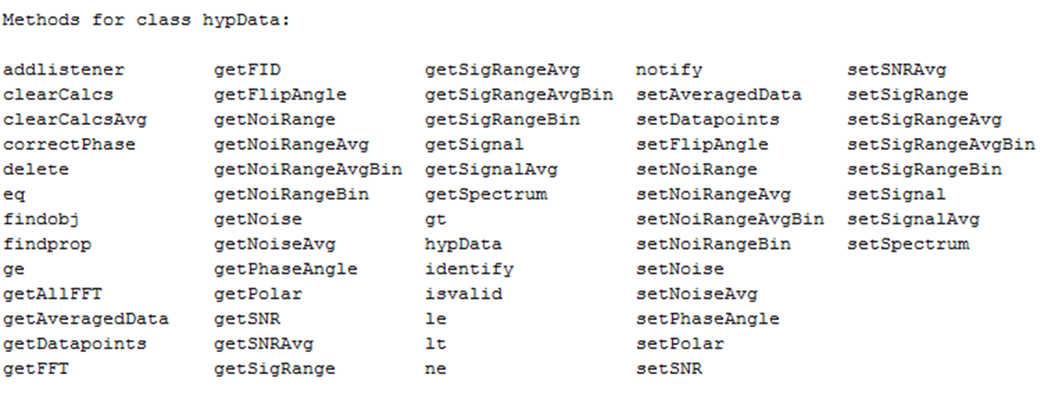

Slide 24
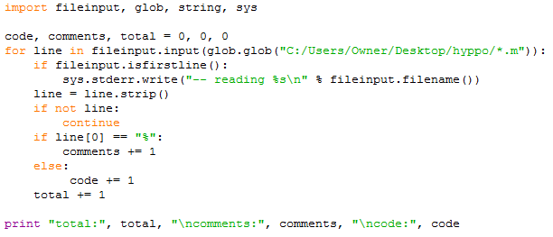
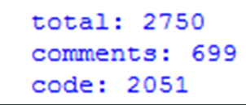
Measuring the size of this program

Slide 25
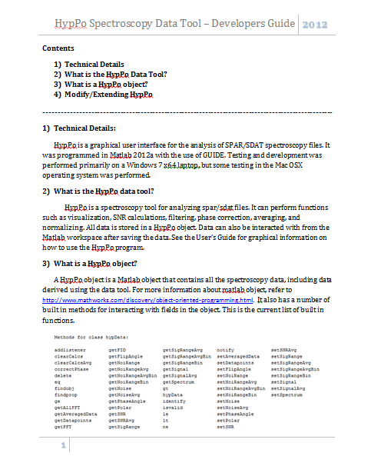
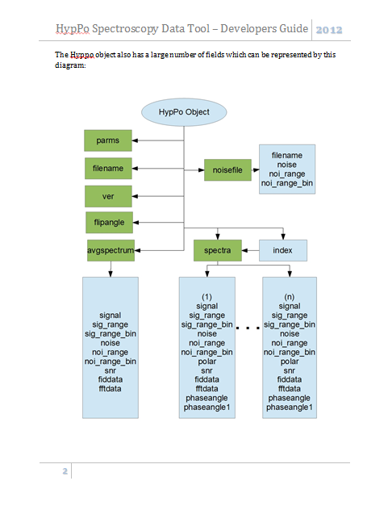
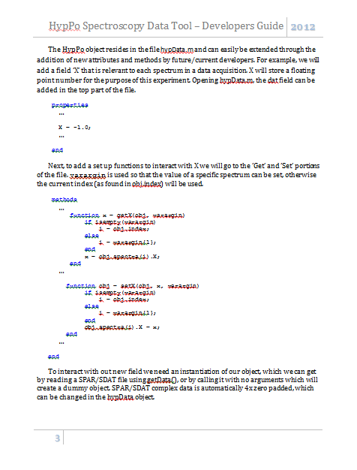
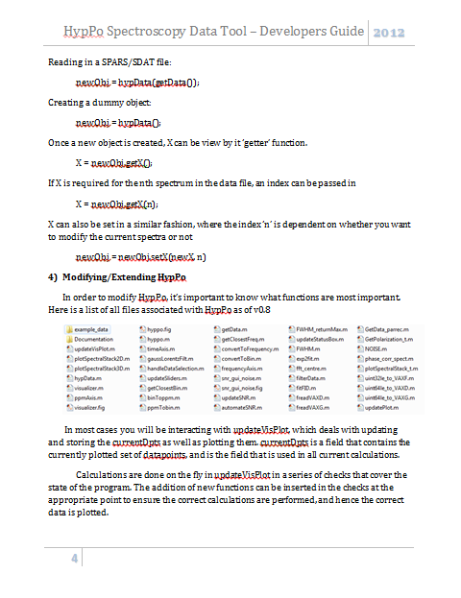
For information about extending HypPo, see Code Documentation – Developers Guide

