Slide 1
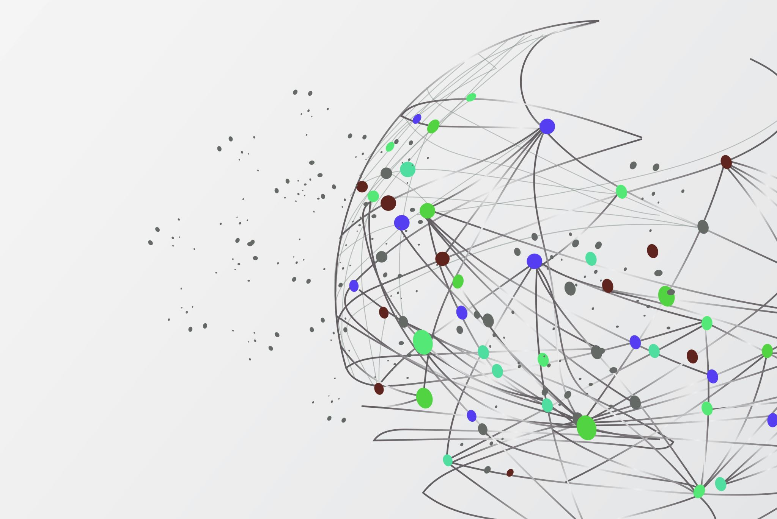
Enhancing Neural Vocoders for High-Quality Speech Synthesis
ZHOU Hanbo BTGY7K
YANG Deyu E44MLP
XIA Xihang BX7F0X Dec. 2024

Slide 2
1 Introduction and Related Work
Neural vocoders are essential in modern text-to-speech (TTS) systems, converting intermediate acoustic representations, such as mel-spectrograms, into high-quality speech waveforms. Models like HiFi-GAN and AutoVocoder have significantly improved audio fidelity and computational efficiency, but challenges persist in achieving robustness to speaker variability, handling environmental noise, and maintaining real-time synthesis performance.
Our project explores neural vocoder architectures, focusing on HiFi-GAN and AutoVocoder, to enhance quality, speed, and generalization. By training and testing these vocoders on datasets like LJSpeech (single-speaker) and VCTK (multi-speaker), the aim is to synthesize natural, high-quality speech that generalizes well across diverse speakers and noise conditions.

Slide 3
1 Introduction and Related Work
• HiFi-GAN:
Kong et al. (2020) introduced HiFi-GAN, a GAN based vocoder with a multi-scale discriminator and generator optimized using mel-spectrogram and feature-matching losses. It achieves high fidelity and real-time synthesis performance. – Reference: Kong, J., Kim, J., & Bae, J. (2020). HiFi-GAN: Generative Adversarial Networks for Efficient and High Fidelity Speech Synthesis. NeurIPS. https://github.com/jik876/hifi-gan
• AutoVocoder:
Designed to streamline vocoder functionality by focusing on computational efficiency and robustness. AutoVocoder introduces architectural simplifications while ensuring competitive perceptual quality. – Reference: https://github.com/hcy71o/AutoVocoder

Slide 4
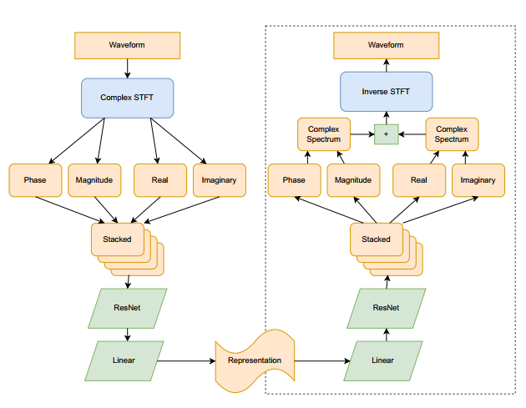
2 Methods of Training
Type of Neural Network
• HiFi-GAN: – Generator: A convolutional architecture with dilated and residual layers designed to model long-range dependencies in audio. – Discriminator: Multi-scale and multi-period discriminators evaluate the realism of generated audio at various resolutions and periodicities.
• AutoVocoder: – Use machine learning to obtain a representation that replaces the mel-spectrogram, and that can be inverted back to a waveform using simple, fast operations including a differentiable implementation of the inverse STFT.

Slide 5
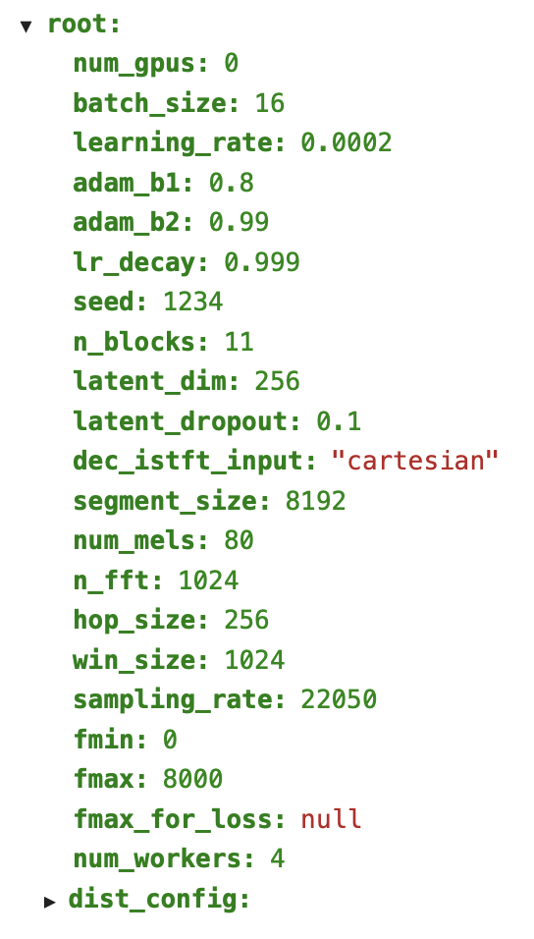
2 Methods of Training
Datasets • LJSpeech: Single-speaker dataset ( 24 hours of clean speech). • VCTK : Multi-speaker dataset (109 speakers with diverse accents and noise conditions).
Hyperparameter • Learning Rate: 0.0002. • Learning Rate Decay: 0.999. • Batch Size: 16. • Optimizer: Adam (β1 = 0.8, β2 = 0.99). • N FFT: 1024. • Hop Size: 256. • Win Size: 1024. • Sampling Rate: 22050.

Slide 6
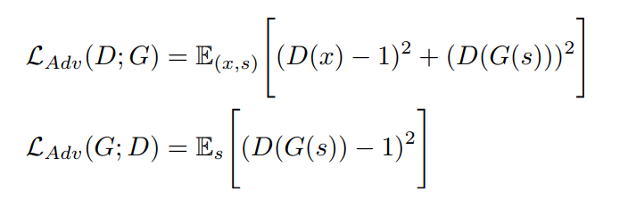
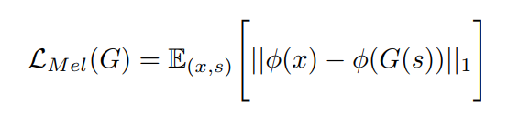
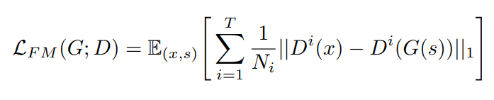
2 Methods of Training
Loss Functions • HiFi-GAN: – Adversarial Loss: Drives realism by training the generator to fool the discriminator. – Mel-Spectrogram Loss: Ensures alignment between generated and target spectrograms. – Feature Matching Loss: Encourages perceptual similarity in intermediate features. • AutoVocoder: – Additional attention and periodic losses for better pitch and temporal alignment.

Slide 7
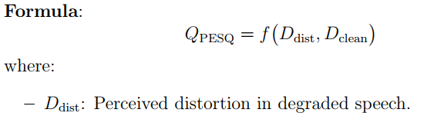
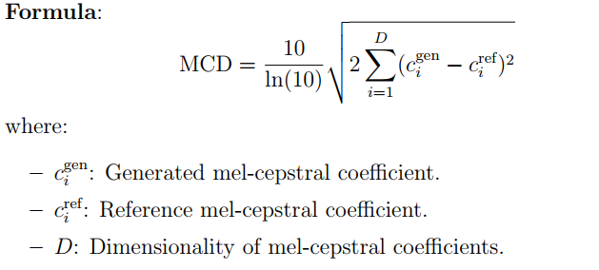
3 Evaluation
Evaluation Metrics • PESQ (Perceptual Evaluation of Speech Quality) Function: Predicts speech quality by comparing the synthesized audio with a reference signal, simulating human auditory perception. Output: A scalar score ranging from -0.5 to 4.5. • MCD (Mel Cepstral Distortion) : Function: Measures the spectral distortion between synthesized and reference audio using mel-cepstral coefficients (MCCs). Output: Measured in decibels (dB), lower values indicate better quality. • Robustness: – Performance on unseen speakers and noisy datasets. A test by using our own voice recorded in a cafe.

Slide 8
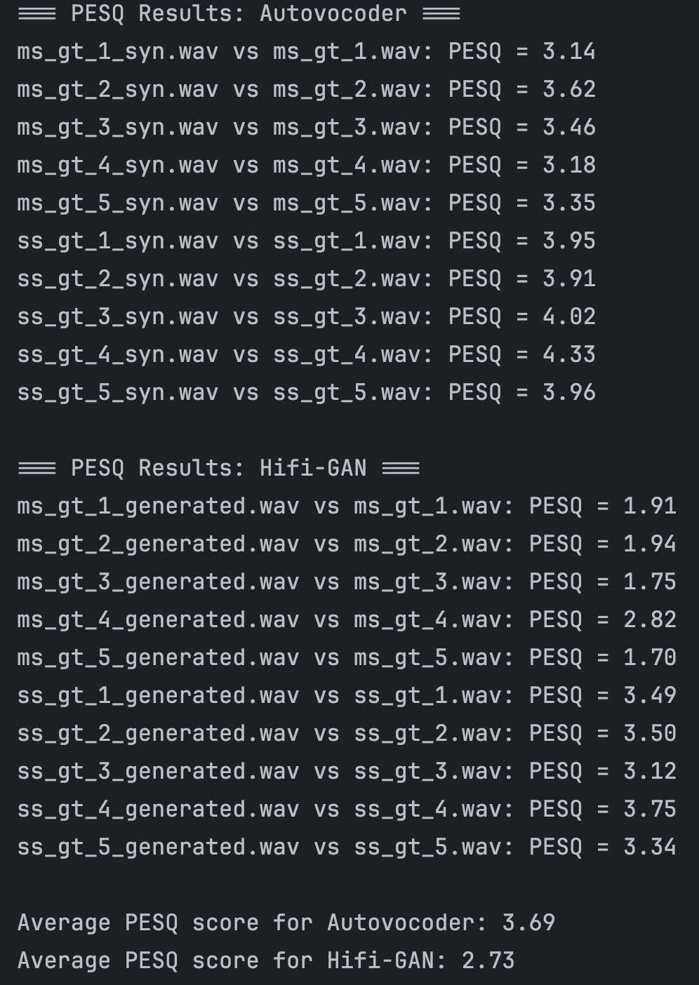
3 Evaluation
Results
Metric | HiFi-Gan | AutoVocoder
Average generation time per file | 9 seconds | 1 seconds
Average memory usage per file | 500+ MB | 70+ MB
Table 1: Use CPU inference 6s audios, The Summary of Average Time and Memory Usage for HiFi-Gan and AutoVocoder
Model | Average PESQ Score | Average MCD Score
Autovocoder | 3.69 | 3.57
Hifi-GAN | 2.73 | 4.61
Table 2: Comparison of Average PESQ and MCD Scores for Autovocoder and Hifi-GAN

Slide 9

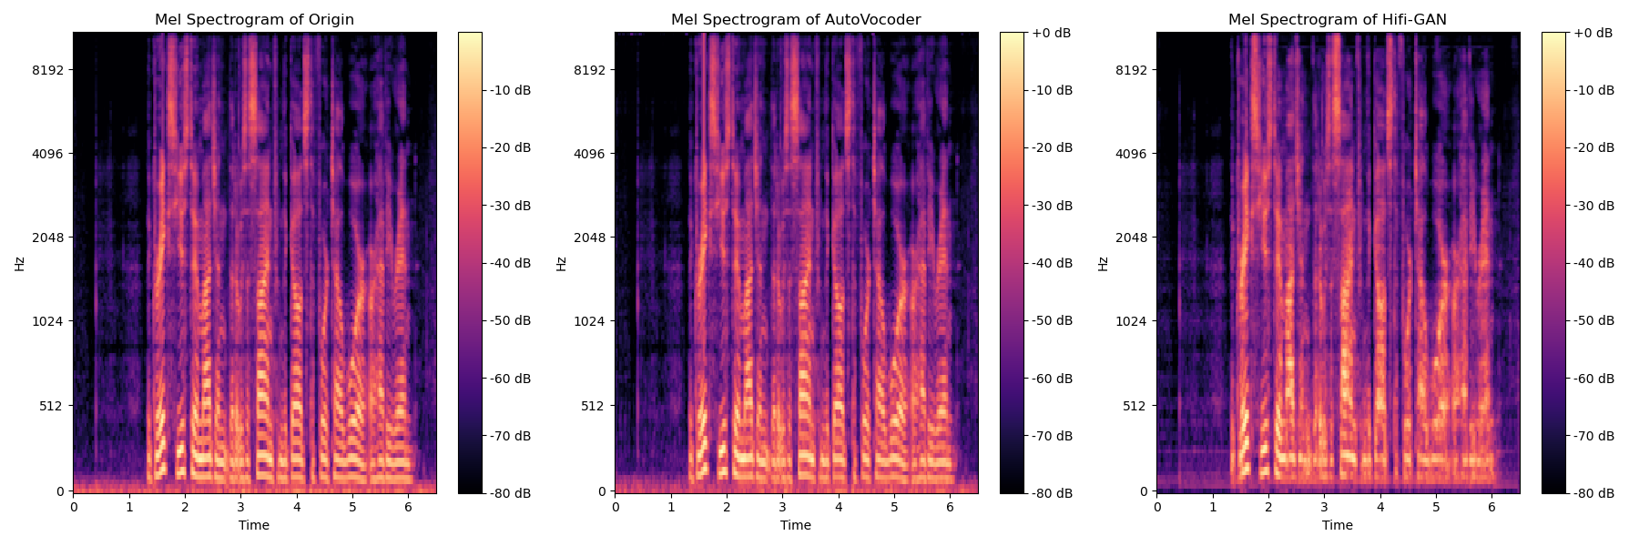
3 Evaluation
Visualizations
First test file: ms gt 5 Figure 1: Comparison of Mel Spectrograms for Origin, Hifi-GAN, and AutoVocoder

Slide 10
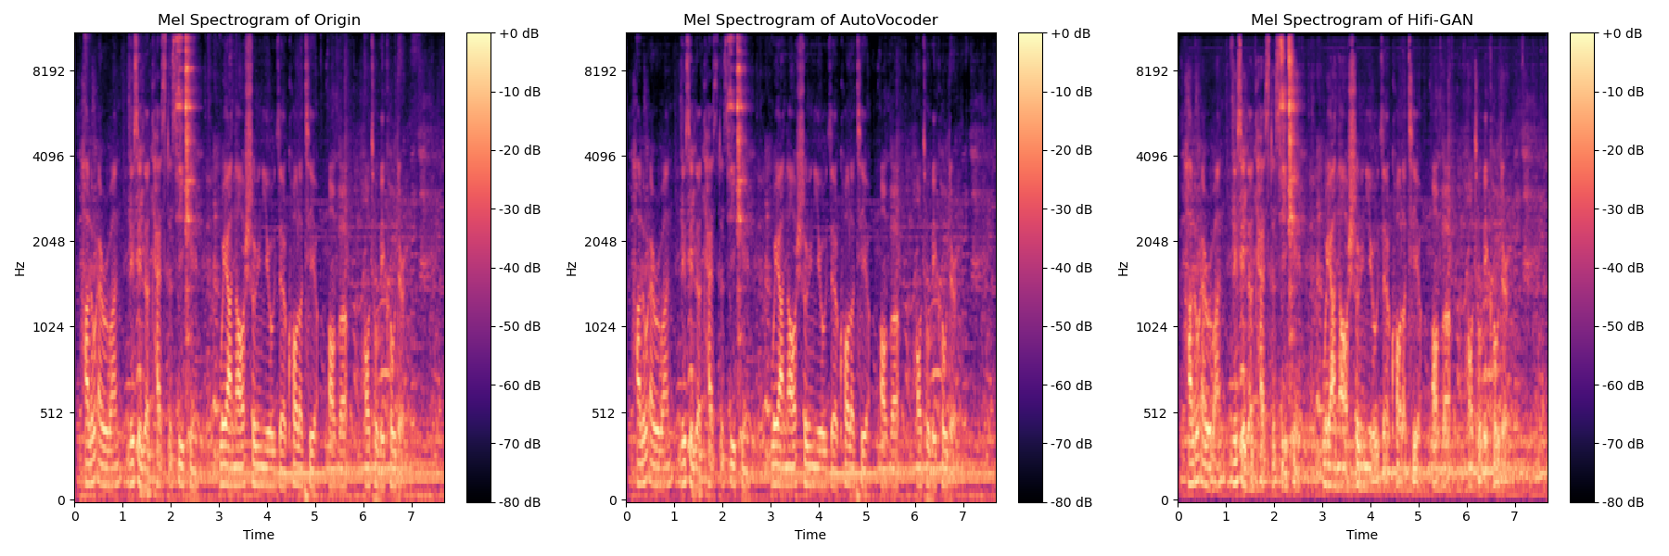
3 Evaluation
Visualizations
Second test file: my voice

Slide 11
4 Conclusion
Summary The project implemented and compared neural vocoders for high-quality speech synthesis. HiFi-GAN demonstrated strong single-speaker performance, while AutoVocoder shows good adaptability and robustness across multispeaker datasets.

Slide 12

Thank you

