Slide 1
Diabetes Prediction
By Yuhao Sun, Yu Wang

Slide 2
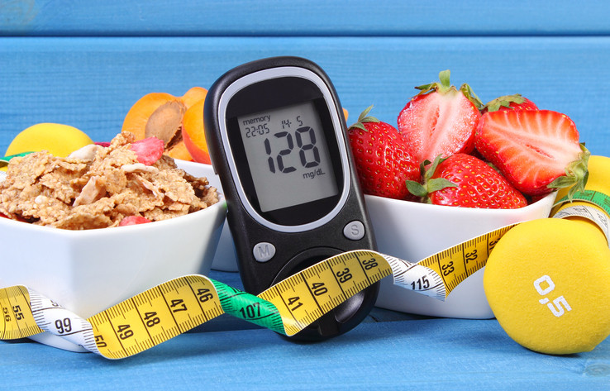
Introduction
Diabetes: a major global health concern
Insulin deficiency leads to high blood sugar levels
Consequences include cardiovascular disease, nerve damage, and kidney damage
Objective: develop an accurate predictive model
Aid healthcare professionals in identifying at-risk patients
Enable early interventions and better patient outcomes

Slide 3
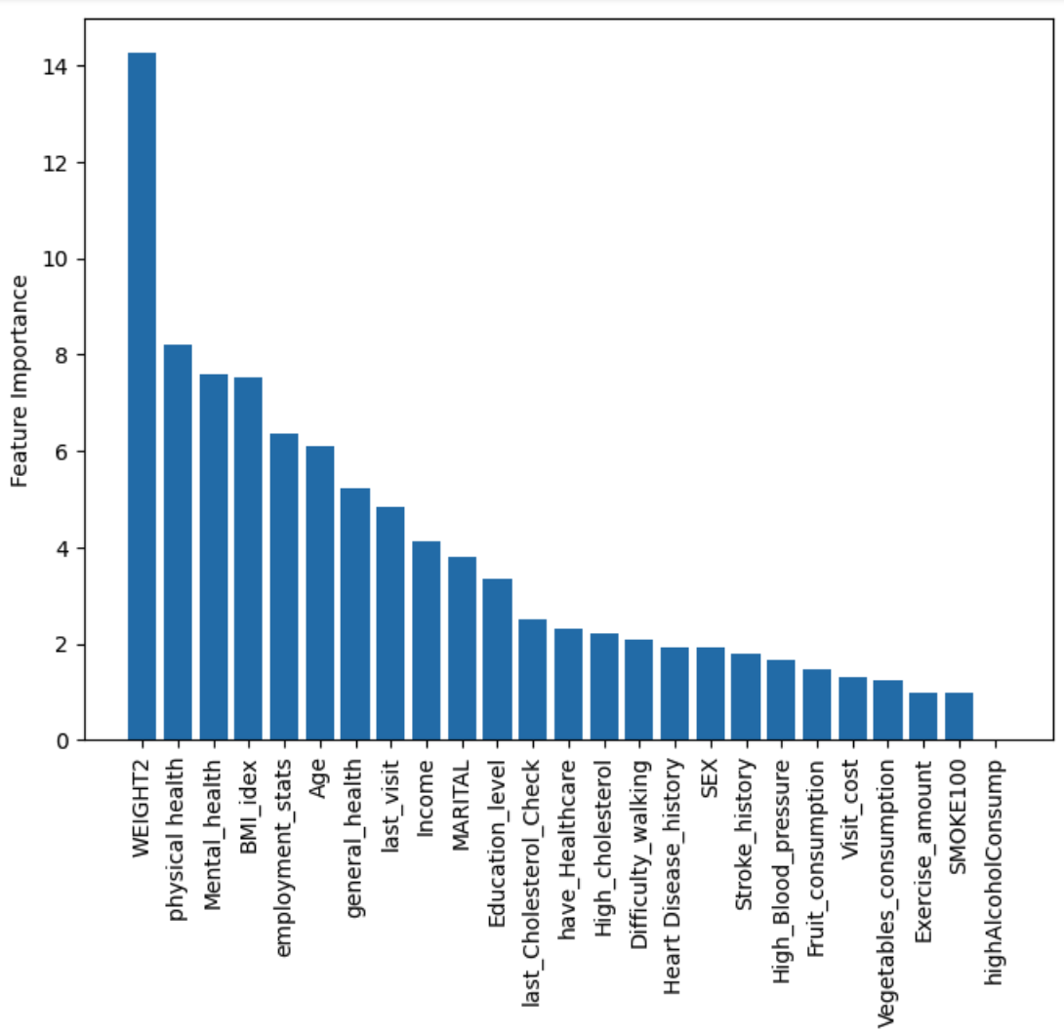
Data & Methodology
Inspiration: American Diabetes Association's self-test webpage
Predicts likelihood of developing type 2 diabetes
Dataset: BRFSS
Abundant data records suitable for our goal
Methodology: evaluate multiple models
Optimize accuracy and efficiency
Reduce healthcare costs through improved predictions
Optimized Random Forest Model Feature of Importance

Slide 4
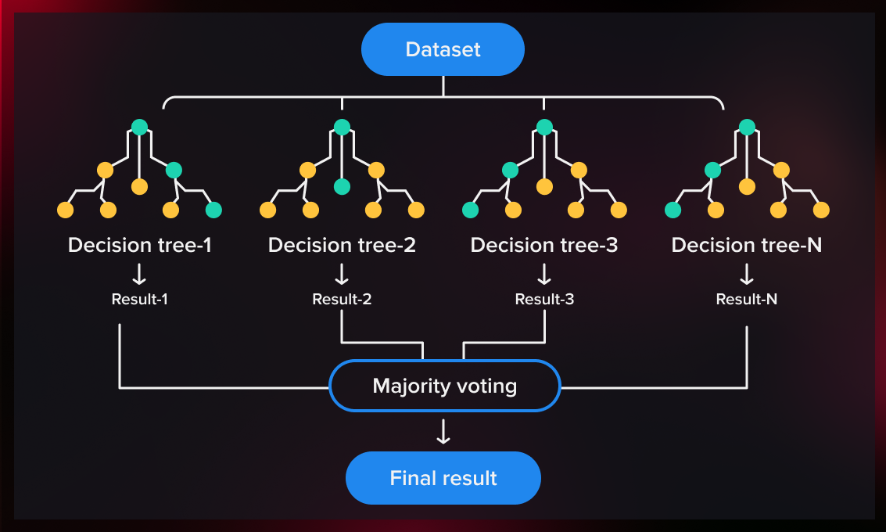
Machine Learning Model
RandomForestClassifier
Hyperparameter tuning
GridsearchCV
'bootstrap', 'max_depth', and 'n_estimators'
Highest accuracy: 0.83

Slide 5
Project Architecture
Data & Model
Model API Machine
Raw data
Train Model
Model
API server
End-user Browser
Notes:
This diagram illustrates the architecture for our app development process. We began by acquiring the dataset, processed the data and fitted a Random Forest model that can predict the likelihood of developing Type 2 diabetes, by utilizing each individual's habits and health information. In the final stage, we serialized our model and integrated it with our app achieved by using Flask and html. Then we used was Google Cloud Run as a container for our app

Slide 6
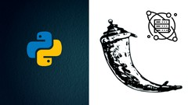
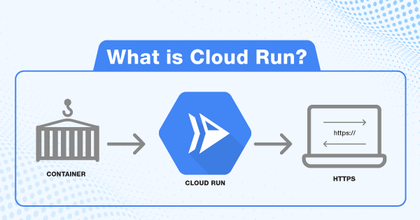
Model API Workflow
Random forest Model
Google Cloud SDK
Google Cloud Run
End-user browser
Develop the Flask App
Google Container Registry (GCR)
Containerize Flask app
Notes:
Here's a step-by-step workflow for creating our Flask app and the process of deploying it to Google Cloud Run:
first Develop the Flask app:
b. Write the Flask app code which includes importing the model and connections between the developed website.
Prepare the app for deployment:
a. Create a "requirements.txt" file to list all the necessary libraries and their versions.
b. Create a "Dockerfile" to containerize the app, which build a Docker image with the necessary base image, libraries, and application code.
configure the SDK:
a. initialize the Google Cloud SDK to authorize our app to access your GCP account. connect it to the project.
Build and push the Docker image to Google Container Registry (GCR):
Deploy the app to Google Cloud Run:
b. The command returns a URL for your deployed Flask app. You can use this URL to access your app on the internet.
the Google Cloud services used in this workflow include Google Cloud Run (for running the containerized app), Google Container Registry (for storing the Docker image), and Google Cloud SDK (for interacting with GCP from your local machine).

Slide 7
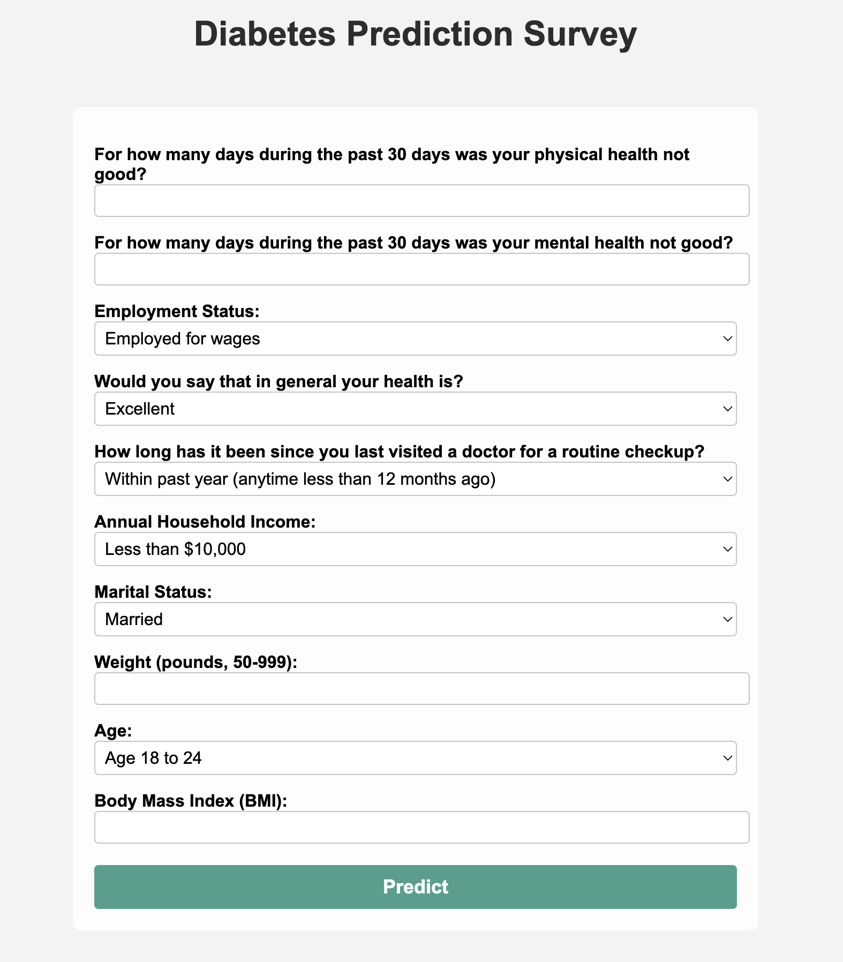
Prediction Survey Website With Top 10 Feature of Importance
https://diabetestheapp-idxlqg3nca-ue.a.run.app
Notes:
This Flask web application is designed to predict the likelihood of having diabetes based on various input features.

Slide 8
Thanks!

