Slide 1
Wireless sensor networks :
A survey on the state of the art and the 802.15.4 and ZigBee standards
Discussion and conclusions
郑浩然 S1408043

Slide 2
Typical functions of the conclusion of a research paper may include:
(1) Summing up
(2) Statement of Conclusions
(3) Statement of Recommendations
(4) Graceful Termination

Slide 3
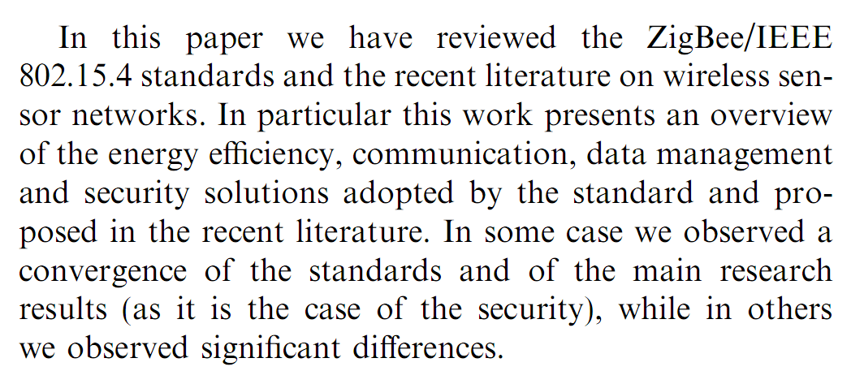
Summing up

Slide 4
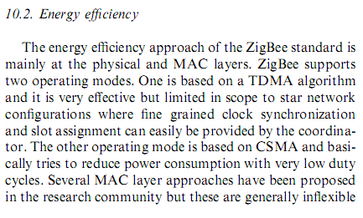
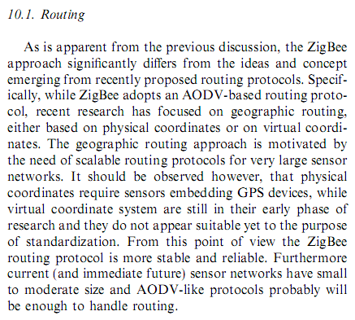
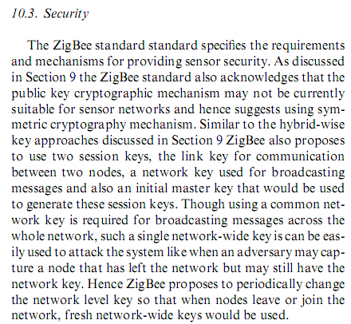
Statement of Conclusions

Slide 5
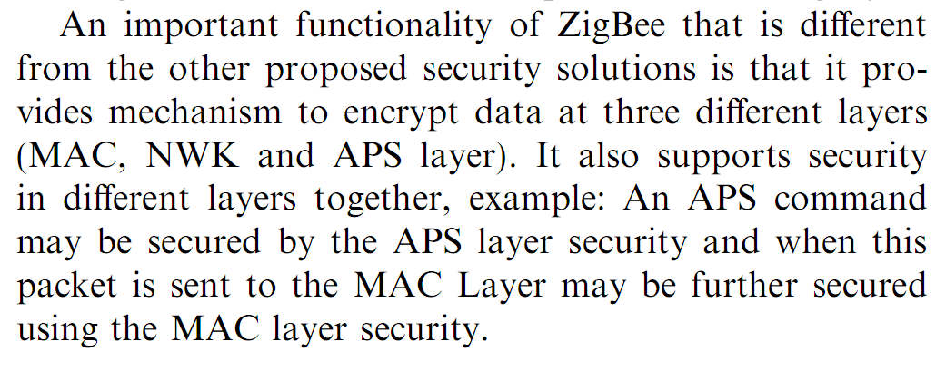
Graceful Termination

Slide 6
THANK YOU

