Slide 1
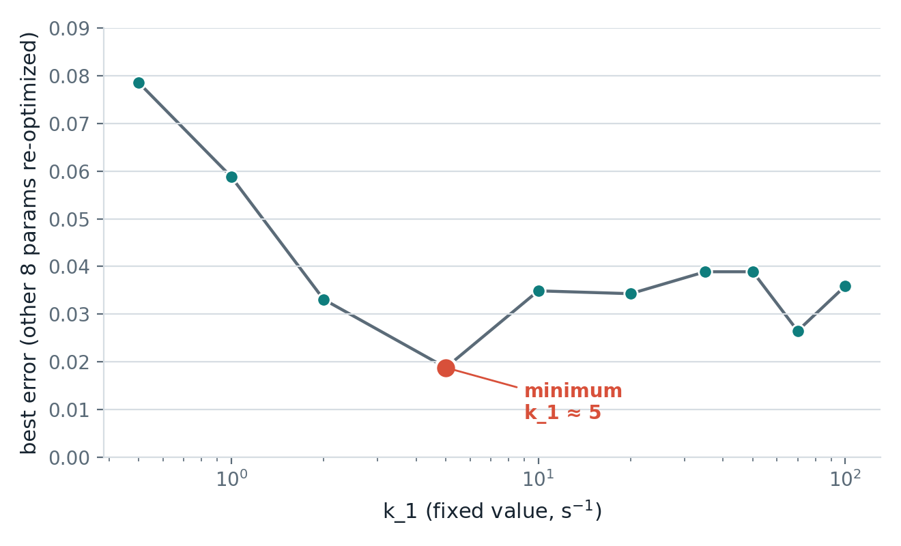
JULY 30 · TESTING WHETHER THE MODEL CAN BE IDENTIFIED
Built a joint fit to force control and HCM to agree
The idea
The stress test
Last week's problem: restarting the HCM fit from different guesses landed on totally different “which knob changed” stories.
This week I built a joint fit: control and HCM are fit at the same time, sharing 7 of 10 knobs. Only 3 (k_1, k_5_0, k_4_0) are allowed to differ between conditions — the direct computational version of “HCM = a few things changed.”
Ran it 4 independent times from different/adversarial starting points, plus a profile-likelihood scan — lock one knob (k_1) at a fixed value, let the fit re-optimize everything else, repeat across a range.
This directly answers: is there a real single best answer the fit keeps missing, or is the question itself genuinely unanswerable from one heartbeat of data?
Locking k_1 and re-fitting everything else reveals a real dip near k_1≈5 — not a flat, unanswerable curve, and not noise.
1 / 3
HCM CROSSBRIDGE MODELING

Slide 2
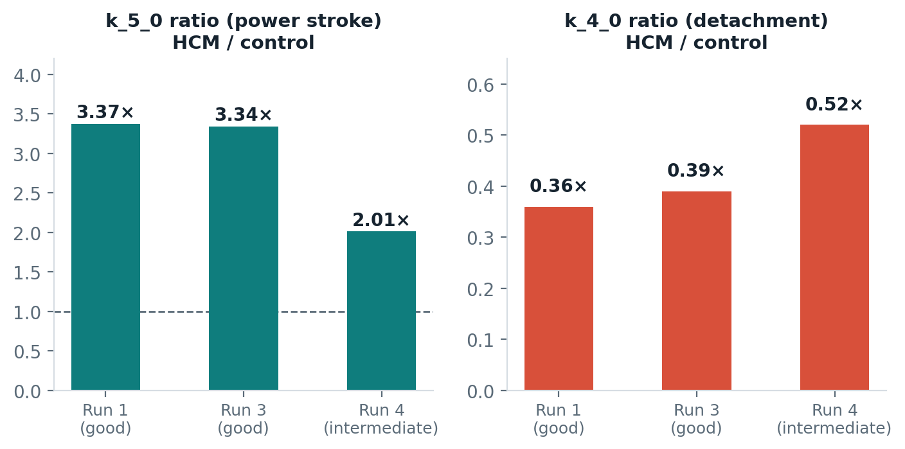
JULY 30 · RESULTS
One signal survived every test — one didn't
Power stroke rate up, detachment rate down — direction never flipped across 4 independent restarts, including one that disagreed on everything else.
k_1 (SRX exit rate) is not resolved: two good-error basins say HCM's k_1 isn't elevated; a third, only slightly worse basin says it's 48× higher.
Also found: a bound on one parameter (k_coop) is pinned at its ceiling in 3 of 4 runs — may be hiding part of the real answer.
Bottom line
Not ready to hand Julia a single number yet. But for the first time, something survived adversarial testing — that's real progress on a question that looked unanswerable last week. Next: widen the k_coop bound and re-test.
2 / 3
HCM CROSSBRIDGE MODELING

Slide 3
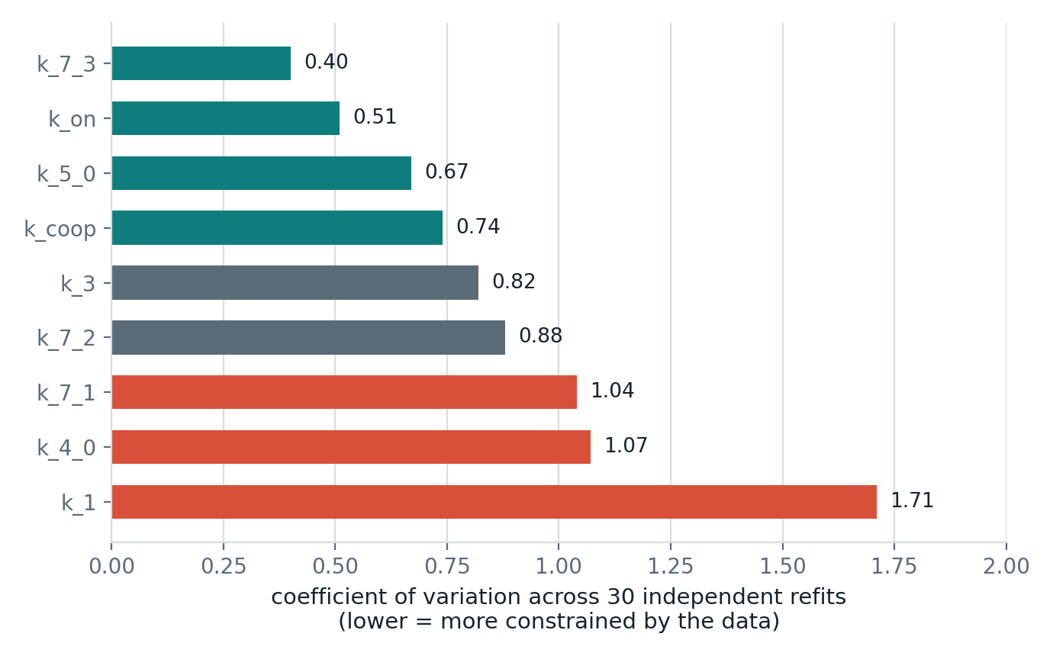
PUBLISHED REFERENCE · SYSTEMS BIOLOGY, NOT CARDIAC
Our problem has a name: “sloppy” models
The paper
Gutenkunst et al. 2007, PLoS Comp. Biol. — tested 17 unrelated systems-biology ODE models (metabolic, signaling, developmental — no myosin, no cardiac).
Every single one showed the same shape: a few tightly-constrained parameter combinations, most individual parameters barely constrained — even though the model fits data well.
Why this matters for us
This reframes this week's result: it's not a bug in our fitting, it's the expected shape for a model like ours.
Their advice: stop chasing individual parameters, chase the stiff combinations — exactly what k_5_0/k_4_0's direction may be. Next: a real eigen-analysis of our own fit, not just CVs.
Our own 30-restart spread, re-plotted parameter by parameter. No clean split between “good” and “bad” knobs — a smooth ramp, the signature Gutenkunst et al. describe.
3 / 3
HCM CROSSBRIDGE MODELING

