Slide 1
VANDER ROEST LAB · RESEARCH UPDATE · JULY 23, 2026
Two weeks of teaching a computer
how a heart muscle squeezes
I build a math model of one unit of heart muscle and tune it until it contracts like real lab data. The goal: find which molecular knob is turned wrong in HCM — a disease that makes the heart wall too thick and stiff.
Sensitivity analysis
A physics bug hunt
A rebuilt foundation
A better experiment recipe
An honest catch
Tom Tan · Biomedical Engineering · University of Michigan
Notes:
Say this: Your heart is a pump made of muscle, and that muscle is built from millions of tiny motors. I write a computer model of those motors and adjust its settings until it pushes exactly as hard, and with the same timing, as muscle we measure in the lab. HCM is a genetic heart disease that makes the heart wall too thick. If my model can copy a diseased heartbeat, I can look inside it and see which tiny motor setting is broken — something you can't see in a real patient. These are the five things I got done in the last two weeks.

Slide 2
THE BIG PICTURE · WHY THIS MATTERS
One tiny muscle model → a whole-heart simulation
The problem
My job
The method
In HCM the heart squeezes too hard and relaxes badly. Doctors see the thick wall, but not the broken molecule causing it.
Find the crossbridge-level setting that drives the extra force, then hand that number to Julia's whole-heart geometry model as an input.
Compare models of increasing detail (3, 4, and 6 “states”) and let the computer fit each to real control vs HCM heartbeat data.
A “state” = one pose a muscle motor can be in (resting, primed, gripping, pulling). More states = more realistic, but more knobs to tune.
01 / 10
HCM CROSSBRIDGE MODELING
Notes:
Say this: Think of a single muscle motor like a tiny hand that grabs a rope and pulls. It moves through a few poses: resting, getting ready, gripping, and pulling. I test models that allow 3, 4, or 6 of these poses. More poses is more realistic but also means more dials to set. My north star is practical: whatever setting makes the diseased muscle stronger, I pass that one number to my labmate Julia, whose model simulates the shape of the entire heart.

Slide 3
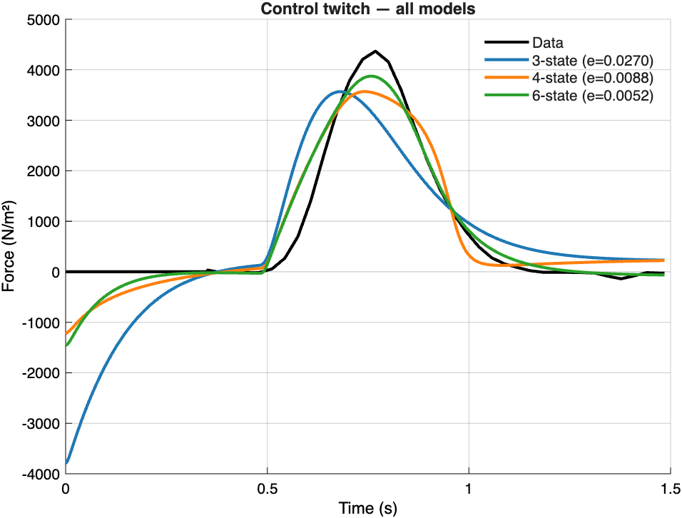
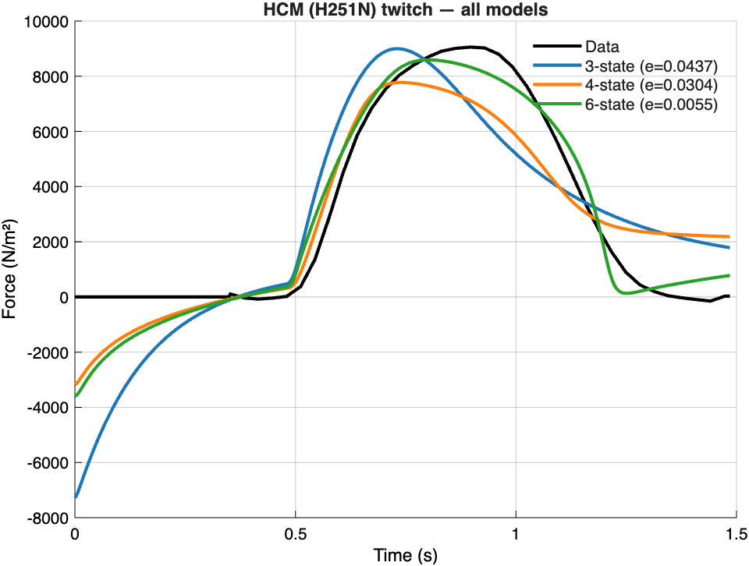
RESULT · THE MODEL COMPARISON
The 6-state model wins in healthy and diseased muscle
Healthy (control) heartbeat
Diseased (HCM) heartbeat
Black = real lab data; each colored curve is a model's best attempt. Lower “e” = closer to reality. The green 6-state curve hugs the data far better than the 3-state (blue) and 4-state (orange).
02 / 10
HCM CROSSBRIDGE MODELING
Notes:
Say this: Each graph is one heartbeat — force going up as the muscle squeezes, then back down as it relaxes. The black line is what really happened in the lab. The colored lines are my three models trying to copy it. The number e is the error, so smaller is better. The green line — my 6-state model — is almost on top of the black data in both the healthy and the diseased case. The simpler blue and orange models miss the shape, especially where they dip below zero at the start. So the extra detail in the 6-state model earns its keep.

Slide 4
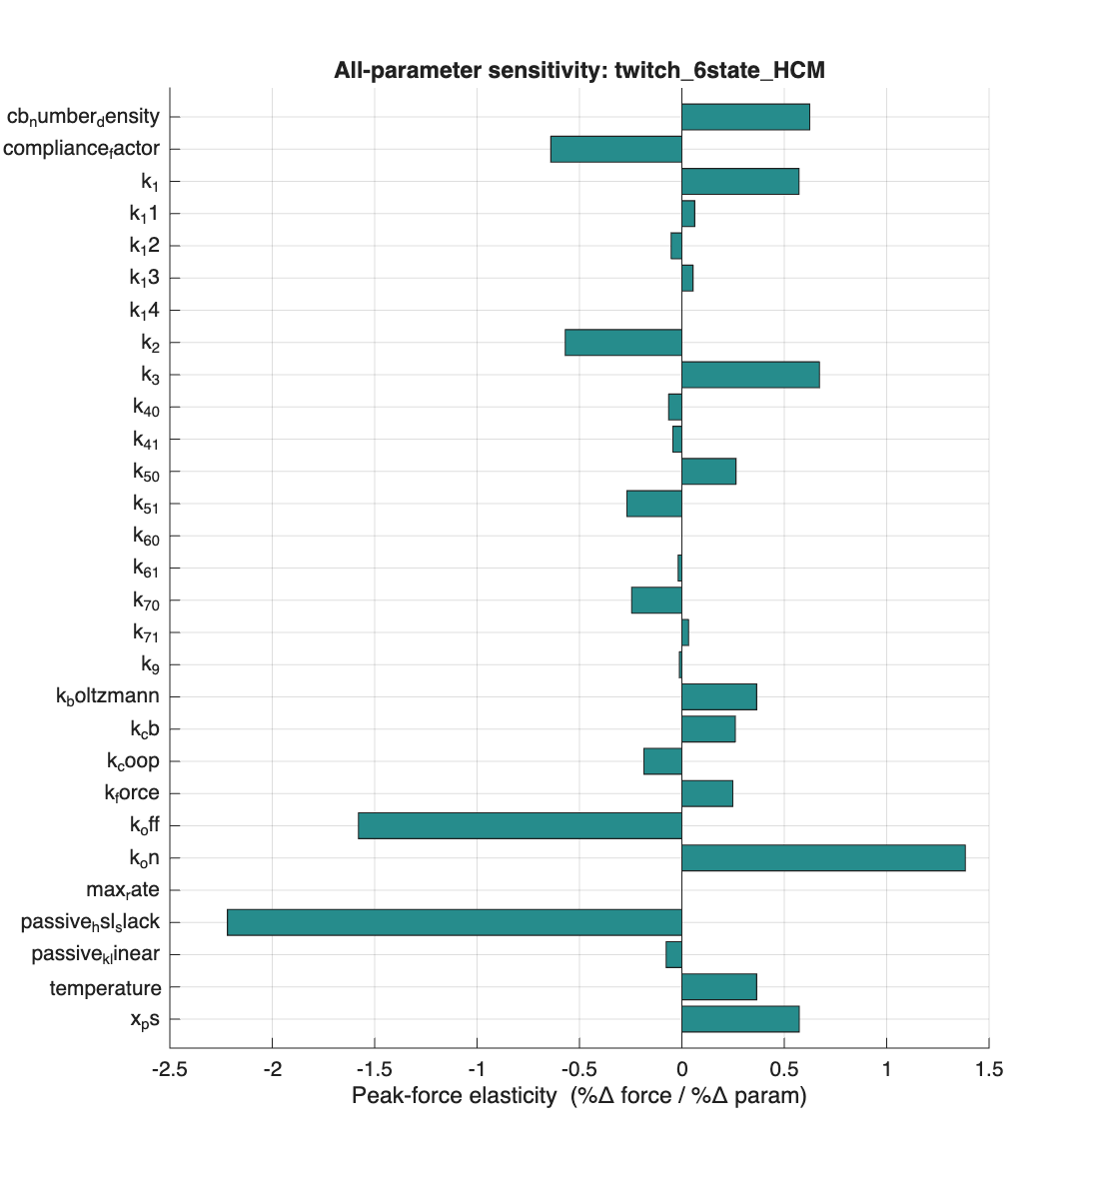
JULY 7 · SENSITIVITY ANALYSIS
Which knobs actually change the force?
I nudged each of ~30 settings by 10% and measured how much peak force moved. Bars right = raises force, left = lowers it.
Big movers: how sticky the calcium switch is (k_on / k_off) and the muscle's resting length.
Middle: attachment rate k_3, motor density, and SRX release rate k_1.
Near zero: most new 6-state coupling knobs — they shape the timing, not the peak height.
03 / 10
HCM CROSSBRIDGE MODELING
Notes:
Say this: Before hunting for the broken knob, I need to know which knobs even matter. So I turned each one up by 10% and watched what happened to the peak force. A long bar means that knob is powerful; a tiny bar means it barely does anything. The biggest levers were how tightly calcium flips the muscle on, and how stretched the muscle is to begin with. A lot of the fancy new knobs I added barely moved the peak — a clue that they control the timing of the beat, not how strong it is. That sets up the next slide.

Slide 5
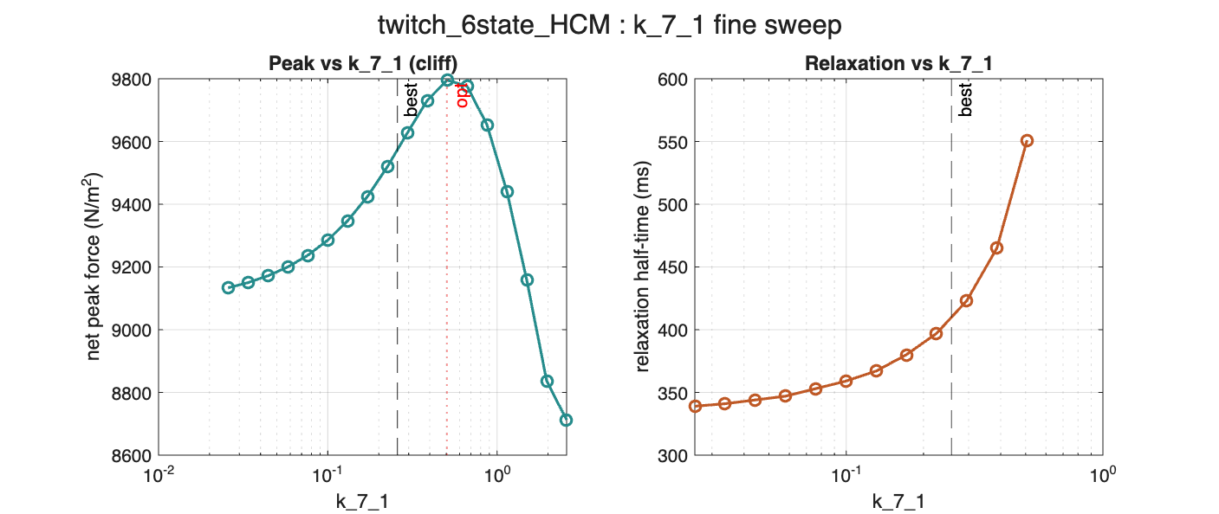
JULY 7 · A DETECTIVE STORY
The knob that looked useless controls relaxation
Sweeping one knob (k_7_1 — how strongly load keeps a motor gripping) across a wide range.
Left — peak force
Right — relaxation time
Barely changes, then falls off a cliff. That flat top is why it looked “useless” in the bar chart.
Climbs steadily: crank this knob and the muscle takes far longer to let go. A relaxation knob, not a force knob.
04 / 10
HCM CROSSBRIDGE MODELING
Notes:
Say this: This one is a little detective story. In the last slide this knob — called k_7_1 — looked useless because it didn't change the peak force. But I zoomed in and swept it across a huge range. The left graph shows peak force: flat, flat, flat, then a sudden cliff. The right graph shows how long the muscle takes to relax: it climbs steadily. So the knob isn't useless at all — it controls how quickly the muscle lets go after squeezing, which is exactly the part of the heartbeat that goes wrong in HCM. I'd mislabeled it before; now I know what it really does.

Slide 6
JULY 14 & 20 · FIXING THE PHYSICS
Three foundation bugs that were quietly wrong
01
Titin was pushing when it should rest
The elastic “rubber band” protein resisted squishing as hard as stretching — creating impossible negative force. Real titin only pulls when stretched. Fixed.
02
Wrong resting length
The model sat at 1265 nm; the lab works near 1000 nm. Re-based everything to 1000 nm so simulated and real muscle start from the same place.
03
The “snap-back” release was missing
Added a sharp let-go when a motor is pulled too far. This one fix took the 4-state disease error from 0.37 → 0.03 — a 10× jump in realism.
A hidden pipeline file was also missing since a June cleanup — no fit could actually re-run until I restored it.
05 / 10
HCM CROSSBRIDGE MODELING
Notes:
Say this: Good results mean nothing if the physics underneath is wrong, so I spent a couple days bug-hunting. First: there's a stretchy protein called titin that acts like a rubber band. My code made it push back when the muscle got shorter — that's not real, and it created negative force, which is impossible. Real rubber bands only pull when you stretch them. Second: the model's resting length was set wrong, so I reset it to match the lab. Third: I added a realistic snap-back where a motor lets go if it's stretched too far — and that one fix made the diseased-muscle fit ten times more accurate. I also found a file that had gone missing in an earlier cleanup that had quietly broken the whole pipeline.

Slide 7
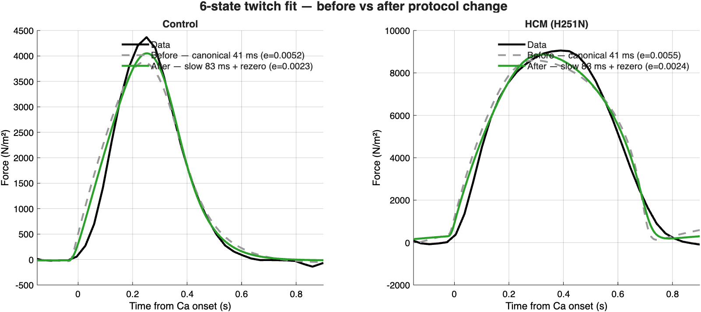
JULY 22 · A BETTER EXPERIMENT RECIPE
Slowing the calcium “go” signal cut the error in half
Grey dashed = old fast-onset recipe · Green = new slow-onset recipe · Black = data
0.0052 → 0.0023
0.0055 → 0.0024
≈ 2×
Control error
HCM error
Better in both
06 / 10
HCM CROSSBRIDGE MODELING
Notes:
Say this: The muscle contracts because calcium floods in and flips a switch. How fast that calcium arrives is part of the recipe I feed the model. I'd been using a version that turned on too abruptly. When I gave the calcium a more realistic, gentler rise and let the muscle settle first, the green curve snapped almost perfectly onto the black data — the error dropped by about half in both cases. Same model, better instructions. Feeding the model an accurate description of the experiment matters as much as the model itself.

Slide 8
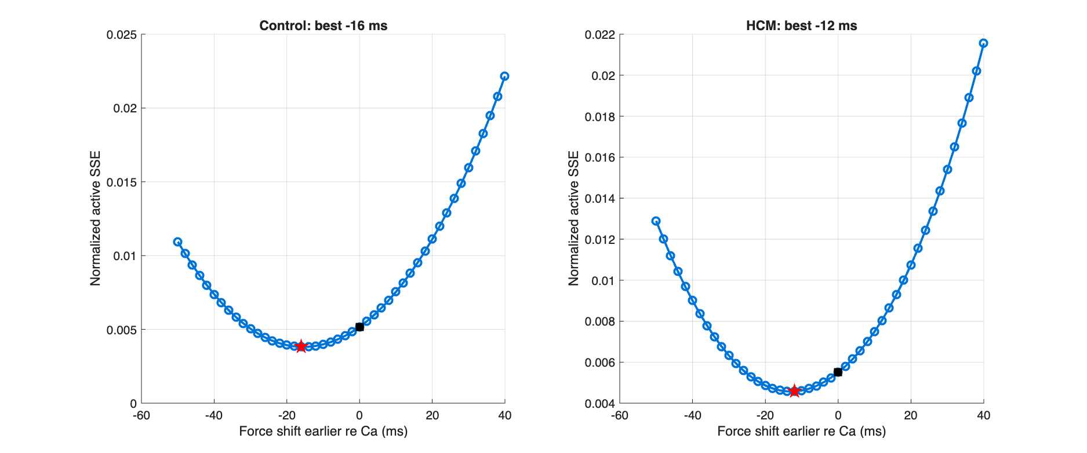
JULY 23 · TIMING CHECK
Is the model's force arriving at the right moment?
Sliding the model's force earlier/later in time and measuring the error. The dip = best alignment.
Lowest error sits at −16 ms (control) and −12 ms (HCM) — the model's force currently rises a hair too early. A ~14 ms calcium-timing tweak would tighten it further. Small, but worth logging.
07 / 10
HCM CROSSBRIDGE MODELING
Notes:
Say this: Last check for the two weeks — is my model's squeeze happening at the exact right moment relative to the calcium signal? I slid the model's whole force curve a little earlier and later in time and measured the error at each shift. The bottom of the U is the best match. It landed at about minus 15 thousandths of a second, which tells me the model's force is rising just a touch too early. It's a tiny amount — about blink-speed — but now it's documented, and I know a small timing tweak could make the fit even better.

Slide 9
THE HONEST CATCH
The winning model can't yet name one culprit
What I hoped
What I found
“HCM is driven by this one knob turned up this much” — a single number to hand Julia.
Restarting the fit from different guesses lands on different knob combinations that all fit almost equally well. k_1 ranged 3–17×; several knobs trade off against each other.
Why: the 6-state model has more knobs than a single heartbeat can pin down — like two unknowns and one equation. This is the real headline: I can't responsibly report a single HCM driver yet.
08 / 10
HCM CROSSBRIDGE MODELING
Notes:
Say this: Here's the honest part, and it's actually the most important slide. My dream result was to say HCM is caused by exactly this one setting turned up exactly this much, and hand Julia that number. But when I restart the computer's search from different starting guesses, it finds different combinations of settings that all copy the heartbeat about equally well. It's like being told two numbers add to ten — could be four and six, could be three and seven; one equation isn't enough to know. My model has more knobs than a single heartbeat can pin down. So the grown-up, scientific answer is: not yet. I shouldn't claim one culprit until I add more data or constraints.

Slide 10
WHERE THIS GOES NEXT
Takeaways & the plan
What's solid
Next steps
• 6-state model fits both conditions best (error < 0.006).
• Physics foundation now correct (titin, length, snap-back).
• Every knob's role mapped; k_7_1 = relaxation control.
• Run many restarts on a computing cluster to test identifiability.
• Add constraints / more data to narrow the HCM driver.
• Only then hand a defensible number to Julia's heart model.
Bottom line: the model is finally trustworthy, the physics is right, and I know precisely what question to attack next.
09 / 10
HCM CROSSBRIDGE MODELING
Notes:
Say this: To wrap up — the good news is real. The 6-state model fits both the healthy and diseased heartbeats better than anything simpler, the underlying physics is now correct, and I understand what every knob does. The next step is to run hundreds of fits at once on a computing cluster to figure out which settings are truly pinned down, and to add more real data so the model can only give one answer. Once it does, that answer goes into Julia's whole-heart model. So in two weeks I went from a model with hidden bugs to one I actually trust — and I know exactly what to do next.

