Slide 1
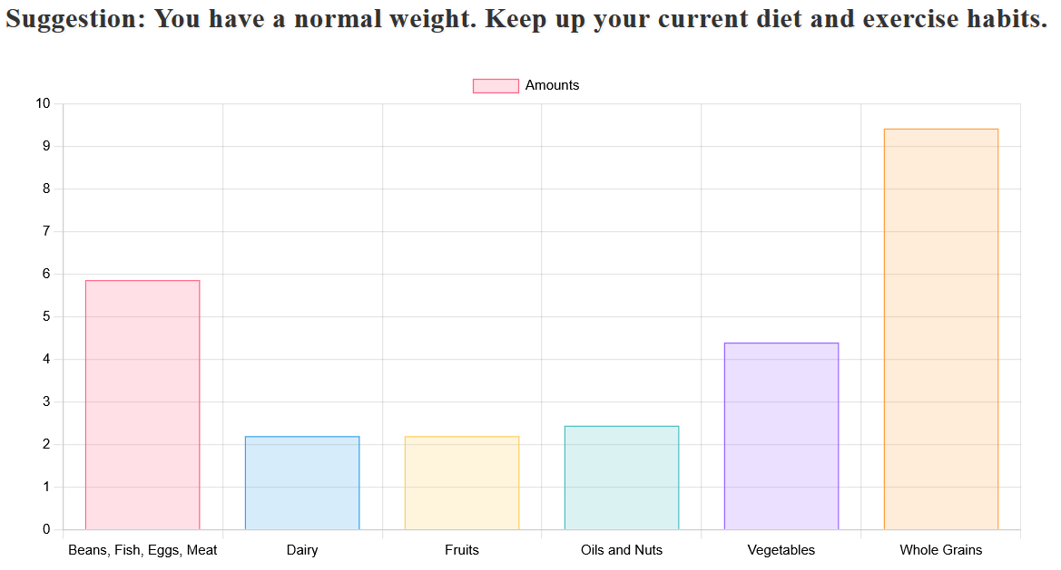
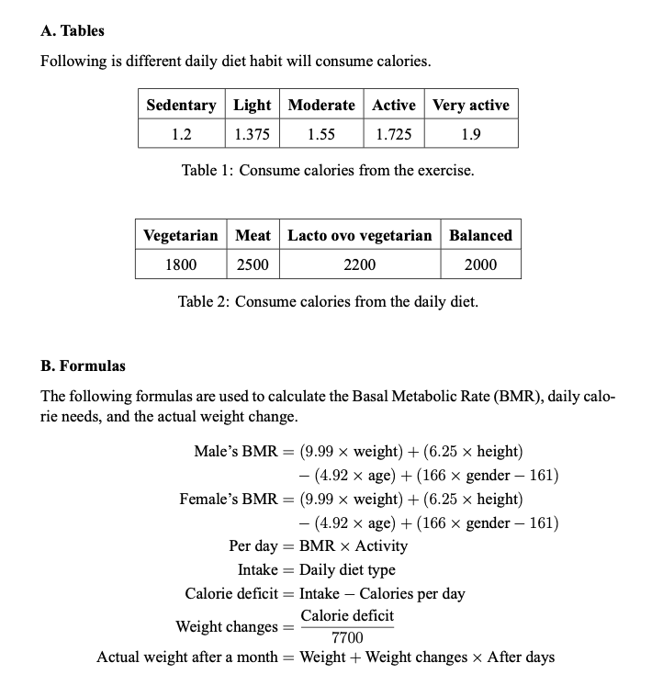

The impact of daily diet and exercise on weight
Ren-Song Ko, Wen-Shou Hsu and Tzu-Chi Hsiao
Introduction
People emphasize health nowadays. We are interested in developing a website that displays suggestion and a histogram to the user.
IV. Results
II. Project architecture
Front-end
Exchange
Back-end
Transmit
V. Future Work
I. Professional.
II. UI friendly.
VI. Conclusion
We learned front-end and back-end technologies such as using HTML to establish the structure of our website and JavaScript to enhance its appearance. We also used Python with the Flask package to connect the front-end and back-end, while incorporating our formulas within the application.
1. HTML
2. CSS
3. JavaScript
Python
Flask
III. Calculate tool
Wanna more information ?
Using phone to scanning our official website.

