Slide 1
Summer Incubator Workshop
Introduction to working with web-APIs
Tom Theile
Lab of digital and computational demography

Slide 2
Agenda
What is the Internet? How do websites work?
How to scrape data from websites?
What are APIs?
Workshop: Working with a weather-API
Workshop: Getting Tweet-counts from the Twitter-API
Feel free to interrupt me at any time!
Notes:
First time I give the course, the materials for the later days are still not completely finished, please bear with me
My goal is that everyone understands almost everything that I try to bring across. So please interrupt me and ask questions if you can't follow along. I don't know all your skill-levels, so it might happen that I assume to much or too little knowledge about some things.
I will also try to add a few „dard magic“ bits into the course: Things that are not possible to completely understand in a short course, but which are maybe very helpful for some of you (who then can dive deeper into these topics themselves). Like: Machine Learning, Sentiment analysis, etc. If you don’t understand all the inner workings of these parts: Ask, but don’t worry.

Slide 3
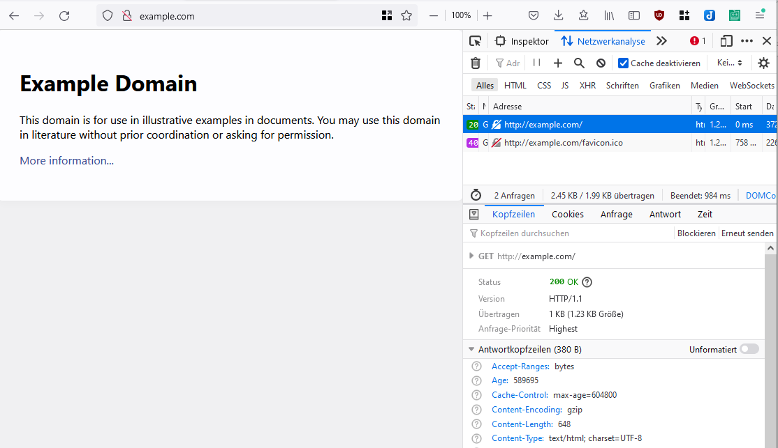
What is the Internet
Notes:
First time I give the course, the materials for the later days are still not completely finished, please bear with me
My goal is that everyone understands almost everything that I try to bring across. So please interrupt me and ask questions if you can't follow along. I don't know all your skill-levels, so it might happen that I assume to much or too little knowledge about some things.
I will also try to add a few „dard magic“ bits into the course: Things that are not possible to completely understand in a short course, but which are maybe very helpful for some of you (who then can dive deeper into these topics themselves). Like: Machine Learning, Sentiment analysis, etc. If you don’t understand all the inner workings of these parts: Ask, but don’t worry.

Slide 4
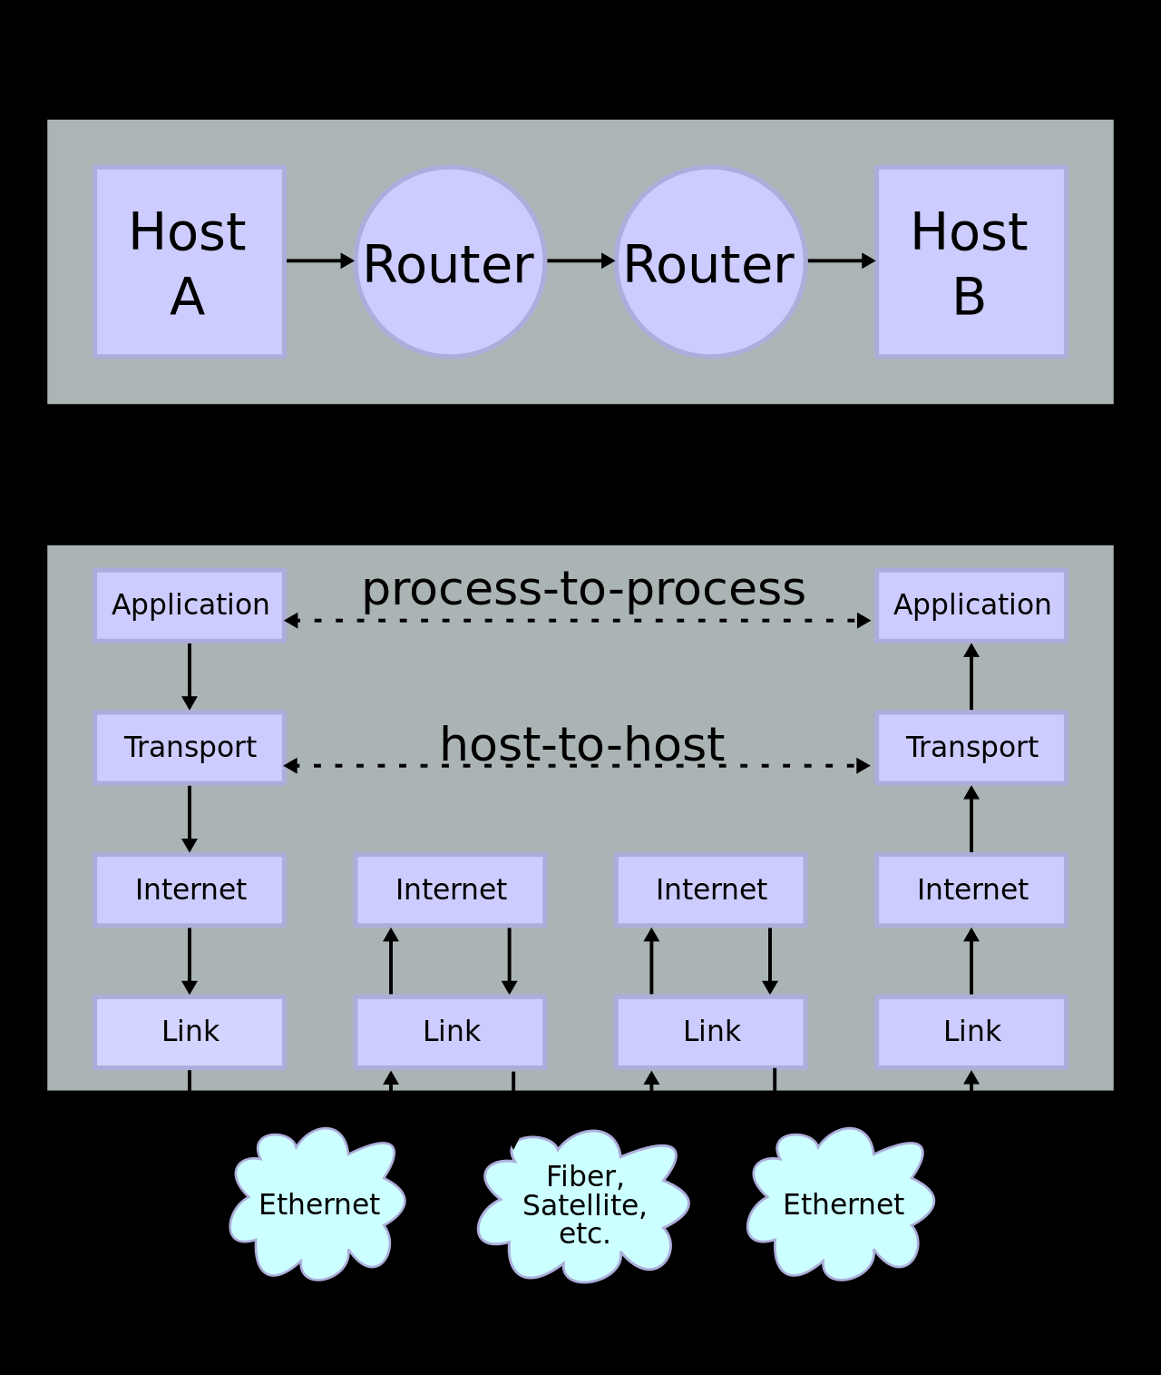
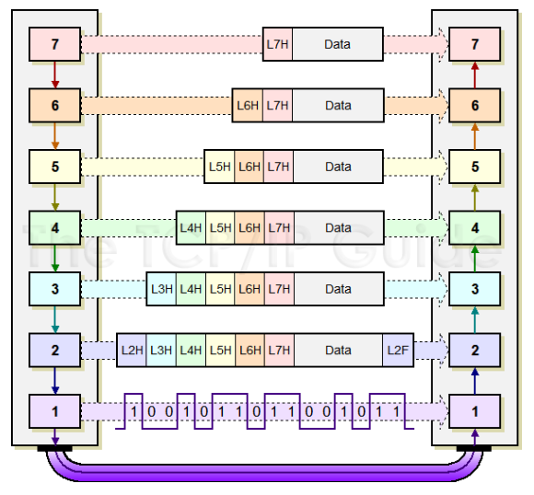
What is the Internet
Notes:
First time I give the course, the materials for the later days are still not completely finished, please bear with me
My goal is that everyone understands almost everything that I try to bring across. So please interrupt me and ask questions if you can't follow along. I don't know all your skill-levels, so it might happen that I assume to much or too little knowledge about some things.
I will also try to add a few „dard magic“ bits into the course: Things that are not possible to completely understand in a short course, but which are maybe very helpful for some of you (who then can dive deeper into these topics themselves). Like: Machine Learning, Sentiment analysis, etc. If you don’t understand all the inner workings of these parts: Ask, but don’t worry.

Slide 5
What is the Internet
Browser sends a „GET“-request (HTTP-protocol)
DNS-server looks up IP-address of domain name
TCP-IP-packet is send to your internet-provider with destination IP-address
Routers pass the packet on to other routers that are nearer to the destination
Destination webserver reads the innermost header and the data and returns a response … the journey starts again!
Notes:
First time I give the course, the materials for the later days are still not completely finished, please bear with me
My goal is that everyone understands almost everything that I try to bring across. So please interrupt me and ask questions if you can't follow along. I don't know all your skill-levels, so it might happen that I assume to much or too little knowledge about some things.
I will also try to add a few „dard magic“ bits into the course: Things that are not possible to completely understand in a short course, but which are maybe very helpful for some of you (who then can dive deeper into these topics themselves). Like: Machine Learning, Sentiment analysis, etc. If you don’t understand all the inner workings of these parts: Ask, but don’t worry.

Slide 6
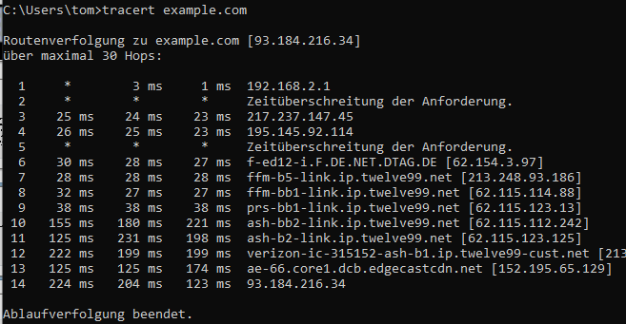
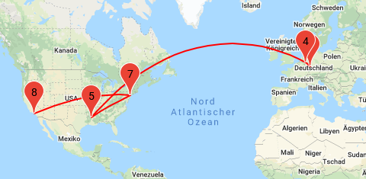
You can list all the routers on this journey with traceroute (tracert on Windows)
Tracert example.com
Visualize it with https://stefansundin.github.io/traceroute-mapper/
Notes:
First time I give the course, the materials for the later days are still not completely finished, please bear with me
My goal is that everyone understands almost everything that I try to bring across. So please interrupt me and ask questions if you can't follow along. I don't know all your skill-levels, so it might happen that I assume to much or too little knowledge about some things.
I will also try to add a few „dard magic“ bits into the course: Things that are not possible to completely understand in a short course, but which are maybe very helpful for some of you (who then can dive deeper into these topics themselves). Like: Machine Learning, Sentiment analysis, etc. If you don’t understand all the inner workings of these parts: Ask, but don’t worry.

Slide 7
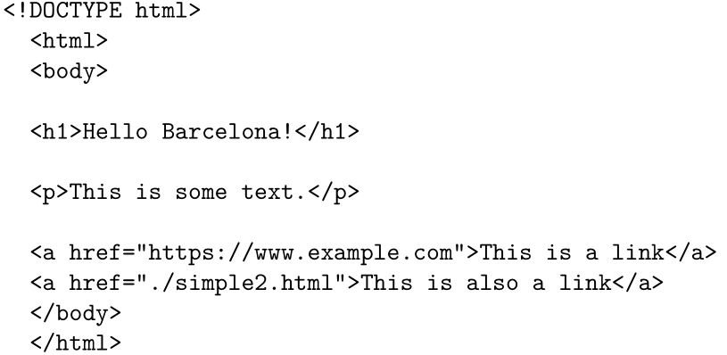
Surfing the web with R
With Python or R can also send and receive HTTP requests:
Notes:
First time I give the course, the materials for the later days are still not completely finished, please bear with me
My goal is that everyone understands almost everything that I try to bring across. So please interrupt me and ask questions if you can't follow along. I don't know all your skill-levels, so it might happen that I assume to much or too little knowledge about some things.
I will also try to add a few „dard magic“ bits into the course: Things that are not possible to completely understand in a short course, but which are maybe very helpful for some of you (who then can dive deeper into these topics themselves). Like: Machine Learning, Sentiment analysis, etc. If you don’t understand all the inner workings of these parts: Ask, but don’t worry.

Slide 8
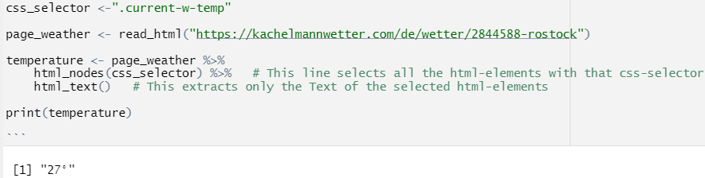
Surfing the web with R
The library rvest includes helpful tools to extract information from HTML-pages:
Notes:
First time I give the course, the materials for the later days are still not completely finished, please bear with me
My goal is that everyone understands almost everything that I try to bring across. So please interrupt me and ask questions if you can't follow along. I don't know all your skill-levels, so it might happen that I assume to much or too little knowledge about some things.
I will also try to add a few „dard magic“ bits into the course: Things that are not possible to completely understand in a short course, but which are maybe very helpful for some of you (who then can dive deeper into these topics themselves). Like: Machine Learning, Sentiment analysis, etc. If you don’t understand all the inner workings of these parts: Ask, but don’t worry.

Slide 9
Different APIs
There are different classes of APIs
  Operating System APIs (e.g.: write a file to a folder)
  R-package APIs (e.g.: read a dataframe from a csv-file with read.csv())
  …
  Web-APIs
We only care about Web-APIs in this course
Notes:
First time I give the course, the materials for the later days are still not completely finished, please bear with me
My goal is that everyone understands almost everything that I try to bring across. So please interrupt me and ask questions if you can't follow along. I don't know all your skill-levels, so it might happen that I assume to much or too little knowledge about some things.
I will also try to add a few „dard magic“ bits into the course: Things that are not possible to completely understand in a short course, but which are maybe very helpful for some of you (who then can dive deeper into these topics themselves). Like: Machine Learning, Sentiment analysis, etc. If you don’t understand all the inner workings of these parts: Ask, but don’t worry.

Slide 10
web APIs
Web APIs are "websites for machines". They provide machine-readable access to to data and services.
While websites are designed to be read by humans, APIs are designed to be read by machines.
That means that the answers of APIs don't need to be formatted in a fancy style (like a flashy website), but have to follow predictable rules.
Test it: https://dog-facts-api.herokuapp.com/api/v1/resources/dogs?number=3
Notes:
First time I give the course, the materials for the later days are still not completely finished, please bear with me
My goal is that everyone understands almost everything that I try to bring across. So please interrupt me and ask questions if you can't follow along. I don't know all your skill-levels, so it might happen that I assume to much or too little knowledge about some things.
I will also try to add a few „dard magic“ bits into the course: Things that are not possible to completely understand in a short course, but which are maybe very helpful for some of you (who then can dive deeper into these topics themselves). Like: Machine Learning, Sentiment analysis, etc. If you don’t understand all the inner workings of these parts: Ask, but don’t worry.

Slide 11
From Scraping to APIs
Webpages are for Humans, APIs are for computers
Webpages change over time and all the scraping scripts won’t work anymore…
APIs are structured and machine readable
→ let’s use an API!
Notes:
First time I give the course, the materials for the later days are still not completely finished, please bear with me
My goal is that everyone understands almost everything that I try to bring across. So please interrupt me and ask questions if you can't follow along. I don't know all your skill-levels, so it might happen that I assume to much or too little knowledge about some things.
I will also try to add a few „dard magic“ bits into the course: Things that are not possible to completely understand in a short course, but which are maybe very helpful for some of you (who then can dive deeper into these topics themselves). Like: Machine Learning, Sentiment analysis, etc. If you don’t understand all the inner workings of these parts: Ask, but don’t worry.

Slide 12
From Scraping to APIs
RESTful APIs - most common nowadays
GraphQL - can make complex queries, newer, not as common
APIs can response with any data type, but most often: JSON
https://dog-facts-api.herokuapp.com/api/v1/resources/dogs?number=3
https://docs.openalex.org/about-the-data/work https://api.openalex.org/authors?filter=display_name.search:tom+theilehttps://api.openalex.org/works?filter=author.id:A773951722 as webpage
Please open 02_using_a_simple_API.Rmd
Notes:
First time I give the course, the materials for the later days are still not completely finished, please bear with me
My goal is that everyone understands almost everything that I try to bring across. So please interrupt me and ask questions if you can't follow along. I don't know all your skill-levels, so it might happen that I assume to much or too little knowledge about some things.
I will also try to add a few „dard magic“ bits into the course: Things that are not possible to completely understand in a short course, but which are maybe very helpful for some of you (who then can dive deeper into these topics themselves). Like: Machine Learning, Sentiment analysis, etc. If you don’t understand all the inner workings of these parts: Ask, but don’t worry.

Slide 13

The Twitter API
https://developer.twitter.com/en https://developer.twitter.com/en/docs/twitter-api
Different access levels (Commercial, free, academic access)
extensively documented (but not always easy to find the right information)
Access to tweets, tweetcounts, users, trends and more
„Over 11% of Twitter's revenue in FY 2021, or $571.8 million, was from data licensing and other sources.“ (https://www.investopedia.com/ask/answers/120114/how-does-twitter-twtr-make-money.asp)
Notes:
First time I give the course, the materials for the later days are still not completely finished, please bear with me
My goal is that everyone understands almost everything that I try to bring across. So please interrupt me and ask questions if you can't follow along. I don't know all your skill-levels, so it might happen that I assume to much or too little knowledge about some things.
I will also try to add a few „dard magic“ bits into the course: Things that are not possible to completely understand in a short course, but which are maybe very helpful for some of you (who then can dive deeper into these topics themselves). Like: Machine Learning, Sentiment analysis, etc. If you don’t understand all the inner workings of these parts: Ask, but don’t worry.

Slide 14
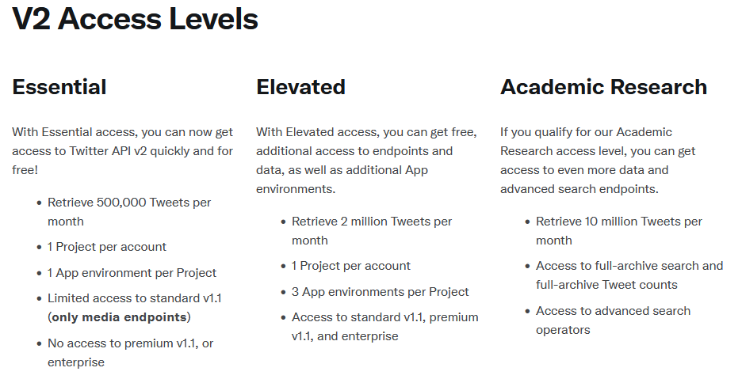
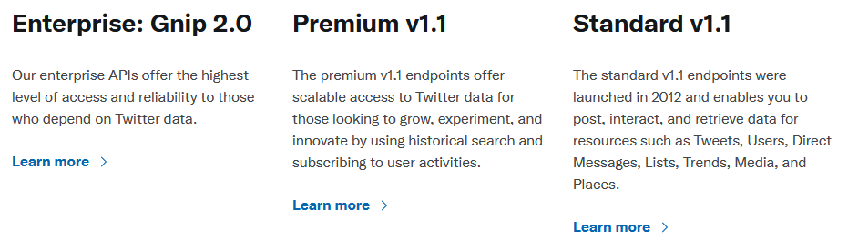
The Twitter API
https://developer.twitter.com/en https://developer.twitter.com/en/docs/twitter-api
Different access levels (Commercial, free, academic access)
  https://developer.twitter.com/en/docs/twitter-api
Notes:
First time I give the course, the materials for the later days are still not completely finished, please bear with me
My goal is that everyone understands almost everything that I try to bring across. So please interrupt me and ask questions if you can't follow along. I don't know all your skill-levels, so it might happen that I assume to much or too little knowledge about some things.
I will also try to add a few „dard magic“ bits into the course: Things that are not possible to completely understand in a short course, but which are maybe very helpful for some of you (who then can dive deeper into these topics themselves). Like: Machine Learning, Sentiment analysis, etc. If you don’t understand all the inner workings of these parts: Ask, but don’t worry.

Slide 15
Twitter API
Notes:
First time I give the course, the materials for the later days are still not completely finished, please bear with me
My goal is that everyone understands almost everything that I try to bring across. So please interrupt me and ask questions if you can't follow along. I don't know all your skill-levels, so it might happen that I assume to much or too little knowledge about some things.
I will also try to add a few „dard magic“ bits into the course: Things that are not possible to completely understand in a short course, but which are maybe very helpful for some of you (who then can dive deeper into these topics themselves). Like: Machine Learning, Sentiment analysis, etc. If you don’t understand all the inner workings of these parts: Ask, but don’t worry.

Slide 16

Thank you for your attention!
Tom Theile
Software developer at the lab of digital and computational demography
theile@demogr.mpg.de

Slide 17
Thank you!

