Slide 1
EDSD 2022
Accessing and analysing web and social media data
Using an API, accessing the Twitter API
Tom Theile
Lab of digital and computational demography

Slide 2
What is an API
Application Programming Interfaces
→ Communication interfaces between different programs
APIs are provided by applications to send and receive commands and data to other applications
Like a User interface, but not for Humans, for other applications!
If two applications implement the same API, they can be exchanges without the other applications of that system noticing it
There are
Notes:
First time I give the course, the materials for the later days are still not completely finished, please bear with me
My goal is that everyone understands almost everything that I try to bring across. So please interrupt me and ask questions if you can't follow along. I don't know all your skill-levels, so it might happen that I assume to much or too little knowledge about some things.
I will also try to add a few „dard magic“ bits into the course: Things that are not possible to completely understand in a short course, but which are maybe very helpful for some of you (who then can dive deeper into these topics themselves). Like: Machine Learning, Sentiment analysis, etc. If you don’t understand all the inner workings of these parts: Ask, but don’t worry.

Slide 3
Different APIs
There are different classes of APIs
  OS APIs
  R-package APIs
  …
  Web-APIs
We only care about Web-APIs in this course
Notes:
First time I give the course, the materials for the later days are still not completely finished, please bear with me
My goal is that everyone understands almost everything that I try to bring across. So please interrupt me and ask questions if you can't follow along. I don't know all your skill-levels, so it might happen that I assume to much or too little knowledge about some things.
I will also try to add a few „dard magic“ bits into the course: Things that are not possible to completely understand in a short course, but which are maybe very helpful for some of you (who then can dive deeper into these topics themselves). Like: Machine Learning, Sentiment analysis, etc. If you don’t understand all the inner workings of these parts: Ask, but don’t worry.

Slide 4
web APIs
Web APIs are "websites for machines". They provide machine-readable access to to data and services.
While websites are designed to be read by humans, APIs are designed to be read by machines.
That means that the answers of APIs don't need to be formatted in a fancy style (like a flashy website), but have to follow predictable rules.
Test it: https://dog-facts-api.herokuapp.com/api/v1/resources/dogs?number=3
Notes:
First time I give the course, the materials for the later days are still not completely finished, please bear with me
My goal is that everyone understands almost everything that I try to bring across. So please interrupt me and ask questions if you can't follow along. I don't know all your skill-levels, so it might happen that I assume to much or too little knowledge about some things.
I will also try to add a few „dard magic“ bits into the course: Things that are not possible to completely understand in a short course, but which are maybe very helpful for some of you (who then can dive deeper into these topics themselves). Like: Machine Learning, Sentiment analysis, etc. If you don’t understand all the inner workings of these parts: Ask, but don’t worry.

Slide 5
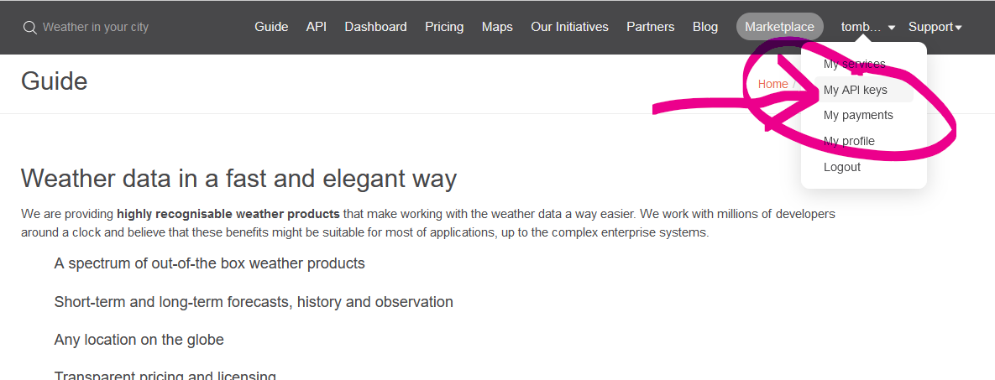
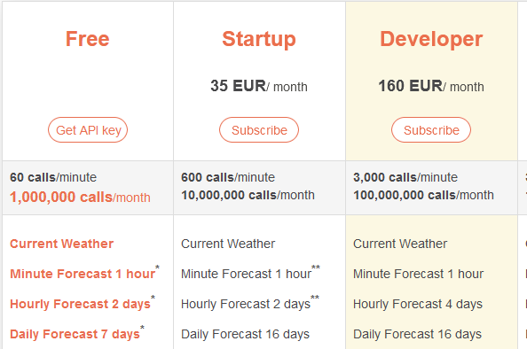
Openweathermap.org
Free API that delivers weatherforecasts to you
You need an API-key to make requests
  Create an account, confirm email, log in
  Retrieve you API-key, copy it
  → you are ready to use the api
Browser: https://api.openweathermap.org/data/2.5/weather?lat=90&lon=2&appid=17c05109bd812076cdd25e9bbeffedb7&units=metric
https://api.openweathermap.org/data/2.5/weather?q=Barcelona&appid=17c05109bd812076cdd25e9bbeffedb7&units=metric
Notes:
First time I give the course, the materials for the later days are still not completely finished, please bear with me
My goal is that everyone understands almost everything that I try to bring across. So please interrupt me and ask questions if you can't follow along. I don't know all your skill-levels, so it might happen that I assume to much or too little knowledge about some things.
I will also try to add a few „dard magic“ bits into the course: Things that are not possible to completely understand in a short course, but which are maybe very helpful for some of you (who then can dive deeper into these topics themselves). Like: Machine Learning, Sentiment analysis, etc. If you don’t understand all the inner workings of these parts: Ask, but don’t worry.

Slide 6
Work with Openweathermap in R
simple_api.Rmd
Notes:
First time I give the course, the materials for the later days are still not completely finished, please bear with me
My goal is that everyone understands almost everything that I try to bring across. So please interrupt me and ask questions if you can't follow along. I don't know all your skill-levels, so it might happen that I assume to much or too little knowledge about some things.
I will also try to add a few „dard magic“ bits into the course: Things that are not possible to completely understand in a short course, but which are maybe very helpful for some of you (who then can dive deeper into these topics themselves). Like: Machine Learning, Sentiment analysis, etc. If you don’t understand all the inner workings of these parts: Ask, but don’t worry.

Slide 7
Work with the Twitter API in R
twitter1.Rmd
Notes:
First time I give the course, the materials for the later days are still not completely finished, please bear with me
My goal is that everyone understands almost everything that I try to bring across. So please interrupt me and ask questions if you can't follow along. I don't know all your skill-levels, so it might happen that I assume to much or too little knowledge about some things.
I will also try to add a few „dard magic“ bits into the course: Things that are not possible to completely understand in a short course, but which are maybe very helpful for some of you (who then can dive deeper into these topics themselves). Like: Machine Learning, Sentiment analysis, etc. If you don’t understand all the inner workings of these parts: Ask, but don’t worry.

Slide 8

Thank you for your attention!
Tom Theile
Software developer at the lab of digital and computational demography
theile@demogr.mpg.de

Slide 9
Thank you!

