Slide 1
EDSD 2022
Accessing and analysing web and social media data
Tom Theile
Lab of digital and computational demography

Slide 2
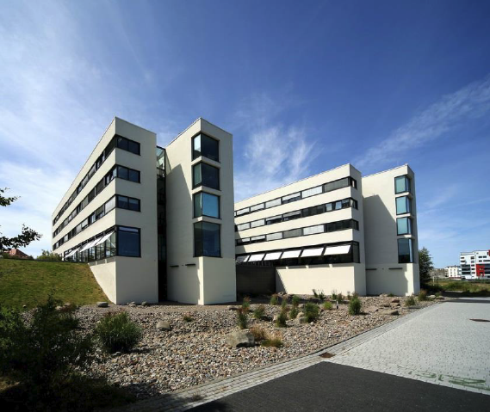
About Myself
Software developer at the lab of digital and computational demography
https://www.demogr.mpg.de/en/about_us_6113/staff_directory_1899/tom_theile_3933/
https://github.com/tomthe
https://twitter.com/TheileTom
https://btw21.deinwal.de/
Notes:
I have studied mechanical engineering, then tried my luck with doing a phd - like you! But I failed and worked in the industry for a few years. before I got fed up and saw the job ad of the MPIDR
Now I help the other researchers in Emilio Zaghenis Lab with coding-specific tasks.
A lot of it is typical Data Science. E.g. Bibliometrics: getting data, processing it, augmenting it with other data or neural networks...etc.
Also a lot of Scraping and collecting data from the internet (which is why emilio asked me to teach this to you)
Also maintaining a C++ Microsimulation Software: SocSim - if you work with that
Last year the EDSD students asked whether there could be more practical examples of getting internet and social-media data
That is why I am standing here now!
normally no teaching - so please give me feedback, so that I can improve now and for next year.

Slide 3
Agenda
Day 1
  What is the Internet?
  How to scrape data from websites?
Day 2
  Finding and working with good datasets
Day 3
  Working with APIs
  Getting data from Twitter
  Working with Twitter-data
Day 4
  Getting data from Facebook audience estimates
Less theory, more practice than other courses!
Feel free to interrupt me at any time!
Notes:
First time I give the course, the materials for the later days are still not completely finished, please bear with me
My goal is that everyone understands almost everything that I try to bring across. So please interrupt me and ask questions if you can't follow along. I don't know all your skill-levels, so it might happen that I assume to much or too little knowledge about some things.
I will also try to add a few „dard magic“ bits into the course: Things that are not possible to completely understand in a short course, but which are maybe very helpful for some of you (who then can dive deeper into these topics themselves). Like: Machine Learning, Sentiment analysis, etc. If you don’t understand all the inner workings of these parts: Ask, but don’t worry.

Slide 4
Introduce yourself, please!
What is your name?
What is your background? (Do you have knowledge relevant to this course already (Scraping, APIs, etc. ?)
What central question would you like to answer with your research?
What data would be helpful to answer your question?
Notes:
First time I give the course, the materials for the later days are still not completely finished, please bear with me
My goal is that everyone understands almost everything that I try to bring across. So please interrupt me and ask questions if you can't follow along. I don't know all your skill-levels, so it might happen that I assume to much or too little knowledge about some things.
I will also try to add a few „dard magic“ bits into the course: Things that are not possible to completely understand in a short course, but which are maybe very helpful for some of you (who then can dive deeper into these topics themselves). Like: Machine Learning, Sentiment analysis, etc. If you don’t understand all the inner workings of these parts: Ask, but don’t worry.

Slide 5
What is the Internet
Continuation in RMarkdown: Day1-1-Introduction-Extracting_data_from_the_web.pdf
Materials are available on Github:
https://github.com/tomthe/EDSD22_web_and_social_media_data
Notes:
First time I give the course, the materials for the later days are still not completely finished, please bear with me
My goal is that everyone understands almost everything that I try to bring across. So please interrupt me and ask questions if you can't follow along. I don't know all your skill-levels, so it might happen that I assume to much or too little knowledge about some things.
I will also try to add a few „dard magic“ bits into the course: Things that are not possible to completely understand in a short course, but which are maybe very helpful for some of you (who then can dive deeper into these topics themselves). Like: Machine Learning, Sentiment analysis, etc. If you don’t understand all the inner workings of these parts: Ask, but don’t worry.

Slide 6

Thank you for your attention!
Tom Theile
Software developer at the lab of digital and computational demography
theile@demogr.mpg.de

Slide 7
Thank you!

