Slide 1
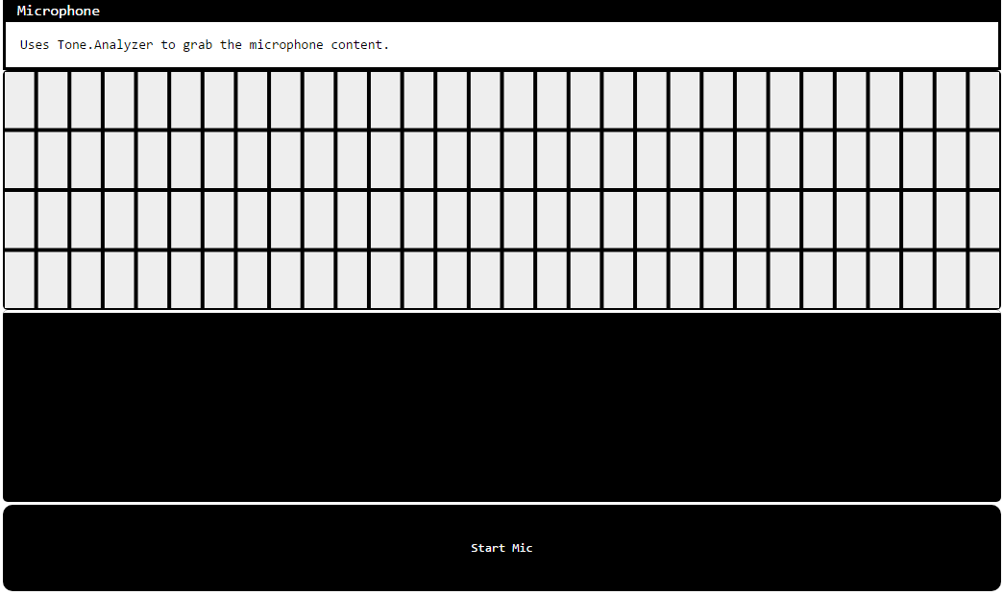
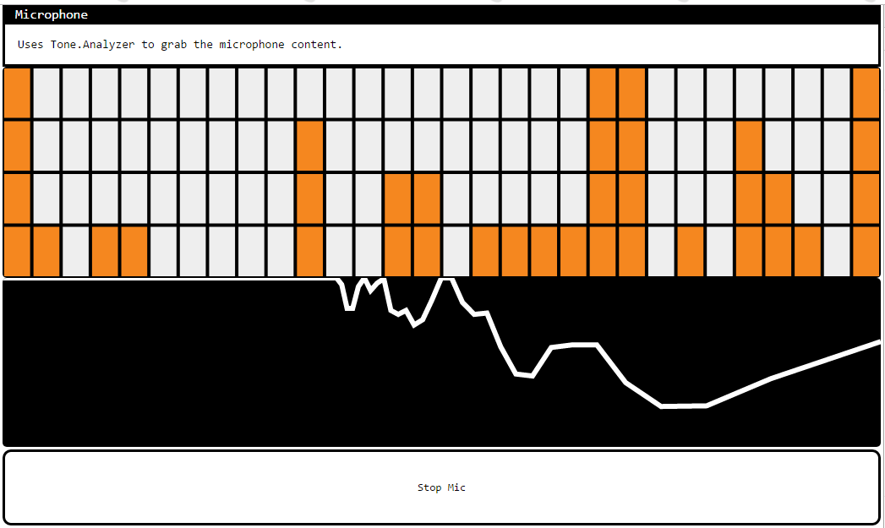
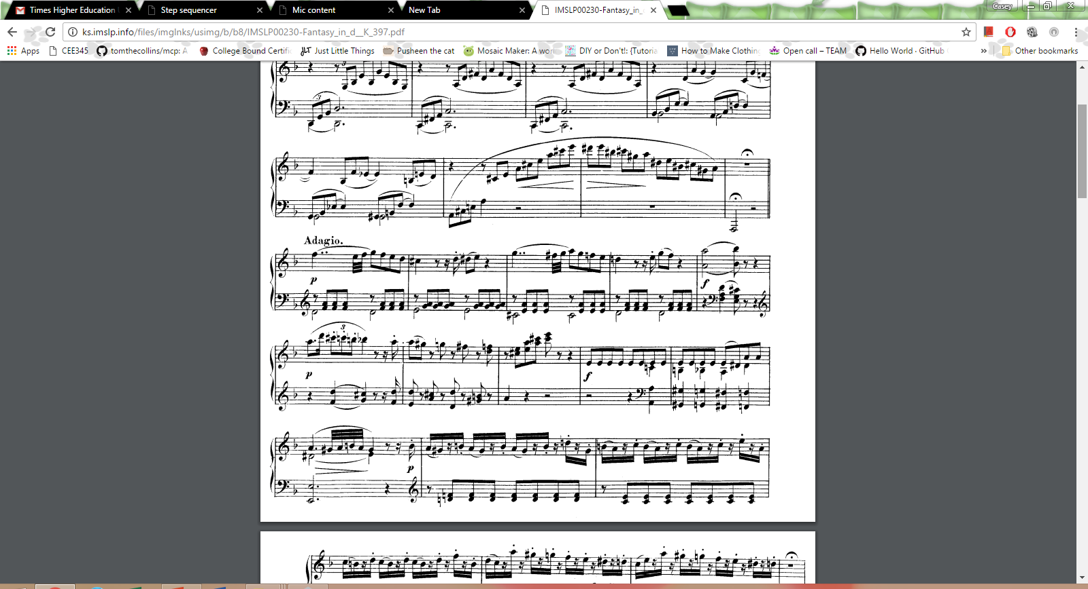
Speech to Rhythm
typedrummer & speech-to-song
Threshold tests determine the rhythm produced
Does not pass minimum threshold level → a “rest”
Passes maximum threshold level → a strong beat
Data organized in an array
Onsets/index = time where beat occurs
Amp = how strong a beat is
Rhythm presentation methods
Visual representation (this project, index.html)
NEXUSUI
Audio representation
Graphical rhythmic notation
Mozart, Fantasia in D minor K397
CASEY CHING

