Slide 1
Fraido
Intubation
Easy - Fast - Safe
© Fraido • July 2026 • All rights reserved

Slide 2




Difficult Intubation
Space limitation
Time Critical
Skill - dependent
+€20k per patient^{[1]}
[1]: April MD, Schauer SG, Nikolla DA, Casey JD, Semler MW, Ginde AA, Carlson JN, Long BJ, Brown CA 3rd. Association between multiple intubation attempts and complications during emergency department airway management: A national emergency airway registry study. Am J Emerg Med. 2024 Nov;85:202-207. doi: 10.1016/j.ajem.2024.09.014. Epub 2024 Sep 11. PMID: 39288499.
Fraido
© Fraido • July 2026 • All rights reserved

Slide 3
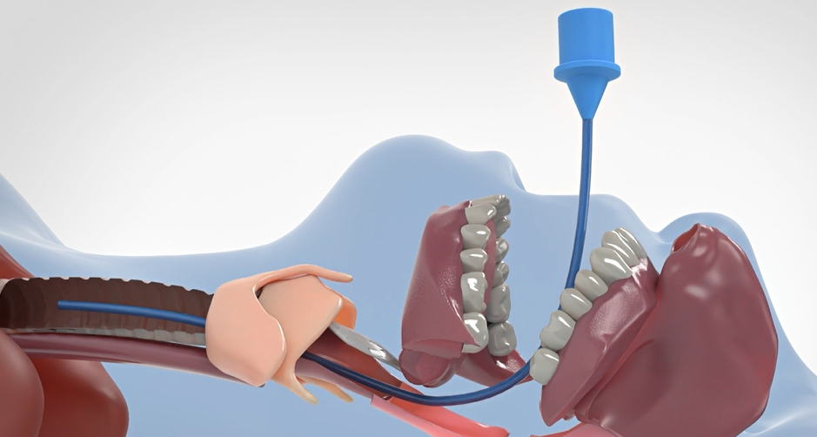
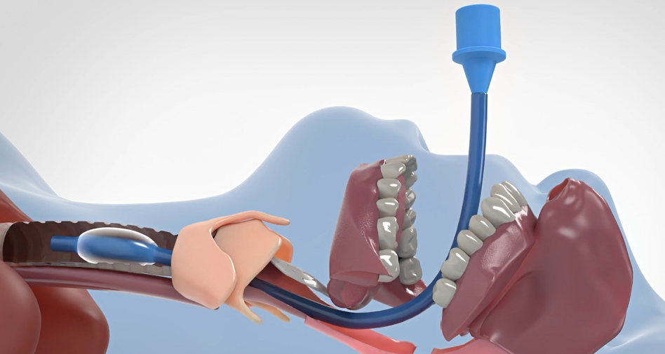
Our Solution
*Patent pending
TRL 3 TRL 5
Adaptable diameter
Less invasive
Single device procedure
Fraido
© Fraido • July 2026 • All rights reserved

Slide 4




Our Solution
*Patent pending
IP
Mechanism possible applications
Airways
Vascular
Drainages
Aligned with DAS Guidelines^{[1]}
[1]: DAS 2025 Intubation Guidelines — Difficult Airway Society, Br J Anaesthesia (2025)
Fraido
© Fraido • July 2026 • All rights reserved

Slide 5




B2B2B
Disposable device
Fraido
Manufacturer
Distributors
Hospitals
Fraido
© Fraido • July 2026 • All rights reserved

Slide 6

Go To Market
Designed by
KOL^{(Loi)}
Distributors partnership
KOL:
Early adopters
Guidelines implementation
Fraido
© Fraido • July 2026 • All rights reserved

Slide 7




Why Fraido
FRAIDO
Fiberscope
Stylet
Bougie
Laryngeal
Mask
Endotracheal Tube
Modular diameter
Single device
Difficult intubation
Awake intubation
Protected extubation
Fraido
© Fraido • July 2026 • All rights reserved

Slide 8
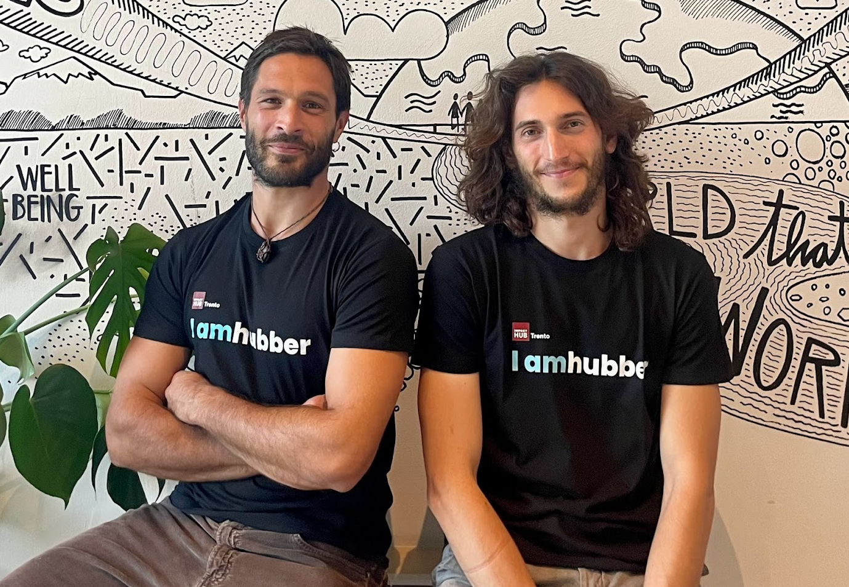
Team
Founders
Advisors
Prof. Pietro Arina - Professor UCL London
Dr. Chiara Sansovini - Autor Stargate Study
Dr. Roberto Righetti - Airway Instructor
Dr. Marco Garroni - Airway Instructor
Prof. Giacomo Bellani - Head of Intensive Care Unit
Antonio Maria Vizioli
Elia Fregonese
Dr. Andrew Markle
Dr. Stefano Bonvini - Head of Vascular Surgery
A&E Nurse
Mat & Nanotechnology
Engineer
5Y Emergency CEO
4Y Space CTO
Dr. Andrew Markle - Quality specialist, Saint Mary
Martin Gossling - Head of commercial innovation at UHS
Fraido
© Fraido • July 2026 • All rights reserved
Notes:
I’m a Materials Engineer, graduated here at Politecnico di Milano. Before founding Fraido, I worked at OHB Italia, an aerospace company, where I was involved in projects characterized by long development timelines, high technical complexity, and strict regulatory constraints. This experience translates directly to Fraido, where structured development, risk management, and regulatory discipline are essential from the very beginning.
Antonio, my co-founder, comes from a clinical background. He worked as a nurse, and it was through this experience that he identified a critical and unmet need in airway management. His background gives Fraido a direct and continuous connection to the clinicians who will ultimately use the device, allowing us to validate decisions early and design around real-world practice.
Supporting us is a group of clinical advisors, drawn directly from this network, who have already contributed significantly to the project’s development and provide Fraido with clinical credibility, guidance, and relevance.
→ Next Slide →

Slide 9
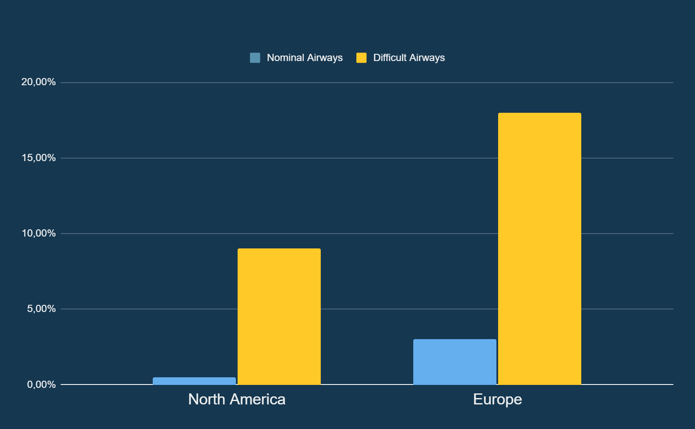
Market
€3.1B
6.5M
€25
Endotracheal Tube Global Market
6.1% CAGR
Difficult Airway
Procedures/Year EU-NA
Unit Price
Projected penetration Y5
Projected Sales - Y5
€35.4M
Fraido
© Fraido • July 2026 • All rights reserved

Slide 10
Timeline & Need
€300K
€1.6M
€4M
2031
TRL 5
Cadaver & Mannequin testing
TRL 7
DFM
Pre clinical Trials
TRL 8
MDR - Class IIa
Market
2026
2027
2028
2029
2030
2031
Current need
€200K
Fraido
© Fraido • July 2026 • All rights reserved

Slide 11

Fraido
Easy, Fast, Safe
Curious? Have a look.
Questions? Let's talk.
www.fraido.it
info@fraido.it
Fraido
© Fraido • July 2026 • All rights reserved

