Slide 1


Master practical
Signal peptide prediction with SecVec
By: Thomas Heinzinger, Martin Pavlov
Supervisor: Michael Bernhofer

Slide 2
Background
ELMo embeddings

Slide 3
Data & Biological Background
Training and benchmark set with 20758 and 8809 proteins respectively
Non-signal peptides Symbol: 0
Sec/SPI: “Standard" secretory signal peptides, exclusive to eukaryotes Symbol: S
Sec/SPII: Lipoprotein signal peptides Symbol: L
Tat/SPI: Tat signal peptides Symbol: T
Notes:
lipoprotein signal peptides transported by the Sec translocon and cleaved by Signal Peptidase II (Lsp)
Tat signal peptides transported by the Tat translocon and cleaved by Signal Peptidase I (Lep)
Important for cellular localization

Slide 4
Class imbalance
0: 0.913
S: 0.054
T: 0.011
L: 0.022
→ Class weighting

Slide 5
Application of SecVec on the data
Training and benchmark datasets are processed with the latest SecVec model → Output = Vector: (1024*protein length) for every protein
Transformation (cutting & elongating) of the SecVec output → embeddings of every protein are of length 70
Training and benchmarking on the transformed output

Slide 6
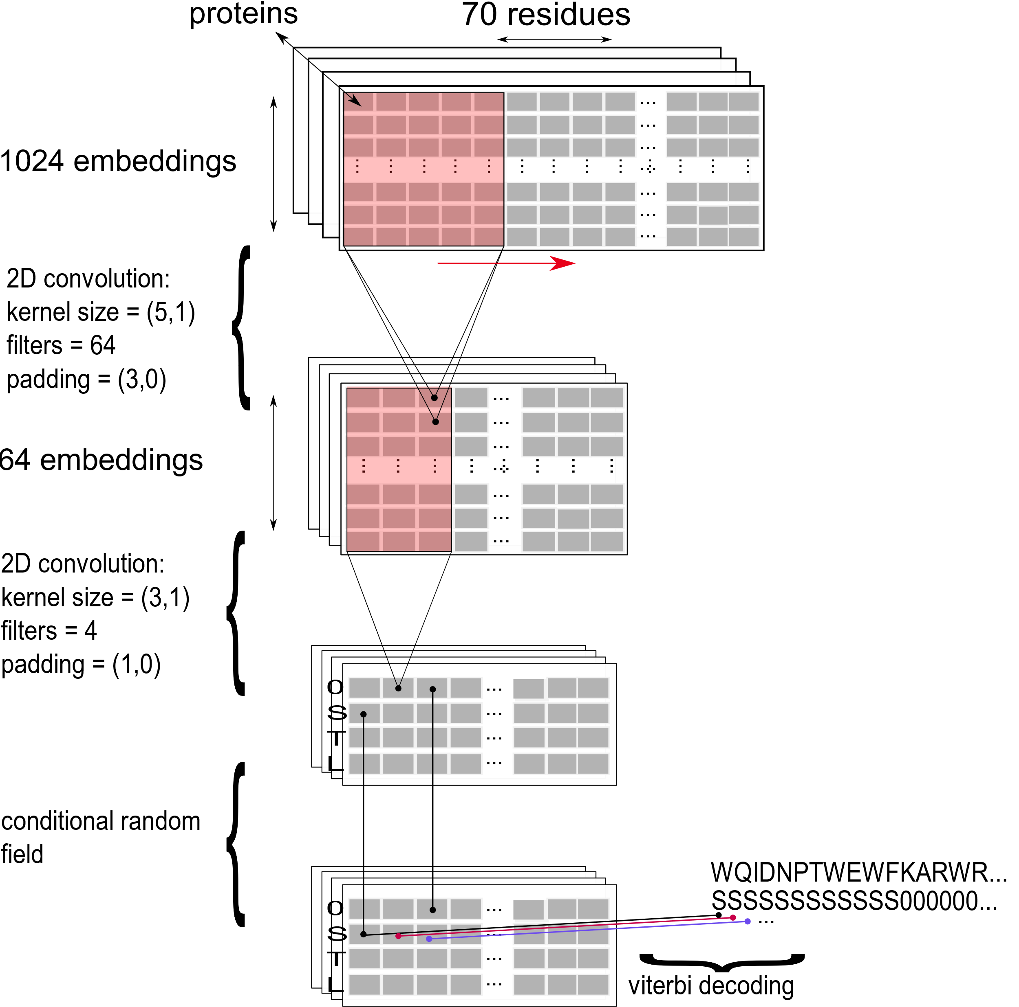
Model configuration
Learning rate = 0.03
Batch size = 128
Dropout and batch-normalization
Class weights (1/N_{class})
Conditional random field
Notes:
TO DO: Martin tests those parameters → maybe 1 slide for both

Slide 7
Results
Thomas
Martin
Q4 (with CRF) =
Q4 (without CRF) =
MCC (with CRF) per protein =
MCC (with CRF) per residue =
MCC (without CRF) per protein =
MCC (without CRF) per residue =
Mean deviation from real cleavage site (with CRF) =
Mean deviation from real cleavage site (without CRF) =
Q4 (with CRF) =
Q4 (without CRF) =
MCC (with CRF) per protein =
MCC (with CRF) per residue =
MCC (without CRF) per protein =
MCC (without CRF) per residue =
Mean deviation from real cleavage site (with CRF) =
Mean deviation from real cleavage site (without CRF) =
Notes:
TO DO: make shorter

Slide 8
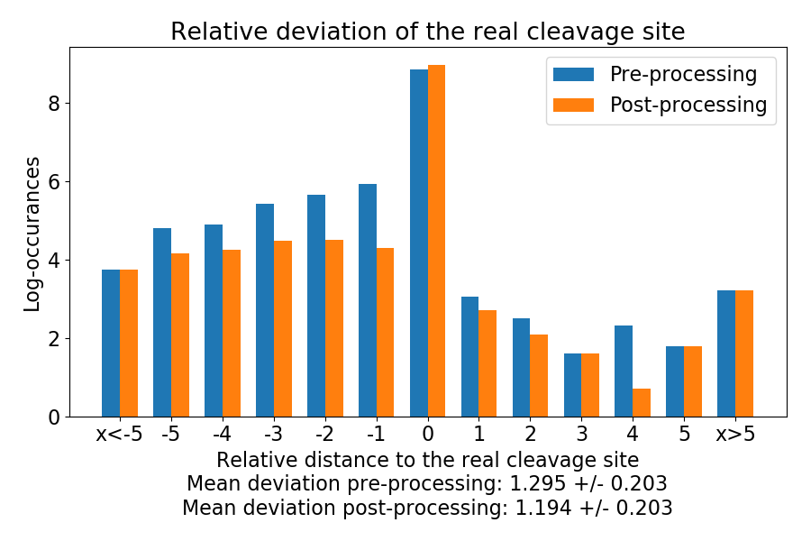
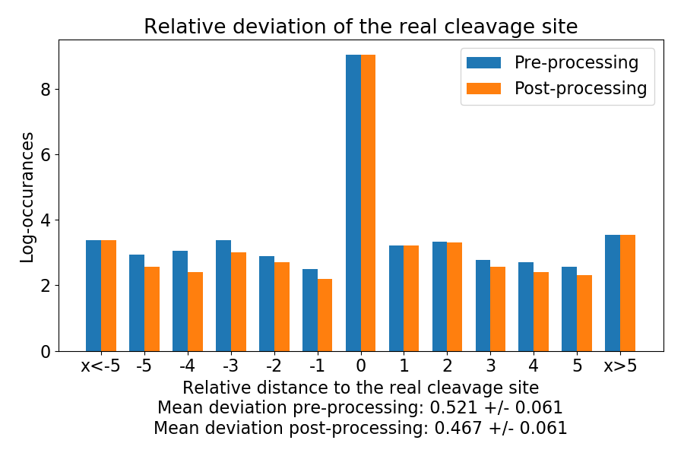
Results without and with a CRF: cleavage site
Notes:
TO DO: pre-processing → no post-processing
GOAL: show that CRF helps → from now on results with CRF only

Slide 9
Confusion Matrices

Slide 10
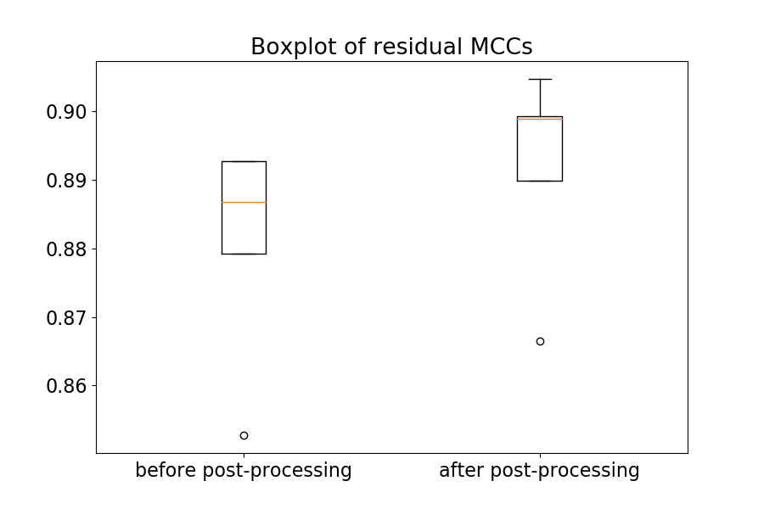
Results: residual MCC
Thomas
Martin

Slide 11
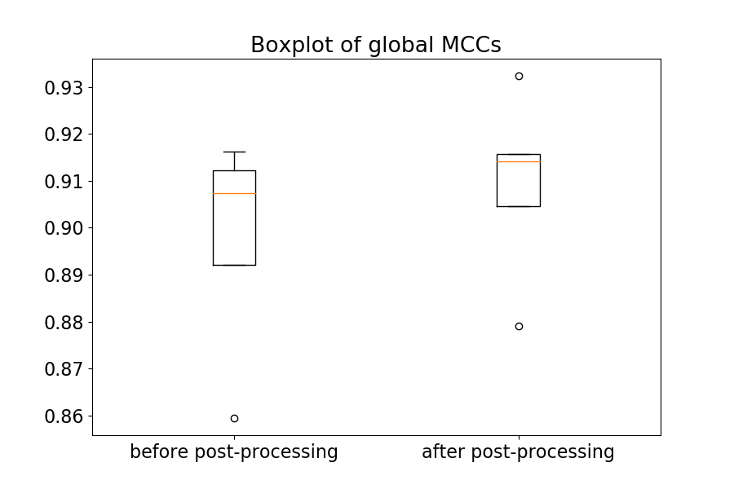
Results: global MCC
Thomas
Martin

Slide 12
SecVec vs SignalP5.0

