Slide 1


Master practical
Signal peptide prediction with SecVec

Slide 2
Background

Slide 4
Data
Training and benchmark set with 20758 and 8809 proteins respectively
Non-signal peptides Symbol: 0
Sec/SPI: “Standard" secretory signal peptides, exclusive to eukaryotes Symbol: S
Sec/SPII: Lipoprotein signal peptides Symbol: L
Tat/SPI: Tat signal peptides Symbol: T
Notes:
lipoprotein signal peptides transported by the Sec translocon and cleaved by Signal Peptidase II (Lsp)
Tat signal peptides transported by the Tat translocon and cleaved by Signal Peptidase I (Lep)

Slide 5
Class imbalance
0: 0.913
S: 0.054
T: 0.011
L: 0.022
→ Class weighting

Slide 6
Application of SecVec on the data
All proteins in the training and benchmark are processed with the latest SecVec model: Output = Vector: (1024*protein length) for every protein
Transformation of the output so that the embeddings of every protein are of length 70
Training and benchmark on the results

Slide 7
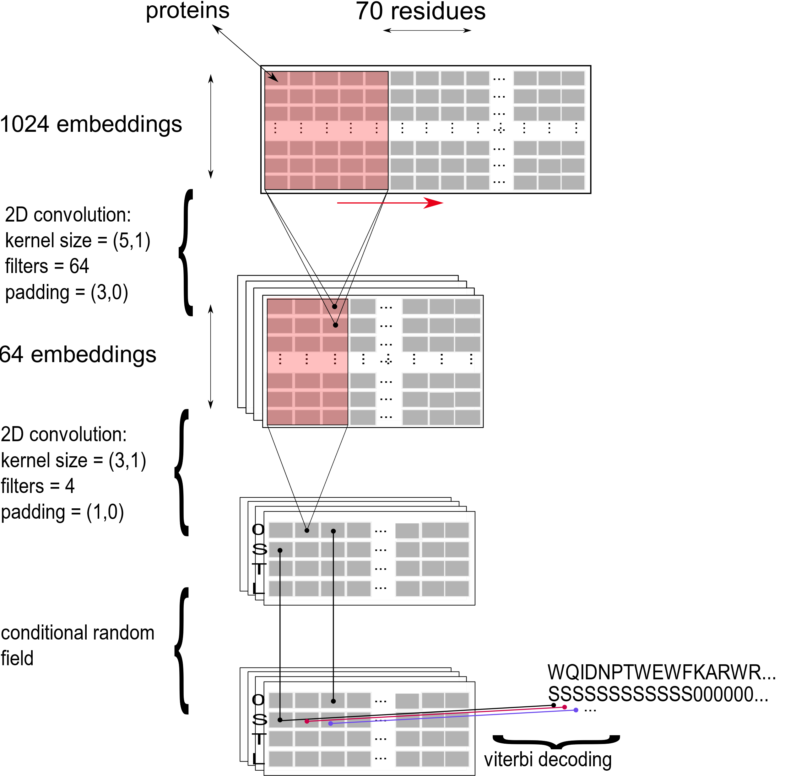
Model configuration
Learning rate = 0.03
Batch size = 128
Dropout and batch-normalization
Class weights (1/N_{class})
Conditional random field

Slide 8
Results
Q4 =

Slide 9
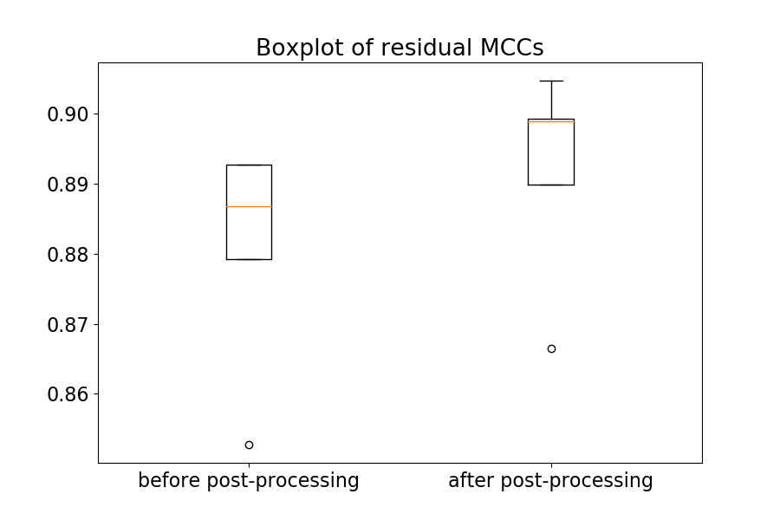
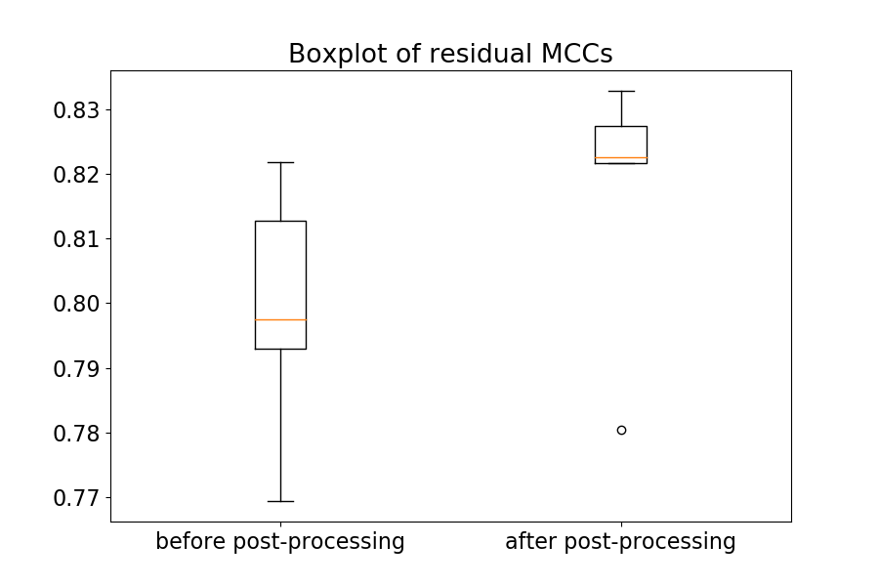
Results without and with a CRF: residual MCC

Slide 10
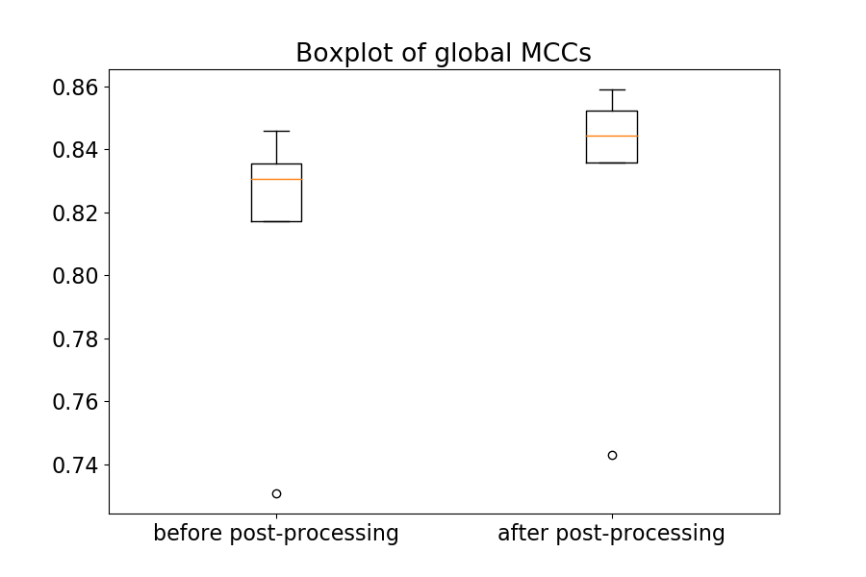
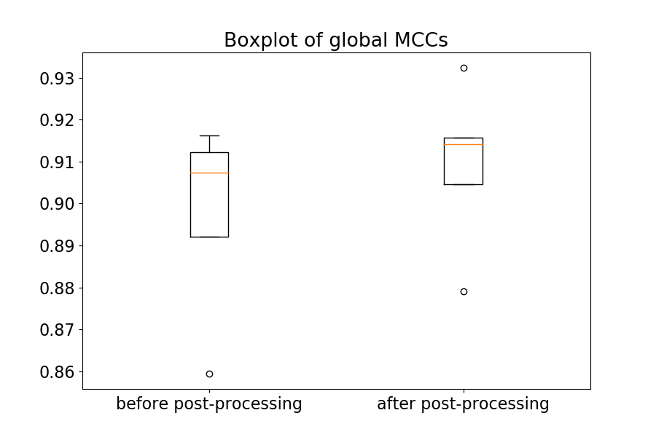
Results without and with a CRF: global MCC

Slide 11
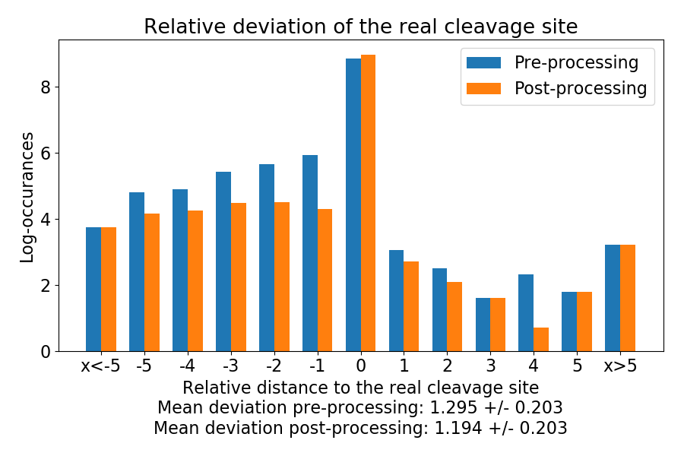
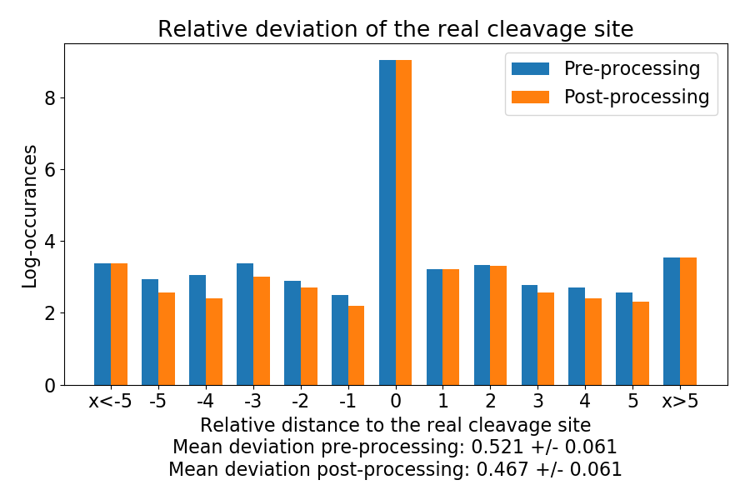
Results without and with a CRF: cleavage site

