Slide 1

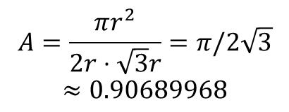


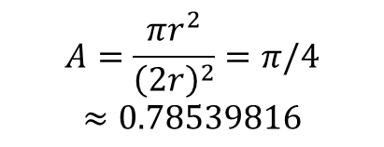







$$r$$
$$r$$
$$r$$
$$r$$
$$\sqrt{3}r$$
$$r$$
$$r$$
$$r$$
$$r$$
$$r$$
$$A=\frac{πr^{2}}{{\left(2r\right)}^{2}}=π/4$$
$$≈0.78539816$$
$$A=\frac{πr^{2}}{2r⋅\sqrt{3}r}=π/2\sqrt{3}$$
$$≈0.90689968$$

