Slide 1
Tighter financing goes with lower ESG scores in Taiwan’s food industry
Financial constraints (SA index) and ESG performance (TEJ TESG score): 24 TWSE-listed food firms, 219 firm-years, 2016–2025
Vo Manh Tuan Tran
Ming Chuan University, Taiwan · November 2026
TAKEAWAY
Financially constrained TWSE food firms score lower on ESG, which supports H1, but the evidence is a between-firm association tied to firm size.
This deck follows the structure of the final report: Introduction, Methods, Results and Discussion. Using TEJ data on 24 TWSE-listed food firms (219 firm-years, 2016–2025), it relates the TESG composite score to the Hadlock and Pierce SA index. Hausman and Mundlak tests select random effects with year effects and firm-clustered standard errors. The SA coefficient is −4.805 (p = 0.0498), supporting H1. The sign holds in every robustness check, but significance does not survive adding firm size, and the pattern is between firms rather than within them.
Notes:
This deck follows the structure of the final report: Introduction, Methods, Results and Discussion. Using TEJ data on 24 TWSE-listed food firms (219 firm-years, 2016–2025), it relates the TESG composite score to the Hadlock and Pierce SA index. Hausman and Mundlak tests select random effects with year effects and firm-clustered standard errors. The SA coefficient is −4.805 (p = 0.0498), supporting H1. The sign holds in every robustness check, but significance does not survive adding firm size, and the pattern is between firms rather than within them.

Slide 2
Higher financial constraints go with lower ESG scores, supporting H1, but only as a between-firm pattern tied to firm size
SUMMARY
INTRODUCTION METHODS RESULTS DISCUSSION
−4.805
WHAT SUPPORTS H1
Negative and significant at 5%: −4.805 (p = 0.0498). The one-year lagged index is also negative: −3.745 (p = 0.055)
The sign is negative in all four robustness checks
Concentrated in the social pillar: −8.274 (p = 0.002)
TESG points per one-unit
rise in the SA index
p = 0.0498 (t(23) critical values)
219 firm-years, 24 firms
Random effects, year effects, SE clustered by firm
WHAT LIMITS IT
A between-firm pattern: the fixed-effects estimate is +2.245, because SA barely moves within a firm
Tied to firm size: adding SIZE cuts the coefficient to −2.519 (p = 0.260)
Only 24 firms, and p = 0.0498 sits right at the 5% line
ROADMAP
Introduction → Methods → Results → Discussion
Source: TEJ; own calculations. Table 4 and Table 5 of the report.
2 / 22
TAKEAWAY
One more unit of SA goes with 4.805 fewer TESG points, but the result is fragile and cannot be separated from firm size.
The headline is the coefficient on the SA index in the random-effects model with year effects: −4.805, p = 0.0498. A higher SA index means tighter financial constraints, so constrained firms have lower TESG scores, which is what H1 predicts. Three things back it up: the sign is negative in all four robustness checks, the lagged index is significant at 10%, and the social pillar carries most of the effect. Three things limit it: it is a between-firm pattern, it weakens sharply once firm size is added, and with 24 firms the p-value sits right at the 5% line. The rest of the deck follows the report: Introduction, Methods, Results, Discussion.
Notes:
The headline is the coefficient on the SA index in the random-effects model with year effects: −4.805, p = 0.0498. A higher SA index means tighter financial constraints, so constrained firms have lower TESG scores, which is what H1 predicts. Three things back it up: the sign is negative in all four robustness checks, the lagged index is significant at 10%, and the social pillar carries most of the effect. Three things limit it: it is a between-firm pattern, it weakens sharply once firm size is added, and with 24 firms the p-value sits right at the 5% line. The rest of the deck follows the report: Introduction, Methods, Results, Discussion.

Slide 3
ESG research asks whether ESG pays; whether a firm’s finances shape its ESG is much less studied
BACKGROUND AND GAP
INTRODUCTION METHODS RESULTS DISCUSSION
What we know
What is missing
Why food firms
≈ 90%
of about 2,200 studies report a nonnegative link between ESG and financial performance (Friede et al., 2015, p. 210). Yet hypotheses and results still conflict (Gillan et al., 2021, p. 1).
Reverse link
Little work asks whether a firm’s financial position shapes how much it invests in ESG. Taiwan evidence runs the other way: Chang et al. (2025) regress constraint indices on lagged ESG scores, TWSE and OTC firms, 2015–2021.
Since 2014
TWSE-listed food companies must publish CSR reports and have them assured (Tseng, 2022, p. 487). TEJ’s TESG score, launched in 2022, rates all listed Taiwanese firms.
RESEARCH QUESTION
Do financial constraints affect the ESG performance of TWSE-listed food firms in 2016–2025, and in which direction?
Sources: Friede et al. (2015); Gillan et al. (2021); Chang et al. (2025); Tseng (2022); TEJ (2022). Introduction of the report.
3 / 22
TAKEAWAY
The gap is the reverse direction, from financial constraints to ESG, in a sector where ESG disclosure is mandatory and assured.
Start with the gap. Most ESG research asks whether ESG pays: about 90% of roughly 2,200 studies find a nonnegative link with financial performance, though hypotheses and results still conflict. Far less asks the reverse question, whether a firm’s financial position shapes its ESG, and the Taiwan evidence we found runs from ESG to constraints. Food firms are a clean setting because CSR reports have been mandatory and assured since 2014, and TEJ’s TESG score now rates every listed firm. That gives the research question on this slide.
Notes:
Start with the gap. Most ESG research asks whether ESG pays: about 90% of roughly 2,200 studies find a nonnegative link with financial performance, though hypotheses and results still conflict. Far less asks the reverse question, whether a firm’s financial position shapes its ESG, and the Taiwan evidence we found runs from ESG to constraints. Food firms are a clean setting because CSR reports have been mandatory and assured since 2014, and TEJ’s TESG score now rates every listed firm. That gives the research question on this slide.

Slide 4
Two theories predict opposite signs for the same coefficient, so the data must decide
HYPOTHESES
INTRODUCTION METHODS RESULTS DISCUSSION
H1 (−) ESG is a discretionary cost
H2 (+) ESG opens access to finance
Higher financial constraints lead to lower ESG scores: firms cut ESG spending to conserve cash.
Fazzari et al. (1988): internal and external funds are not perfect substitutes, so spending depends on financial condition. Hong et al. (2012): less constrained firms have higher corporate goodness scores.
Higher financial constraints lead to higher ESG scores: firms invest in ESG to attract ESG-conscious capital and lower the cost of funds.
Cheng et al. (2014): firms with better CSR performance face significantly lower capital constraints.
The test: the sign of β₁ on the SA index. β₁ < 0 supports H1; β₁ > 0 supports H2.
Contribution: industry-level evidence on the direction from financial constraints to ESG, for a sector with mandatory, assured sustainability reporting.
Sources: Fazzari et al. (1988); Hong et al. (2012); Cheng et al. (2014). See the report’s references.
4 / 22
TAKEAWAY
If ESG is a cost, constrained firms cut it (H1); if ESG buys access to finance, constrained firms do more of it (H2).
The literature points both ways. Fazzari et al. and Hong et al. imply that constrained firms spend less on discretionary items such as ESG, so more constraint means a lower score. Cheng et al. show that better CSR lowers capital constraints, which gives constrained firms a reason to invest in ESG. The coefficient on the SA index decides between them: negative supports H1, positive supports H2. The contribution is industry-level evidence for a sector with mandatory, assured sustainability reporting. Next: Methods, starting with how the sample was built.
Notes:
The literature points both ways. Fazzari et al. and Hong et al. imply that constrained firms spend less on discretionary items such as ESG, so more constraint means a lower score. Cheng et al. show that better CSR lowers capital constraints, which gives constrained firms a reason to invest in ESG. The coefficient on the SA index decides between them: negative supports H1, positive supports H2. The contribution is industry-level evidence for a sector with mandatory, assured sustainability reporting. Next: Methods, starting with how the sample was built.

Slide 5
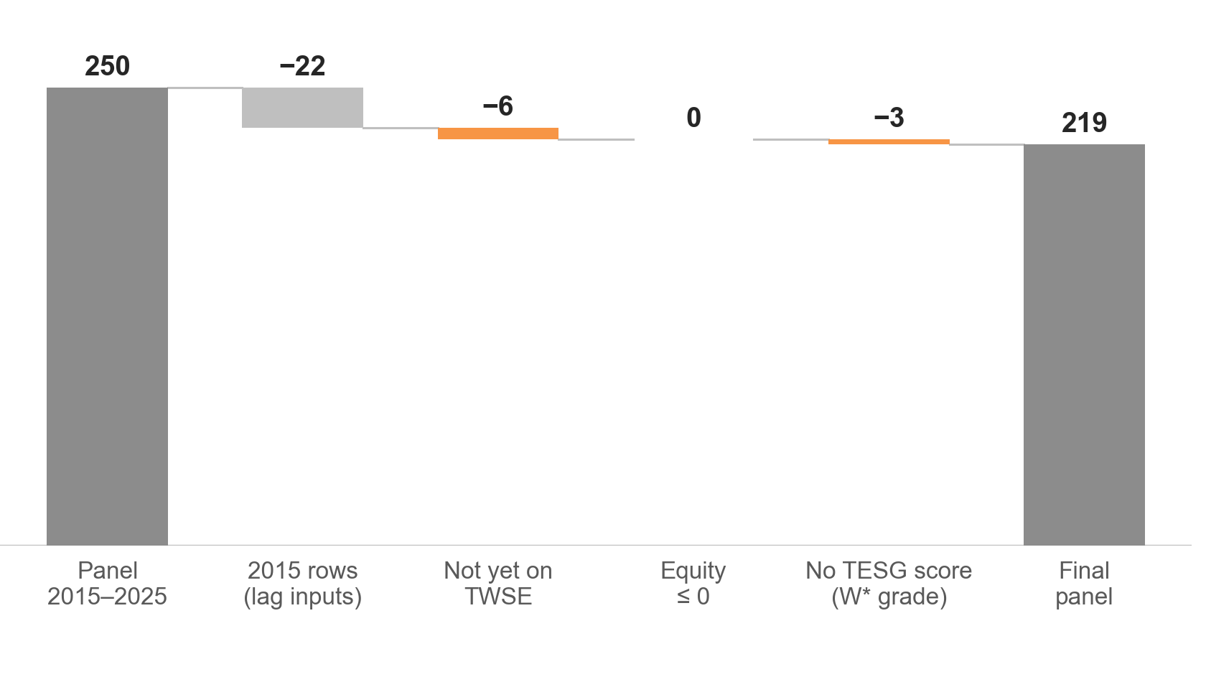
The panel keeps 219 of 250 rows: 22 are 2015 lag inputs and only 9 fail the sample rules
DATA AND SAMPLE
INTRODUCTION METHODS RESULTS DISCUSSION
39 → 24 firms
TEJ returned 39 food entries for TWSE. Five depositary receipts and ten firms delisted before 2016 are removed. None left during 2016–2025.
22 rows set aside
2015 data are used only as lagged inputs (GROWTH and lagged SA in 2016). They never enter a regression.
3 firms, no 2025 score
1218, 1219 and 1225 carry the W* warning grade (a prosecutor’s indictment). They are not a random group.
Source: TEJ; own calculations. Table 1 and Section 3.1 of the report; data_clean/sample_attrition.csv.
5 / 22
TAKEAWAY
The final panel has 219 firm-years from 24 TWSE-listed food firms, built from TEJ in a fixed order.
Methods, part one: the data. The firm universe comes only from the TEJ query: 39 food entries, minus 5 depositary receipts and 10 firms delisted before 2016, leaves 24 firms. Observations are then selected in a fixed order. The 22 rows of 2015 are set aside as lagged inputs, 6 rows are dropped because the firm was not yet traded on the TWSE, no row has non-positive equity, and 3 rows have no TESG score. The three missing scores are firms 1218, 1219 and 1225 in 2025, graded W*. That group is not random, which matters for the limits. Next: how the outcome and the constraint measure are built.
Notes:
Methods, part one: the data. The firm universe comes only from the TEJ query: 39 food entries, minus 5 depositary receipts and 10 firms delisted before 2016, leaves 24 firms. Observations are then selected in a fixed order. The 22 rows of 2015 are set aside as lagged inputs, 6 rows are dropped because the firm was not yet traded on the TWSE, no row has non-positive equity, and 3 rows have no TESG score. The three missing scores are firms 1218, 1219 and 1225 in 2025, graded W*. That group is not random, which matters for the limits. Next: how the outcome and the constraint measure are built.

Slide 6
The outcome is the TESG score and constraints are measured by the SA index, built from size and age
VARIABLES
INTRODUCTION METHODS RESULTS DISCUSSION
Outcome: TESG score
Constraint: SA index
Controls
TEJ composite score, 0–100: fully quantitative, three pillars, sixteen themes
E, S and G pillar scores serve as alternative outcomes
December rating, merged to the year of the sustainability report it uses
Numeric score used throughout; winsorized at 1% and 99%
SA = −0.737 × Size + 0.043 × Size² − 0.040 × Age
Size: ln of total assets in US$ million, at each year’s average USD/NTD rate
Age: observation year minus founding year
Both winsorized at 1%/99%; SA is negative in every observation (−6.002 to −2.540); higher means tighter constraints
ROA: net income after tax / total assets
LEV: total liabilities / total assets
TQ: (market capitalisation + total liabilities) / total assets
GROWTH: revenue change / previous-year revenue
CASH: cash and equivalents / total assets
SIZE (ln total assets) enters only Model 2, because it is part of SA
Source: TEJ; own calculations. Sections 3.3.1 to 3.3.3 and Appendix Table A2 of the report.
6 / 22
TAKEAWAY
Both variables come from TEJ; the SA index adapts Hadlock and Pierce (2010) in the same way as Chang et al. (2025).
Methods, part two: the variables. The outcome is the TEJ TESG composite score, 0 to 100, taken from the December rating and merged to the year of the report it uses. The constraint measure is the SA index: size and age only, with size in US$ million and age from the founding year, both winsorized at 1% and 99%. It differs from Hadlock and Pierce in three respects: nominal rather than 2004 dollars, age since founding rather than years with a stock price, and percentile trimming rather than fixed caps. Controls are ROA, leverage, Tobin’s Q, revenue growth and cash. Next: the model.
Notes:
Methods, part two: the variables. The outcome is the TEJ TESG composite score, 0 to 100, taken from the December rating and merged to the year of the report it uses. The constraint measure is the SA index: size and age only, with size in US$ million and age from the founding year, both winsorized at 1% and 99%. It differs from Hadlock and Pierce in three respects: nominal rather than 2004 dollars, age since founding rather than years with a stock price, and percentile trimming rather than fixed caps. Controls are ROA, leverage, Tobin’s Q, revenue growth and cash. Next: the model.

Slide 7
The model follows the Hausman rule, uses firm-clustered errors and is stress-tested four ways
MODEL AND TESTS
INTRODUCTION METHODS RESULTS DISCUSSION
TESG_{it} = α_{i} + β₁SA_{it} + β₂ROA + β₃LEV + β₄TQ + β₅GROWTH + β₆CASH + γ_{t} + ε_{it}
α: firm effect; γ: year effects. SIZE is left out of the main model because ln(total assets) is already a component of SA.
1 Choose the estimator
2 Estimate the main model
3 Stress-test it
Hausman test, fixed versus random effects, on the six slope coefficients: p < 0.05 → fixed effects; p ≥ 0.05 → random effects is acceptable.
Mundlak test as a check: firm means of the regressors added to the random-effects model.
Firm effects, year effects (dummies), standard errors clustered by firm (CR1).
With 24 firms, stars use t(23) critical values (Cameron and Miller, 2015, p. 340).
β₁ < 0 supports H1; β₁ > 0 supports H2.
Four checks with the same estimator and inference:
SA dummy: 1 if above the sample median
E, S and G regressions, one pillar at a time
SA index lagged one year
SIZE added as a control (Model 2), with VIFs
Source: TEJ; own calculations. Sections 3.4 and 3.5 of the report.
7 / 22
TAKEAWAY
The estimator is chosen by test, inference allows for few clusters, and four checks probe the result.
Methods, part three: the model. The equation has a firm effect, year effects and the SA index plus five controls. The estimator is not assumed: a Hausman test compares fixed and random effects, with a Mundlak test as a check. Standard errors are clustered by firm, and because there are only 24 firms the significance stars use t with 23 degrees of freedom. Four robustness checks follow: a median-split dummy, the three pillars separately, a one-year lag and the SIZE control. Results come in the same order: descriptive statistics, the estimator test, the main regression and the checks.
Notes:
Methods, part three: the model. The equation has a firm effect, year effects and the SA index plus five controls. The estimator is not assumed: a Hausman test compares fixed and random effects, with a Mundlak test as a check. Standard errors are clustered by firm, and because there are only 24 firms the significance stars use t with 23 degrees of freedom. Four robustness checks follow: a median-split dummy, the three pillars separately, a one-year lag and the SIZE control. Results come in the same order: descriptive statistics, the estimator test, the main regression and the checks.

Slide 8
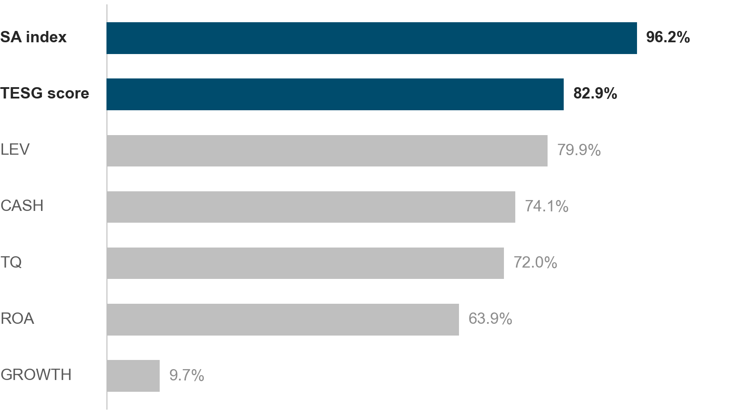
Most variation lies between firms: 83% of TESG and 96% of SA variance
DESCRIPTIVE STATISTICS
INTRODUCTION METHODS RESULTS DISCUSSION
0.32%
of the variance in SA is left after removing firm and year means: fixed effects have almost nothing to work with.
Age + year
Age is calendar year minus founding year, so within a firm it rises one for one with time and the SA index barely moves.
Source: TEJ; own calculations. Share of each variable’s variance between firms; winsorized variables; Section 4.1 of the report.
8 / 22
TAKEAWAY
SA barely changes within a firm, so any estimate that uses only within-firm variation has little to work with.
Results, descriptive statistics. Variance decomposition of each variable into between-firm and within-firm parts. For TESG, 82.9% of the variance is between firms; for the SA index, 96.2%. After removing firm and year means, only 0.32% of the variance in SA remains. This sets up the estimator test: a fixed-effects estimate is identified from that tiny remainder, while random effects also uses the differences between firms. Full descriptive statistics are in Appendix A.
Notes:
Results, descriptive statistics. Variance decomposition of each variable into between-firm and within-firm parts. For TESG, 82.9% of the variance is between firms; for the SA index, 96.2%. After removing firm and year means, only 0.32% of the variance in SA remains. This sets up the estimator test: a fixed-effects estimate is identified from that tiny remainder, while random effects also uses the differences between firms. Full descriptive statistics are in Appendix A.

Slide 9
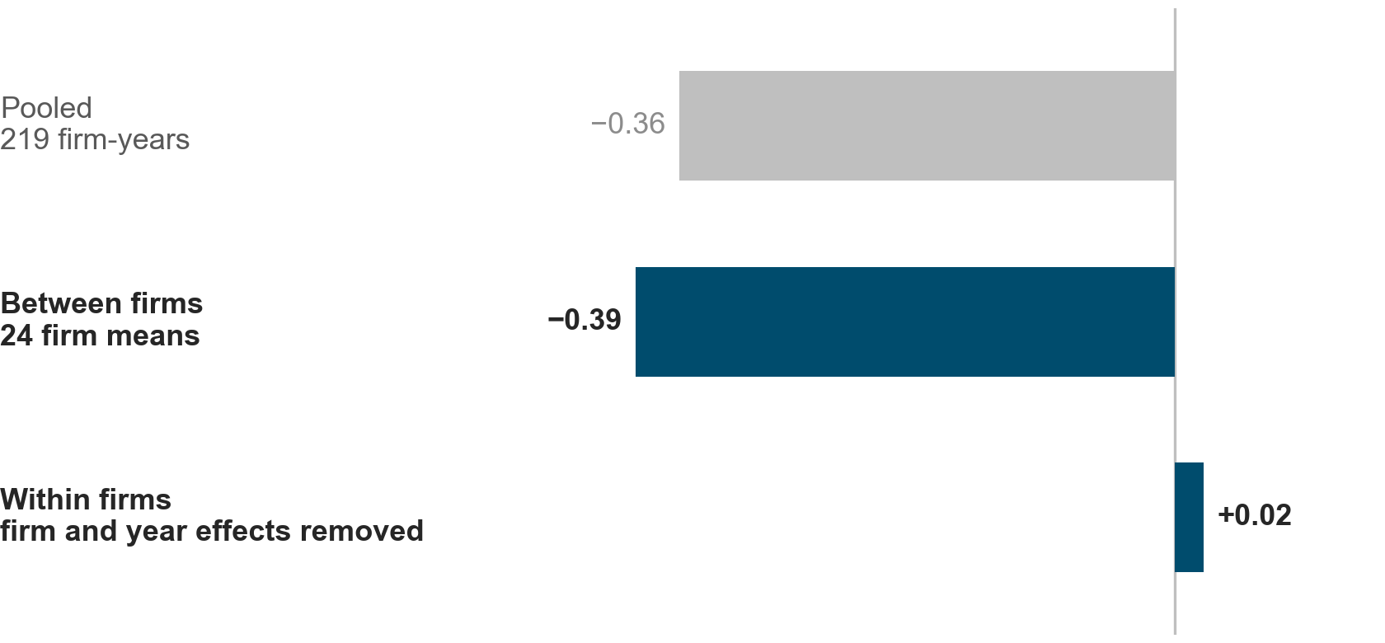
The link lives between firms: r = −0.39 across firm means, +0.02 once firm and year effects are removed
CORRELATION STRUCTURE
INTRODUCTION METHODS RESULTS DISCUSSION
r = −0.39
across the 24 firm means: firms with tighter constraints score lower.
r = +0.02
once firm and year effects are removed: no link inside a firm over time.
So any estimate will say how firms with different constraint levels differ in ESG, not how one firm’s ESG changes when its own constraints change. Hadlock and Pierce (2010, p. 1931) expect this: the index captures cross-sectional rather than time variation.
Source: TEJ; own calculations. Figure 1 of the report; outputs/tables/eda_corr_decomposition.csv.
9 / 22
TAKEAWAY
The negative SA–TESG association is a cross-sectional pattern, not a within-firm response to changing constraints.
Results, correlations. Correlation of the SA index with TESG, three ways. Pooled over all 219 firm-years it is −0.359. Across the 24 firm means it is −0.39, similar. After removing firm and year effects it is +0.02. This matches Figure 1 of the report and anticipates why fixed effects and random effects will disagree: the information is in the differences between firms. No pair of regressors exceeds |r| = 0.7 (Appendix B).
Notes:
Results, correlations. Correlation of the SA index with TESG, three ways. Pooled over all 219 firm-years it is −0.359. Across the 24 firm means it is −0.39, similar. After removing firm and year effects it is +0.02. This matches Figure 1 of the report and anticipates why fixed effects and random effects will disagree: the information is in the differences between firms. No pair of regressors exceeds |r| = 0.7 (Appendix B).

Slide 10
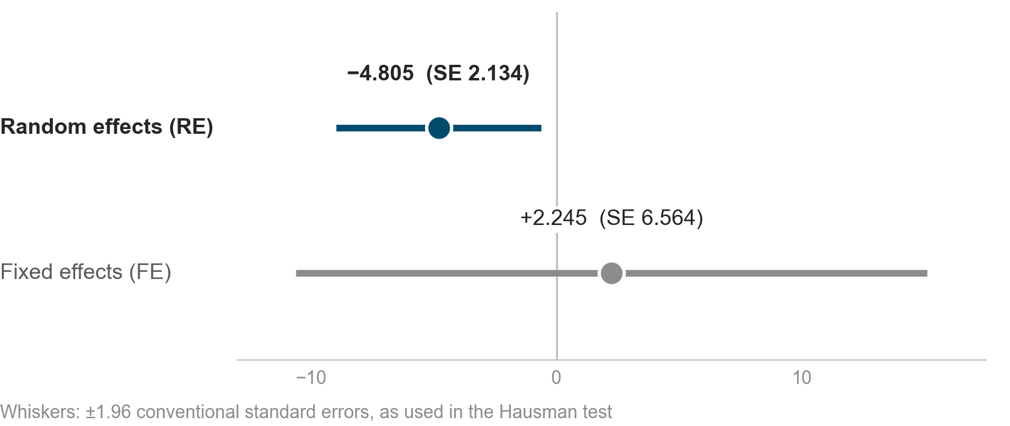
Tests do not reject random effects, and the fixed-effects SA estimate is three times less precise
ESTIMATOR CHOICE
INTRODUCTION METHODS RESULTS DISCUSSION
p = 0.816
Hausman χ²(6) = 2.94: no evidence that firm effects are correlated with the regressors. Mundlak agrees: χ²(6) = 3.25, p = 0.776.
SE 6.564 vs 2.134
Fixed effects uses only the tiny within-firm variation in SA. Random effects also uses differences between firms, where most of it lies.
Decision rule: p ≥ 0.05, so random effects is acceptable and is used for the main regression and every robustness check.
Source: TEJ; own calculations. Appendix Table A3 of the report. Whiskers use conventional standard errors; Table 4 uses firm-clustered ones.
10 / 22
TAKEAWAY
Following the Hausman rule (p ≥ 0.05), the main model is random effects with year effects and firm-clustered standard errors.
Results, estimator choice. The two estimators disagree on sign: random effects gives −4.805, fixed effects +2.245. But fixed effects is about three times less precise (standard error 6.564 against 2.134), so the Hausman test cannot tell them apart: chi-square(6) = 2.94, p = 0.816. The Mundlak test, which does not need a positive-definite covariance difference, agrees (p = 0.776). Following the decision rule, random effects is used for the main regression and all robustness checks. Details in Appendix C.
Notes:
Results, estimator choice. The two estimators disagree on sign: random effects gives −4.805, fixed effects +2.245. But fixed effects is about three times less precise (standard error 6.564 against 2.134), so the Hausman test cannot tell them apart: chi-square(6) = 2.94, p = 0.816. The Mundlak test, which does not need a positive-definite covariance difference, agrees (p = 0.776). Following the decision rule, random effects is used for the main regression and all robustness checks. Details in Appendix C.

Slide 11
A one-unit rise in the SA index goes with a 4.8-point lower TESG score (p = 0.0498)
MAIN REGRESSION
INTRODUCTION METHODS RESULTS DISCUSSION
−4.805
 | Coefficient | SE
SA Index | −4.805** | (2.320)
ROA | 3.995 | (10.693)
LEV | −7.327 | (5.972)
TQ | 0.851 | (1.807)
GROWTH | −3.301 | (2.305)
CASH | 8.712 | (6.369)
Firm effects | Random
Year effects | Yes
Observations | 219
Firms | 24
Overall R² | 0.180
TESG points per one-unit rise in the SA index (p = 0.0498)
≈ −3.82 points
for one between-firm standard deviation of SA (0.796): about 0.45 of the between-firm standard deviation of TESG (8.47).
No control variable is significant at the 10% level.
Source: TEJ; own calculations. Table 4 of the report. Stars: *** p<0.01, ** p<0.05, * p<0.1, t(23) critical values, SE clustered by firm.
11 / 22
TAKEAWAY
The SA coefficient is −4.805 (p = 0.0498), significant at 5% but only just, supporting H1.
Results, main regression (Table 4 of the report). The SA coefficient is −4.805 with a clustered standard error of 2.320, t = −2.07, p = 0.0498 with t(23) critical values. Scaled by the between-firm standard deviation of the SA index, the effect is −3.82 TESG points, about 0.45 of the between-firm standard deviation of TESG. None of the controls is significant at 10%. The estimate draws mainly on differences between firms. Next: do four robustness checks keep it?
Notes:
Results, main regression (Table 4 of the report). The SA coefficient is −4.805 with a clustered standard error of 2.320, t = −2.07, p = 0.0498 with t(23) critical values. Scaled by the between-firm standard deviation of the SA index, the effect is −3.82 TESG points, about 0.45 of the between-firm standard deviation of TESG. None of the controls is significant at 10%. The estimate draws mainly on differences between firms. Next: do four robustness checks keep it?

Slide 12
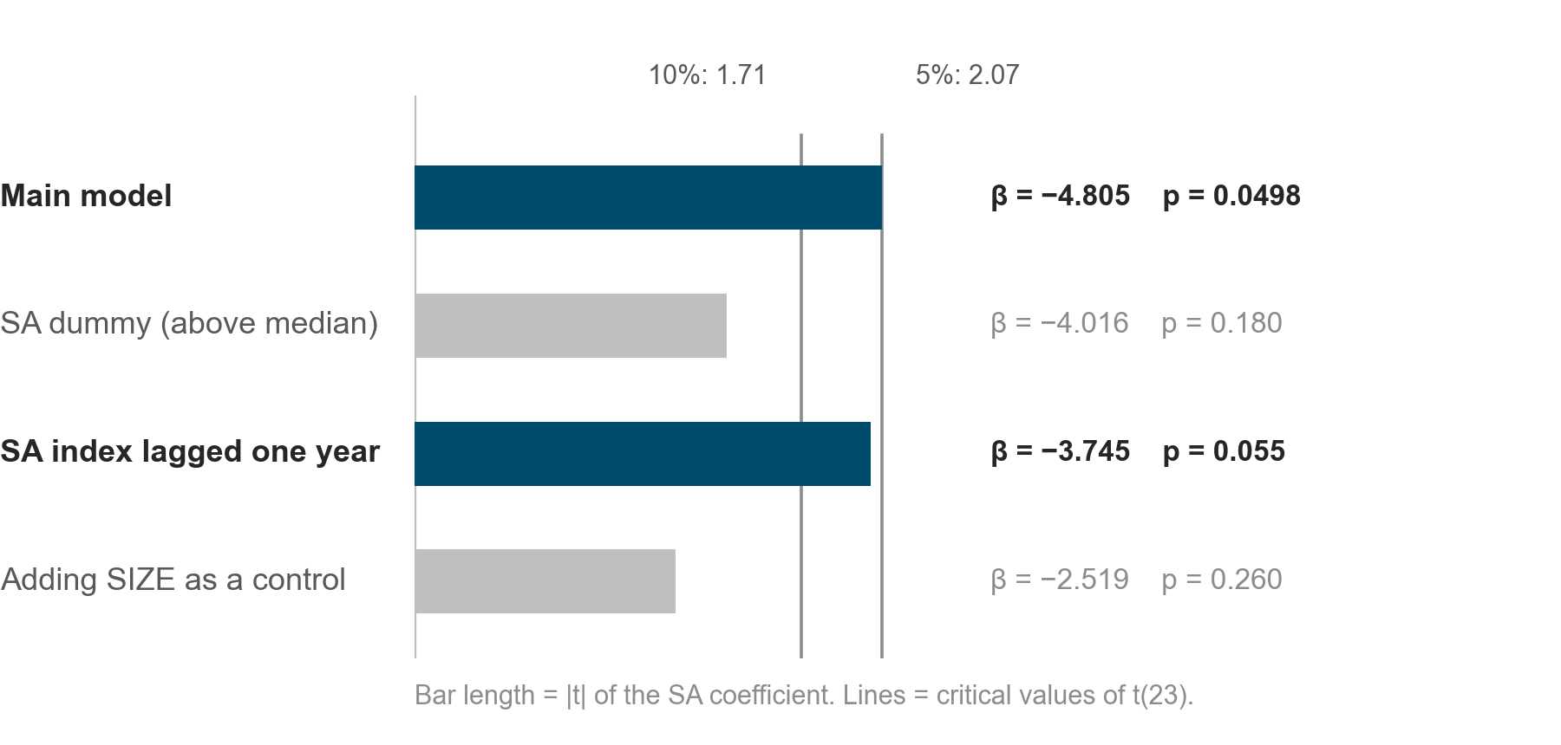
The sign holds in all four checks; only the main model (5%) and the lagged index (10%) are significant
ROBUSTNESS CHECKS
INTRODUCTION METHODS RESULTS DISCUSSION
SIZE
Adding it cuts SA to −2.519 (p = 0.260); SIZE is +2.222 (p = 0.231). SA and SIZE correlate at −0.59.
Lag
Constraints measured a year earlier also go with lower ESG (−3.745, p = 0.055), which eases reverse-causality concerns.
Source: TEJ; own calculations. Table 5 of the report. Critical values of t(23): 1.71 at 10%, 2.07 at 5%.
12 / 22
TAKEAWAY
The result does not flip sign anywhere, but it loses significance when firm size is added or the index is dichotomised.
Results, robustness (Table 5). Four checks with the same estimator and inference. The SA dummy (above the sample median) gives −4.016, p = 0.180; it keeps only the ordering around the median. The lagged index gives −3.745, p = 0.055, significant at 10%. Adding SIZE gives −2.519, p = 0.260: the standard error does not rise (2.181 against 2.320), the coefficient itself falls. SA is built from size and age, so part of the main result is shared with firm size and the two cannot be separated here. Next: which pillar drives it?
Notes:
Results, robustness (Table 5). Four checks with the same estimator and inference. The SA dummy (above the sample median) gives −4.016, p = 0.180; it keeps only the ordering around the median. The lagged index gives −3.745, p = 0.055, significant at 10%. Adding SIZE gives −2.519, p = 0.260: the standard error does not rise (2.181 against 2.320), the coefficient itself falls. SA is built from size and age, so part of the main result is shared with firm size and the two cannot be separated here. Next: which pillar drives it?

Slide 13
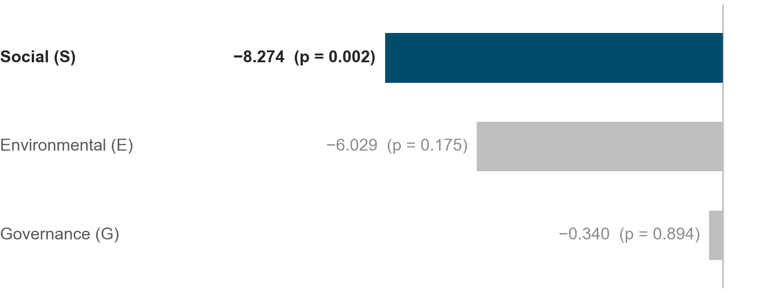
The association sits in the social pillar (−8.27, p = 0.002); E and G are not significant
E, S AND G PILLARS
INTRODUCTION METHODS RESULTS DISCUSSION
Leverage too
LEV on the social score: −13.439 (p = 0.021). More indebted firms also score lower on social performance.
Consistent
Cheng et al. (2014) and Chang et al. (2025) also find the social dimension among the most consistent links with constraints.
Read as suggestive: four scores are tested, and the pillar models use the main specification without a SIZE control.
Source: TEJ; own calculations. Table 6 of the report.
13 / 22
TAKEAWAY
Constrained firms look weakest on the social dimension, in line with earlier work, but the pillar result is suggestive.
Results, pillars (Table 6). The main model is re-estimated with each pillar score as the outcome. The SA coefficient is negative for all three, but only the social pillar is significant: −8.274 (p = 0.002), against −6.029 for E (p = 0.175) and −0.340 for G (p = 0.894). Four scores are tested in total and the pillar models do not control for SIZE, so this is evidence on where the effect sits, not a separate finding. Next: what the results mean.
Notes:
Results, pillars (Table 6). The main model is re-estimated with each pillar score as the outcome. The SA coefficient is negative for all three, but only the social pillar is significant: −8.274 (p = 0.002), against −6.029 for E (p = 0.175) and −0.340 for G (p = 0.894). Four scores are tested in total and the pillar models do not control for SIZE, so this is evidence on where the effect sits, not a separate finding. Next: what the results mean.

Slide 14
The result fits the discretionary-cost view and repeats the size sensitivity seen in earlier Taiwan work
INTERPRETATION
INTRODUCTION METHODS RESULTS DISCUSSION
Fits H1, the discretionary-cost view
Less constrained firms spend more on corporate goodness (Hong et al., 2012, p. 2), and higher ESG performance is most prevalent in larger firms with more resources (Gillan et al., 2021, p. 10).
Describes differences between firms
The random-effects estimate draws mainly on how firms with different constraint levels differ, not on how one firm’s ESG moves when its constraints change, as Hadlock and Pierce (2010, p. 1931) expect of the SA index.
Repeats the size sensitivity of earlier Taiwan work
Chang et al. (2025, p. 5) report a similar sensitivity of the SA index to firm size; here the coefficient falls from −4.805 to −2.519 once SIZE is added.
Points to the social dimension
In line with Cheng et al. (2014, p. 1), whose results are driven by the social and environmental dimensions, and with Chang et al. (2025, p. 6).
Sources: Hong et al. (2012); Gillan et al. (2021); Hadlock and Pierce (2010); Chang et al. (2025); Cheng et al. (2014). Sections 4.3 and 4.4 of the report.
14 / 22
TAKEAWAY
The negative sign is consistent with H1 and with the literature, but it is a statement about differences between firms.
Discussion, interpretation. The negative coefficient is what the discretionary-cost view of Hong et al. predicts, and Gillan et al. note that higher ESG performance is most prevalent in larger firms. Because the estimate draws mainly on differences between firms, it describes how firms with different constraint levels differ, as Hadlock and Pierce expect of the index. The sensitivity to firm size matches Chang et al., and the social pillar matches both Cheng et al. and Chang et al. The limits come next.
Notes:
Discussion, interpretation. The negative coefficient is what the discretionary-cost view of Hong et al. predicts, and Gillan et al. note that higher ESG performance is most prevalent in larger firms. Because the estimate draws mainly on differences between firms, it describes how firms with different constraint levels differ, as Hadlock and Pierce expect of the index. The sensitivity to firm size matches Chang et al., and the social pillar matches both Cheng et al. and Chang et al. The limits come next.

Slide 15
Read it as an association between firms, not as a causal effect of constraints on ESG
LIMITATIONS
INTRODUCTION METHODS RESULTS DISCUSSION
Size, or constraints?
Between firms, not within
SA is built from size and age. With SIZE added the coefficient falls to −2.519 (p = 0.260); the two cannot be separated in this sample (r = −0.59).
The fixed-effects estimate is +2.245 (SE 6.564). Random effects assumes firm traits are uncorrelated with the regressors, a strong assumption when SA is close to a function of size.
Few clusters
Data and causality
24 firms, so inference rests on few clusters. We use t(23) critical values, and p = 0.0498 sits right at the 5% line.
TESG for 2016–2020 was computed retrospectively in 2022; three W*-graded firms have no 2025 score; the firm list is TEJ’s current table. Estimates are associations: reverse causality is not resolved.
Source: TEJ; own calculations. Section 5 of the report.
15 / 22
TAKEAWAY
Four limits stop the result from being read as causal: size, between-firm identification, few clusters and data quirks.
Discussion, limitations. First, the SA index is close to a function of firm size, and the coefficient loses significance once SIZE is controlled. Second, the result is between firms: the fixed-effects estimate is +2.245 and random effects assumes firm traits are uncorrelated with the regressors. Third, 24 firms is few, and p = 0.0498 is right at the 5% line. Fourth, TESG for 2016–2020 was scored retrospectively, three firms lack a 2025 score, and the firm list is TEJ’s current table. Reverse causality remains a general difficulty in this literature.
Notes:
Discussion, limitations. First, the SA index is close to a function of firm size, and the coefficient loses significance once SIZE is controlled. Second, the result is between firms: the fixed-effects estimate is +2.245 and random effects assumes firm traits are uncorrelated with the regressors. Third, 24 firms is few, and p = 0.0498 is right at the 5% line. Fourth, TESG for 2016–2020 was scored retrospectively, three firms lack a 2025 score, and the firm list is TEJ’s current table. Reverse causality remains a general difficulty in this literature.

Slide 16
Constrained firms score lower on ESG, so low scores may partly reflect tight finance
CONCLUSION
INTRODUCTION METHODS RESULTS DISCUSSION
ANSWER TO THE RESEARCH QUESTION
IMPLICATIONS
Yes: firms with tighter financial constraints have lower ESG scores, supporting H1.
Within the food industry, ESG performance is weaker where financing is tighter, particularly on the social dimension
Investors and lenders that use ESG scores should know that low scores may partly reflect financial constraints, not only management choices
Policy that eases access to finance for smaller listed firms may support their sustainability performance
β = −4.805, p = 0.0498. ESG behaves as a discretionary cost rather than as a signal for access to finance (H2); the pattern is between firms and cannot be separated from firm size.
NEXT STEPS
Constraint measures less tied to size, such as the KZ and WW indices (Cheng et al., 2014; Chang et al., 2025)
A cross-industry sample of Taiwanese firms, to add clusters
Source: TEJ; own calculations. Section 5 of the report.
16 / 22
TAKEAWAY
H1 is supported as an association between firms; the next step is a constraint measure that is less tied to size.
Discussion, conclusion. The answer to the research question is yes, in the direction of H1: firms with tighter constraints have lower ESG scores, −4.805 points per unit of SA, p = 0.0498. For practice, ESG performance is weaker where financing is tighter, especially on the social dimension, so investors and lenders using ESG scores should know that low scores may partly reflect financial constraints. Future work could use constraint measures less tied to size, such as the KZ and WW indices, and a cross-industry sample with more clusters.
Notes:
Discussion, conclusion. The answer to the research question is yes, in the direction of H1: firms with tighter constraints have lower ESG scores, −4.805 points per unit of SA, p = 0.0498. For practice, ESG performance is weaker where financing is tighter, especially on the social dimension, so investors and lenders using ESG scores should know that low scores may partly reflect financial constraints. Future work could use constraint measures less tied to size, such as the KZ and WW indices, and a cross-industry sample with more clusters.

Slide 17
A. TESG averages 60.5 (SD 9.2) and the SA index is negative in all 219 observations
DESCRIPTIVE STATISTICS
APPENDIX
 | N | Mean | SD | Min | Median | Max
Panel A: Model 1 variables
TESG score | 219 | 60.547 | 9.227 | 36.239 | 61.850 | 76.511
SA Index | 219 | −4.765 | 0.735 | −6.002 | −4.761 | −2.540
ROA | 219 | 0.056 | 0.049 | −0.071 | 0.051 | 0.217
LEV | 219 | 0.401 | 0.167 | 0.118 | 0.384 | 0.734
TQ | 219 | 1.452 | 0.658 | 0.759 | 1.246 | 3.587
GROWTH | 219 | 0.037 | 0.135 | −0.333 | 0.025 | 0.560
CASH | 219 | 0.115 | 0.089 | 0.002 | 0.099 | 0.413
Panel B: Other variables
E score | 219 | 61.061 | 15.049 | 30.806 | 62.330 | 85.325
S score | 219 | 64.343 | 10.825 | 38.857 | 66.410 | 85.098
G score | 219 | 56.192 | 9.285 | 30.927 | 56.290 | 72.616
SIZE (ln total assets, NTD thousand) | 219 | 16.250 | 1.310 | 13.623 | 16.059 | 20.283
Size (ln total assets, US$ million) | 219 | 5.924 | 1.311 | 3.269 | 5.757 | 9.943
Age (years) | 219 | 49.553 | 15.181 | 7.180 | 51.000 | 73.820
Source: TEJ; own calculations. Table 2 of the report; N = 219 firm-years, 24 TWSE-listed food firms, 2016–2025.
17 / 22
TAKEAWAY
The typical firm is mature (mean age about 50 years), earns a mean ROA of 5.6% and has leverage of 40% of assets.
Table 2 of the report. The SA index ranges from −6.002 to −2.540, negative for every observation, as it must be when Size is measured in US$ million. All variables except the SA index are winsorized at the 1st and 99th percentiles; the SA index is computed from winsorized Size and Age.
Notes:
Table 2 of the report. The SA index ranges from −6.002 to −2.540, negative for every observation, as it must be when Size is measured in US$ million. All variables except the SA index are winsorized at the 1st and 99th percentiles; the SA index is computed from winsorized Size and Age.

Slide 18
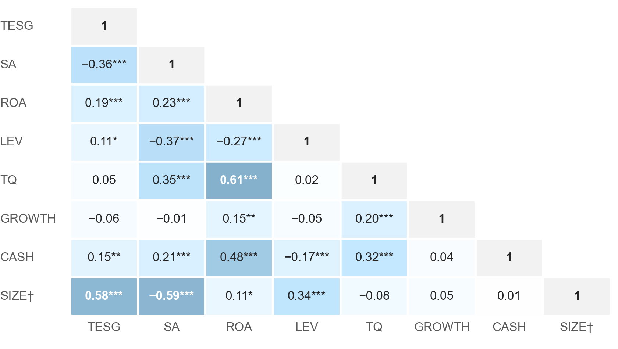
B. No pair of variables exceeds |r| = 0.7; SA and SIZE correlate at −0.59
CORRELATIONS AND VIF
APPENDIX
−0.59
SA and SIZE (ln total assets) are strongly negatively correlated: SIZE is a component of SA, so it is tested only in Model 2.
VIF ≤ 2.37
Largest VIF is 2.13 in Model 1 and 2.37 in Model 2 (ROA): multicollinearity is not a concern.
Source: TEJ; own calculations. Table 3 of the report. *** p<0.01, ** p<0.05, * p<0.1. † SIZE = ln(total assets), Model 2 only.
18 / 22
TAKEAWAY
Collinearity is low for the main model; SA and SIZE move together by construction.
Table 3 of the report. Pearson correlations over 219 firm-years; darker cells are stronger. TESG correlates with SA at −0.359 and with SIZE at 0.575. SIZE is not in Model 1 and appears here only because it is mechanically related to SA.
Notes:
Table 3 of the report. Pearson correlations over 219 firm-years; darker cells are stronger. TESG correlates with SA at −0.359 and with SIZE at 0.575. SIZE is not in Model 1 and appears here only because it is mechanically related to SA.

Slide 19
C. Hausman (p = 0.816) and Mundlak (p = 0.776) tests do not reject random effects
HAUSMAN AND MUNDLAK TESTS
APPENDIX
 | FE | RE | Difference | SE (FE) | SE (RE)
SA Index | 2.245 | −4.805 | 7.049 | 6.564 | 2.134
ROA | 1.048 | 3.995 | −2.947 | 11.231 | 10.922
LEV | −8.851 | −7.327 | −1.524 | 4.186 | 3.973
TQ | 0.793 | 0.851 | −0.058 | 0.887 | 0.863
GROWTH | −3.599 | −3.301 | −0.298 | 2.376 | 2.303
CASH | 7.329 | 8.713 | −1.384 | 6.464 | 6.170
Test | Statistic | df | p-value
Hausman (classic) | 2.94 | 6 | 0.816
Mundlak | 3.25 | 6 | 0.776
Both models include year dummies and use conventional covariance matrices, as the Hausman test requires, so the standard errors differ from the clustered ones in Table 4. The covariance difference is positive definite, so the statistic is valid.
Source: TEJ; own calculations. Appendix Table A3 of the report.
19 / 22
TAKEAWAY
Neither test finds evidence that firm effects are correlated with the regressors.
Appendix Table A3 of the report. The Mundlak test adds the firm means of the six regressors to the random-effects model and tests them jointly with firm-clustered standard errors; it does not require the covariance difference to be positive definite.
Notes:
Appendix Table A3 of the report. The Mundlak test adds the firm means of the six regressors to the random-effects model and tests them jointly with firm-clustered standard errors; it does not require the covariance difference to be positive definite.

Slide 20
D. Every variable is built from TEJ fields as defined here
VARIABLE DEFINITIONS
APPENDIX
Variable | Definition
TESG | TEJ TESG composite score (0–100), December rating merged to the year of the sustainability report it uses; winsorized 1%/99%
E, S, G | TEJ environmental, social and governance pillar scores (0–100), same timing as TESG; winsorized 1%/99%
Size | ln of total assets in US$ million, converted at each year’s average USD/NTD rate; winsorized 1%/99%
Age | Observation year minus founding year; winsorized 1%/99%
SA Index | −0.737 × Size + 0.043 × Size² − 0.040 × Age, from winsorized Size and Age (Hadlock & Pierce, 2010)
SA dummy | 1 if SA is above the pooled sample median, 0 otherwise
ROA | Consolidated net income after tax / total assets
LEV | Total liabilities / total assets
TQ | (Market capitalisation + total liabilities) / total assets
GROWTH | (Revenue t − Revenue t−1) / Revenue t−1, within firm
CASH | Cash and cash equivalents / total assets
SIZE | ln of total assets in NTD thousand; Model 2 only; winsorized 1%/99%
Source: TEJ; own calculations. Appendix Table A2 of the report (TEJ field names are listed there).
20 / 22
TAKEAWAY
All financial data are annual, consolidated, in NTD thousand; the TEJ field behind each variable is listed in the report.
Appendix Table A2 of the report. Debt is defined as total liabilities in both LEV and TQ. Winsorizing cutoffs are the 1st and 99th percentiles of the 219-row sample; for Size and Age the same cutoffs are applied to the 2015 rows used as lag inputs.
Notes:
Appendix Table A2 of the report. Debt is defined as total liabilities in both LEV and TQ. Winsorizing cutoffs are the 1st and 99th percentiles of the 219-row sample; for Size and Age the same cutoffs are applied to the 2015 rows used as lag inputs.

Slide 21
E. The 24 sample firms: 19 have ten observations, 3 have nine and 2 enter only in 2025
SAMPLE FIRMS
APPENDIX
Code | Firm | Founded | TWSE listing | Firm-years
1201 | WEI CHUAN | 1953 | 1962 | 10
1203 | Ve Wong | 1959 | 1964 | 10
1210 | GREATWALL | 1960 | 1978 | 10
1213 | Oceanic Bev. | 1965 | 1981 | 10
1215 | CPE | 1977 | 1987 | 10
1216 | Uni-President | 1967 | 1987 | 10
1217 | AGV | 1971 | 1989 | 10
1218 | Taisun | 1950 | 1989 | 9
1219 | FWUSOW | 1955 | 1990 | 9
1220 | Tairoun | 1969 | 1991 | 10
1225 | FOPCO | 1986 | 1993 | 9
1227 | SFC | 1986 | 1994 | 10
Code | Firm | Founded | TWSE listing | Firm-years
1229 | LHIHC | 1955 | 1976 | 10
1231 | Lian Hwa Foods | 1970 | 1995 | 10
1232 | TTET | 1982 | 1996 | 10
1233 | Ten Ren | 1975 | 1999 | 10
1234 | HEY SONG | 1969 | 1999 | 10
1235 | ST | 1972 | 2000 | 10
1236 | Hunya | 1976 | 2001 | 10
1256 | Sunjuice | 2010 | 2016 | 10
1702 | Namchow | 1950 | 1973 | 10
1737 | Taiyen | 1995 | 2003 | 10
7780 | Daiken | 2018 | 2025 | 1
7791 | Lucky Royal | 1986 | 2025 | 1
Source: TEJ; own calculations. Appendix Table A1 of the report. Founded = year of establishment (used for Age).
21 / 22
TAKEAWAY
The firm list comes only from the TEJ query; nobody was picked by hand.
Appendix Table A1 of the report. Firms 1218, 1219 and 1225 have nine observations because they carry no TESG score in 2025; firms 7780 and 7791 listed on the TWSE in 2025 and contribute one observation each.
Notes:
Appendix Table A1 of the report. Firms 1218, 1219 and 1225 have nine observations because they carry no TESG score in 2025; firms 7780 and 7791 listed on the TWSE in 2025 and contribute one observation each.

Slide 22
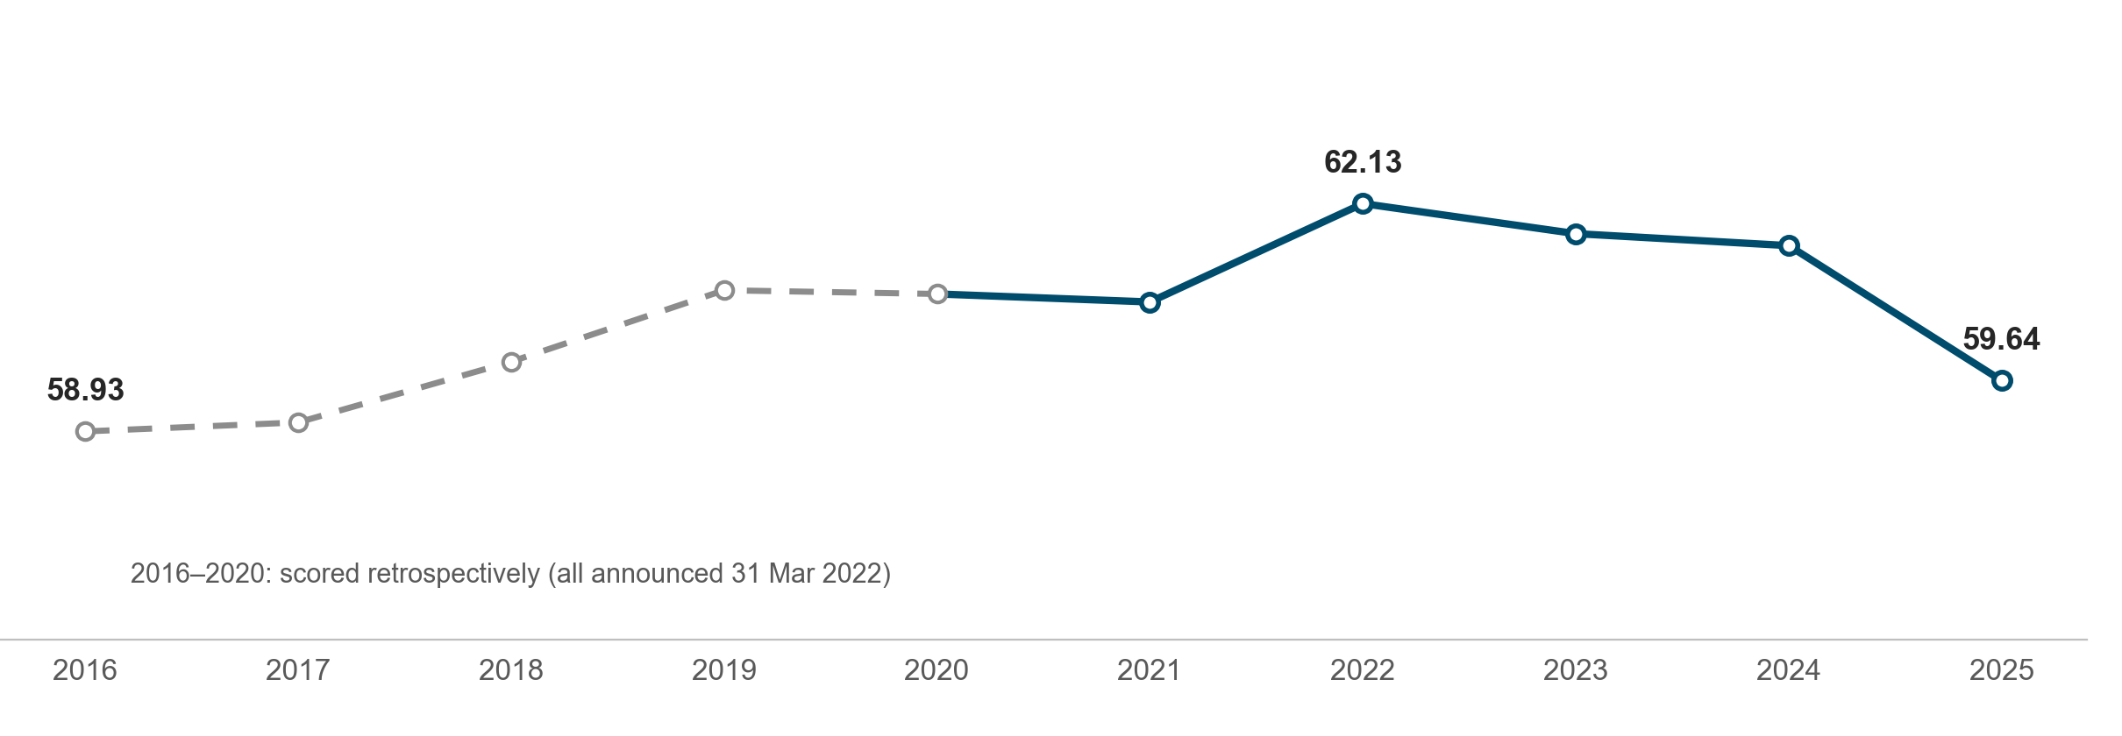
F. Average TESG rose to 62.1 by 2022 and fell back to 59.6 in 2025; scores before 2021 are retrospective
TESG OVER TIME
APPENDIX
Source: TEJ; own calculations. Section 4.1 of the report; outputs/tables/eda_by_year.csv, eda_tesg_announcement.csv.
22 / 22
TAKEAWAY
TESG moves slowly, and the 2025 average falls partly because the three W*-graded firms are absent.
Mean TESG score (winsorized) by data year. It rises from 58.93 in 2016 to 62.13 in 2022 and stands at 59.64 in 2025, when three W*-graded firms are absent. Ratings for data years 2016–2020 all carry the same announcement date, so they were computed retrospectively after TESG launched.
Notes:
Mean TESG score (winsorized) by data year. It rises from 58.93 in 2016 to 62.13 in 2022 and stands at 59.64 in 2025, when three W*-graded firms are absent. Ratings for data years 2016–2020 all carry the same announcement date, so they were computed retrospectively after TESG launched.

