Slide 1
FY2024 performance review
UniSweet Leadership and Finance Business Partners
Prepared from Sales, P&L and Market data | FY2024 versus FY2023
Source: outputs/sales_master.csv, P&L Table.xlsx and Market Report MAT Nov'24.xlsx
Notes:
This pack is built to be read without me. Every slide states its conclusion in the title, and the reasoning sits underneath it.
[Sources]
- outputs/sales_master.csv, P&L Table.xlsx and Market Report MAT Nov'24.xlsx

Slide 2
THE ROUTE
The argument runs in six steps, and the answer comes first
1. How bad is it? — the three topline KPIs
2. Did the market do this to us? — category and segment growth
3. Where exactly did it break? — the channel, then one brand inside it
4. Why did PBO still rise? — marketing and supply chain cost by brand
5. What is left to grow? — COBALT and SKY against their own markets
6. What we are asking for — three gated actions, owners named
Source: outputs/sales_master.csv, P&L Table.xlsx and Market Report MAT Nov'24.xlsx
Notes:
Six questions, six exhibits. Read the titles alone and you have the argument.
Questions 1 and 2 establish how serious this is and whose problem it is. Questions 3 and 4 locate the damage and explain the profit result. Questions 5 and 6 are what we do about it.
[Sources]
- outputs/sales_master.csv, P&L Table.xlsx and Market Report MAT Nov'24.xlsx

Slide 3
THE ANSWER, UP FRONT
Profit rose, but the business did not get healthier
Topline and share fell. Lower spend alone protected PBO.
Restore profitable growth without giving back the protected profit.
Source: outputs/sales_master.csv, P&L Table.xlsx and Market Report MAT Nov'24.xlsx
Notes:
Every favourable line in this year's P&L is a cost line.
I am leading with the conclusion rather than walking you through the analysis. The €15.5m taken out of marketing is larger than the €10.3m of Gross Profit lost — that gap, and nothing about demand, is why PBO is up.
[Sources]
- outputs/sales_master.csv, P&L Table.xlsx and Market Report MAT Nov'24.xlsx

Slide 4
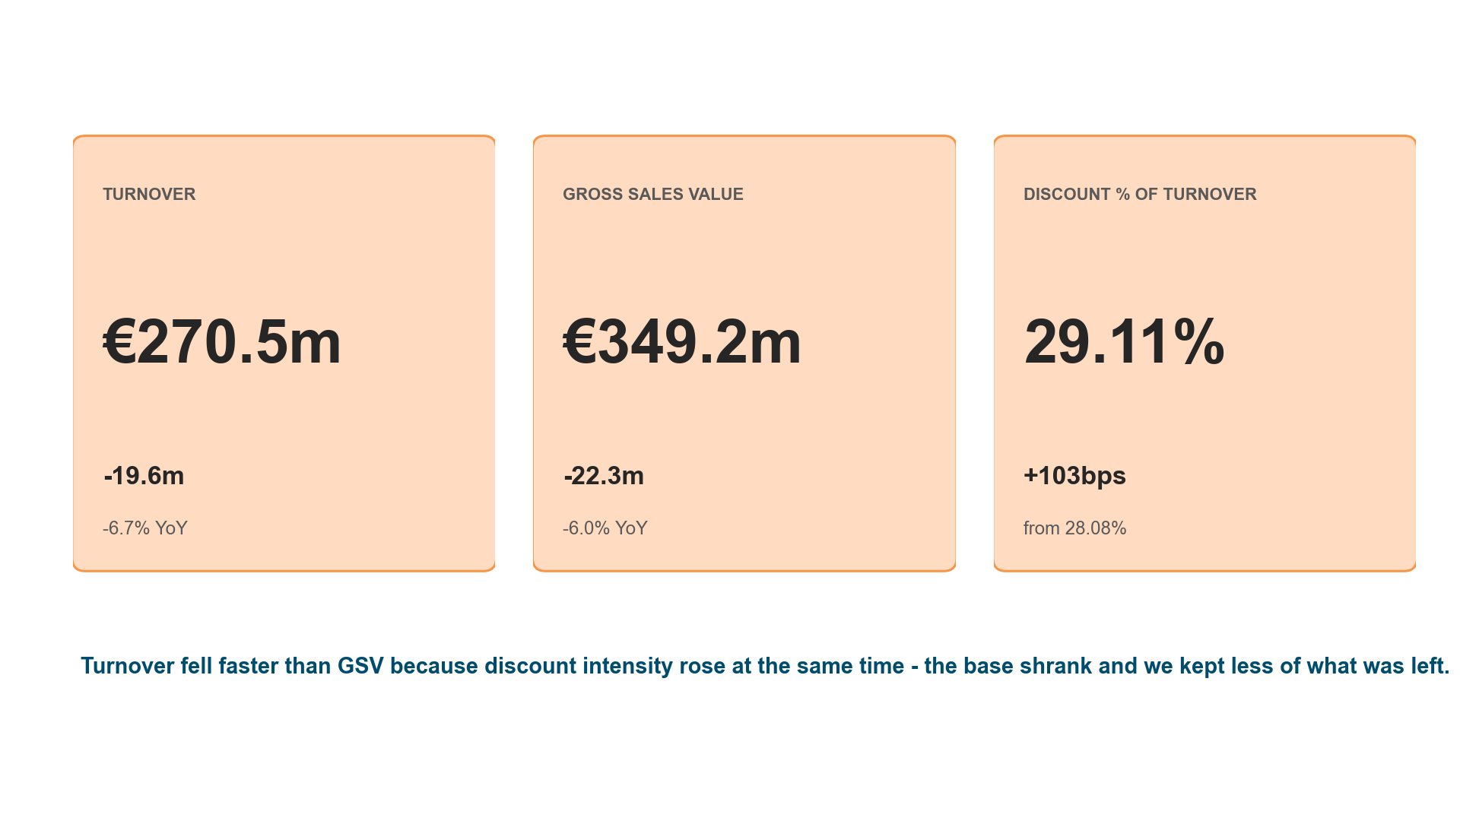
WHERE WE ENDED UP | 1 OF 6
Every topline KPI moved against us in FY2024
FY2024 versus FY2023
Source: P&L Table.xlsx and outputs/sales_master.csv | Discount is stated on Turnover, the P&L convention; on GSV the same movement reads 21.93% to 22.55% (+62bps)
Notes:
Three KPIs, three adverse moves — and the discount rate made the last one worse.
Turnover fell €19.6m and GSV €22.3m. Turnover fell the faster of the two because discount on Turnover rose 103bps at the same time.
[Sources]
- P&L Table.xlsx and outputs/sales_master.csv | Discount is stated on Turnover, the P&L convention; on GSV the same movement reads 21.93% to 22.55% (+62bps)

Slide 5
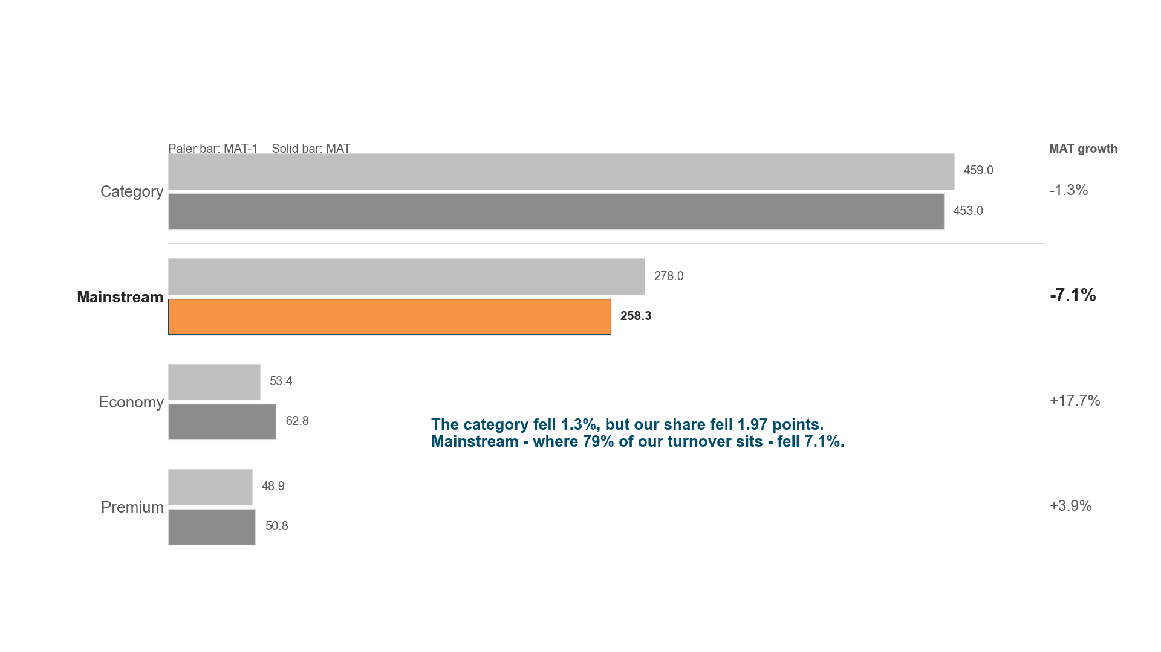
DID THE MARKET DO THIS TO US? | 2 OF 6
The category barely moved; Mainstream is where the value went
Market sales value, EURm | MAT Nov'24 versus MAT-1
Source: Market Report MAT Nov'24.xlsx | Segment rows sum the named brands only, which cover 82.9% of Category; Category is the file's own total, not their sum
Notes:
No. The category fell 1.3% and we fell 4.3% — the gap is ours to explain.
Economy grew 17.7% and Premium 3.9%. The decline is Mainstream, which is where 79% of our turnover sits, and where we gave back 2.98 share points.
[Sources]
- Market Report MAT Nov'24.xlsx | Segment rows sum the named brands only, which cover 82.9% of Category; Category is the file's own total, not their sum

Slide 6
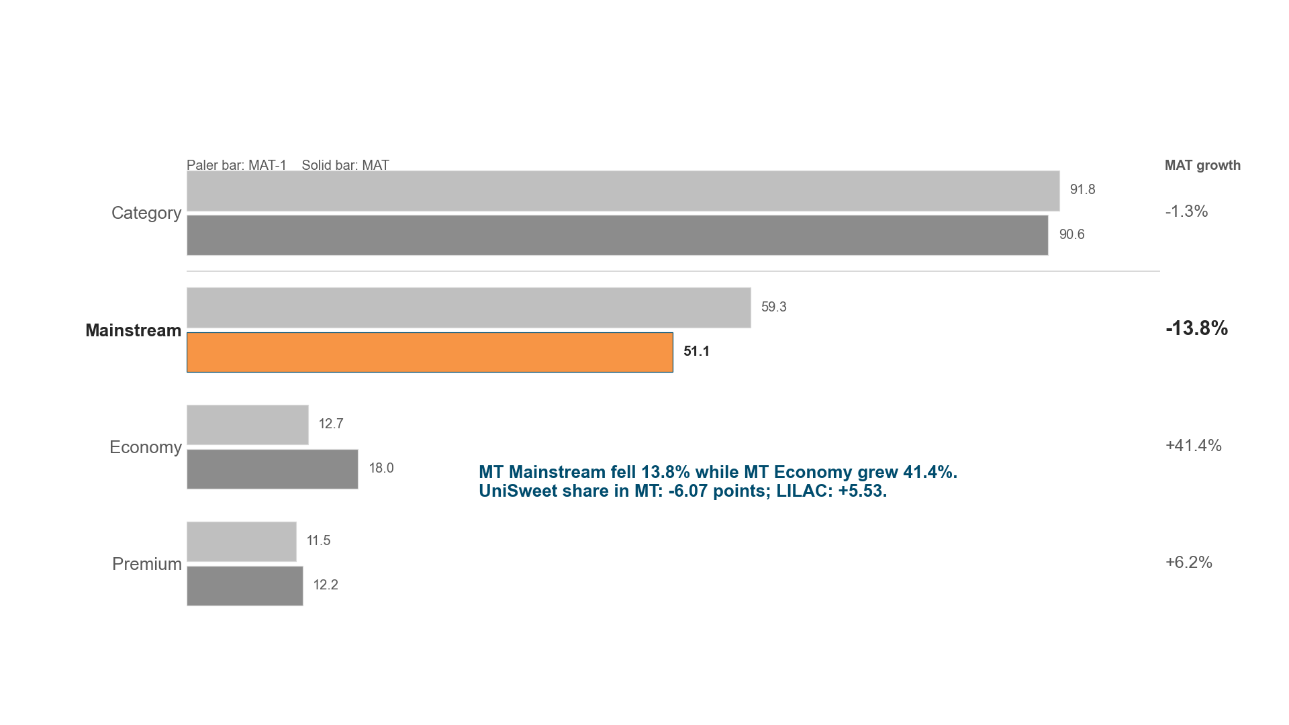
WHERE DID IT BREAK? | 3 OF 6
In Modern Trade the same category decline cost us six share points
Market sales value, EURm | Modern Trade only
Source: Market Report MAT Nov'24.xlsx | Category growth is identical (-1.3%) at Total, DT and MT - the source scales it proportionally, so this row repeats page 2 by construction
Notes:
Modern Trade. Same category decline, six times the share loss.
MT Mainstream fell 13.8% while MT Economy grew 41.4%, most of it LILAC at +5.53 points. DT lost only 0.28 share points against MT's 6.07.
[Sources]
- Market Report MAT Nov'24.xlsx | Category growth is identical (-1.3%) at Total, DT and MT - the source scales it proportionally, so this row repeats page 2 by construction

Slide 7
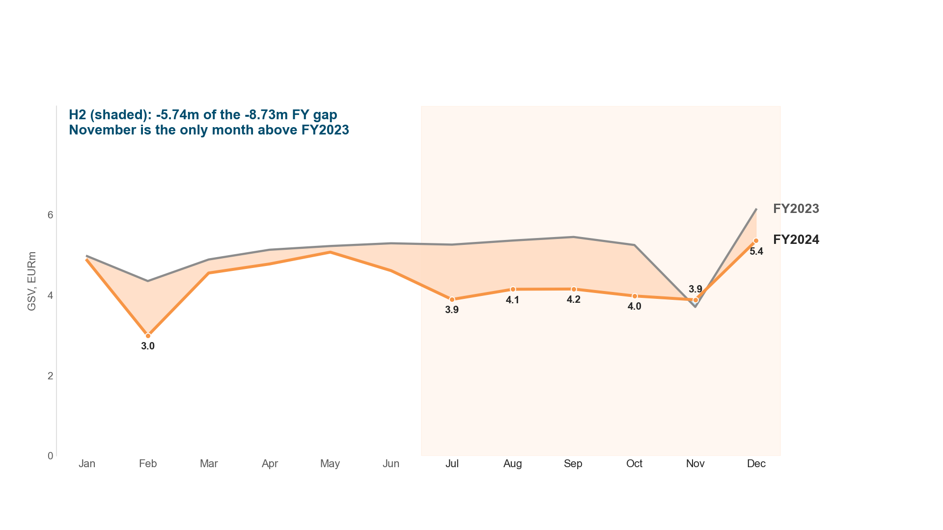
WHERE DID IT BREAK? | 4 OF 6
OLIVE in MT lost €8.73m of GSV, two thirds of it after June
OLIVE gross sales value in Modern Trade, EURm per month
Source: outputs/sales_master.csv | Internal sell-in GSV on the raw reporting base; monthly weakness does not by itself establish seasonality
Notes:
A second-half problem in one brand and one channel — which narrows the fix.
H1 was down €2.99m, H2 down €5.74m. November is the only month above FY2023. Monthly sell-in does not by itself establish seasonality.
[Sources]
- outputs/sales_master.csv | Internal sell-in GSV on the raw reporting base; monthly weakness does not by itself establish seasonality

Slide 8
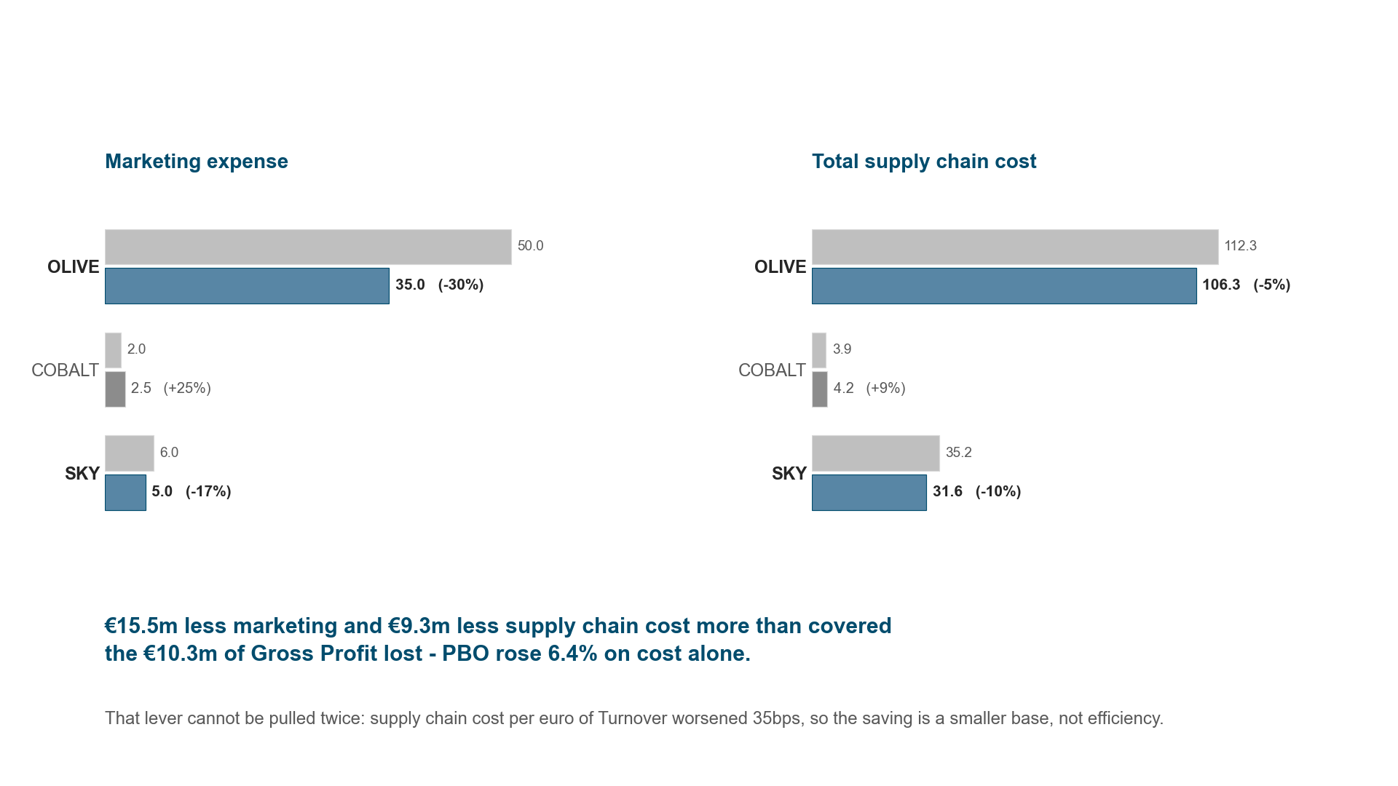
WHY DID PBO STILL RISE? | 5 OF 6
Profit held because we spent less, not because we sold more
Marketing expense and total supply chain cost, EURm
Source: P&L Table.xlsx | Marketing and supply chain cost are P&L assumptions stated in the source workbook, not measured spend
Notes:
PBO protection is cost-led. It is repeatable once, maybe twice.
OLIVE marketing fell 30% and supply chain 5%. Supply chain cost per euro of Turnover still worsened 35bps, so this is a smaller base, not efficiency.
[Sources]
- P&L Table.xlsx | Marketing and supply chain cost are P&L assumptions stated in the source workbook, not measured spend

Slide 9
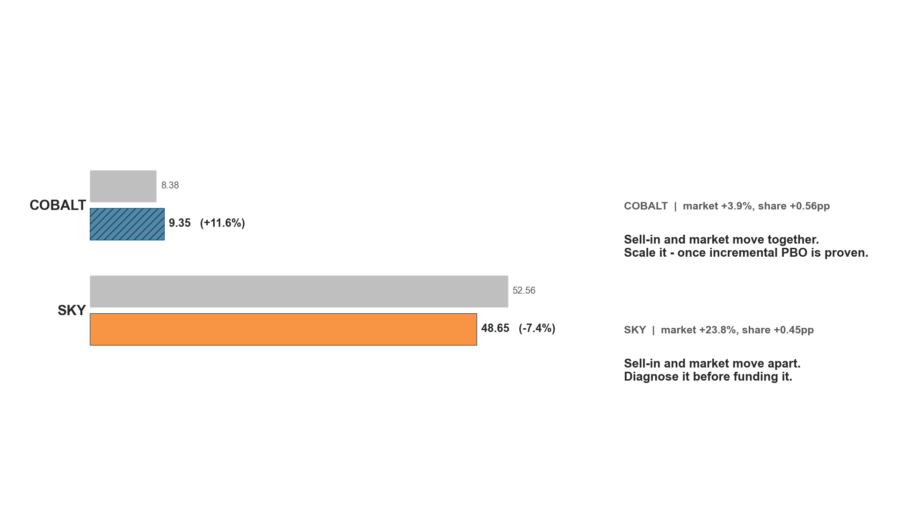
WHAT IS LEFT TO GROW? | 6 OF 6
COBALT is compounding; SKY is losing sell-in into a market that grew 23.8%
Turnover, EURm | Against each brand's own market
Source: P&L Table.xlsx and Market Report MAT Nov'24.xlsx | Internal Turnover is FY sell-in; market value is MAT Nov'24 sell-out - different periods and different measures
Notes:
One brand to scale on evidence, one to diagnose before funding.
COBALT grew 11.6% against a market up 3.9% and gained 0.56 share points. SKY fell 7.4% while its market grew 23.8% — reconcile that before spending.
[Sources]
- P&L Table.xlsx and Market Report MAT Nov'24.xlsx | Internal Turnover is FY sell-in; market value is MAT Nov'24 sell-out - different periods and different measures

Slide 10
THE ASK
Approve the three week-0 gates today
ACTION 1 · SALES HEAD
Approve the OLIVE × Modern Trade recovery baseline and its customer × SKU economics, weeks 0-2.
ACTION 2 · SALES HEAD
Approve classifying trade spend into keep, test, redesign or stop before any budget is restored.
ACTION 3 · FINANCE HEAD
Agree scale funding is released only after positive incremental Gross Profit — COBALT first, SKY only after diagnosis.
IF WE DO NOTHING
The marketing lever cannot be pulled twice; FY2025 PBO carries the full topline decline.
Source: references/domain/calls-to-action-by-audience.md
Notes:
Restore profitable growth without giving back the protected PBO.
Each action has a first gate rather than a budget, so the decision today is to start, not to spend. Owners are named and the KPIs are already defined.
[Sources]
- references/domain/calls-to-action-by-audience.md

Slide 11
APPENDIX | HOW TO READ THIS PACK
Sources, definitions and what this analysis does not claim
INTERNAL SALES
outputs/sales_master.csv — every row retained, so GSV, Discount and TO tie exactly to the P&L
P&L
inputs/pnl/P&L Table.xlsx. Marketing and supply chain cost are stated assumptions, not measured spend
MARKET
inputs/market/Market Report MAT Nov'24.xlsx — MAT sell-out, a different clock from internal FY sell-in
TWO LIMITS WORTH STATING
Segment rows sum named brands only (82.9% at Total, 90.9% in MT); category growth is identical in every channel
NOT CLAIMED
Discount movement is not causality. Lower cost is not efficiency. SKY's divergence is a question.
Source: STORYLINE_METRIC_FRAMEWORK.md and visualisations.ipynb
Notes:
These are the qualifications I would give verbally, written down because this pack will be read without me. Every chart has a matching CSV in outputs/report_visuals/data/.
[Sources]
- STORYLINE_METRIC_FRAMEWORK.md and visualisations.ipynb

