Slide 1
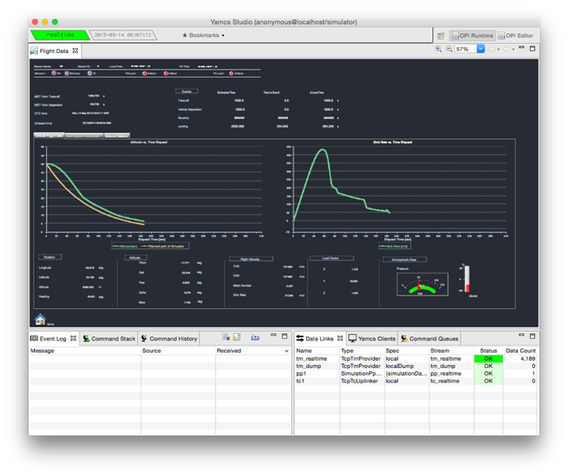
1.
Processor
Info
2. Perspective
Switcher
3.
Display Tabs
4.
Display
Zoom
5.
Operator
Displays
6.
Built-in
Displays
(aka Views)

Slide 2
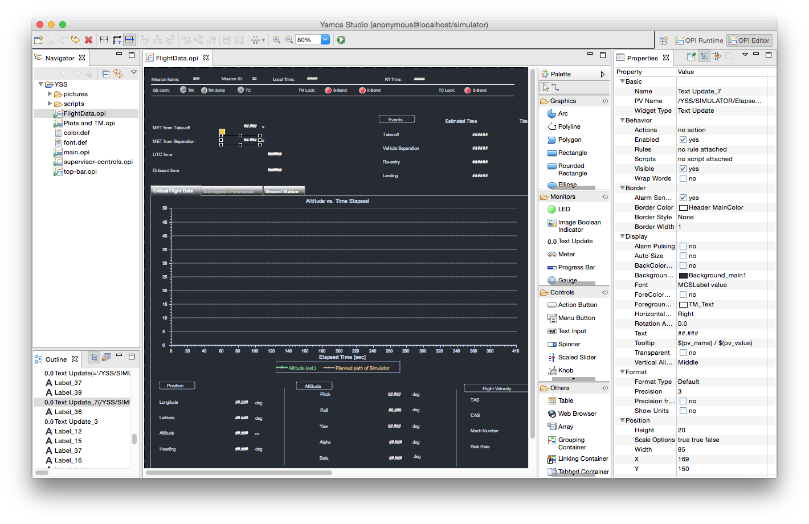
4. Toolbar
1.
Navigator
5.
Widget Properties
2.
Editor Area
3.
Display Outline
6.
Palette of Widgets

