Slide 1
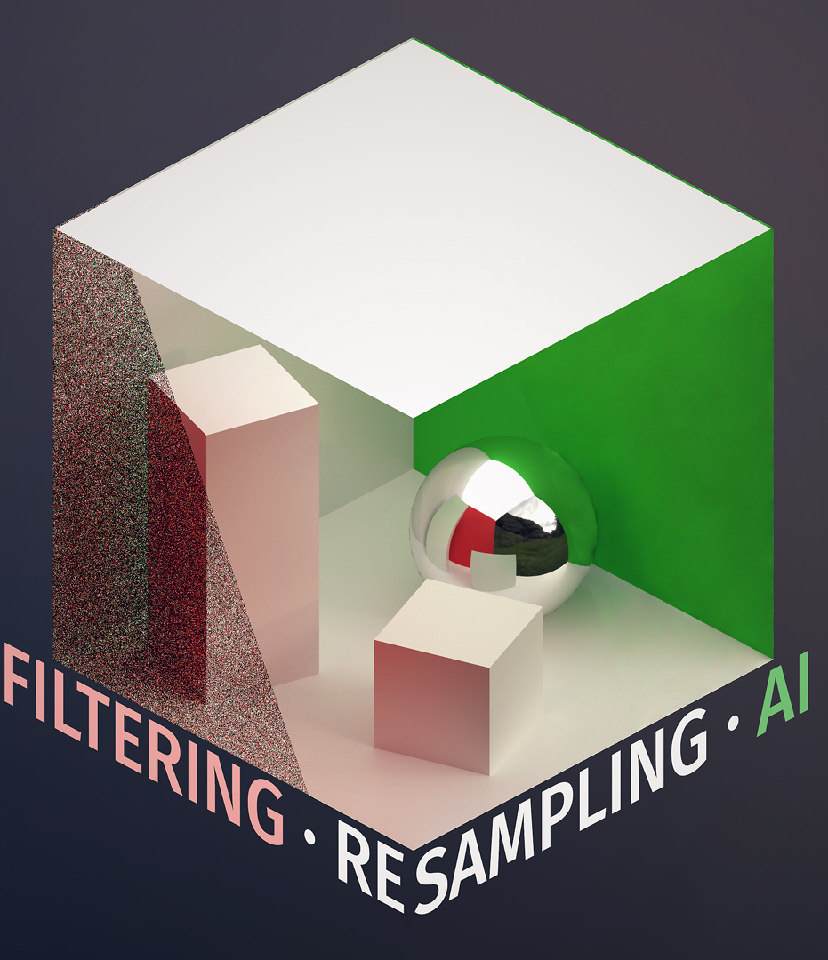
REAL TIME DENOISING WITH DL
Ryan Tong, Tom Donnelly, Shixuan Fang
Advised by Liam Dugan

Slide 2
PROJECT OVERVIEW
01
02
03
04
05
06
Implement
Integrate
Expand
Implement a deep learning based denoiser in CUDA with cuDNN
Integrate CUDA denoiser into Path-Tracer/Denoiser assignment
Expand Path-Tracer/Denoiser to be temporal/real time
Integrate
Fine Tune
Time Permitting…
Integrate CUDA denoiser to denoise in real time path-tracer
Fine tune denoiser model and optimize for run time as needed
Add resolution upscaling model or 2-in-1 model

Slide 3
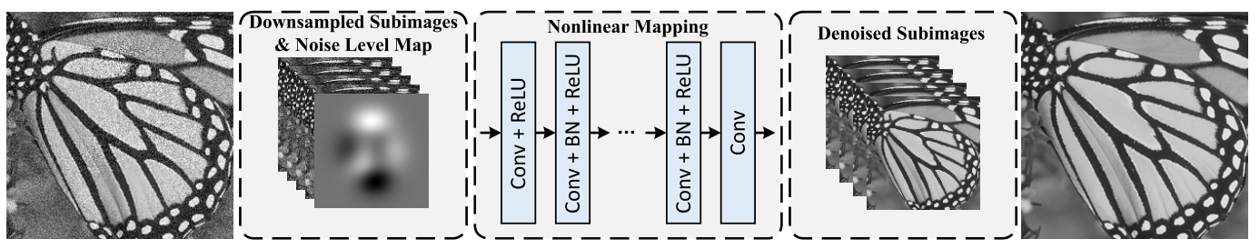
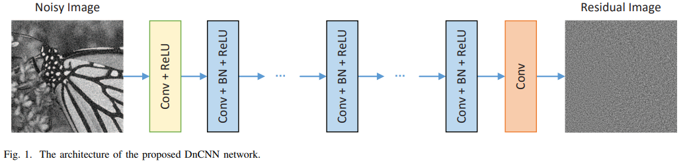
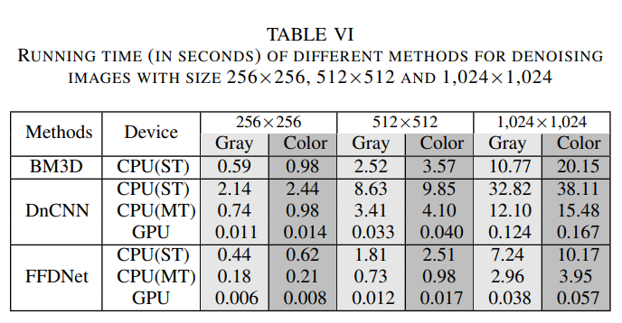
METHOD OVERVIEW
FFDNET: Fast, Flexible Denoising Net
DNCNN: Denoiser CNN
Both achieve close to SOTA on denoising benchmarks
Real time capabilities
Simple (relatively) from a DL perspective
FFDNet is built upon DnCNN and thus is more complicated (same authors)
Adds downsampled subimages and noise level map
DnCNN learns the noise to be removed
First choice is FFDNet, fallback is DnCNN

Slide 4
OUTSIDE RESOURCES
Model papers and code repos
TensorRT & ONXX
PyTorch
(pretrained models)
To convert trained models
For any fine-tuning / training necessary
cuBLAS & cuDNN
Project 3-4 from class

Slide 5
TIMELINE
MILESTONE 1
Be able to load pretrained models into CUDA
Finish path tracing framework with mesh loading, textures, etc
MILESTONE 2
Be able to run an inference of model in CUDA on path-traced image
Finalize path tracing framework to support denoising in real time
Evaluate performance of model both in runtime and denoising quality
MILESTONE 3
Optimize performance to meet real time performance
Fine tune model (if needed) on images from path-tracer
FINAL DEADLINE
Polish assignment, README etc
Finalize code and model

Slide 6
REFERENCES
FFDNet
https://arxiv.org/pdf/1608.03981.pdf (paper)
https://github.com/cszn/FFDNet (author repo)
Https://github.com/LucasElbert/FFDNet (repo with trained model)
DnCNN
https://arxiv.org/pdf/1608.03981.pdf (paper)
https://github.com/cszn/DnCNN (author repo) https://github.com/LabForComputationalVision/bias_free_denoising/tree/master/pretrained/dncnn/bias (repo with trained model)
https://alain.xyz/blog/ray-tracing-denoising(from slides)

