Slide 1
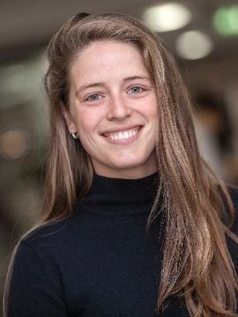
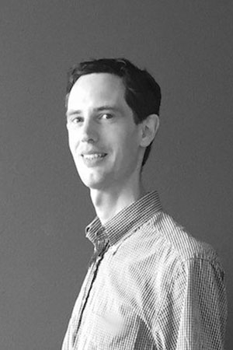
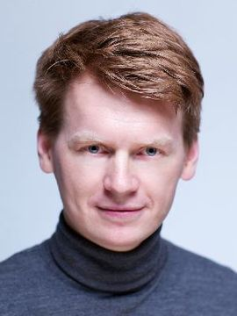
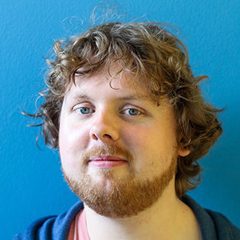
Engineering with AI Minor Capstone meeting
August 4, 2021
Tom Viering
Neeltje van Roessel
Neil Yorke-Smith
Przemek Pawelczak

Slide 2
Agenda
Open the padlet https://bit.ly/2RzS4KN
Highlights of document in 15 min
Please save questions, comments; discussion for afterward
During talk: fill in padlet with questions, comments, thoughts
Questions, feedback, discussion guided by padlet (15 min)
Check interest and (optionally) plan a follow up meeting for more help to develop projects proposals

Slide 3

Capstone Applied AI project
AI minor: Engineering with AI
Bsc students from any faculty can enroll
30 EC
Q1 & Q2 (sept-jan)
Pilot year 2021-2022, 100 students
Capstone Applied AI project
Apply knowledge of AI minor in a group project in the field of the major program
Example: physics student combines physics with AI
AI minor
Capstone project (10EC)
Q2
Intro to
Machine Learning
Algorithms and
Data Structures
Intro to AI & Responsible AI
Q1
Intro to Python
More info on the minor: https://www.tudelft.nl/ewi/studeren/minoren/engineering-with-ai
Study guide has been published, see: https://studiegids.tudelft.nl/a101_displayProgram.do?program_tree_id=27617

Slide 4
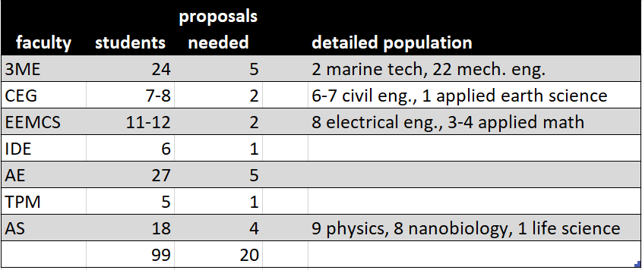
Students origins
5 students per group (4-6 to accommodate student population)
In project proposal: state which students (major) are allowed to join your project
Usually: only students from your own faculty (e.g. physics bachelor student will do physics project)
Interfaculty projects: OK, but first priority are within faculty project proposals
We need to make sure that all students in each faculty can find a suitable project from their own major
Example: avoid that a physics student needs to do an IDE project because there are not enough physics projects

Slide 5
Why participate?
Build a relation with (potential) MSc students
Student output may be useful for your research
In this prototype year we need your help to improve the course!

Slide 6
What we need from you
Suggestion:
PhD student supervises project, postdoc / staff formulate proposals
One supervisor per project
This can be a PhD, postdoc, staff
Ideally: has knowledge of domain of faculty and AI. If problematic: consider 2 supervisors
Provides domain knowledge in weekly meeting (1h) and guide students to find the right AI formulation / techniques
Provides input, feedback for grading by course organizers
Total time per group: 20-25 hours
We offer TAs for help with the group process (planning, coding, coordination, reflection, …)
Project proposals

Slide 7
Project Proposal
Goal: align projects with research
Thus: much freedom to tailor the project proposal to your research interests
Timeline
Week 1.4 20 sept submit proposals to course organizers
Week 1.6 4 oct we provide feedback / advice on proposals
Week 1.7 11 oct final proposal submission, start student bidding
Week 2.1 8 nov capstone course starts, groups assigned

Slide 8
Mandatory components project
Use or analyze an AI technique; examples:
Use (learning) algorithm on a dataset
Theoretical analysis of algorithms
User study (explainable AI, fairness)
Build visualization
Investigate a provided model
Reproduce experiment from a published paper
Build something reproduceable
Reflect on ethics and impact
More examples in Appendix A

Slide 9
Out of scope proposals
These do not fit with this course:
Producing a research question (should be given)
A complete literature study
Only data collection or building software
Can be a part, but not only component
Implementing a paper from scratch (when no code is available) may be too demanding
See also Appendix A

Slide 10
Project Template
Background and project aim
MOSCOW analysis (preliminary)
Must Have, Should Have, Could Have, Won’t Have
Ethical aspects (HREC approval needed?)
Prerequisites (related to major)
Provided data by faculty member (optional)
Recommended libraries, tools, code
References
Completely worked out Twitter example in Appendix B

Slide 11
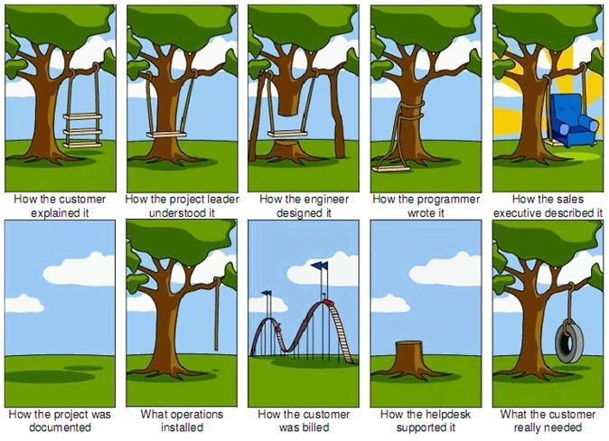
Requirements
Students discuss and negotiate with the supervisor to set their own requirements / goals
Requirements in project proposal not visible to students: you explains goals to group
Why?
Students learn to take a problem from major domain and frame it as an ‘AI problem’ with help of supervisor
Improve student understanding
Match students' capabilities and interest (motivation)
Students write project plan before start in week 3
Contains requirements in MOSCOW framework
Needs to be approved by supervisor before start (feasible?)

Slide 12
Assessment
If students do not meet all mandatory req.
They can still pass
Inform supervisor asap to negotiate new requirements
Reflection in report to compensate
Mandatory midterm presentation in W2.7
Signal: green / orange / red; red = danger of fail
Final presentation and report W2.10
No resit: complete redo next year
For more details see the document (rubric, learning objectives)

Slide 13

Timeline and deadlines
Project Proposals
Week 1.4 20 sept submit proposals to course organizers
Week 1.6 4 oct we provide feedback on proposals
Week 1.7 11 oct final proposal submitted, bidding starts
Capstone course
Week 2.1 8 nov course kickoff, groups assigned, students start on project plan,
supervisor provides the data described in project proposal
Week 2.3 22 nov students submit project plan, supervisor approves / reject, resubmit
Week 2.4 29 nov group work starts full time
Week 2.7 20 dec midterm presentations; supervisor provide feedback
Week 2.10 24 jan final presentations and final report due; supervisor provide feedback
Find an interested PhD student
Think about suitable projects
Contact me if you need help! t.j.viering@tudelft.nl

