Slide 1
Semantic Web Services
Research and Applications
Tomas Vitvar
DERI Galway, Ireland
Tomas Vitvar
firstname.lastname@deri.org
Talk at Ericsson Research
1st December 2006, Athlone, Ireland

Slide 2
Agenda
DERI Organization
Introduction to Semantic Web Services
Semantic Web Services in DERI
Standardizations and Applications

Slide 3
Agenda
DERI Organization
Introduction to Semantic Web Services
Semantic Web Services in DERI
Standardizations and Applications

Slide 4
DERI Organization – Vision and Focus
Vision:
„Make the Semantic Web and Semantic Web Services a reality and enabling fully flexible integration of information and services in both inter- and intra-enterprise integration settings“

Slide 5
DERI Organization – Structure
DERI Galway, Ireland
  National University of Ireland
  member of DERI International
DERI International
  Family of DERI Institutes
  DERI Institutes associated with Universities as legal entities
  Institutes:
    DERI Galway, Ireland (National University of Ireland)
    DERI Innsbruck, Austria (University of Innsbruck)
    DERI Stanford, USA (Stanford University)
    DERI Seoul, Korea (University of Seoul)
    DERI Milano, Italy (Milano University)

Slide 6
DERI Organization – DERI Galway
Research – Basic and Applied Research
  Semantic Web
  Semantic Web Services
  Distributed Systems and P2P Networks
Projects – Research and Development
  Science Foundation Ireland
  Enterprise Ireland
  EU FP6 -> FP7

Slide 7
DERI Organization – DERI Galway Projects
Semantic Web
  Semantic Desktop, Integration of Online Communities, Semantic Web Search Engine, Semantic WiKis, eLearning
Semantic Web Services
  Development of SWS Framework known as WSMO, WSML, WSMX
  Core SWS development
    Lion – Science Foundation Ireland
    KnowledgeWeb (FP6)
    DIP (FP6)
  Applications to:
    E-Government (SemanticGov project – FP6)
    E-Health (EI and FP6)
    E-Business and BPM (FP6)
    ...

Slide 8
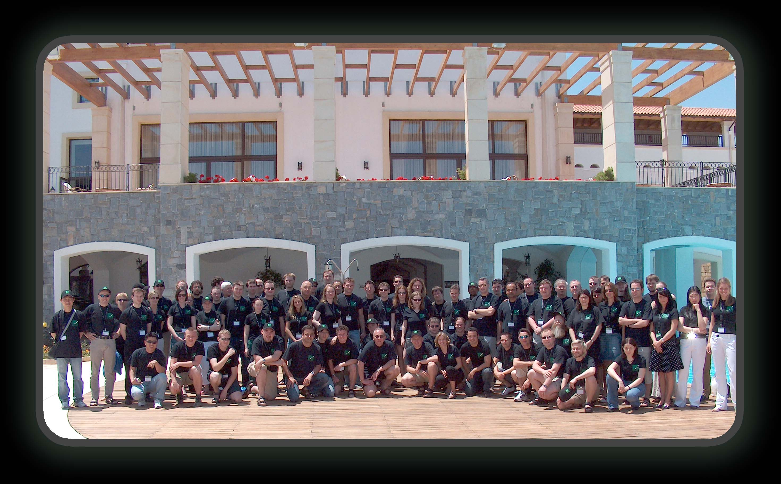
DERI Organization – DERI Team

Slide 9
Agenda
DERI Organization
Introduction to Semantic Web Services
Semantic Web Services in DERI
Standardizations and Applications

Slide 10







Semantic Web and Web Services
500 million user
more than 3 billion pages
WWW
URI, HTML, HTTP
Static

Slide 11

Semantic Web and Web Services
  Serious Problems in
  information finding,
  information extracting,
  Information representing,
  information interpreting and information maintaining.
WWW
URI, HTML, HTTP
Semantic Web
RDF, RDF(S), OWL
Static

Slide 12

Semantic Web and Web Services
Web Services
UDDI, WSDL, SOAP
Dynamic
  Bringing the computer back as a device for computation
WWW
URI, HTML, HTTP
Semantic Web
RDF, RDF(S), OWL
Static

Slide 13
Semantic Web and Web Services
  Bringing the Web to its full potential
Web Services
UDDI, WSDL, SOAP
Intelligent Web
Services
Dynamic
WWW
URI, HTML, HTTP
Semantic Web
RDF, RDF(S), OWL
Static

Slide 14
Semantic Web
The next generation of the WWW
Information has machine-processable and machine-understandable semantics
Not a separate Web but an augmentation of the current one
Ontologies as basic building block

Slide 15
Semantic Web – Ontology Definition
unambiguous terminology definitions
conceptual model of a domain (ontological theory)
Formal, explicit specification of a shared conceptualization
machine-readability with computational semantics
commonly accepted understanding

Slide 16
Semantic Web – Ontology Example
Concept
– Conceptual entity of a domain
Property
– Attributes describing a concept
Relation
– Relationships between concepts or properties
Axiom
– Coherency description between Concepts / Properties / Relations using logical expressions
name
email
Person
number
research
field
isA – hierarchy
(taxonomy)
Student
Professor
attends
holds
Lecture
lecture
nr.
topic
holds(Professor, Lecture) =>
Lecture.topic = Professor.researchField

Slide 17
Semantic Web – Ontology Technology
Ontology Languages:
  expressivity
  reasoning support
  web compliance
Ontology Management Techniques:
  editing and browsing
  storage and retrieval
  versioning and evolution Support
Ontology Integration Techniques:
  ontology mapping/aligning, merging

Slide 18
Web Services
Loosely coupled, reusable components
Encapsulate discrete functionality
Accessible over standard internet protocols

Slide 19
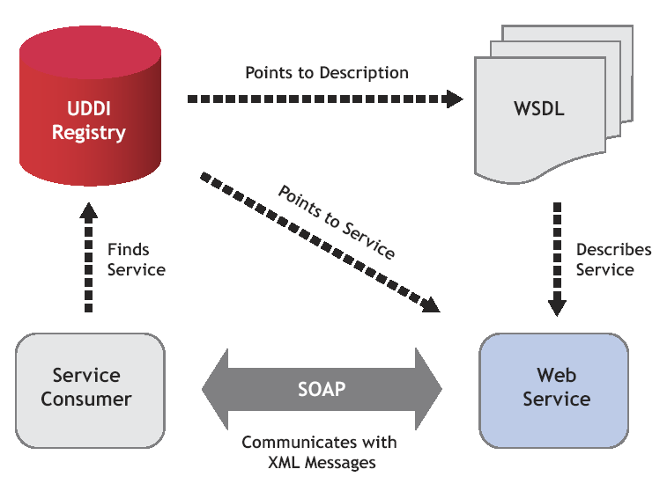
Web Services – Architecture

Slide 20
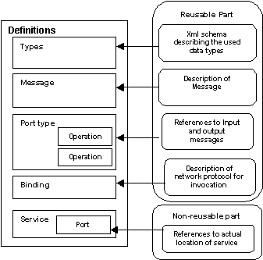
Web Services – WSDL
Web Service Description Language
W3C effort, WSDL 2.0

Slide 21
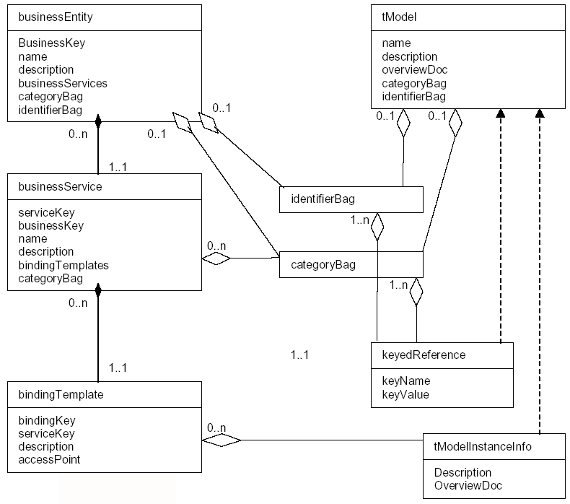
Web Services – UDDI
Universal Description, Discovery, and Integration Protocol
OASIS driven standardization effort
Information stored in UDDI
  White Pages
    Name of Business, Contact Information
    Description of the Company
  Yellow Pages
    Business Classification Information
    Based on NAICS, or Geographical Index
    List of Products (multiple entries)
  Green Pages
    Technical Information about services
    Example: business processes, binding info, etc.

Slide 22
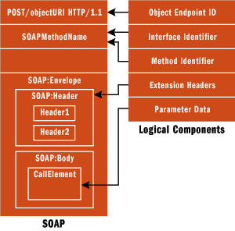
Web Services – SOAP
Simple Object Access Protocol
W3C Recommendation
XML Data Transport
  Sender <-> receiver
  Protocol Binding
  Communication Aspects
  Messages – content

Slide 23
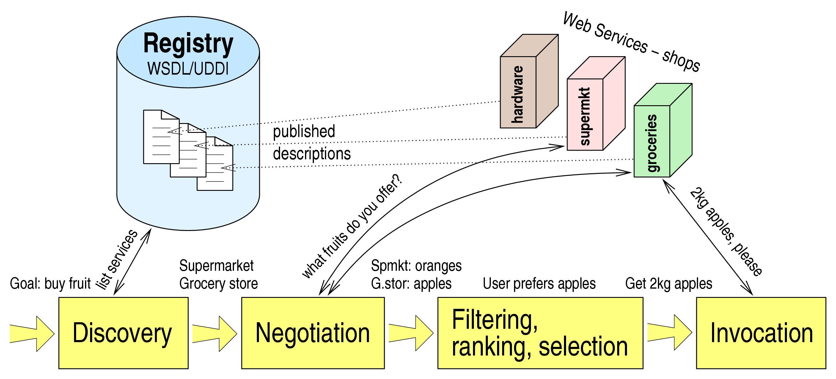
Web Services – Usage Process

Slide 24
Web Services – Difficulties
Only Syntactical Information Descriptions
  Syntactic support for discovery, composition and execution
  Web Service usage and integration needs to be supported manually
No Semantic mark-up for content and services
No support for Semantic Web

Slide 25
Semantic Web Services
Semantic Web Technology
+
Web Service Technology
allow machine supported data interpretation
ontologies as data model
messaging, invocation of services
security, etc.
=> Semantic Web Services as integrated solution for realizing the vision of the next generation of the Web

Slide 26
Semantic Web Services – New Layer
Knowledge
Representation
Semantic Web
Semantic Web Service Layer
WSMO
OWL-S
WSDL-S
…
grounding
Web Service Layer
WSDL
SOAP
UDDI
…

Slide 27
Semantic Web Services - Aspects
Service Model – framework for description of Web Services and related aspects (Service Ontology)
Ontologies as Information Model – support ontologies and make use of ontology languages for definition of underlying information model
Define semantically driven techniques for total or partial automation of the web service execution process

Slide 28
Agenda
DERI Organization
Introduction to Semantic Web Services
Semantic Web Services in DERI
  WSMO
Standardizations and Applications

Slide 29
WSMO – Scope
WSMO defines conceptual model for Semantic Web Services
  Ontology of core elements for Semantic Web Services
  Formally defined using WSML language
  Derived from the Web Service Modelling Framework (WSMF)
WSMO defines requirements for Web Service Modelling Language (WSML)
WSMO defines framework for architecture and execution environment (WSMX)
WSMO is developed as part of SWS Community in Europe

Slide 30




WSMO – Working Groups
A Conceptual Model for SWS
A Formal Language for WSMO
Execution Environment for WSMO
A Rule-based Language for SWS

Slide 31
WSMO – Design Principles
Web Compliance
Ontology-Based
Goal-driven
Centrality of Mediation
Execution Semantics

Slide 32
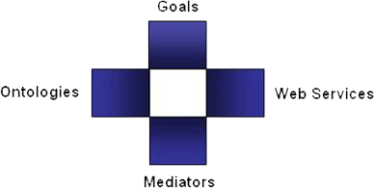
WSMO – Top Level Elements
Objectives that a client wants to
achieve by using Web Services
Provide the formally specified terminology
of the information used by all other components
Semantic description of Web Services:
Capability (functional)
Interfaces (usage)
Connectors between components with mediation facilities for handling heterogeneities
  WSMO D2, version 1.2, 13 April 2005 (W3C submission)

Slide 33
Non-Functional Properties
Every WSMO elements is described by properties that contain non-functional aspects of web services
Dublin Core Metadata Set
  Used for resource management
Versioning Information
  Evolution support
Quality of Service Information
  Availability of services, reliability
Other
  Owner, financial aspects, etc.

Slide 34
List of Non-functional Properties
Dublin Core Metadata
  Contributor
  Coverage
  Creator
  Description
  Format
  Identifier
  Language
  Publisher
  Relation
  Rights
  Source
  Subject
  Title
  Type
Quality of Service
  Accuracy
  NetworkRelatedQoS
  Performance
  Reliability
  Robustness
  Scalability
  Security
  Transactional
  Trust
Other
  Financial
  Owner
  TypeOfMatch
  Version

Slide 35
WSMO Ontologies
Objectives that a client wants to
achieve by using Web Services
Provide the formally specified terminology
of the information used by all other components
Semantic description of Web Services:
Capability (functional)
Interfaces (usage)
Connectors between components with mediation facilities for handling heterogeneities

Slide 36
WSMO Ontologies – usage and design principles
Ontologies are used as the ‘data model’ throughout WSMO
  all WSMO element descriptions rely on ontologies
  all data interchanged in Web Service usage are ontologies
  Ontology reasoning and semantic information processing
WSMO Ontology Language WSML
  conceptual syntax for describing WSMO elements
  logical language for axiomatic expressions (WSML Layering)
WSMO Ontology Design
  Modularization: import / re-using ontologies, modular approach for ontology design
  De-Coupling: heterogeneity handled by OO Mediators

Slide 37
WSMO Web Services
Objectives that a client wants to
achieve by using Web Services
Provide the formally specified terminology
of the information used by all other components
Semantic description of Web Services:
Capability (functional)
Interfaces (usage)
Connectors between components with mediation facilities for handling heterogeneities

Slide 38
WSMO Web Service Description
Complete item description
Quality aspects
Advertising of Web Service
Support for WS Discovery
Non-functional Properties
DC + QoS + Version + financial
Capability
functional description
client-service interaction interface for consuming WS
External Visible
Behavior
- Communication
Structure
- ‘Grounding’
realization of functionality by aggregating
other Web Services
functional
decomposition
interaction with
aggregated WS
Web Service
Implementation
(not of interest in Web Service Description)
WS
WS
WS
Choreography --- Service Interfaces ---
Orchestration

Slide 39
WSMO Web Service – Capability Specification
Non functional properties, Imported Ontologies, Used mediators
Preconditions
  what a web service expects in order to be able to provide its service (conditions over the input)
Assumptions
  conditions on the state of the world that has to hold before the Web Service can be executed
Postconditions
  Describes the result of the Web Service in relation to the input, and conditions on it
Effects
  conditions on the state of the world that hold after execution of the Web Service (i.e. changes in the state of the world)

Slide 40
WSMO Web Service – Interface Specification
Service Interface – consumption and interaction
  Choreography and Orchestration – described as sub-elements of WSMO Web Service Interface
  Formalism used: Abstract States Machines
  Grounding to WSDL
Choreography
  External Visible Behaviour of a Web Service
Orchestration
  Decomposition of Web Service functionality
  Interaction with aggregated web services

Slide 41
Choreography and Orchestration – Example
VTA example:
Choreography = how to interact with the service to consume its functionality
Orchestration = how service functionality is achieved by aggregating other Web Services
When the service is
requested
When the service
requests
Date, Time
Hotel Service
Date
VTA
Service
Hotel
Time
Flight, Hotel
Error
Error
Date, Time
Flight Service
Confirmation
Flight
Error

Slide 42
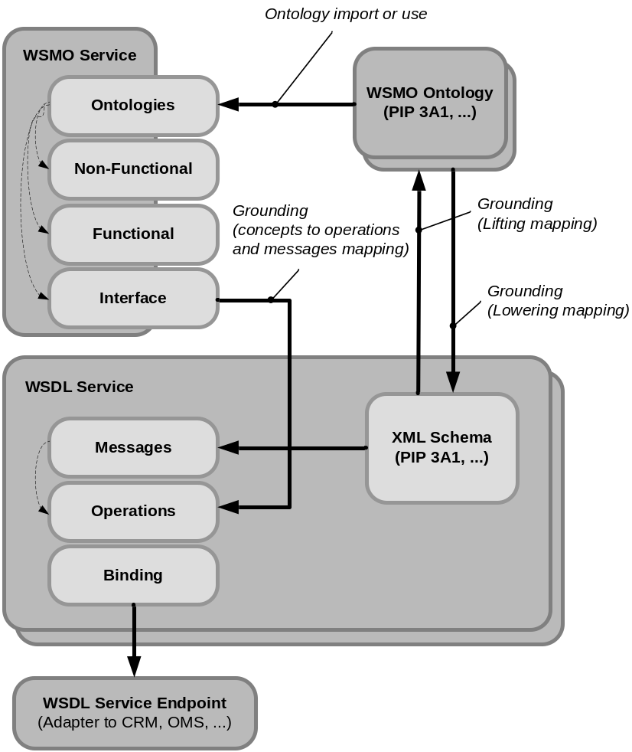
WSMO Service, WSMO Ontology and WSDL

Slide 43
WSMO Goals
Objectives that a client wants to
achieve by using Web Services
Provide the formally specified terminology
of the information used by all other components
Semantic description of Web Services:
Capability (functional)
Interfaces (usage)
Connectors between components with mediation facilities for handling heterogeneities

Slide 44
WSMO Goal
Basis for Goal-driven Architetcure
  requester formulates objective independently
  ‘intelligent’ mechanisms detect suitable services for solving the Goal
  allows re-use of Services for different purposes
Requests may in principle not be satisfiable
Derived from different AI-approaches for intelligent systems
  Intelligent Agents
  Problem Solving Methods

Slide 45
WSMO Goal Specification
Non functional properties, Imported Ontologies, Used mediators
Requested Capability
  describes service functionality expected to resolve the objective
Requested Interface
  describes communication behaviour supported by the requester for consuming a Web Service (Choreography)

Slide 46
WSMO Mediators
Objectives that a client wants to
achieve by using Web Services
Provide the formally specified terminology
of the information used by all other components
Semantic description of Web Services:
Capability (functional)
Interfaces (usage)
Connectors between components with mediation facilities for handling heterogeneities

Slide 47
WSMO Mediators
Heterogeneity …
  Mismatches on structural / semantic / process levels
  Occur between different components that shall interoperate
  Especially in distributed & open environments like the Internet
Concept of Mediation:
  Mediators as components that resolve mismatches
  Mediation cannot be always fully automated
  Several types of mediators defined by WSMO
    OOMediators, WWMediators, GGMediators, WGMediators

Slide 48
WSMO Mediators – General Approach
Source
Component
WSMO Mediator
uses a Mediation Service via
1
Target
Component
1 .. n
Source
Component
as a Goal
Mediation
Services

Slide 49
WSMO OO Mediator
Merging 2 ontologies
Train Connection
Ontology (s1)
OO Mediator
Mediation Service
Train Ticket
Purchase Ontology
Purchase
Ontology (s2)
Goal:
“merge s1, s2 and
s1.ticket subclassof s2.product”
Discovery
Mediation
Services

Slide 50
WSMO GG Mediator
Aim:
  Support specification of Goals by re-using existing Goals
  Allow definition of Goal Ontologies (collection of pre-defined Goals)
  Terminology mismatches handled by OO Mediators
Example: Goal Refinement
Source Goal
“Buy a ticket”
GG Mediator
Mediation Service
Target Goal
“Buy a Train Ticket”
postcondition:
“aTicket memberof trainticket”

Slide 51
Process Mediation (WWMediator)
internal business logic of Web Service
(not of interest in Service Interface Description)
internal business logic of Web Service
(not of interest in Service Interface Description)
WW Mediator
if a choreography does not exist, then find an appropriate WW Mediator that
  resolves possible mismatches to establish Information Compatibility (OO Mediator usage)
  resolves process / protocol level mismatches in to establish Communication Compatibility

Slide 52
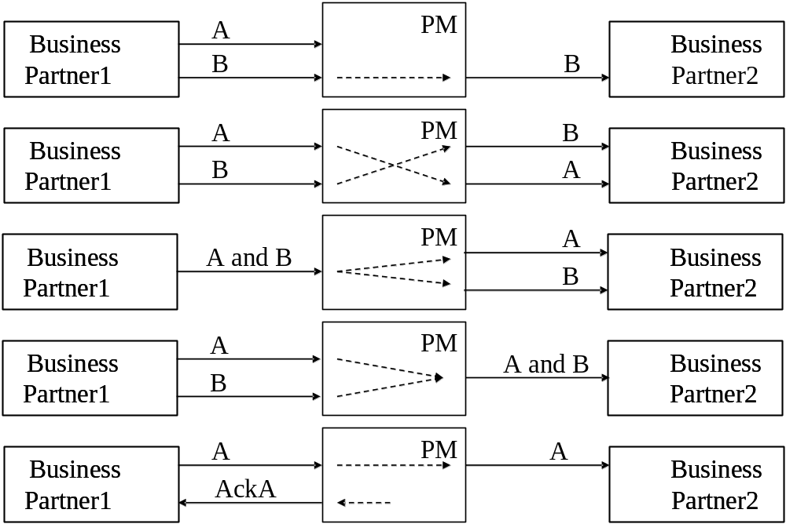
Process Mediator – Addressed mismatches

Slide 53
Agenda
DERI Organization
Introduction to Semantic Web Services
Semantic Web Services in DERI
  WSML
Standardizations and Applications

Slide 54
Web Service Modeling Language (WSML)
Aim – to provide a language (or a set of interoperable languages) for representing the elements of WSMO:
  Ontologies, Web services, Goals, Mediators
WSML provides a formal language for the conceptual elements of WSMO, based on:
  Description Logics
  Logic Programming
  First-Order Logic
  Frame Logic

Slide 55
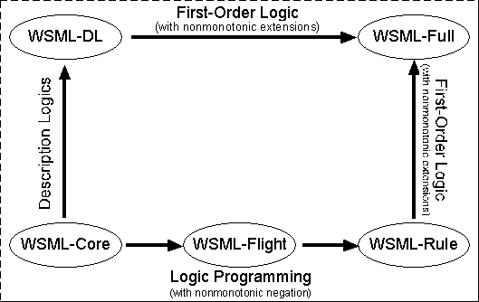
WSML Overview
Web Service Modeling Language
  Language to describe WSMO elements
  Variants: WSML Core, WSML DL, WSML Flight/Rule, WSML Full

Slide 56
Agenda
DERI Organization
Introduction to Semantic Web Services
Semantic Web Services in DERI
  WSMX
Standardizations and Applications

Slide 57
WSMX – Introduction
An execution environment for Semantic WS based on WSMO model
Extend SOA to cater for semantics
Foundation for OASIS Technical Committee on Semantic Execution Environments (OASIS SEE TC)
Integration Middleware based on Java Technology
  Operates on WSMO descriptions grounded to WSDL
Open source

Slide 58
WSMX Architecture – Governing Design Principles
Service Oriented Principle
  Service reusability, loose coupling, abstraction, composability, autonomy, discoverability
Semantic Principle
  Semantic description of services to (semi) automate discovery, composition, mediation, …
Distributed Principle
  Various WSMX components distributed over network
Layered Principle
  Layered architecture (requestor’s – stakeholders, front-office, middleware, providers – back-office)

Slide 59
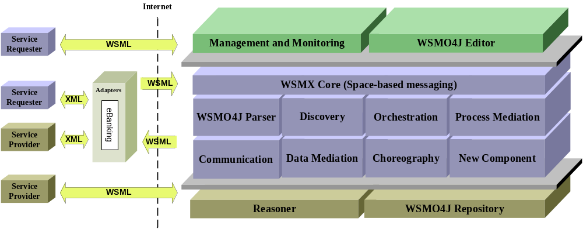
WSMX Architecture Middleware

Slide 60
WSMX – Middleware Services
Basic
  Reasoner, Semantic Repository
Core
  Parser
  Discovery, Selection, Contracting
  Mediation – Data and Process
  Communication
  Orchestration, Choreography
Management (WSMT)
  Ontology Management Tools
  Monitoring Tools

Slide 61
WSMX Middleware Core – Execution Semantics
Describe the the interaction of architecture components for achieving specific tasks
WSMX supports multiple concurrent execution semantics – flexible SOA architecture

Slide 62
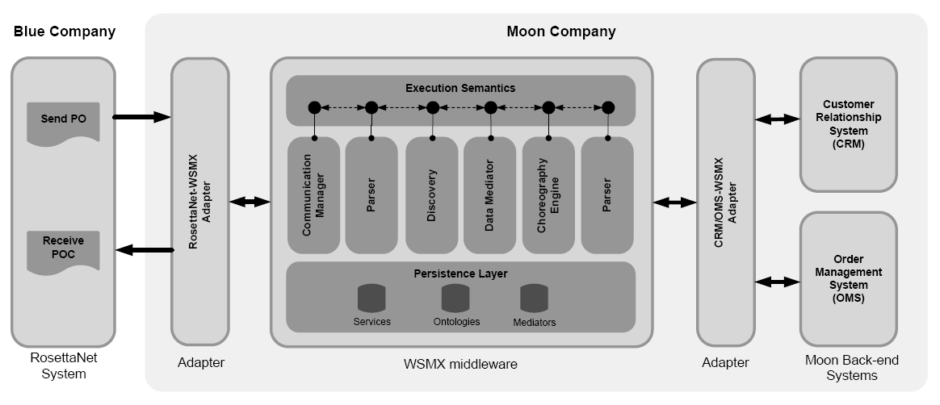
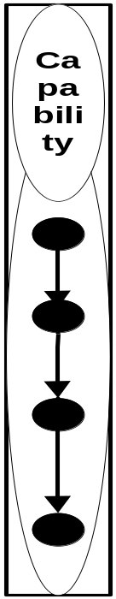
Use of WSMX in the B2B Scenario
WSMO Goal
Description
WSMO Service
Description

Slide 63
Links
WSMX, WSMO home pages
  http://www.wsmx.org
  http://www.wsmo.org
Open source
  http://sourceforge.net/projects/wsmx
  http://wsmo4j.sourceforge.net
OASIS SEE TC
  http://www.oasis-open.org/apps/org/workgroup/semantic-ex

Slide 64
Agenda
DERI Organization
Introduction to Semantic Web Services
Semantic Web Services in DERI
Standardizations and Applications

Slide 65
Standardization Working Groups
OASIS SEE TC
  Standardization of the architecture for the Semantic Web Services
  Main input: WSMX WG
  Chaired by DERI
W3C SAWSDL WG
  Semantic Annotations for WSDL
  Definition of WSDL 2.0 extensions for semantic annotations
  2 extension elements:
    ModelReference – reference from WSDL element to ontological concepts
    SchemaMapping (lowering/lifting) – transformation of data from XML Schema to ontology (e.g. Mapping functions)

Slide 66
Laboratory Scenario
Integration of Voice and Information Services
Builds on VoIP technology (SIP protocol) and WSMO, WSML and WSMX Framework
Integration happens at the level of call set-up

Slide 67
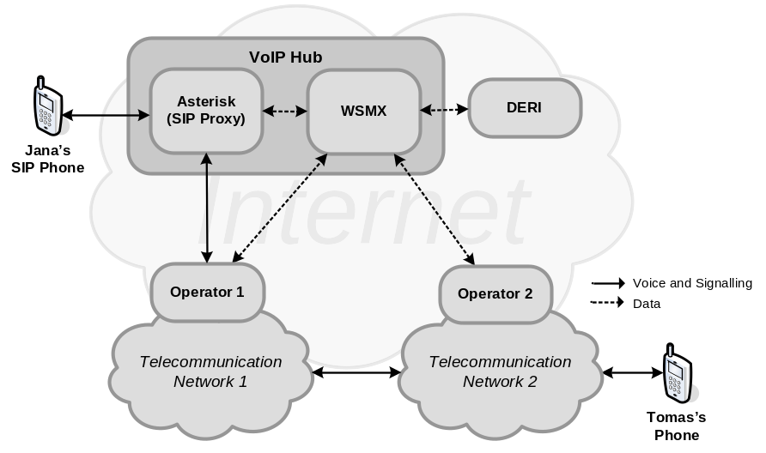
Scenario
Jana wants to make a call with Tomas
  She knows:
  Tomas’s name and where he works
  She doesn’t know:
  Tomas number
  She is using standard SIP phone
Jana is connected with VoIP Hub
  SIP Proxy and WSMX
Services Providers
  DERI web service resolve-name
  Telecom operator 1 and 2 each having one service authorize-call registered with WSMX
  Each operator provides access to his network through SIP GW

Slide 68
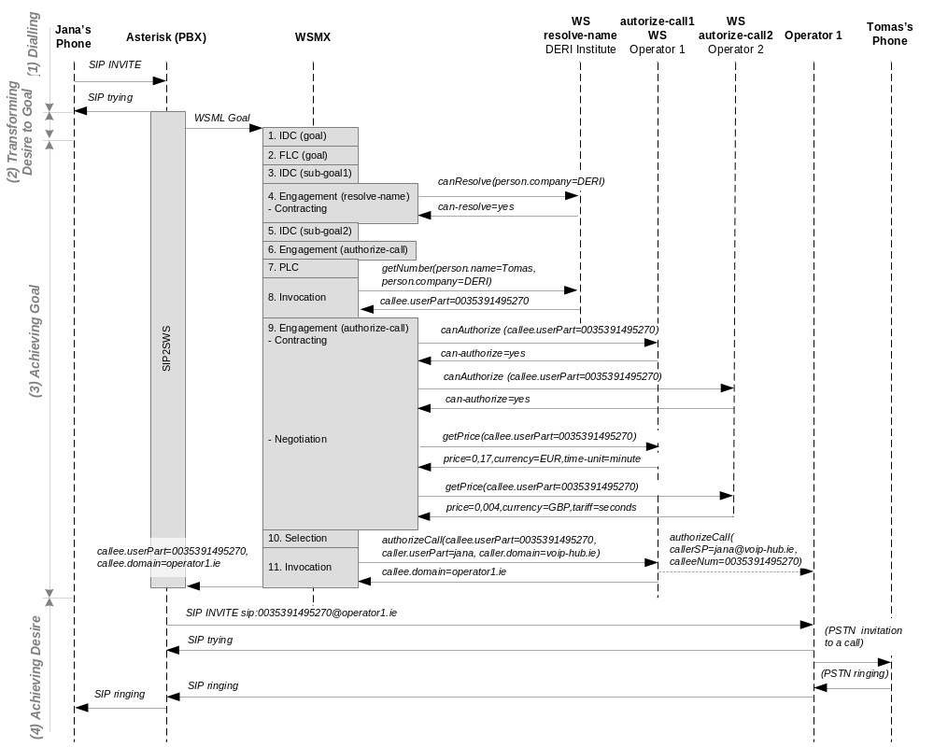
Scenario – interactions diagram

Slide 69
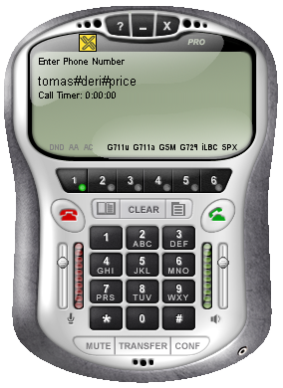
(1) Dialling
tomas#deri#price
INVITE sip:tomas#deri#price@voip-hub.ie SIP/2.0

Slide 70
(2) Transforming Desire to Goal: SIP2SWS
Asterisk Dial Plan
SIP2SWS
  Transform
  tomas#deri#price to
  WSML goal
  Call achieveGoal
  entry point of WSMX
exten => _.#.#., AGI(sip2sws, ${EXTEN})

Slide 71
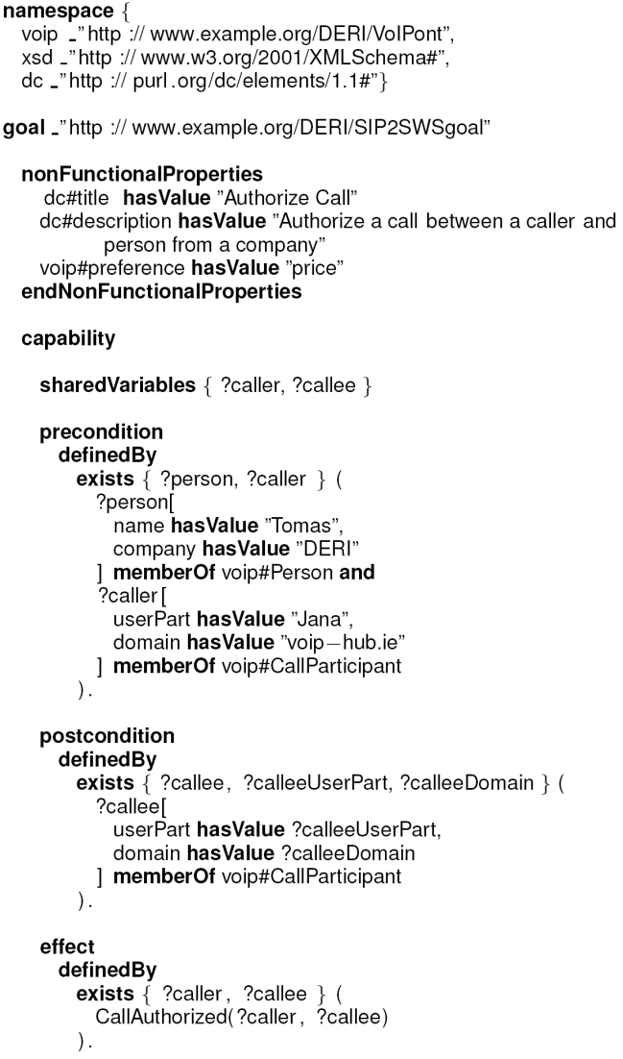
(2) Transforming Desire to Goal: WSML Goal
WSML Goal
  Non-functional properties
  Preconditions
    Person (name, company)
    Caller (userPart, domain)
  Postconditions
    Callee (userPart, domain)
  Effect
    callAuthorized(caller, callee)

Slide 72
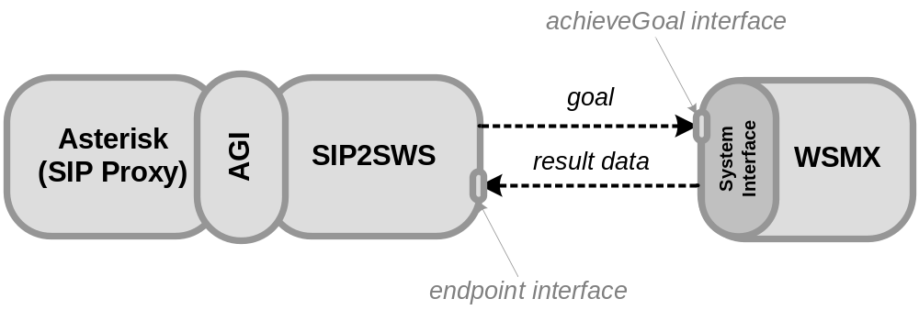
(2) Transforming Desire to Goal: call WSMX
WSMX System Entry Point
  achieveGoal(WSMLDocument goal)

Slide 73
Scenario – interactions diagram

Slide 74
(3) Achieving Goal
1. IDC(goal)
  Match goal with
  services in
  repositories
  No services found
2. FLC(goal)
  Goal is refined into
  sub-goals
  (1) lookup callee
  (2) authorize call

Slide 75
(3) Achieving Goal
3. IDC(sub-goal1)
  Match goal with
  services in
  repositories
  WS resolve-name
  found
4. Contracting
  Can resolve-name
  provide concrete/requested
  service?
  Result: yes, resolve-name is engaged

Slide 76
(3) Achieving Goal
5. IDC(sub-goal2)
  Match goal with
  services in
  repositories
  authorize-call1 and authorize-call2 found
6. Contracting
  Can authorize-call
  provide concrete
  service?
  Result: required input values not known
  resolve-name must be invoked

Slide 77
(3) Achieving Goal
7. PLC
  Creates workflow based on discovered services resolve-name and authorize-call
8. Invocation
  engaged service is called: resolve-name(Tomas, DERI)
  Result: callee.userPart=0035391495270

Slide 78
(3) Achieving Goal
9. Contracting
  Can authorize-call1 and authorize-call2 provide concrete service?
  Result: yes
9. Negotiation
  Get price for both services
  Both services are engaged and could be invoked
  Only one can be invoked -> selection

Slide 79
(3) Achieving Goal
10. Selection
  authorize-call1 or authorize-call2 are selected based on price (user preference)
  Different ontologies used (time-unit, tariff)
  Data mediation (mapping rules created during design-time)
  Result: authorize-call1 is selected

Slide 80
(3) Achieving Goal
11. Invocation
  The rest of the workflow is invoked (authorize-call1 WS)
  SIP GW is “opened” in operator1 for Jana and Tomas for the call

Slide 81
(3) Achieving Goal
SIP2SWS endpoint interface
  Result received

Slide 82
Scenario – interactions diagram

Slide 83
(4) Achieving Desire
RTP

Slide 84
Summary
Semantic Web Services
  Combination of Semantic Web and Web Service technology
  Automation of tasks e.g. Discovery, selection, composition, mediation, ... of services
  Complementing existing Web Service technology
Semantic Web Services in DERI
  WSMO, WSML, WSMX
  Community driven effort (national and international funding)
Standardization
  OASIS SEE TC, W3C SAWSDL WG
Applications
  E-government, e-health, BPM, ... and telecommuncations!

Slide 85
Q & A

