Slide 1

WSMX: a Semantic Service Oriented Middleware for B2B Integration
Thomas Hasselwanter, Paavo Kotinurmi, Mathew Moran,
Tomas Vitvar, Maciej Zaremba
Tomas Vitvar
tomas.vitvar@deri.org
4th International Conference on Service Oriented Computing
December 4-7, 2006, Chicago, U.S.A.

Slide 2
Overview
Objectives
Introduction to SWS: WSMO/L/X
B2B Integration Scenario, Modelling of Ontologies and Services, WSMX Middleware
Conversation: walk-through
Conclusion

Slide 3
Objectives
Semantic Web Services
  Manual support in existing Web Usage process (discovery, selection, composition, mediation, negotiation, ...)
  No support of the semantic web in web service description
  Goal:
    Increase automation in web service usage process
    Machine processable semantics
      Information models (ontologies), Service descriptions (capabilities, behavior)
Semantic Web Services for B2B integration
  Modelling of business services and their information models
  Enhance data and process integration of business services
    Requester and providers are decoupled and binded during runtime

Slide 4
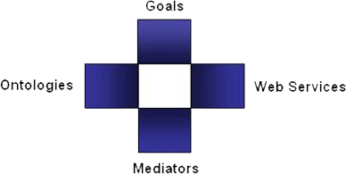
SWS: WSMO, WSML, WSMX
Semantic Web Services in DERI
  SWS: WSMO, WSML, WSML
    community Effort driven by DERI
    EU FP6 and national funding
Web Service Modelling…
… Ontology -> WSMO
  Conceptual model for SWS:
  goal, ontologies, mediators, services
… Language -> WSML
  Ontology Language for SWS
  WSML Variants: WSML Core, WSML DL, WSML Rule, WSML Full
… Execution Environment and Architecture -> WSMX
  Middleware platform for SWS
  Now in OASIS SEE TC

Slide 5
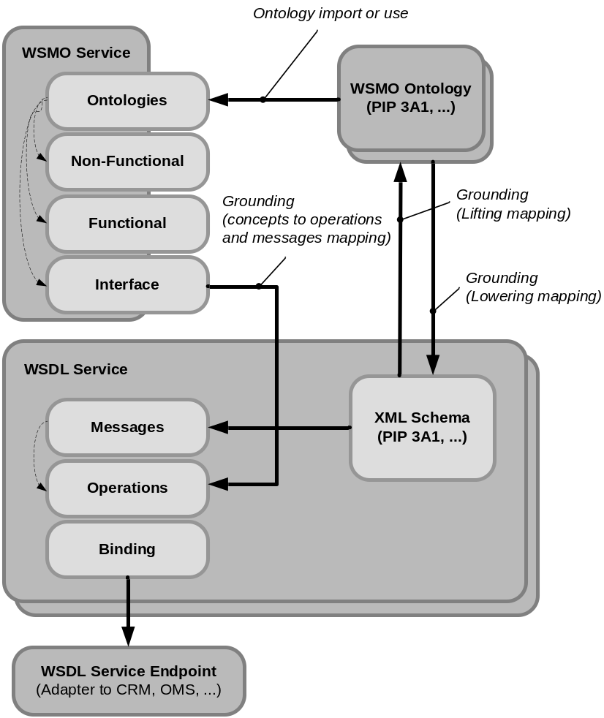
WSMO Service, WSMO Ontology and WSDL

Slide 6
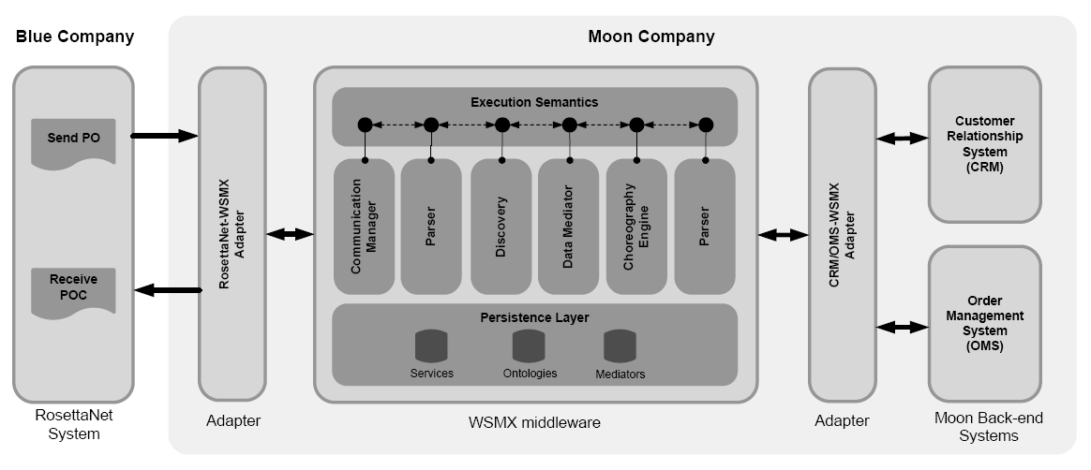
Scenario
Moon company wants to build B2B integration with Blue company
Blue – RosettaNet to be integrated with Moon back-end CRM and OMS
Integration builds on semantic technologies – WSMO/L/X

Slide 7
Scenario: Blue RosettaNet
PO[id, item1, item2, item3]
POC[confirmationID
Blue sends purchase order (customer id, and items to be ordered)
and expects order confirmation with confirmation id
Blue uses RosettaNet Standard PIP3A4 for Purchase Orders

Slide 8
Scenario: Moon Back-end Systems
id
cid
openOrder
addItem*
closeOrder
Internal customer id must be obtained from CRM system based on provided ID by Blue
Order must be opened in OMS system
Individual items are placed in OMS
Order is closed in OMS

Slide 9
Scenario: Interoperability Problems
Data
Interoperability
PO[id, item1, item2, item3]
Id’
cid
Process
Interoperability
POC[confirmationID
openOrder
addItem*
closeOrder
Interoperability Problems:
  Incompatible XML schemas for Blue’s and Moon’s messages
  Incompatible choreographies of Blue’s and Moon’s systems

Slide 10
Scenario: WSMX to Facilitate Integration
Modelling of information and
behaviour of standard
RosettaNet definitions
Modelling of information and
behaviour of proprietary
back-end systems

Slide 11
Scenario: What to model
RosettaNet
PIP 3A4
CRM, OMS
systems
WSMO
Ontology
WSMO
Ontology
Grounding
WSMO
Service
WSMO
Service
Grounding

Slide 12
Scenario: Deploy Models and Ontology Mappings
RosettaNet
PIP 3A4
CRM, OMS
systems
WSMO
Ontology
WSMO
Ontology
mapping rules
Grounding
WSMO
Service
WSMO
Service
Grounding

Slide 13
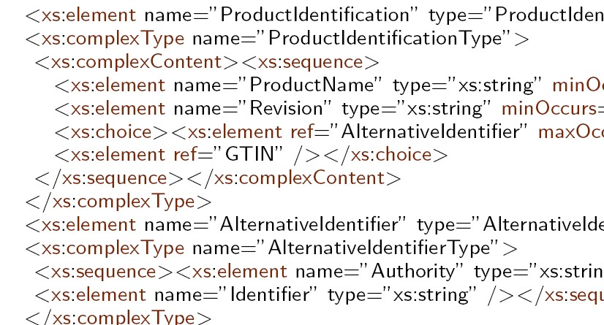
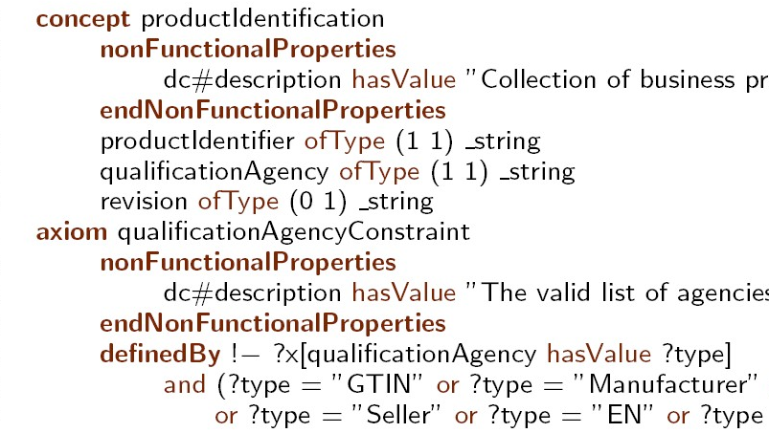
WSMO Ontology: Modelling of Information
Web
Service
RosettaNet
PIP 3A4
Lowering Schema Mapping
WSMO
Ontology
XML Schema
Lifting Schema Mapping
Lifting Rules in XSLT

Slide 14
WSMO Service: Modelling of Choreography, Grounding
WSDL Web Service Operations,
Input and output messages
Web
Service
WSMO Choreography and Grounding Definition
a
b
Abstract State Machine Rules
stateSignature
in a → wsdl.interfaceMessageReference …
out b → wsdl.interfaceMessageReference …
…
transitionRules
If a then add(b)
…
RosettaNet
PIP 3A4
If message A is in the memory, then
add message B to the memory
from invocation of related operation.

Slide 15
Conversation: Involved WSMX Components
Adapters (RN-Adapter, CRM/OMS Adapter)
  Lifting and lowering from xml schema, receiving messages from back-end systems and sending messages to WSMX middleware
Communication Engine
  Sends and receives messages from outside of middleware according to the grounding definitions of choreography
Choreography Engine
  Blue and Moon choreographies are loaded to Choreography Engine
  Drives the conversation by evaluating 2 choreographies and execution of rules
Process Mediator
  Decisions which data to put to which choreographies loaded in the chor. engine
  Decisions for necessity of data mediation
Data Mediator
  Performs data mediation of required data according to the mapping rules (available from design stage).

Slide 16
Conversation: Process and Data Mediation
WSMO
Ontology
(Blue-PIP3A4)
Mapping Rules
WSMO
Ontology
(Moon-CRM/OMS)
a ↔ o, b ↔ p, c ↔ q, d ↔ r
Data Mediator
Send PO
Process Mediator
GetCustomer
OpenOrder
Choreography
Engine
AddItem
Receive POC
CloseOrder

Slide 17
Conversation: Conversation Set-up
Data
Mediator
Comm.
Manager
Process
Mediator
Comm.
Manager
Processing
Memory
Processing
Memory
Rule Base
Rule Base
1: Blue and Moon choreographies are
loaded to the choreography engine.
{rule_{j}}
{rule_{i}}
Blue Choreography
Moon Choreography

Slide 18
Conversation: Communication with Blue
Data
Mediator
PO[id, item1, item2, item3]
Comm.
Manager
Process
Mediator
<empty>
id’, item1’,
Item2’, item3’
2: PO is received, process mediatior evaluates
the data should be mediated and added
to the Moon’s choreography memory.
{rule_{j}}
{rule_{i}}
Blue Choreography
Moon Choreography

Slide 19
Conversation: Communication with Moon
Data
Mediator
Comm.
Manager
Process
Mediator
cid
Comm.
Manager
<empty>
cid, id’, item1’,
Item2’, item3’
searchCustomerID(id’)
3: The rule 1 of the Moon choreography is evaluated:
- cid (Moon’s internal customer id) to be added
to the memory;
- According to the grounding definition of cid,
searchCustomerId is invoked, cid is obtained
and process mediator evaluates cid is added to the
Moon’s choreography memory.
1: If id’ then
add(cid),
remove(id’)
{rule_{j}}
{rule_{i}}
Blue Choreography
Moon Choreography

Slide 20
Conversation: Communication with Moon
Data
Mediator
Comm.
Manager
Process
Mediator
orderId
Comm.
Manager
<empty>
orderId, cid, item1’,
Item2’, item3’
createOrder(cid)
4: The rule 2 of Moon choreography is evaluated:
- orderId to be added to the memory;
- According to the grounding definition of orderId,
createOrder is invoked, orderId is obtained
and process mediator evaluates orderId is added
to the Moon’s choreography memory.
2: If cid then
add(orderId),
remove(cid)
{rule_{j}}
{rule_{i}}
Blue Choreography
Moon Choreography

Slide 21
Conversation: Communication with Moon
Data
Mediator
Comm.
Manager
Process
Mediator
response
Comm.
Manager
<empty>
response, orderId,
item1’, Item2’, item3’
addItem(orderId, item)
5: The rule 3 of Moon choreography is evaluated 3x:
- response of item order to be added to the memory;
- According to the grounding definition of response,
addItem is invoked, response is obtained…
3: If orderId, item
then
add(response),
remove(item)
{rule_{j}}
{rule_{i}}
Blue Choreography
Moon Choreography

Slide 22
Conversation: Communication with Moon
Data
Mediator
Comm.
Manager
Process
Mediator
OC
Comm.
Manager
<empty>
…, orderId
closeOrder(orderId)
6: The rule 3 of Moon choreography can be evaluated:
- order confirmation (OC) to be added to the memory;
- According to the grounding definition of result,
addItem is invoked, OC is obtained.
- Moon Choreography gets to the end of conversation
state (no other rule can be evaluated)
3: If orderId, !item
then
add(OC),
remove(orderId)
{rule_{j}}
{rule_{i}}
Blue Choreography
Moon Choreography

Slide 23
Conversation: Communication with Blue
Data
Mediator
POC
Comm.
Manager
Process
Mediator
OC
Comm.
Manager
OC’
<empty>
7: The process mediator evaluates the data should
be mediated and added to the Blue’s choreography
memory.
- The rule of Blue choreography is evaluated sending
POC back to the Blue system.
- Blue Choreography gets to the end of conversation
state (no other rule can be evaluated)
1: If OC’ then
add(OCresp),
remove(OC’)
{rule_{j}}
{rule_{i}}
Blue Choreography
Moon Choreography

Slide 24
Conclusion
Semantic Web Services
  Increase automation in web service usage process
  Machines processable semantics
    Information models (ontologies), Service descriptions (capabilities, behavior)
B2B integration on SWS
  SWS to business services
  Business services as decoupled services bound during run-time
    Mechanism Data and Process mediation during run-time
  Implementation – SWS Challenge Scenario

Slide 25
Thanks!

