Slide 1

WP3: SemanticGov Architecture Meeting
4th October, 2006
Tomas Vitvar
firstname.lastname@deri.org
SemanticGov 4rd Planetary Meeting
4-6 October 2006, Darmstadt, Germany

Slide 2
Agenda
SemanticGov Conceptual Architecture
  Global view on Architecture
ORDI Presentation (Ontotext)
Issues – Discussion
Work Plan

Slide 3
Agenda
SemanticGov Conceptual Architecture
ORDI Presentation (Ontotext)
Issues – Discussion
Work Plan

Slide 4
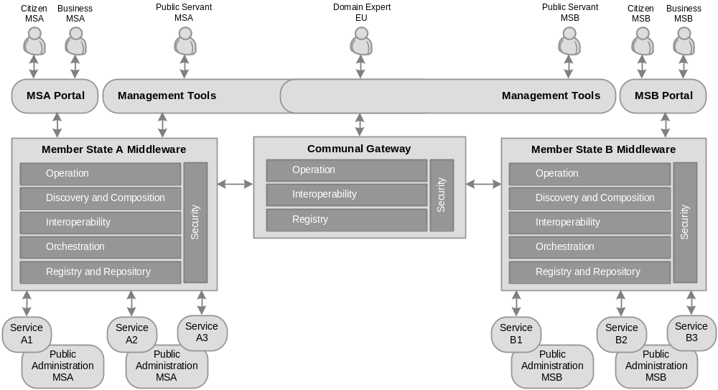
Global View on Architecture

Slide 5
Global View on Architecture – Governing Principles
Service Oriented Principle
  Service reusability, loose coupling, abstraction, composability, autonomy, discoverability
Semantic Principle
  Semantic description of services to (semi) automate discovery, composition, mediation, …
Distributed Principle
  Various components distributed over network (in line with distributed aspect of PA domain)
Layered Principle
  Layers reflecting PA domain (communal, national, regional, municipal)
  Layers reflecting layered architecture (requestor’s – stakeholders, front-office, middleware, providers – back-office)

Slide 6
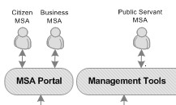
Global View on Architecture – Layers (1)
Service Requestor’s
  Stakeholders – Citizens, Businesses, Public
  Servants
  Citizens, Business – consumers of PA services
  Public Servants – consumers of architecture services (operational services)
Front-Office
  Portal – part of the public administration portal of certain state (e.g. portal of the public administration of the czech republic)
    Used by citizens and businesses to consume PA services
  Management Tools - Ontology editors, monitoring tools, etc.
    used by public servants (administrators, domain expets) to define/create PA services

Slide 7
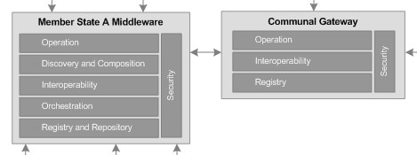
Global View on Architecture – Layers (2)
Middleware
  Member State Middleware
    Integration of PA services
    Facilitates architecture
    (operational) processes
    Components:
      Operation (execution semantics), Discovery, Composition, Interoperability, Orchestration, Registry/Repository
  Communal Middleware
    Interoperability in cross-border PA services integration
  Integration of MS Middleware and Communal Middleware
    At the operation level of both middlewares (execution semantics)

Slide 8

Global View on Architecture – Layers (3)
Service Providers
  PA Services
    WSDL
    WSMO-PA
      Ontologies
      Capabilities
      Choreography
      Orchestration
  Service creation/definition
    Domain experts
      Creating/resusing ontology
      Defining service semantics

Slide 9
Agenda
SemanticGov Conceptual Architecture
ORDI Presentation (Ontotext)
Issues – Discussion
Work Plan

Slide 10
Agenda
SemanticGov Conceptual Architecture
ORDI Presentation (Ontotext)
Issues – Discussion
Work Plan

Slide 11

Member State Portal
Overview
  Web-based portal (client/server)
  Functionality for citizens and businesses to consume services/processes offered by the architecture
  UI for citizens, businesses
  This design will be based on design of other architecture components
Issues
  Issues?
Browser
(User Interface)
Web Server
(Interface to middleware)
Middleware
(Integration Logic)

Slide 12
Management Tools
WSMO Editor (Ontotext) or WSMT (DERI)?
  Plug-ins could be reused in one another?
WSMO Ontology Editors
  WSMO Editor, WSMT
  Ontology editor is a plug-in for both environments?
  Ontology visualization
WSMO Service Editors
  WSMT, WSMO Editor?
WSMX Monitoring
  Status?
WSMT Data Mediation (design)
  Status?
Integration of WSMO Editor/WSMT with WSMX (middleware)?
  Get/store/update object (-> invocation of WSMX entrypoint -> execution semantics?)
Notes:
Edit scenario: Get object from repository, edit/change object, store object back to repository
Mapping scenario: get ontology1 and ontology2 from the repository, map between ontologies, store mappings between ontologies

Slide 13
Discovery (1)
Issue 28: Needs2Services
  Based on user profile, the set of services is found in the knowledge base
    Knowledge Base: OWL Ontology
    SPARQL is used to query the ontology
  Issues:
    How to represent user profiles (language)?
    Relationship between user profile and WSMO goal?
    How to use profile to services matching wrt goal-based discovery?
      Is this the 2 different approaches?
Option 1:
Option 2:
User Profile/
User Need
WSMO Goal
Goal-based
Discovery
User Profile/
User Need
Needs2Services
?

Slide 14
Discovery (2)
Issue 28: Needs2Services
  Option 2 approach:
    No goal-based discovery (no WSMO goal)
    WSMO Ontology in WSML to RDF (WSML/RDF) -> Knowledge Base
    SPARQL to query knowledge base
Option 2:
SPARQL
WSML/RDF
WSMO Ontology
(WSML)
User Profile
Needs2Services
KB
(RDFS/OWL)

Slide 15
Discovery (3)
issue 9: Desired (user) choreography from discovery
  Set of services returned from discovery -> input for composition
  UOR composition also needs requested choreography?
  Where to get this choreography?
Needs2Services/
Discovery
Composition
?
chor

Slide 16
Registry and Repository (1)
issue 4: which registry to use for services and ontologies
  CentraSite – does not provide semantic support
  ORDI – compliant with WSMO, aligned with WSMOLX research ideas
  Proposal (1):
    CentraSite as a repository for WSDL
    ORDI as a repository for WSMO objects
    -> how to connect WSMO grounding to location of WSDL
      WSMO grounding is URI from WSDL TargetNamespace which usually resolve to URL where WSDL can be found
      Can we resolve WSMO grounding URI to location of repository?
  Proposal (2):
    Sanaullah: CentraSite can be used as a registry for locating domain specific repositories which would be ORDI repositories?

Slide 17
Registry and Repository (2)
Issue 8: Distributed Repository (sanaullah)
  Domain specific repositories (a number of repositories will exist in member states - e.g. repository for transportation, construction, etc.)
  Registry for each MS with information on the location of domain repositories (tuples: domain repositories and their locations)
  Discovery first locates the domain repository and then performs discovery of services in the repository.
  CentraSite will be used as a registry,
  ORDI will be used as a repository.
REGISTRY
(Member State)
REPOSITORY
(Domain)
Member State A
Query Processor
Query Processor
Member State B
JAXR, WebDAV
Light-weight reasoner
(WSML Core)
Member State C
CentraSite?
ORDI
WSML Reasoner
(DL, LP)

Slide 18
Composition
Issue 10: WSMO Choreography and UniRoma choreography
  Resolved
  UniRoma can use WSMO choreographies restricted to FSM
    No use of "forall" and "choose" in choreography

Slide 19
Orchestration
Issue 11: Executing Orchestration
  Resolved
  UniRoma can generate WSMO choreographies/orchestrations from FSM
  Orchestrations will be executed by WSMX

Slide 20
Interoperability
Member State Level
  Do we need data/process mediation?
  -> depends on the use case (probably not)
Communal Level – Communal Gateway
  Data Mediation – core functionality
  Separated deliverable (D3.2 Design and Implementations of Mediators)

Slide 21
Operation (Execution Semantics)
Different execution semantics to support different processes
Depends on definition of processes which will be implemented by the architecture
  (1) get services + orchestration for my need (through member state portal)
  (2) execute orchestration (through member state portal)
  (3) store/get WSMO services/ontologies (through management tool)
  (4) store/get mappings between ontologies
  …

Slide 22
PA Services
PA
Ontologies
PA
Ontologies
PA Ontologies
WSMO-PA services
(grounding WSMO-PA to WSDL)
Semantic Repository
WSMO-PA
WSMO-PA
Grounding
WSDL
WSDL
WSDL services from existing
Applications
Existing PA
Application
Repository (UDDI)

Slide 23
Summary – work plan (1)
Architecture Document Scope, 2nd October 2006
  Conceptual Architecture as basis (DERI Galway) – done
Use Case (NUIG)
  State-of-the-art definition of the use case
  Deadline: 15th October 2006
First draft descriptions of components (All involved)
  Deadline: 30th October 2006 (according to the information in the document)
  Management Tools (Ontotext, LFUI)
  Discovery (NUIG, LFUI, CERTH)
  Registry/Repository (NUIG, Ontotext, SAG)
  Composition (UOR)
  Interoperability + Communal Gateway (LFUI)
  Orchestration (LFUI, NUIG)
  Operation (NUIG, LFUI)

Slide 24
Work Plan (2) – outlook
SemanticGov Architecture – 1st version, 30th December
Mediatiors – 1st version, 30th December
SemanticGov Architecture – 2nd version
  Jan – Apr 2007
Mediators – 2nd version
  Jan – Apr 2007

