Slide 1

WP3: SemanticGov Architecture
5th October, 2006
Tomas Vitvar
firstname.lastname@deri.org
SemanticGov 4rd Planetary Meeting
4-6 October 2006, Darmstadt, Germany

Slide 2
Agenda
WP3 Overview, Progress to date, Work Plan
Global SemanticGov Architecture

Slide 3
Overview
Design of Semantic Web Service architecture for National and Pan European eGovernment services.
  Conceptual and technical architecture for SemanticGov
Start: M6 (June 2006)
Finish: M16 (April 2007)
Total effort: 66MM
CERTH | NUIG | LFUI | UOR | CAPGEMINI | SOFTWARE AG | ONTO | ALTEC S.A. | MOI | RCM | Citta Di Torino
7 | 6 | 11 | 15 | 6 | 3 | 9 | 5 | 1 | 1 | 1

Slide 4
Tasks
Tasks 3.1/3.3: Application of WSMF to Semantic Government services
    WSMO/L/X for SemanticGov architecture
    … + softwareAG technology + WS, BPEL, Ontotext, UniRoma composition tools, IDABC PEGS Architecture, GEA PA model
Deliverables:
    SemanticGov Architecture version 1, total effort: 10MM
    SemanticGov Architecture version 2, total effort: 20MM
Milestones:
    M12 (December 2006): SemanticGov Architecture version 1
    M16 (April 2007): SemanticGov Architecture version 2

Slide 5
Tasks
Tasks 3.2/3.4: Development of Mediator Support
    Design of WSMO mediator to address the issue of interoperability in the overall framework.
      Technical – adapters, lifting on non-semantic messages to semantic level, integration with existing standards and systems
      Data – Data Mediator to achieve semantic interoperability
      Process level – Process Mediator to achieve interoperability of processes if different communication patterns are used (choreographies)
    Aligned with interoperability problems in PEGS
Deliverables:
    Analysis of Mediator Requirements and Mediator Implementation : 36MM
Milestones:
    M16: Analysis of Mediator Requirement and Mediator Implementation

Slide 6
SemanticGov Architecture Dependencies
Relations with other WPs
  WP1: Overall Conceptual Analysis
    SemanticGov architecture should be conceptually inline with WP1 results
  WP2: Requirements Analysis
    SemanticGov architecture should support requirements from WP2
Issues
  Requirements (WP2)
    Requirements Catalogue
      how requirements are supported by architecture
  Use Case – WP2?
    Needs to be translated to “technical terms”

Slide 7
Progress to date
Analysis of available technology (from partners)
  Visit to Software AG in June
  Overview of technologies from partners in Rome and Darmstadt meetings
Technical meetings
  Identification of Issues, documentation of issues, resolving of issues
  Architecture meetings
    Rome, September 2006
    Darmstadt, October 2006
First draft of architecture deliverable available (v0.1) (1st October)
  Global SemanticGov Architecture
  Proposed Structure of deliverable (will evolve)

Slide 8
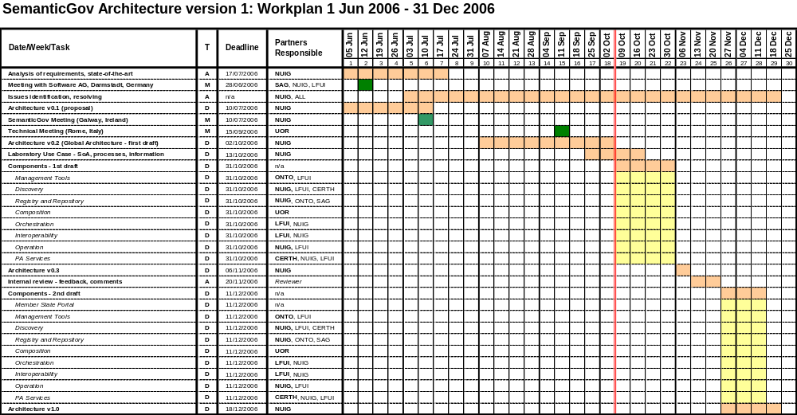
Work Plan

Slide 9
Next Steps
Laboratory Use Case
  Detail specification of information, information flow, activity diagrams, entities involved, services involved
  Define some WSMO-PA services from this specification
    WSMO Ontology, WSMO-PA Service (capability, interface)
Design of Architecture Components first version deadline Oct 30, next version Dec 10
  Components from Global Architecture
  For each component
    Describe architecture and core functionality
    Describe interfaces with other components
    Should be compatible with technical direction of architecture (WSMO, WSML, WSMX)
    Size: max 15-20 pages (like conference paper)

Slide 10
Agenda
WP3 Overview, Progress to date, Work Plan
SemanticGov Architecture

Slide 11
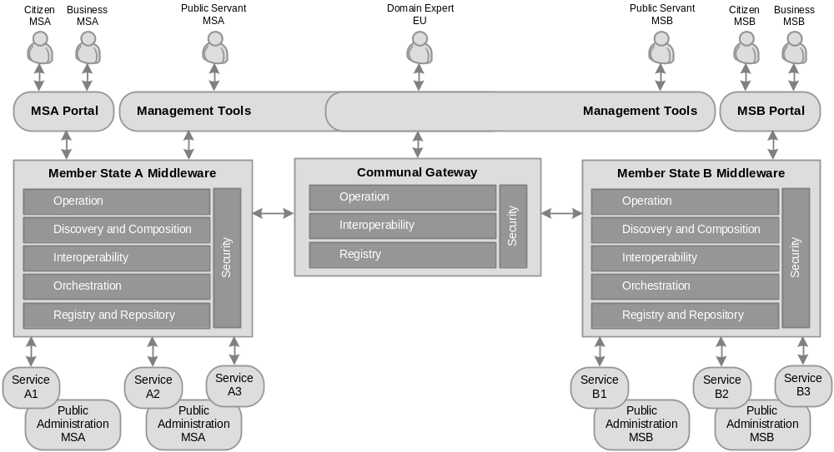
Global View on Architecture

Slide 12
SemanticGov Architecture – major parts
Global Architecture
  Global View on the architecture
Laboratory Use Case
  Demonstrating of the architecture components
  Technical aspects of use case (definitions of WSMO ontologies, WSMO-PA services)
Software Architecture
  Software components of architecture
    Technology, core functionality, interfaces with other software components
Process Architecture
  Which process will architecture support
    Creation of PA services and PEGS processes, storing/getting WSMO documents, processes performed by citizens, businesses

Slide 13
Global View on Architecture – Governing Principles
Service Oriented Principle
  Service reusability, loose coupling, abstraction, composability, autonomy, discoverability
Semantic Principle
  Semantic description of services to (semi) automate discovery, composition, mediation, …
Distributed Principle
  Various components distributed over network (in line with distributed aspect of PA domain)
Layered Principle
  Layers reflecting PA domain (communal, national, regional, municipal)
  Layers reflecting layered architecture (requestor’s – stakeholders, front-office, middleware, providers – back-office)

Slide 14
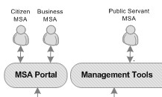
Global View on Architecture – Layers (1)
Service Requestor’s
  Stakeholders – Citizens, Businesses, Public
  Servants
  Citizens, Business – consumers of PA services
  Public Servants – consumers of architecture services (operational services)
Front-Office
  Portal – part of the public administration portal of certain state (e.g. portal of the public administration of the czech republic)
    Used by citizens and businesses to consume PA services
  Management Tools - Ontology editors, monitoring tools, etc.
    used by public servants (administrators, domain expets) to define/create PA services

Slide 15
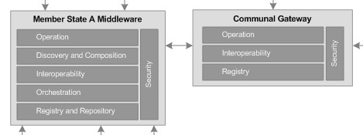
Global View on Architecture – Layers (2)
Middleware
  Member State Middleware
    Integration of PA services
    Facilitates architecture
    (operational) processes
    Components:
      Operation (execution semantics), Discovery, Composition, Interoperability, Orchestration, Registry/Repository
  Communal Middleware
    Interoperability in cross-border PA services integration
  Integration of MS Middleware and Communal Middleware
    At the operation level of both middlewares (execution semantics)

Slide 16

Global View on Architecture – Layers (3)
Service Providers
  PA Services
    WSDL
    WSMO-PA
      Ontologies
      Capabilities
      Choreography
      Orchestration
  Service creation/definition
    Domain experts
      Creating/resusing ontology
      Defining service semantics

Slide 17
Agenda
WP3 Overview, Progress to date, Work Plan
Global SemanticGov Architecture
  Components

Slide 18

Member State Portal
Overview
  Web-based portal (client/server)
  Functionality for citizens and businesses to consume services/processes offered by the architecture
  UI for citizens, businesses
  This design will be based on design of other architecture components
Issues
  Issues?
Browser
(User Interface)
Web Server
(Interface to middleware)
Middleware
(Integration Logic)

Slide 19
Management Tools
WSMO Editor (Ontotext) or WSMT (DERI)?
  Plug-ins could be reused in one another?
WSMO Ontology Editors
  WSMO Editor, WSMT
  Ontology editor is a plug-in for both environments?
  Ontology visualization
WSMO Service Editors
  WSMT, WSMO Editor?
WSMX Monitoring
  Status?
WSMT Data Mediation (design)
  Status?
Integration of WSMO Editor/WSMT with WSMX (middleware)?
  Get/store/update object (-> invocation of WSMX entrypoint -> execution semantics?)
Notes:
Edit scenario: Get object from repository, edit/change object, store object back to repository
Mapping scenario: get ontology1 and ontology2 from the repository, map between ontologies, store mappings between ontologies

Slide 20
Discovery (1)
Issue 28: Needs2Services
  Based on user profile, the set of services is found in the knowledge base
    Knowledge Base: OWL Ontology
    SPARQL is used to query the ontology
  Issues:
    How to represent user profiles (language)?
    Relationship between user profile and WSMO goal?
    How to use profile to services matching wrt goal-based discovery?
      Is this the 2 different approaches?
Option 1:
Option 2:
User Profile/
User Need
WSMO Goal
Goal-based
Discovery
User Profile/
User Need
Needs2Services
?

Slide 21
Discovery (2)
Issue 28: Needs2Services
  Option 2 approach:
    No goal-based discovery (no WSMO goal)
    WSMO Ontology in WSML to RDF (WSML/RDF) -> Knowledge Base
    SPARQL to query knowledge base
Option 2:
SPARQL
WSML/RDF
WSMO Ontology
(WSML)
User Profile
Needs2Services
KB
(RDFS/OWL)

Slide 22
Discovery (3)
issue 9: Desired (user) choreography from discovery
  Set of services returned from discovery -> input for composition
  UOR composition also needs requested choreography?
  Where to get this choreography?
Needs2Services/
Discovery
Composition
?
chor

Slide 23
Registry and Repository (1)
issue 4: which registry to use for services and ontologies
  CentraSite – does not provide semantic support
  ORDI – compliant with WSMO, aligned with WSMOLX research ideas
  Proposal (1):
    CentraSite as a repository for WSDL
    ORDI as a repository for WSMO objects
    -> how to connect WSMO grounding to location of WSDL
      WSMO grounding is URI from WSDL TargetNamespace which usually resolve to URL where WSDL can be found
      Can we resolve WSMO grounding URI to location of repository?
  Proposal (2):
    Sanaullah: CentraSite can be used as a registry for locating domain specific repositories which would be ORDI repositories?

Slide 24
Registry and Repository (2)
Issue 8: Distributed Repository (sanaullah)
  Domain specific repositories (a number of repositories will exist in member states - e.g. repository for transportation, construction, etc.)
  Registry for each MS with information on the location of domain repositories (tuples: domain repositories and their locations)
  Discovery first locates the domain repository and then performs discovery of services in the repository.
  CentraSite will be used as a registry,
  ORDI will be used as a repository.
REGISTRY
(Member State)
REPOSITORY
(Domain)
Member State A
Query Processor
Query Processor
Member State B
JAXR, WebDAV
Light-weight reasoner
(WSML Core)
Member State C
CentraSite?
ORDI
WSML Reasoner
(DL, LP)

Slide 25
Composition
Issue 10: WSMO Choreography and UniRoma choreography
  Resolved
  UniRoma can use WSMO choreographies restricted to FSM
    No use of "forall" and "choose" in choreography

Slide 26
Orchestration
Issue 11: Executing Orchestration
  Resolved
  UniRoma can generate WSMO choreographies/orchestrations from FSM
  Orchestrations will be executed by WSMX

Slide 27
Interoperability
Member State Level
  Do we need data/process mediation?
  -> depends on the use case (probably not)
Communal Level – Communal Gateway
  Data Mediation – core functionality
  Separated deliverable (D3.2 Design and Implementations of Mediators)

Slide 28
Operation (Execution Semantics)
Different execution semantics to support different processes
Depends on definition of processes which will be implemented by the architecture
  (1) get services + orchestration for my need (through member state portal)
  (2) execute orchestration (through member state portal)
  (3) store/get WSMO services/ontologies (through management tool)
  (4) store/get mappings between ontologies
  …

Slide 29
PA Services
PA
Ontologies
PA
Ontologies
PA Ontologies
WSMO-PA services
(grounding WSMO-PA to WSDL)
Semantic Repository
WSMO-PA
WSMO-PA
Grounding
WSDL
WSDL
WSDL services from existing
Applications
Existing PA
Application
Repository (UDDI)

