Slide 1
Dynamic Service Discovery through Meta-Interactions with Service Providers
Tomas Vitvar, Maciej Zaremba, Mathew Moran
Tomas Vitvar
tomas.vitvar@deri.org
The 4th European Semantic Web Conference (ESWC2007)
June 03-07, 2007, Innsbruck, Austria

Slide 2
Overview
B ackground and Objectives
Service Discovery and Data-Fetching
Implementation and Evaluatuion (SWS Challenge)
Future Work

Slide 3
Background
Semantic Web Services
  Semantic descriptions of services
  Late-Binding – semi-automated binding of requester‘s goal and services
    Includes discovery, selection, composition, ... mediation, ...
  Invocation – invocation of „bound“ services to consume the service functionality
    Includes conversation and mediation
Service Discovery
  Two stages:
    Web Service Discovery (abstract level) – operates on abstract description of a goal and a service
    Service Discovery (instance-level) – elaborates on results from abstract level and takes into account input data

Slide 4

Background
I want to buy 2 cheap IBM T60p laptops and ship them to Galway
E-Hub
I am selling and shipping computers (publish service description)
Web Service
Discovery
Mueller Service
May be Mueller can do it
Service
Discovery
yes, 1300€
yes, 100€
Mueller can do it
Do you have 2 IBM T60p and for how much?
Selection
Do you ship to Galway and for how much?

Slide 5
Objectives
Service Discovery
  Data needed: user data and service data
  User Data is either part of user goal request or can be supplied through user‘s interactions
  Service Data: need to be supplied thorugh service dynamically
  Questions (we only care about service data)
    (1) Which service data to supply for discovery
    (2) How to supply the service data for discovery

Slide 6
Objectives
    Which service data to supply for discovery?
      modeling of service „data-fetching“ interface
How to supply the service data for discovery?
  invocaction of the service „data-fetching“ interface as part of the discovery process

Slide 7
Modeling of Service „data-fetching“ interface
    Choreography (service view): all input messages are sent from the network and all output messages are sent to the network
    State Machine
      ontology conpcets as input/output messages
    Data-fetching interface is part of service description created by the service provider
      Service provider decides on which data can be fetched
      Data-fetching interface defines meta-interactions with the service

Slide 8
Service Interface and Grounding to WSDL
WSDL Web Service Operations,
Input and output messages
Web
Service
Choreography and Grounding Definition
a
b
State Machine Rules
Input/output concepts
in a → grounding to a WSDL operation’s message
out b → grounding to a WSDL operation‘s message
…
Transition Rules
If a then add(b)
…
If message A is available then
add message B through
from invocation of related operation.

Slide 9
Data Fetching and Service Discovery Integration
Init
KB
G, W
G and W match
Match(G, KB)
_{yes}
G and W
do not match
_{no}
Get r from W_{I}: holds(r.ant)
_{no}
_{yes}
Service W
Process r
  fetch
  update
_{data}
_{data}

Slide 10
Implementation
    SWS Challenge Scenarion (Discovery)
    WSMO Service Model
      Modeling of Ontologies, Goals, and Services
      WSML Ontology Language
      Extending WSMO Service Choreography Interface
      => choreography interface for data-fetching
      (distinguished through non-functional property)
      All service providers use WSMO
      All service providers follow common ontology (no mediation)
    WSMX Middleware
      Implementation of Service Discovery Component
      Whole scenario Implementation

Slide 11
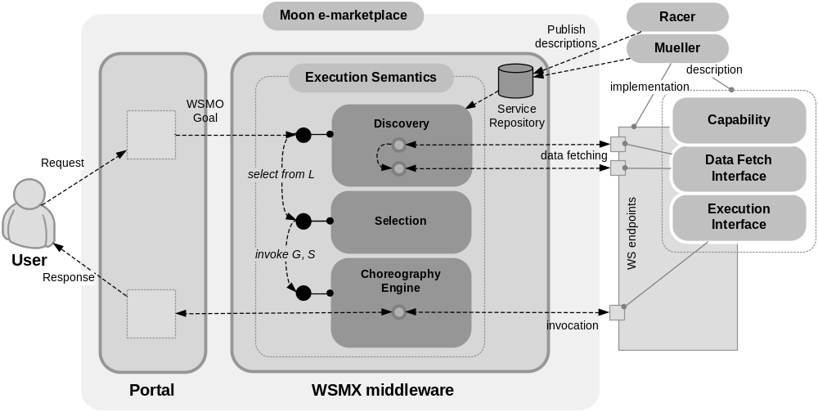
Scenario

Slide 12
Modeling
    WSMO Ontology
      Common Ontology: Shared concepts
    WSMO Services
      Capability (Functional Description)
      Choreography Interfaces
        Data-Fetching and Invocation
    WSMO Goals
      User wants to buy some products and ship them to some location (postcondition of the goal – query)
      Preference: price (non-functional property)

Slide 13
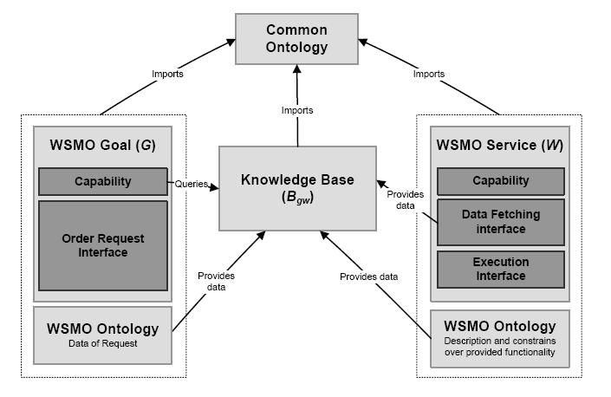
Integration

Slide 14
Evaluation – SWS Challenge
    SWS Challenge defines standard set of requirements for evaluation of SWS technologies (scenarios – data mediation,discovery, etc.)
    Process
      Entrants first address initial scenario
      Organizers make changes to the scenario
      Peer-Evaluation (success levels)
    Success levels: 0 – messages were exchanged, 1 – code modifications and recompiliations, 2 – no code but descriptions changed, 3 – no modifications needed;
    Our solution: success level 2 (only WSMO descriptions need to be changed)

Slide 15
Future Work
    Additional tasks build on the top – e.g. Contracting/negotation (definition of a concrete protocol on a data-fetch interface)
    Scalability – the whole data-fetch interface needs to be procssed until the new data can be fetch or the match if found
    Integration with data mediation

Slide 16
    Thanks!

