Slide 1

KW WP2.4 Meeting
JPA, Collaboration, KW Review, Meeting Agenda
DERI International Meeting, Galway November 2005

Slide 2
Overview
New JPA 25-42
Distribution of the work
Collaboration within KW
Review in March – results to be presented
Meeting Agenda

Slide 3
New JPA 25-42
Deliverables from previous period
  Integration of discovery and composition (prototype) – M30
  Interoperation and Invocation of Web Services (report v2, prototype) – M30
  Tupple Space computing (report v2, prototype) – M36
New Deliverables
  Architecture and execution semantics for SWS – M42
  Data Mediation in SWS – M36
  Reputation-based service level agreements – M36
  Decentralized Orchestration of SWS – M42

Slide 4
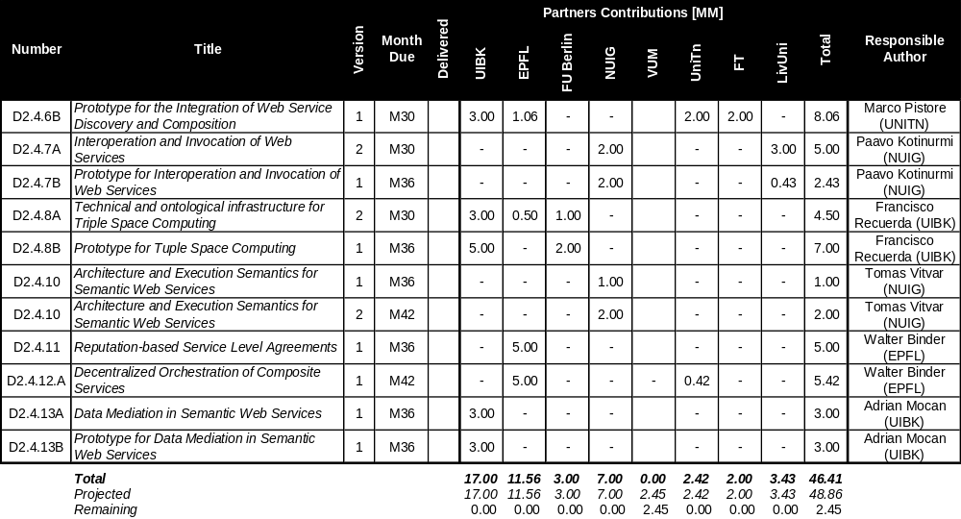
Distribution of the work

Slide 5
Collaboration within KW
WP2.2 – WP2.4
  Collaboration on integration of Ontology alignment techniques to Data Mediation (new Data Mediation Deliverable)
Collaboration with Industry
  Feedback from the last GA: in use cases lack of Web Services
  Provide use case for the Semantic Web Services
  Integration of e-business frameworks with the SWS
    Subject of deliverable on interoperation and invocation of WS

Slide 6
Review in March
Location: Innsbruck, 9-10 March
Results to be presented
  Key-aspects of the SWS
    SWS conceptual model
    Discovery and composition
    interoperation
  Conceptual Framework for the Semantic Web Services?
  Integrated Discovery and Composition?
  Interoperation of Web Services?

Slide 7
Meeting Agenda (1)
Meeting Slot 1 (16/2/2006): 14:00 – 17:30
  14:20 – 14:50: D2.4.5 Conceptual and Formal Framework for Semantic Web Services (M24, version 2 – final) – Axel
  14:50 – 15:20: D2.4.6A Theoretical Integration of Web Service Discovery and Composition (M24, version 2 – final)
  15:30 – 16:00: Coffee break
  16:00 – 16:30: D2.4.9 – Reputation Mechanism (M24, version 2 – final)
  16:30 – 17:00: D2.4.7 A – Interoperation and Invocation of Web Services (M24 – version 1)
  17:00 – 17:30 D2.4.8 A – Technical and Ontological Infrastructure for Triple Space Computing (M24 – version 1)

Slide 8
Meeting Agenda (2)
Meeting Slot 4 (17/2/2006): 11:00 – 12:30
  11:00 – 11:10: Goals
  11:10 – 11:30: Data mediation in Semantic Web Services
  11:30 – 11:50: How ontology alignment fits in the web service landscape and vice versa and future work with WP2.4
  11:50 – 12:30: Discussions on collaboration

