Slide 1

Dynamic RosettaNet Integration on Semantic Web Services
Tomas Vitvar, Matthew Moran, Emilia Cimpian, Adrian Moca, Maciej Zaremba
Tomas Vitvar
tomas.vitvar@deri.org
Semantic Web Services Challenge
Stanford University, USA, March 9-10 2006

Slide 2
Overview
SWS in DERI – WSMO, WSML, WSMX
Interoperability in WSMO/WSMX
Interoperability in SWS Challenge

Slide 3



Semantic Web Services in DERI
Semantic Web Services
  (semi) automate discovery, composition, mediation, negotiation, invocation of services
  DERI: WSMO, WSML, WSMX Working Groups
  Projects: DIP, KW, SEKT, SWWS, ASG, …
  New Projects in areas of e-government, e-health, BPM
WSMO WG
Conceptual Model for SWS
WSML WG
WSMX WG
Formal Language for WSMO
Execution Environment for WSMO
Rule-based Language for SW
http://www.wsmo.org/

Slide 4
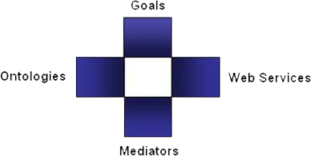
WSMO Top Level Concepts
Objectives that a client may have
when consulting a Web Service
Provide the formally specified terminology of the information used by all other components
Semantic description of Web Services:
Capability (functional)
Interfaces (usage)
Connectors between components with mediation facilities for handling heterogeneities

Slide 5
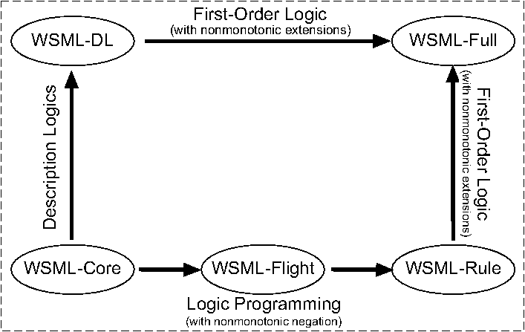
WSML
Ontology Language for WSMO

Slide 6
WSMX Architecture and Execution Environment
Reference implementation of WSMO
WSMX Design Principles == SOA Design Principles
Architecture
  WSMX Core
    Execution Semantics
  WSMX Components
    Discovery, Selection, Mediation, Composition, Contracting, …
    Interactions between components is defined by execution semantics
Architecture
  OASIS Semantic Execution Environment Technical Committee

Slide 7
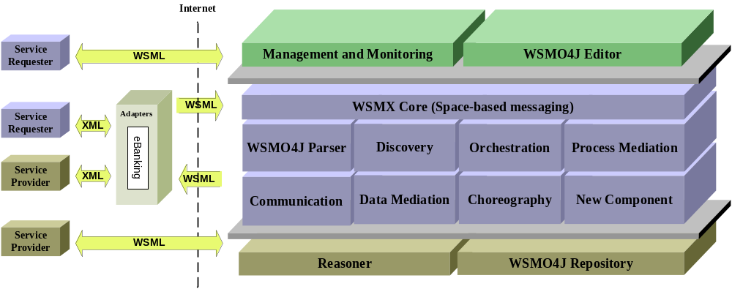
WSMX Architecture

Slide 8
Overview
SWS in DERI – WSMO, WSML, WSMX
Interoperability in WSMO/WSMX
Interoperability in SWS Challenge

Slide 9
Interoperability
Interoperability achieved by mediation
Mediation is achieved by transformation
Mediator – intermediary component between services which performs transformation
Interoperability Levels
  Technical Level – Adapters
  Data (semantic) Level – Data Mediators
  Process Level – Process Mediators

Slide 10
Adapters – Technical Interoperability
Protocol
  Different communication protocols are used by services
    e.g. HTTP and FTP
Syntax
  Different languages are used by services
    e.g. XML and WSML
Data Lifting
  Transformation of data to “semantic” level
    E.g. from XML-Schema to WSML
    During transformation – more semantics is introduced into the message
Data Lowering
  Transformation from semantic level back to “syntactic” level
    E.g. from WSML to XML-Schema

Slide 11
Data Level Interoperability
Related Aspects
  Ontology Integration (Ontology Mapping/Aligning and Merging)
Data Mediation
  Design-time – creation of mappings rules
  Run-time – execution of mapping rules
Mapping Language
  Direction of mapping (uni- / bidirectional)
  Mapping between Ontology Constructs:
    classMapping, attributeMapping, relationMapping (between similar constructs)
    classAtrributeMapping, classRelationMapping, classInstanceMapping, instanceMapping (explicit ontology instance transformation)

Slide 12
Mapping Language Example
Ontology O1
Ontology O2
Person
name
age
Human
- name
1234 memberOf Person
name =James
age = 22
Adult
Child
classMapping(unidirectional o2:Person o1.Adult
attributeValueCondition(o2.Person.age >= 18))
this allows to transform the instance 1234 of ontology O2 into a
valid instance of ‘adult’ in ontology O1

Slide 13
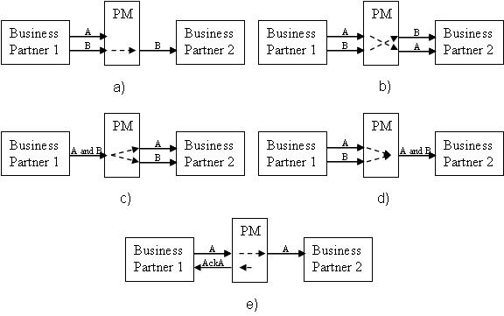
Process Mediation

Slide 14
Unsolvable Mismatches
PM
A
Business Partner1
Business Partner2
?
B
PM
A
Business Partner1
Business Partner2
A
?
B
A
PM
Business Partner1
Business Partner2
Ack
?

Slide 15
WSMX Architecture – Interoperability
Internet
Service
WSML
Management and Monitoring
WSMO
4
J Editor
Requester
Adapters
WSML
WSMX Core
(
Space
-
based messaging
)
Service
XML
Requester
WSMO
4
J Parser
Discovery
Orchestration
Process Mediation
Service
XML
WSML
Provider
Communication
Data Mediation
Choreography
New Component
Service
WSML
Provider
Reasoner
WSMO
4
J Repository

Slide 16
Overview
SWS in DERI – WSMO, WSML, WSMX
Interoperability in WSMO/WSMX
Interoperability in SWS Challenge

Slide 17
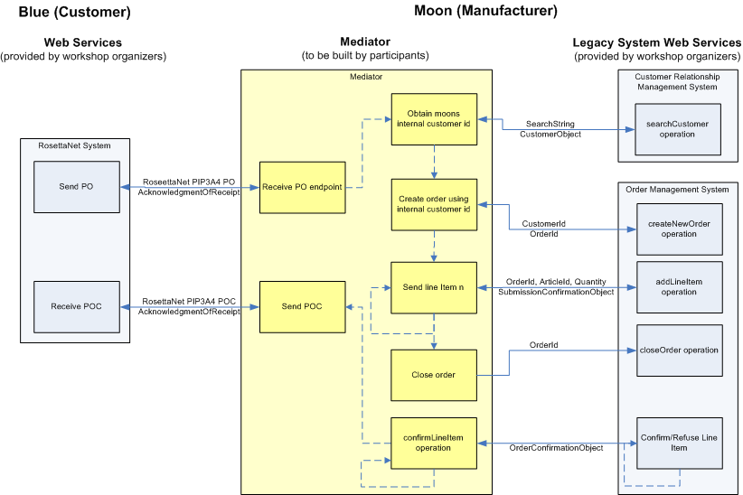
Scenario

Slide 18
Scenario – WSMX
CRM-WSMX
Adapter
CRM System
WSMX
Data mediation
Process mediation
RN System
RN-WSMX
Adapter
OM-WSMX
Adapter
OM System

Slide 19
Components
Ontologies (RN PIP3A4, CRM, OM) registered in WSMX
Mappings between ontologies found and registered in WSMX
Adapters
  RN-WSMX
  CRM-WSMX
  OM-WSMX
WSML Goal
  Generated at RN-WSMX adapter out of XML PIP 3A1 message
    Lifting of PIP 3A4 message to PIP 3A4 WSML
  Sent to WSMX entrypoint – achieveGoal
WSML Service (CRM + OM)
  Created using CRM and OM ontologies
  Service registered in WSMX

Slide 20
WSML Goal
WSML Goal
  Capability
    Precondition: Products, CustomerID
    Postcondition: PO Confirmation
  Choreography Interface
    Grounded to RM-WSMX adapter
    → Purchase order request
    ← Receipt Acknowledgement
    ← Purchase Order Confirmation
    → Receipt Acknowledgement

Slide 21
WSML Goal
WSML Service (CRM + OM)
  Capability
    Precondition: Products, CustomerID, …
    Postcondition: PO Confirmation
  Choreography Interface
    Grounded to CRM-WSMX adapter
    → Search Customer (grounded to CRM system’s adapter)
    ← Customer Details from CRM
    Grounded to OM-WSMX adapter
    → Create new order
    ← Acknowledgement
    → Add line item
    ← Acknowledgement
    → Close Order
    ← Acknowledgement
    ← Order Confirmation
    → Acknowledgement

Slide 22
Execution process
On reception of request – WSML goal is generated in RN-WSMX adapter and sent to WSMX entrypoint interface
In WSMX
  Service is discovered
  Choreography of service started
  Process mediation between goal and service choreographies
  Data mediation between RN, CRM and OM ontologies
  Invocation according to groundings to CRM-WSMX adapter and OM-WSMX adapter
In CRM-WSMX/OM-WSMX adapters
  Lowering/lifting of WSML messages to XML and invoking actions in CRM/OM systems

