Slide 1

WSMX and its Applications
Current Status and Future Plans
Tomas Vitvar tomas.vitvar@deri.org
3rd ASG Week, Tromsø, Norway
July 11-16, 2005

Slide 2
Overview
Introduction
WSMX Architecture
Current and Future Projects
ASG – WSMX Collaboration
Summary

Slide 3




WSMO Working Groups
A Conceptual Model for SWS
A Formal Language for WSMO
Execution Environment for WSMO

Slide 4
DERI SWS Clusters
DERI clusters involved in SWS development
  Semantic Execution Environment (SEE)
    WSMX core development
  Semantic Integration in Business (SIB)
    WSMX application to domains
    E-Business, E-Government, Telecommunications, E-Health
  Industrial and Scientific Applications of SWS
    WSMX application to Robotics and Bioinformatics

Slide 5
WSMX Introduction
WSMX is a software framework that allows runtime binding of service requesters and service providers
WSMX is based on the WSMO conceptual model
WSMX interprets requester’s goal to
  Discovery – matching services
  Engagement – contracting and negotiation
  Selection – select services that best fits user’s needs
  Mediation – data and process
  Invocation
WSMX Architecture
  service oriented and event-based
  Technologies: J2EE, Spring, JMX, etc.
Standardization – W3C, OASIS TC (SEE)
Open Source (http://sourceforge.net/projects/wsmx)

Slide 6
WSMX Design Principles
Strong Decoupling & Strong Mediation
autonomous components, mediators for interoperability
Interface vs. Implementation
distinguish interface (= description) from implementation (=program)
Peer to Peer
interaction between equal partners (in terms of control)
WSMO Design Principles == WSMX Design Principles
== SOA Design Principles

Slide 7
WSMX Development Process
The development process for WSMX includes:
  Requirements Analysis through Use Cases (A2A, B2B, E-Gov, …)
  Conceptual Model and Execution Semantics Design
  Software Architecture Design
  Components Design
  Implementation, testing, verification
Current and Planned releases
November 2005 (WSMX 0.4)
June 2005 (WSMX 0.2)
January 2005 (WSMX 0.1.5)
November 2004 (WSMX 0.1)
2005
2006

Slide 8
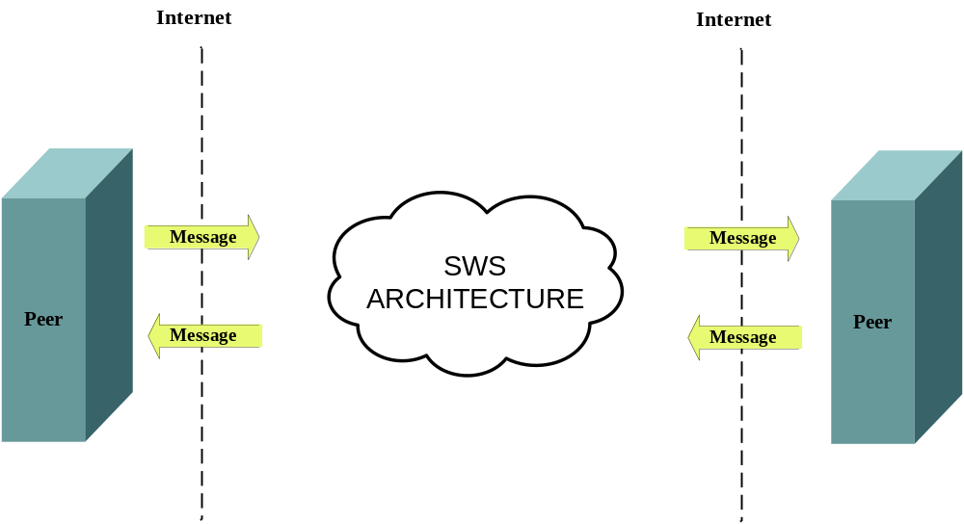
SWS WSMX Architecture (1)

Slide 9
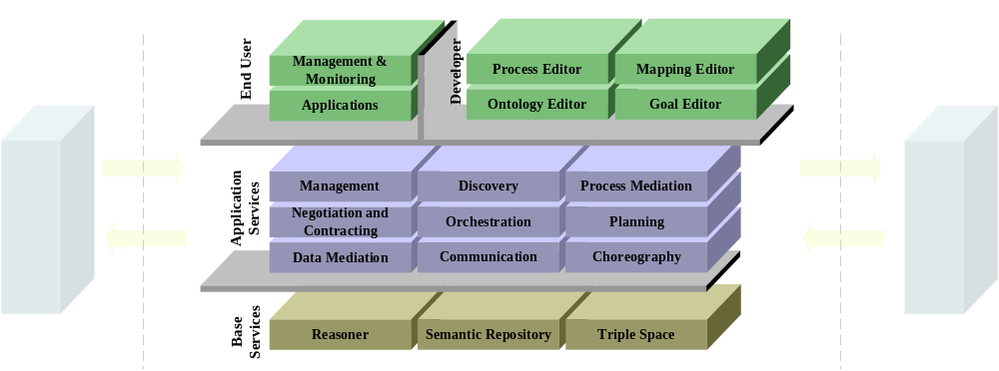
SWS WSMX Architecture (2)

Slide 10
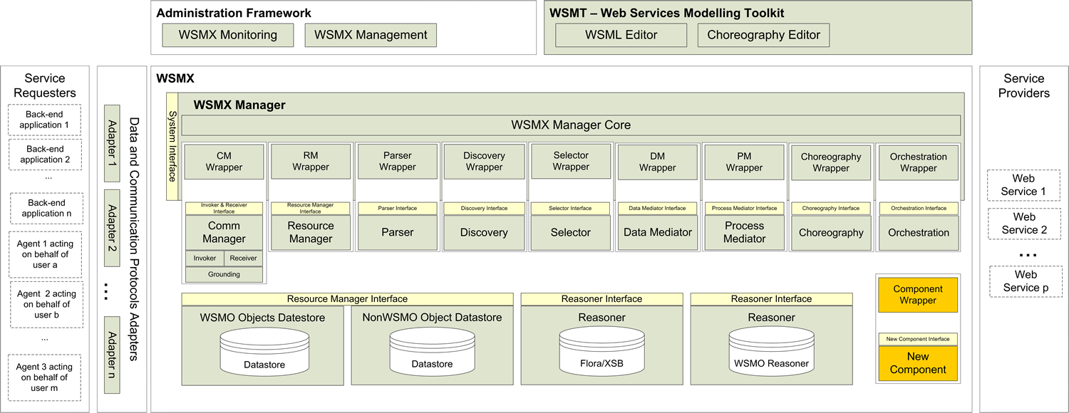
SWS WSMX Architecture (3)

Slide 11
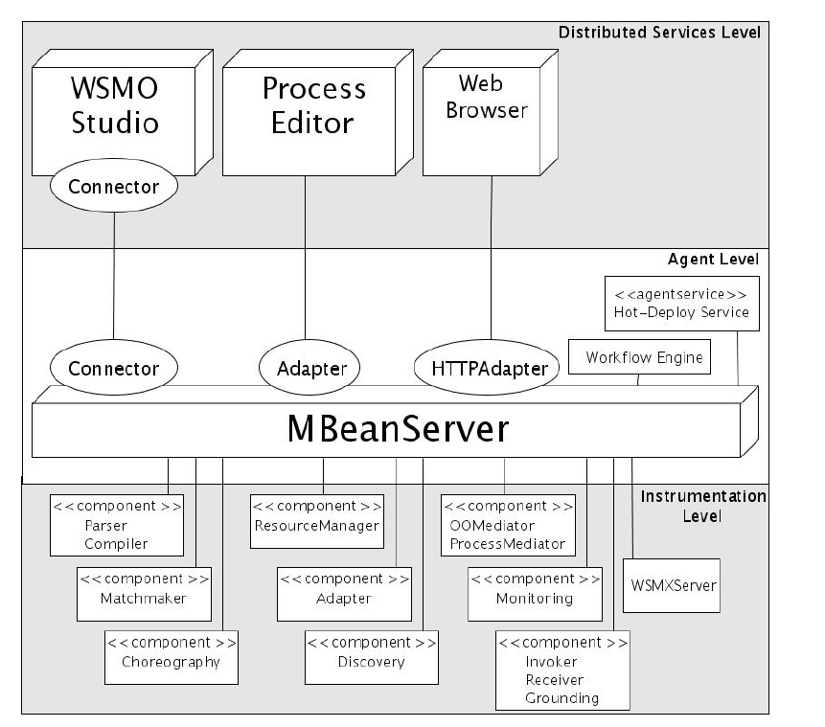
JMX-based WSMX Management

Slide 12
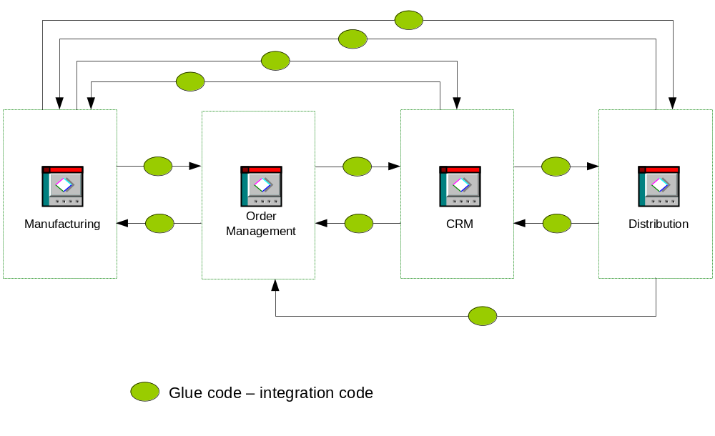
Typical Business Process

Slide 13
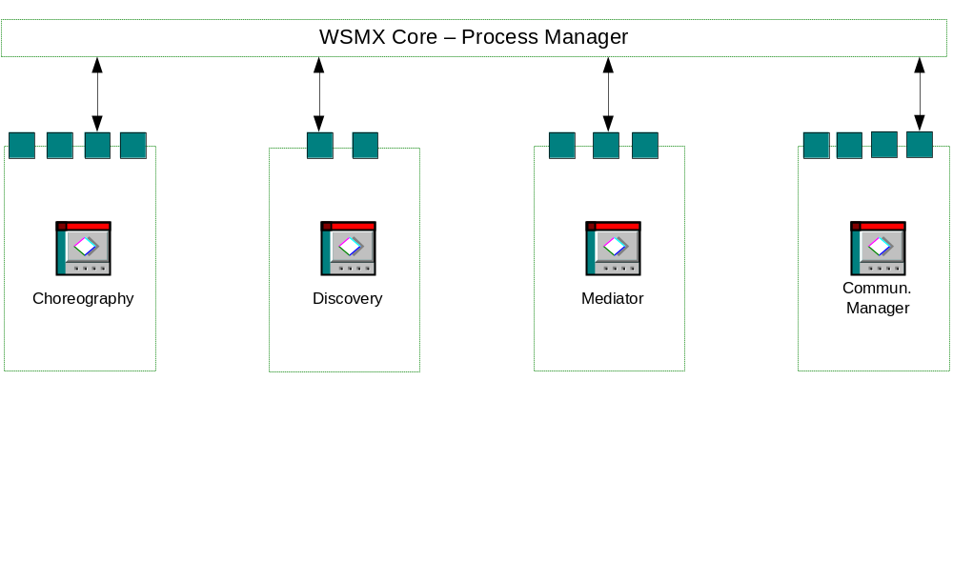
WSMX Design Principles
Decoupling of components
Interface vs. Implementation

Slide 14
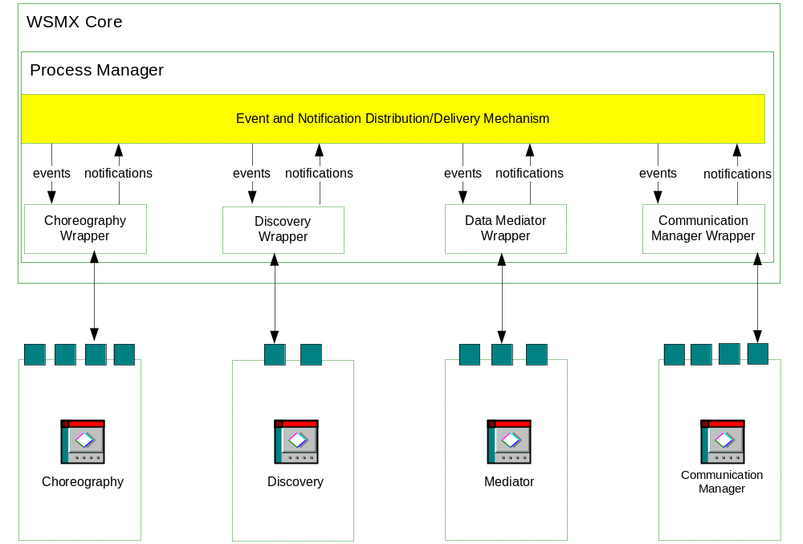
Event Based Architecture

Slide 15
WSMX – Current Status
WSMX Core Level
  Microkernel, Management Framework, HTTP/SSH Adapter
  Process Manager
WSMX Services Level
  Data Mediation, Discovery, Invoker, Receiver, Resource Manager
  (Composition)
User Level
  Ontology Editor, Mapping Editor (WSMO Toolkit)

Slide 16
Application Areas and Projects
E-Business
  Dynamic e-Marketplaces (e-Hubs) (KW – EU FP6)
E-Government
  PEGS ((SemanticGov) – EU FP6)
Telecommunications
  Telecommunication management (DIP Project – EU FP6)
  Voice and data services integration ((ETSI, Bell Labs – EI))
E-Health
  Semantic Annotated Oncology and Radiology (EI)
  Interoperability in e-Health ((RIDE) – EU FP6)

Slide 17
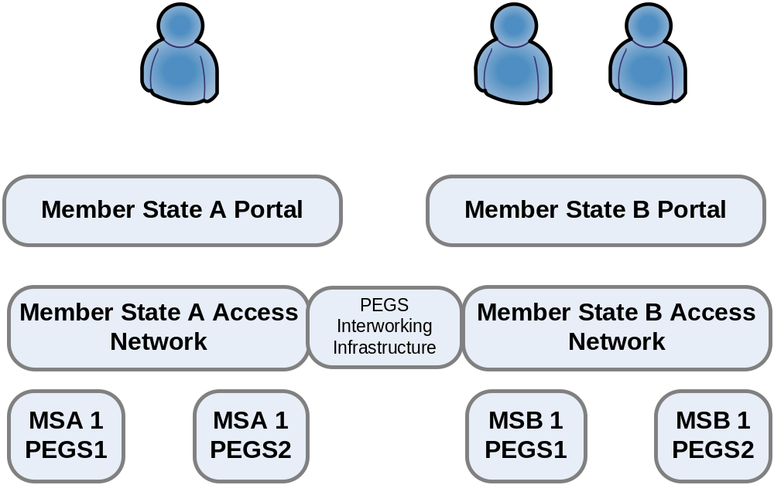
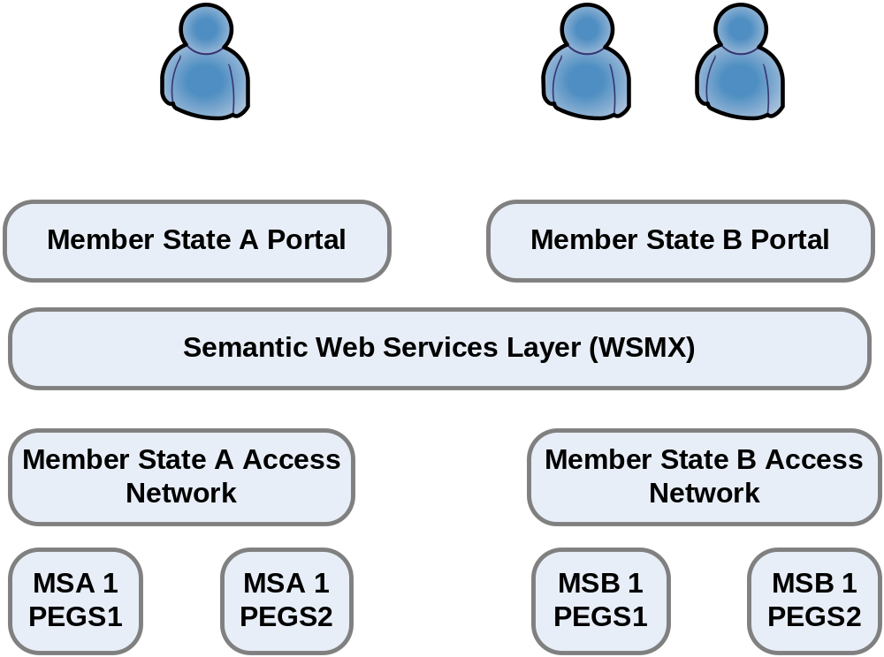
PEGS and WSMX

Slide 18
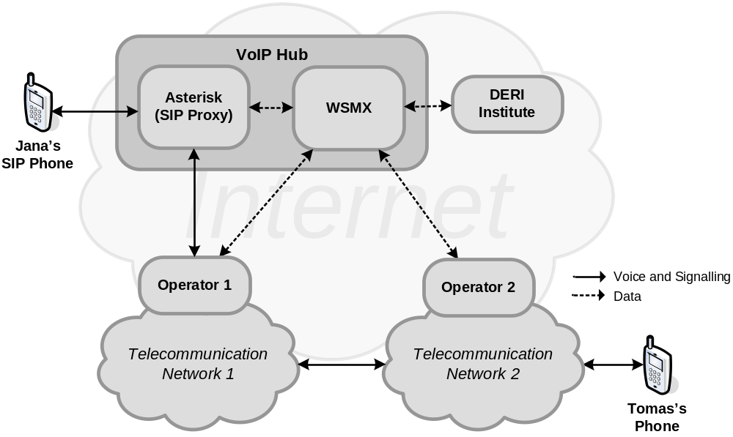
Voice and Data Integration on WSMX

Slide 19
Industrial Partners
Current Partners
  HP
  SAP
  France Telecom
  British Telecom
  …
Future Partners
  Bell Labs
  ETSI
  CapGemini
  …

Slide 20
Collaboration – ASG and WSMX-based projects
Agree on common interfaces
  Components’ interfaces
  ASG platform ↔ WSMX “Entry-point” interfaces
Reuse SWS functionality
  Developed through ASG and through DERI Projects
Join Efforts on Standardization
  W3C, OASIS, ETSI
Share experience from use cases

Slide 21
Summary
SWS – WSMX Core, WSMX Applications
WSMX Architecture – SOA Approach
WSMX Applications in different projects (e-gov, VoIP)
ASG – WSMX collaboration

