Slide 1

Knowledge Web Industry-Research: WP2.4 Use Cases
Tomas Vitvar
Tomas Vitvar
tomas.vitvar@deri.org
Knowledge Web Meeting
January 16-17, 2007, Berlin, Germany

Slide 2
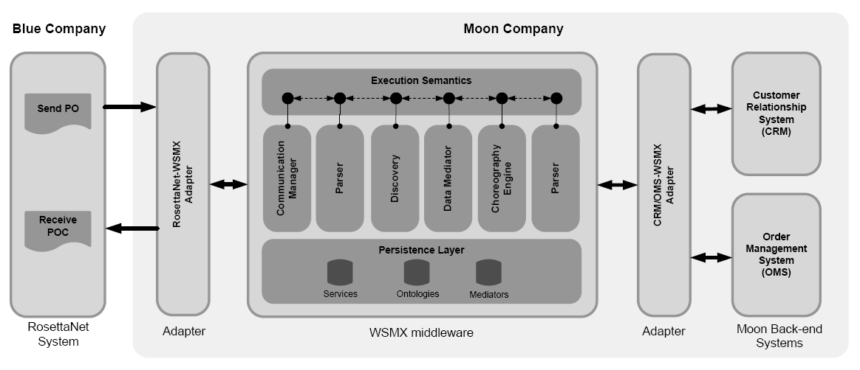
Scenario
Moon company wants to build B2B integration with Blue company
Blue – RosettaNet to be integrated with Moon back-end CRM and OMS
Integration builds on semantic technologies – WSMO/L/X

Slide 3
Scenario: Blue RosettaNet
PO[id, item1, item2, item3]
POC[confirmationID
Blue sends purchase order (customer id, and items to be ordered)
and expects order confirmation with confirmation id
Blue uses RosettaNet Standard PIP3A4 for Purchase Orders

Slide 4
Scenario: Moon Back-end Systems
id
cid
openOrder
addItem*
closeOrder
Internal customer id must be obtained from CRM system based on provided ID by Blue
Order must be opened in OMS system
Individual items are placed in OMS
Order is closed in OMS

Slide 5
Scenario: Interoperability Problems
Data
Interoperability
PO[id, item1, item2, item3]
Id’
cid
Process
Interoperability
POC[confirmationID
openOrder
addItem*
closeOrder
Interoperability Problems:
  Incompatible XML schemas for Blue’s and Moon’s messages
  Incompatible choreographies of Blue’s and Moon’s systems

Slide 6
Scenario: WSMX to Facilitate Integration
Modelling of information and
behaviour of standard
RosettaNet definitions
Modelling of information and
behaviour of proprietary
back-end systems

Slide 7
Scenario: What to model
RosettaNet
PIP 3A4
CRM, OMS
systems
WSMO
Ontology
WSMO
Ontology
Grounding
WSMO
Service
WSMO
Service
Grounding

Slide 8
Scenario: Deploy Models and Ontology Mappings
RosettaNet
PIP 3A4
CRM, OMS
systems
WSMO
Ontology
WSMO
Ontology
mapping rules
Grounding
WSMO
Service
WSMO
Service
Grounding

