Slide 1

Semantic Web Services Cluster
Pan-European E-Government Services (PEGS)
SWS Research Seminar, 16th February 2005
Tomas Vitvar

Slide 2
Pan-European e-Government Services
Scope: IDABC – PEGS in EU
Goal and Requirements
Architecture for PEGS
PEGS and Semantic Web Services
Summary

Slide 3
PEGS in EU
IDABC
  Interoperable Delivery of European e-Government Services to Public Administrations, Businesses and Citizens
  Former IDA (promote interoperability between administrations in EU)
  Sector Projects (e.g. integration of IS in transport, health, …)
  Horizontal Activities
    On-line Front-office services (portals)
    Infrastructure Services (European Interoperability Framework, PEGS Architecture)
Notes:
Current approach to PEGS in EU – defined within IDABC initiative
On-Line front office services
– portal Your Europe
– provides information and services to assist Europe's citizens carry out cross-border activities.
– For example, citizens who wish to move to, or enterprises that would like to establish a subsidiary in, another European country.
– Infrastructure Services
– Common strategy (vision) doesn’t exists –> Architecture for PEGS
– European Interoperability Framework – standards and guidelines to achieve the interoperability

Slide 4
Goal of PEGS
To promote interoperability between Public
Administrations, Businesses and Citizens by means
of current ICT Technology and with respect to EU
requirements and principles.

Slide 5
Requirements for PEGS (1)
Four Freedoms
  Free flow of goods, persons, capital, and services within EU
Subsidiarity
  Governance and operational autonomy
Transparency
  Hide complexity to businesses and citizens
One-stop Government
  Information to be supplied only once
Trust
  Legal protection of citizens and businesses
Multilingualism
  PEGS to support EU languages

Slide 6
Requirements for PEGS (2)
Existing National Interoperability Frameworks
  Guidelines to provide interoperability in Member States
  (data interoperability standards, methodology, etc.)
Types of Services
  National – provided to citizens/businesses at national level
  Communal – provided to citizens/business by EC
  Interworking – bridge differences in national services
Notes:
Interworking services – business, semantic, data levels

Slide 7
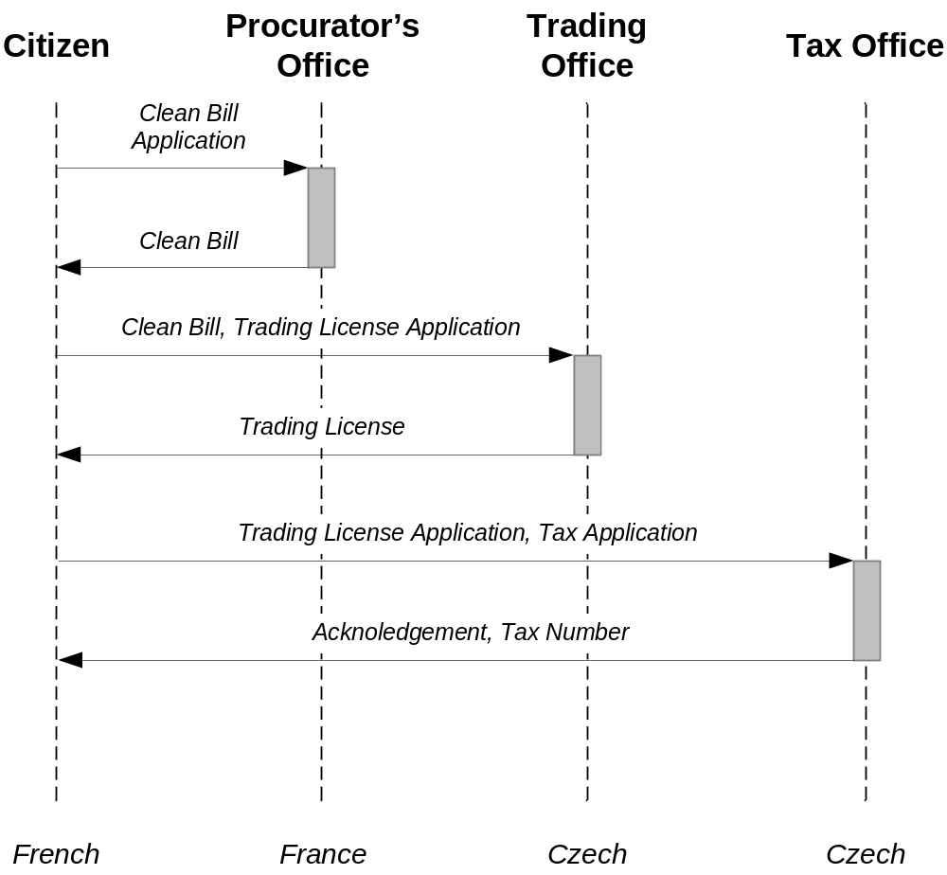
Example – Current approach
French citizen intends to start business in the Czech Republic

Slide 8
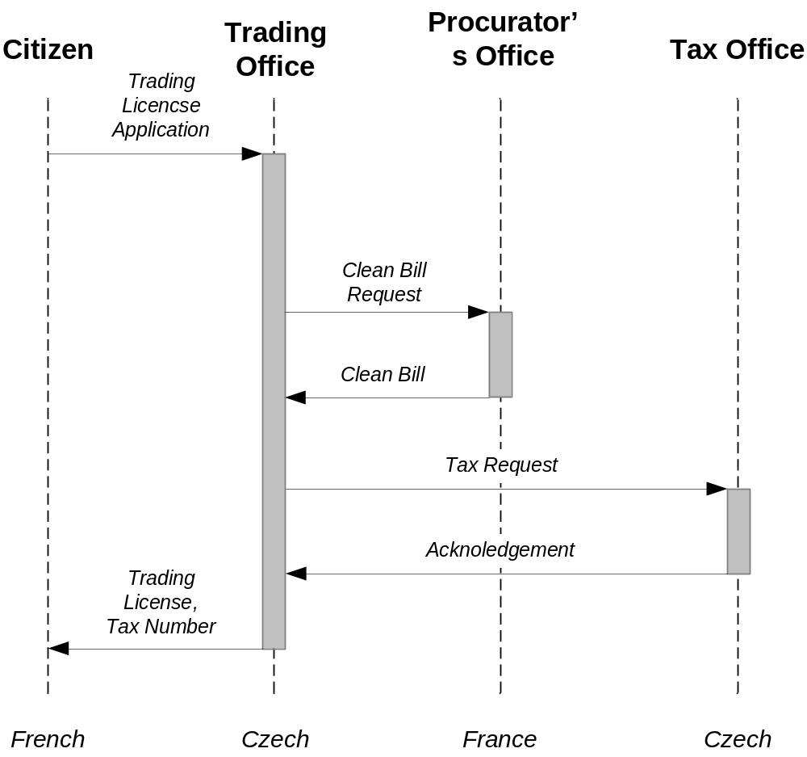
Example – PEGS
French citizen intends to start business in the Czech Republic

Slide 9
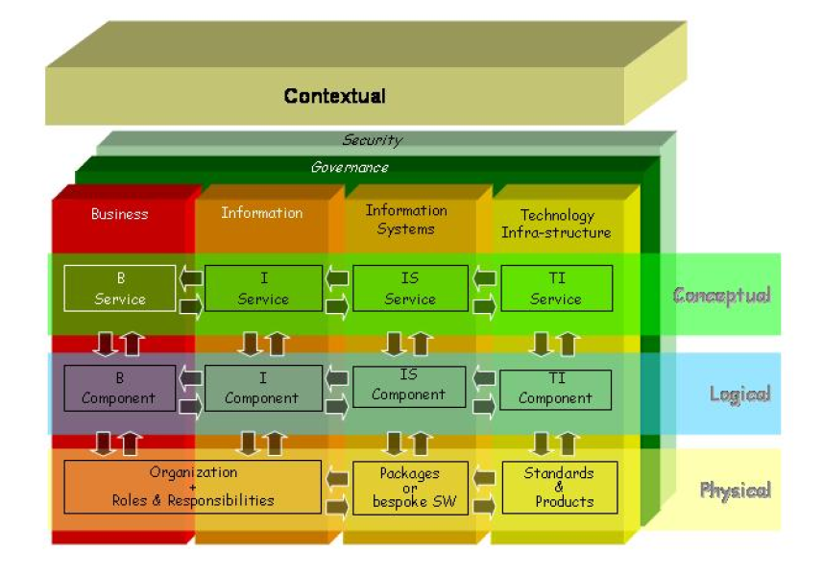
Architecture for PEGS
Notes:
Areas: “dimensions” of PEGS
Business – business processes involved in PEGS
Information – information structure, semantics of information
Information Systems –
Technology-infrastructure –
Governance, Security – emphasize quality aspects of the architecture
Four level of abstraction:
Contextual – answering why we need PEGS – requirements and principles
Conceptual – what: defines the services required and what is required from each service
Logical – how “customer” needs can be realized
Physical – with what PEGS should be delivered

Slide 10
Architecture for PEGS – Interoperability Layers
Organizational Interoperability
  MSAs running incompatible business process
  (1) Procedural gateway (process mediator)
  (2) Procedural adaptation
Semantic Interoparability
  (1) Semantic gateway (data mediatior)
  (2) Common Ontology
Technical Interoperability
  Different character sets, different languages
  (1) Syntactic Translation
Trivial Interoperability

Slide 11
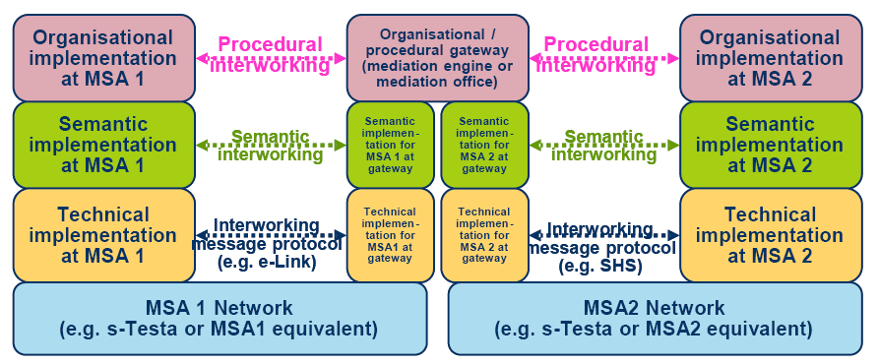
Architecture for PEGS
Interoperability Layers

Slide 12
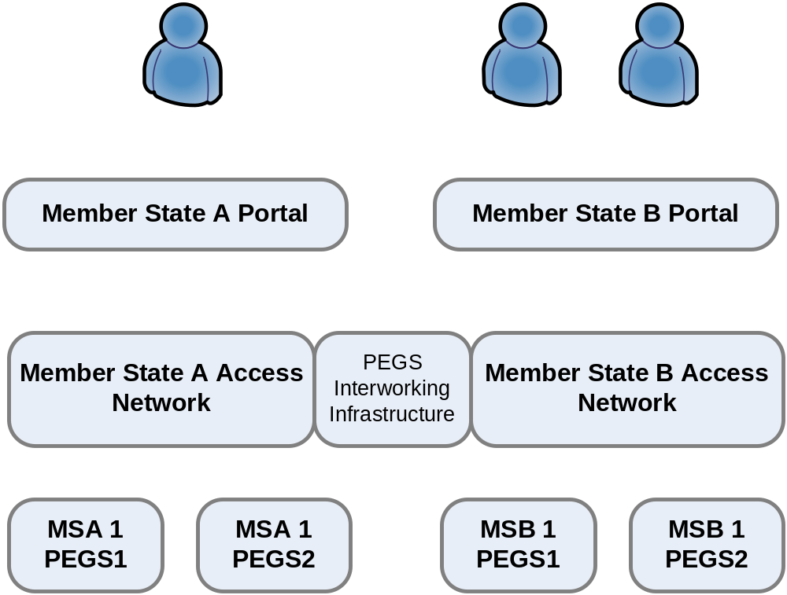
Architecture for PEGS
Access to National Services

Slide 13
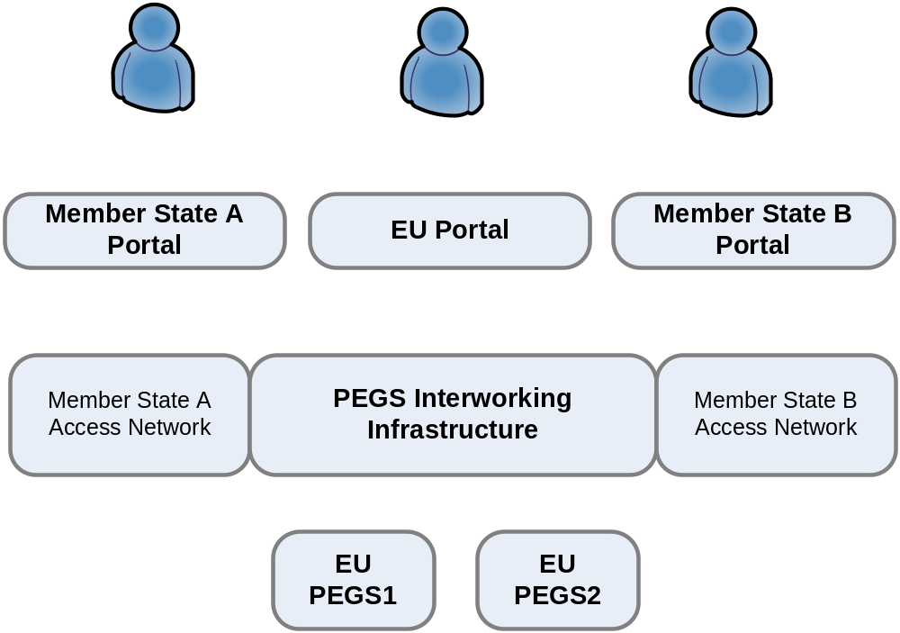
Architecture for PEGS
Access to Communal Services

Slide 14
PEGS and Semantic Web Services
PEGS Interworking Infrastructure – Semantic Web Services Infrastructure
  Organizational Interoperability – Process Mediator
  Semantic Interoperability – Data Mediator
  Technical Interoperability – Adapters

Slide 15
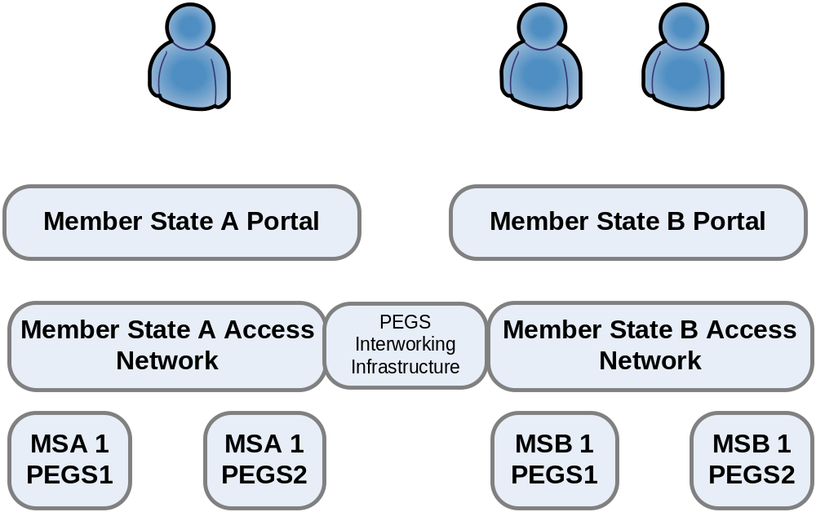
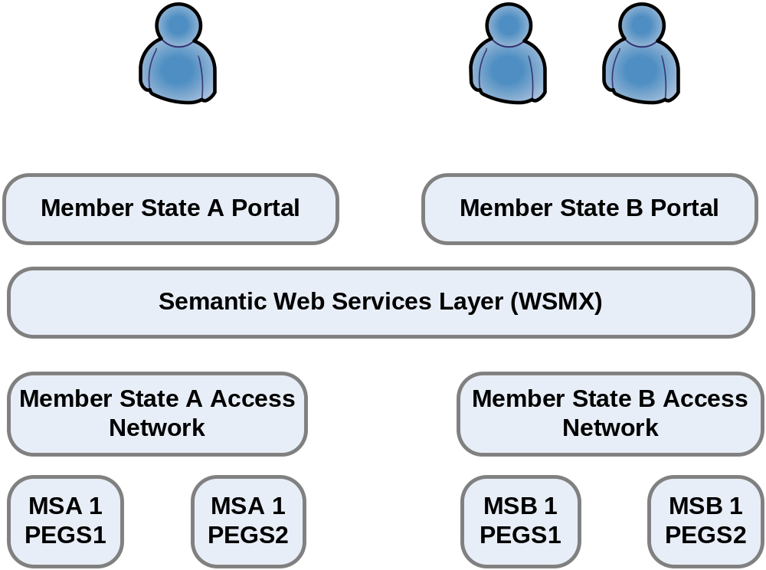
PEGS and Semantic Web Services

Slide 16
Summary
Concepts for PEGS defined within IDABC
Requirements for PEGS
  For Freedom, Trust, One-Stop Government, …
Architecture
  Conceptual, Logical, Physical
  Interoperability: organizational, semantic, technical
PEGS and Semantic Web Services
  SWS x PEGS Interworking Infrastructure

