Slide 1

Semantic-enabled Voice and Data Integration: Telecommunication Use Case
Tomas Vitvar, Jana Viskova
tomas.vitvar@deri.org, viskova@kis.fri.utc.sk
IEEE European Conference on Web Services Vaxjo, Sweden, November 2005

Slide 2
Overview
Motivation
Semantic Web Services and VoIP concepts
Scenario
Related Work, Future Work, Conclusion

Slide 3
Motivation
Convergence of networks
  Voice, data and video services using the same technology/network based on IP
Liberalization of Telecommunication Market
  Users can freely choose operators for different services
  Increasing number of operators and services
  Better services, better deals for users
Integration of voice/video (e.g. make a call, conference call) with data services (e.g. resolve name to number)
  Example: Click to Dial - a call will be automatically made by clicking on a user name. The callee number will be resolved and call will be made through predefined/selected operator.

Slide 4
Motivation – Current and Future Problems
A user manually comparing services and prices of more than one operators is nowadays quite usual
A big number of services will be hard to compare, combine and select manually
  Automatic discovery of services needed (discover operators which satisfy users’ needs – e.g. “make a (video) call”)
  (semi) Automatic composition of services needed (composition of services such as “resolve name to number” and “make a call”)
  (semi) automatic selection of services needed (selection of the “best” services – e.g. “make a call” service with cheapest rate per minute)
Different services will be using different data formats
  Automatic data mediation needed (e.g. operator 1: “time-unit=minute, currency=GBP”, operator 2: “tariff=second, currency=EUR”)

Slide 5
Overview
Motivation
Semantic Web Services and VoIP concepts
Scenario
Related Work, Future Work, Conclusion

Slide 6
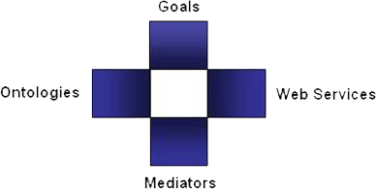
Semantic Web Services
Semantic Web Services
  DERI: WSMO, WSML, WSMX Working Groups
  Projects: DIP, KW, SEKT, SWWS, ASG, …
Web Service Modelling…
… Ontology -> WSMO
  Conceptual model for SWS:
  goal, ontologies, mediators, services
… Language -> WSML
  Ontology Language for SWS
  WSML Variants: WSML DL, WSML Rule, WSML Core, WSML Full
… Execution Environment -> WSMX
  Execution Environment and Architecture for SWS
Notes:
Web service modelling … ontology, language, execution env.
Wsml variants – too detailed

Slide 7
Voice over IP
Voice over IP, VoIP, IPtel
  Voice over Internet Protocol
  circuit switched vs. packet-switched communication
  No dedicated circuits in the network
    (+) Better use of network resources
    (+) Could be used for “Internet-to-Internet” calls “for free”
    (+) Opportunities for alternative operators
    (-) Reliability -> IPv6
    (-) Calls can’t be monitored
  Calling: two phases
    Call set-up: signalling – application protocols SIP, H.323
    Calling itself: RTP protocol

Slide 8
Overview
Motivation
Semantic Web Services and VoIP concepts
Scenario
Related Work, Future Work, Conclusion

Slide 9
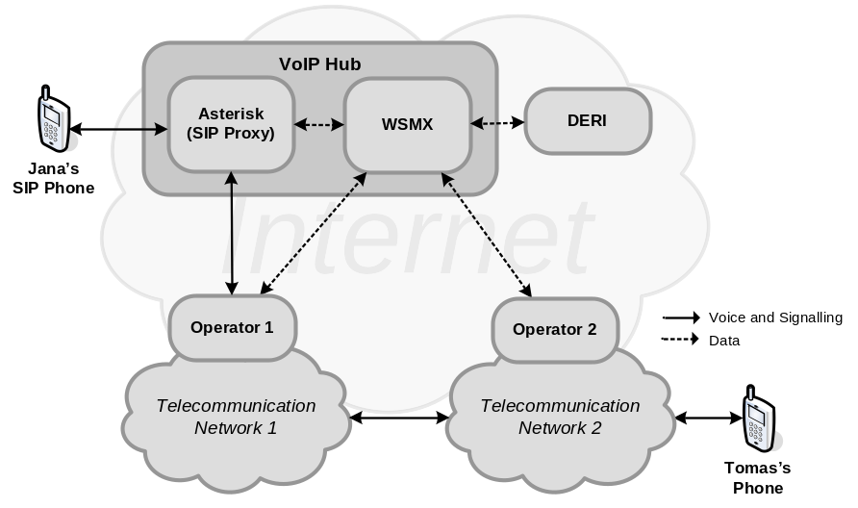
Scenario - prerequisites
Jana wants to make a call with Tomas
  She knows:
  Tomas’s name and where he works
  She doesn’t know:
  Tomas number
  She is using standard SIP phone
Jana is connected with VoIP Hub
  SIP Proxy and WSMX
Services Providers
  DERI web service resolve-name
  Telecom operator 1 and 2 each having one service authorize-call registered with WSMX
  Each operator provides access to his network through SIP GW
Jana wants to make a cheapest call with Tomas of who she only knows he works with DERI institute. She doesn’t know Tomas’s phone number.
Jana expresses her desire using her standard SIP phone by dialling “tomas#deri#price”.

Slide 10
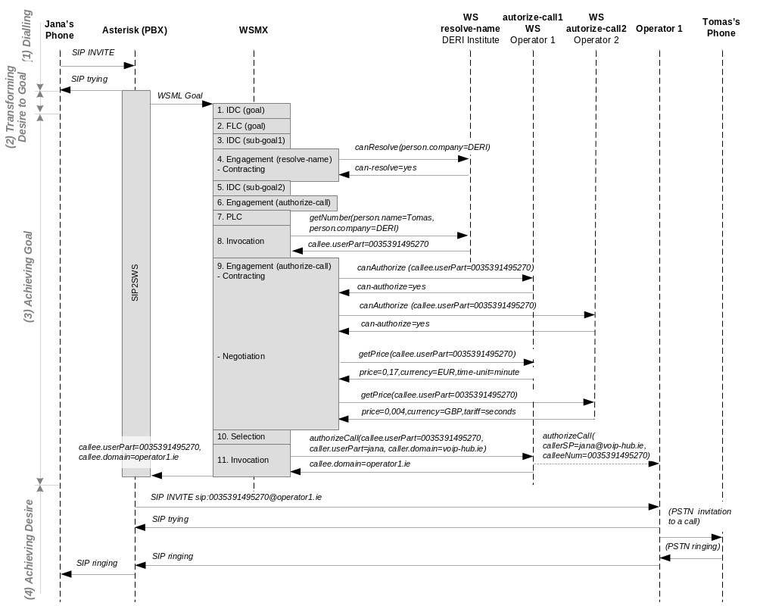
Scenario – interactions diagram

Slide 11
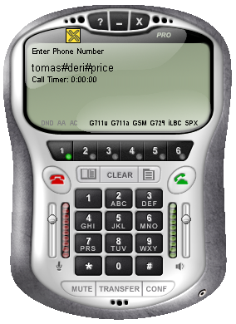
(1) Dialling
tomas#deri#price
INVITE sip:tomas#deri#price@voip-hub.ie SIP/2.0

Slide 12
(2) Transforming Desire to Goal: SIP2SWS
Asterisk Dial Plan
SIP2SWS
  Transform
  tomas#deri#price to
  WSML goal
  Call achieveGoal
  entry point of WSMX
exten => _.#.#., AGI(sip2sws, ${EXTEN})

Slide 13
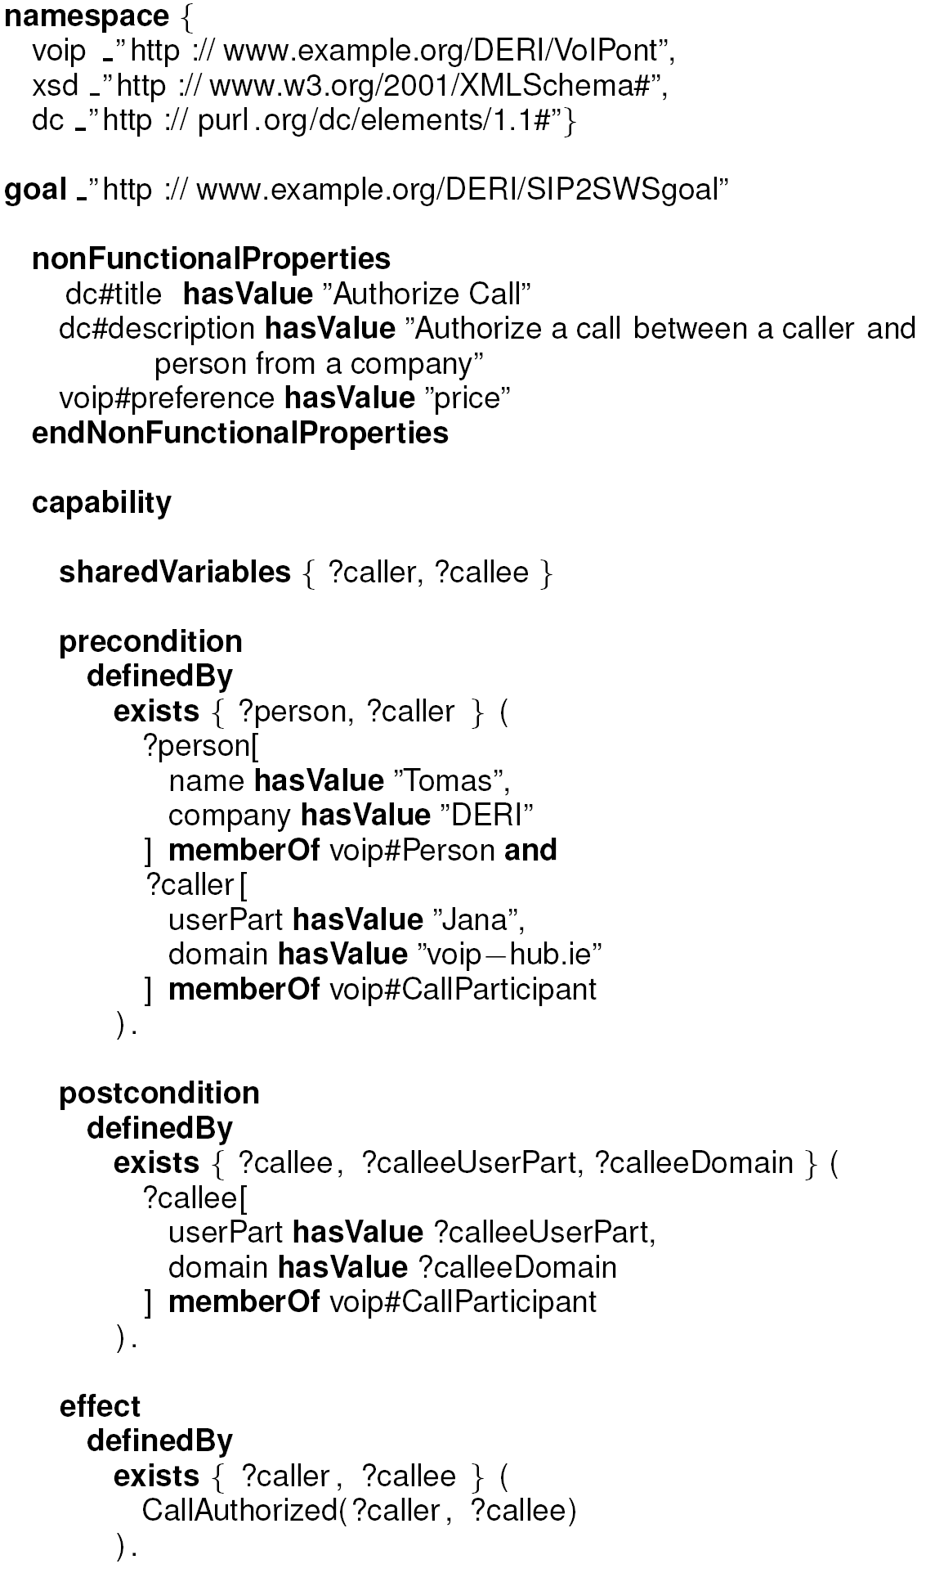
(2) Transforming Desire to Goal: WSML Goal
WSML Goal
  Non-functional properties
  Preconditions
    Person (name, company)
    Caller (userPart, domain)
  Postconditions
    Callee (userPart, domain)
  Effect
    callAuthorized(caller, callee)

Slide 14
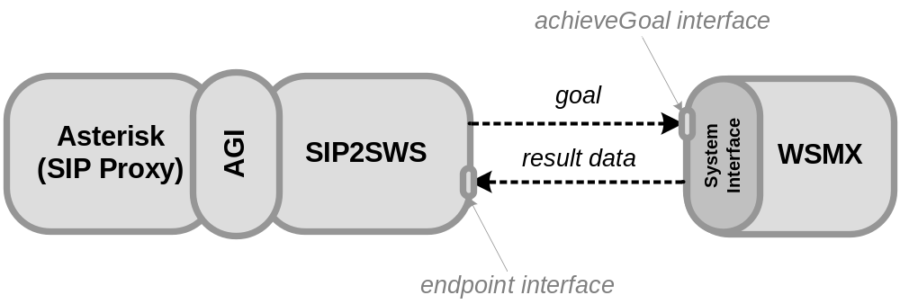
(2) Transforming Desire to Goal: call WSMX
WSMX System Entry Point
  achieveGoal(WSMLDocument goal)

Slide 15
Scenario – interactions diagram

Slide 16
(3) Achieving Goal
1. IDC(goal)
  Match goal with
  services in
  repositories
  No services found
2. FLC(goal)
  Goal is refined into
  sub-goals
  (1) lookup callee
  (2) authorize call

Slide 17
(3) Achieving Goal
3. IDC(sub-goal1)
  Match goal with
  services in
  repositories
  WS resolve-name
  found
4. Contracting
  Can resolve-name
  provide concrete/requested
  service?
  Result: yes, resolve-name is engaged

Slide 18
(3) Achieving Goal
5. IDC(sub-goal2)
  Match goal with
  services in
  repositories
  authorize-call1 and authorize-call2 found
6. Contracting
  Can authorize-call
  provide concrete
  service?
  Result: required input values not known
  resolve-name must be invoked

Slide 19
(3) Achieving Goal
7. PLC
  Creates workflow based on discovered services resolve-name and authorize-call
8. Invocation
  engaged service is called: resolve-name(Tomas, DERI)
  Result: callee.userPart=0035391495270

Slide 20
(3) Achieving Goal
9. Contracting
  Can authorize-call1 and authorize-call2 provide concrete service?
  Result: yes
9. Negotiation
  Get price for both services
  Both services are engaged and could be invoked
  Only one can be invoked -> selection

Slide 21
(3) Achieving Goal
10. Selection
  authorize-call1 or authorize-call2 are selected based on price (user preference)
  Different ontologies used (time-unit, tariff)
  Data mediation (mapping rules created during design-time)
  Result: authorize-call1 is selected

Slide 22
(3) Achieving Goal
11. Invocation
  The rest of the workflow is invoked (authorize-call1 WS)
  SIP GW is “opened” in operator1 for Jana and Tomas for the call

Slide 23
(3) Achieving Goal
SIP2SWS endpoint interface
  Result received

Slide 24
Scenario – interactions diagram

Slide 25
(4) Achieving Desire
RTP

Slide 26
Overview
Motivation
Voice over IP and Semantic Web Services concepts
Scenario
Related Work, Future Work, Conclusion

Slide 27
Related Work
Semantic Web Services
  OWL-S, METEOR-S, IRS-3
Voice and Data Integration
  Click to Dial, Click to SMS, integration with desktop such as MS Outlook etc.
  Integration through Parlay/X interfaces
  Semantic integration based on SWS has not been addressed so far
Notes:
Telecom management

Slide 28
Future Work
Integration of services in the context of NGN networks
  IMS (IP Multimedia System)
  Call Control and Application layers
  Semantic-enabled Service Brokers
Industrial Collaboration
  Bell Labs/Lucent, Telecommunication Operators

Slide 29
Conclusion
Motivation
  Convergence of networks
  Liberalization of telecommunications market
SWS: WSMO, WSML, WSMX; VoIP
Scenario – integration of voice and data services
  Make a cheapest call between caller and callee where callee name and place of work is known
  Integration of SIP Proxy and WSMX (VoIP Hub)
  SWS process: discovery, composition, contracting, negotiation, selection, invocation of services
Related and Future Work
  IMS and WSMX integration

