Slide 1

Tutorial on the Web Services Modeling Ontology
Organized for Bell Labs Ireland and Trinity College Dublin
Tomas Vitvar, Matthew Moran, Maciej Zaremba
DERI Galway
Tomas Vitvar, Matthew Moran, Maciej Zaremba
firstname.lastname@deri.org
WSMO Tutorial
23nd February, Galway, Ireland

Slide 2
Agenda
Semantic Web Services and WSMO
WSMX and WSMT
Hands-on Session and WSMX Demo (WSMT)
WSMX Case Study (buying stocks)

Slide 3
Agenda
Semantic Web Services and WSMO
Tomas Vitvar

Slide 4




Semantic Web and Web Services
500 million user
more than 3 billion pages
WWW
URI, HTML, HTTP
Static

Slide 5

Semantic Web and Web Services
  Serious Problems in
  information finding,
  information extracting,
  Information representing,
  information interpreting and information maintaining.
WWW
URI, HTML, HTTP
Semantic Web
RDF, RDF(S), OWL
Static

Slide 6

Semantic Web and Web Services
Web Services
UDDI, WSDL, SOAP
Dynamic
  Bringing the computer back as a device for computation
WWW
URI, HTML, HTTP
Semantic Web
RDF, RDF(S), OWL
Static

Slide 7
Semantic Web and Web Services
  Bringing the Web to its full potential
Web Services
UDDI, WSDL, SOAP
Intelligent Web
Services
Dynamic
WWW
URI, HTML, HTTP
Semantic Web
RDF, RDF(S), OWL
Static

Slide 8
Web Services
loosely coupled, reusable components
encapsulate discrete functionality
distributed
accessible over standard internet protocols
add new level of functionality on top of the current web

Slide 9
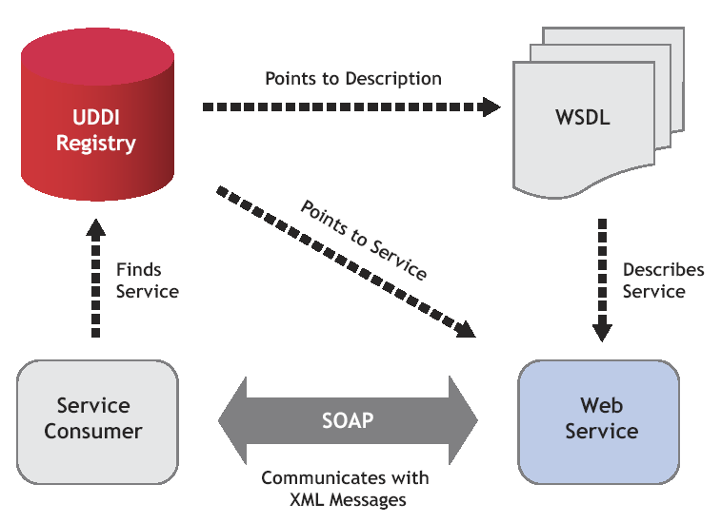
Web Services – standards, roles, actions
web-based SOA as new system design paradigm

Slide 10
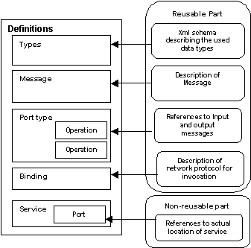
WSDL
Web Service Description Language
W3C effort, WSDL 2 final construction phase
  describes interface for
  consuming a Web Service:
  - Interface: operations (in- & output)
  - Access (protocol binding)
  - Endpoint (location of service)

Slide 11
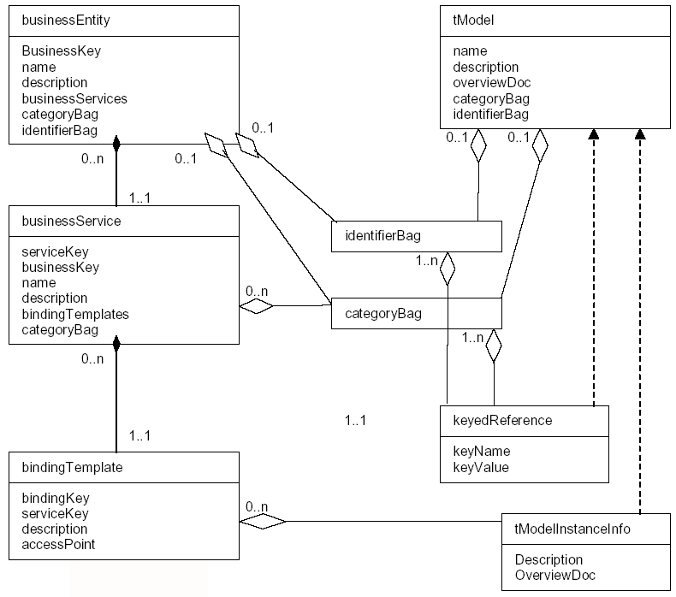
UDDI
Universal Description, Discovery, and Integration Protocol
OASIS driven standardization effort
  Registry for
  Web Services:
  - provider
  - service information
  - technical access

Slide 12
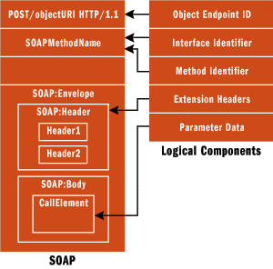
SOAP
Simple Object Access Protocol
W3C Recommendation
  XML data transport:
  - sender / receiver
  - protocol binding
  - communication aspects
  - content

Slide 13
Problems with Web Services
Current technologies allow usage of Web Services
Problems
  only syntactical information descriptions
  syntactic support for discovery, composition and execution
  Web Service usability, usage, and integration needs to be inspected manually
  no support for the Semantic Web

Slide 14
Semantic Web Services
Semantic Web Technology
+
Web Service Technology
allow machine supported data interpretation
ontologies as data model
automated discovery, selection, composition,
and web-based execution of services

Slide 15
Semantic Web Services
SWS Process
  Publication: Make the description of a Web service available on the Web
  Discovery: Detect suitable services for a solving given task
  Selection: Choose the most appropriate services among the usable ones
  Composition: Combine services to achieve a goal
  Mediation: Solve mismatches (data, process) among the elements that shall interoperate
  Execution: Invoke services according to consumption interface and programmatic conventions

Slide 16
Web Service Modeling Ontology
WSMO – Conceptual model for Semantic Web Services
WSML – Formal ontology language
WSMX – Execution environment and architecture for SWS
Derived from and based on the Web Service Modeling Framework WSMF
ESSI cluster (former SDK-Cluster) Working Group
  (joint European research and development initiative)

Slide 17




ESSI Working Groups
A Conceptual Model for SWS
A Formal Language for WSMO
Execution Environment for WSMO
A Rule-based Language for SWS

Slide 18
WSMO Design Principles
Web Compliance
Ontology-Based
Goal-driven
Centrality of Mediation

Slide 19
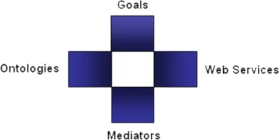
WSMO Top Level Concepts
Objectives that a client wants to
achieve by using Web Services
Provide the formally specified terminology
of the information used by all other components
Semantic description of Web Services:
Capability (functional)
Interfaces (usage)
Connectors between components with mediation facilities for handling heterogeneities
  WSMO D2, version 1.2, 13 April 2005 (W3C submission)

Slide 20
Non-Functional Properties
Every WSMO elements is described by properties that contain relevant non-functional aspects
  Dublin Core Metadata Set:
    complete item description
    used for resource management
    e.g. description, language, creator, …
  Versioning Information
    evolution support, versioning control
  Quality of Service Information
    availability, reliability

Slide 21
WSMO Ontologies
Objectives that a client wants to
achieve by using Web Services
Semantic description of Web Services:
Capability (functional)
Interfaces (usage)
Provide the formally specified terminology
of the information used by all other components
Connectors between components with mediation facilities for handling heterogeneities

Slide 22
Ontology Specification
Non functional properties
Imported Ontologies
  importing existing ontologies where no heterogeneities arise
Used mediators
  OO Mediators (ontology import with terminology mismatch handling)
Ontology Elements:
  Concepts – set of concepts that belong to the ontology, incl.
  Attributes – set of attributes that belong to a concept
  Relations – define interrelations between several concepts
  Functions – special type of relation
  Instances – set of instances that belong to the represented ontology
  Axioms – axiomatic expressions in ontology (logical statement)

Slide 23
WSMO Web Services
Objectives that a client wants to
achieve by using Web Services
Provide the formally specified terminology
of the information used by all other components
Semantic description of Web Services:
Capability (functional)
Interfaces (usage)
Connectors between components with mediation facilities for handling heterogeneities

Slide 24
WSMO Web Service Description
Complete item description
Quality aspects
Advertising of Web Service
Support for WS Discovery
Non-functional Properties
DC + QoS + Version + financial
Capability
functional description
client-service interaction interface for consuming WS
External Visible
Behavior
- Communication
Structure
- ‘Grounding’
realization of functionality by aggregating
other Web Services
functional
decomposition
interaction with
aggregated WS
Web Service
Implementation
(not of interest in Web Service Description)
WS
WS
WS
Choreography --- Service Interfaces ---
Orchestration

Slide 25
Capability Specification
Non functional properties, Imported Ontologies, Used mediators
Preconditions
  what a web service expects in order to be able to provide its service (conditions over the input)
Assumptions
  conditions on the state of the world that has to hold before the Web Service can be executed
Preconditions
  Describes the result of the Web Service in relation to the input, and conditions on it
Preconditions
  conditions on the state of the world that hold after execution of the Web Service (i.e. changes in the state of the world)

Slide 26
Choreography & Orchestration
VTA example:
Choreography = how to interact with the service to consume its functionality
Orchestration = how service functionality is achieved by aggregating other Web Services
When the service is
requested
When the service
requests
Date, Time
Hotel Service
Date
VTA
Service
Hotel
Time
Flight, Hotel
Error
Error
Date, Time
Flight Service
Confirmation
Flight
Error

Slide 27
Service Interface Description Model – Abstract State Machine
Vocabulary Ω:
  ontology schema(s) used in service interface description
  usage for information interchange: in, out, shared, controlled
States ω(Ω):
  a stable status in the information space
  defined by attribute values of ontology instances
Guarded Transition GT(ω):
  state transition
  general structure: if (condition) then (action)
  different for Choreography and Orchestration
  additional constructs: add, delete, update

Slide 28
Service Interface Example
Ω_{in} hasValues {
concept A [
att1 ofType X
att2 ofType Y]
…}
Ω_{out} hasValues {
concept B [
att1 ofType W
att2 ofType Z]
…}
Vocabulary:
- Concept A in Ω_{in}
- Concept B in Ω_{out}
State ω₁
Guarded Transition GT(ω₁)
State ω₂
a memberOf A [
att1 hasValue x
att2 hasValue y]
IF (a memberOf A [
att1 hasValue x ])
THEN
(b memberOf B [
att2 hasValue m ])
a memberOf A [
att1 hasValue x,
att2 hasValue y]
b memberOf B [
att2 hasValue m]
Received instance a
Sent instance b

Slide 29
WSMO Goals
Objectives that a client wants to
achieve by using Web Services
Provide the formally specified terminology
of the information used by all other components
Semantic description of Web Services:
Capability (functional)
Interfaces (usage)
Connectors between components with mediation facilities for handling heterogeneities

Slide 30
Goal Specification
Non functional properties, Imported Ontologies, Used mediators
Requested Capability
  describes service functionality expected to resolve the objective
  defined as capability description from the requester perspective
Requested Interface
  describes communication behaviour supported by the requester for consuming a Web Service (Choreography)

Slide 31
WSMO Mediators
Objectives that a client wants to
achieve by using Web Services
Provide the formally specified terminology
of the information used by all other components
Semantic description of Web Services:
Capability (functional)
Interfaces (usage)
Connectors between components with mediation facilities for handling heterogeneities

Slide 32
Mediation
Heterogeneity …
  Mismatches on structural / semantic / process levels
  Occur between different components that shall interoperate
  Especially in distributed & open environments like the Internet
Concept of Mediation:
  Mediators as components that resolve mismatches
  Several types of mediators defined by WSMO
    Data mediation and process mediation, goal refinement

Slide 33
Mediator Structure
Source
Component
WSMO Mediator
uses a Mediation Service via
1
Target
Component
1 .. n
Source
Component
as a Goal
directly
optionally incl. Mediation
Mediation
Services

Slide 34
OO Mediator Example
Merging 2 ontologies
Train Connection
Ontology (s1)
OO Mediator
Mediation Service
Train Ticket
Purchase Ontology
Purchase
Ontology (s2)
Goal:
“merge s1, s2 and
s1.ticket subclassof s2.product”
Discovery
Mediation
Services

Slide 35
GG Mediator
Aim:
  Support specification of Goals by re-using existing Goals
  Allow definition of Goal Ontologies (collection of pre-defined Goals)
  Terminology mismatches handled by OO Mediators
Example: Goal Refinement
Source Goal
“Buy a ticket”
GG Mediator
Mediation Service
Target Goal
“Buy a Train Ticket”
postcondition:
“aTicket memberof trainticket”

Slide 36
WW Mediators
WW Mediators:
  enable interoperability of heterogeneous Web Services
  support automated collaboration between Web Services
  OO Mediators for terminology import with data level mediation
  Process Mediation for making Business Processes interoperable

Slide 37
Data Level Mediation (OO Mediation)
Related Aspects
  Ontology Integration (Ontology Mapping/Aligning and Merging)
  Data Lifting & Lowering
Mapping Language – Abstract Mapping Language
  independent of ontology specification langauge
  “Grounding” to specific langauges for execution (WSML, OWL, F-Logic)
Main Features:
  Direction of mapping (uni- / bidirectional)
  Mapping between Ontology Constructs:
    classMapping, attributeMapping, relationMapping (between similar constructs)
    classAtrributeMapping, classRelationMapping, classInstanceMapping, instanceMapping (explicit ontology instance transformation)

Slide 38
Mapping Language Example
Ontology O1
Ontology O2
Person
name
age
Human
- name
1234 memberOf Person
name =James
age = 22
Adult
Child
classMapping(unidirectional o2:Person o1.Adult
attributeValueCondition(o2.Person.age >= 18))
this allows to transform the instance 1234 of ontology O2 into a
valid instance of ‘adult’ in ontology O1

Slide 39
Conclusion
Semantic Web Services
  Combination of Web Services Technology with Semantic Web
  Ontology used for definition of data models
WSMO Conceptual Model
  ESSI Working Groups (WSMO WG, WSML WG, WSMX WG)
  Top Level Concepts
    Ontologies, Goals, Mediators, Services
  Specification for Execution Environment for the SWS

Slide 40
Agenda
WSMX Architecture
Matthew Moran

Slide 41
Contents
Introduction & motivation
Structural view
  Functional components
Behavioural view
  Walk-through based on eBanking case study
Summary & links

Slide 42
Part I
Introduction & motivation

Slide 43
Introduction
An execution environment for Semantic WS
Unifying platform for DIP components
  Components plug in as plain Java objects
Foundation for OASIS Technical Committee on Semantic Execution Environments (OASIS SEE TC)
Service Oriented Architecture based on Java JMX
Open source

Slide 44
Motivation
Provide a robust, flexible and extensible environment for the functional components of DIP
Extend SOA to cater for semantics
  SOA without semantics can not solve integration issues
Build on existing Web Service technology
  Web services open the potential of the Web for B2B but need semantic mark-up
Open-source
  Encourage broad adoption

Slide 45
Part II
Structural View

Slide 46
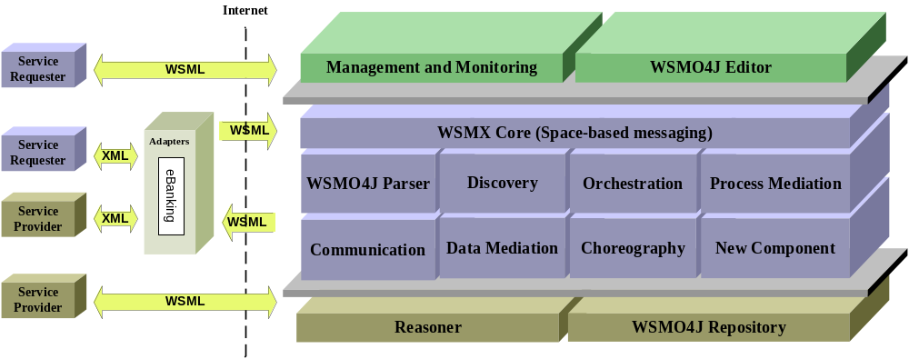
DIP Architecture

Slide 47
Parser
Parse WSML descriptions into an internal Java representation
Java model provided by WSMO4J
Open-source, currently version 0.51

Slide 48
Discovery
Match Goals to potentially suitable Web Services
Currently use keyword matching based on the WSMO descriptions
DIP prototype due for M30

Slide 49
Choreography Engine
The Choreography engine handles the exchange of messages based on WSML descriptions
WSMX ←→ Requester (Goal description)
WSMX ←→ Provider (Web Service description)
Works closely with the communication manager

Slide 50
Data Mediator
Handles semantic mismatches between requester and provider ontologies
Design-time aspect – building of mappings between concepts
Run-time aspect – mappings are loaded as rules into reasoning engine and applied to instance data

Slide 51
Process Mediator
Handles differences between Goal and Web service choreographies (if possible)
Design-time aspect – determine equivalences between the choreographies and store rules
Run-time aspect – analyse the two choreography instances and to use the rules to mediate any mismatches

Slide 52
Communication Manager
Receiver aspect – implements the entry points for WSMX exposed via WSDL (as well as RMI)
Invoker aspect – constructs message to be sent to provider and uses grounding information to make the actual service invocation

Slide 53
Orchestration
How the service fulfills its capabilities using other services (or goals)
Shares underlying formalism with choreography engine
Prototype available M30

Slide 54
Adapters
Overcomes data representation mismatches on the communication layer
Transforms the format of a received message into WSML compliant format
Adapter framework acts as a container into which individual adapters (plain Java) can be plugged

Slide 55
WSMX Core
Provides the plug-in functionality
Handles message routing
  Space-based
  Virtual server
Multiple execution semantics

Slide 56
Reasoners
????

Slide 57
Part III
Behavioural View

Slide 58
Execution Semantics
Describe the behaviour of the architecture for achieving specific tasks
Describes the flow of data and control between components in the architecture
WSMX supports multiple concurrent execution semantics – flexible SOA architecture

Slide 59
Architecture Walk-through
eBanking Case Study
Goal based execution of stock trading service
  Checking the status of stocks
  Stocks are bought or sold depending on price movement

Slide 60
Walk-through

Slide 61
Walk-through
eBanking client sends
a WSML Goal to
WSMX via WSDL
entry-point

Slide 62
Walk-through
An instance of the
achieveGoal
execution semantics
is created in the core

Slide 63
Walk-through
The Goal to BuyOrSell
stock is parsed
into WSMO4J Java
objects

Slide 64
Walk-through
Discovery of a Stock trading
Web service is the next step
defined by execution
semantics

Slide 65
Walk-through
Data mediation may be
necessary if Goal and
service descriptions
use different ontologies.

Slide 66
Walk-through
Choreography engine is used
to create instances of the
choreographies of the
eBanking goal and the
stock trading service

Slide 67
Walk-through
Process mediator is used
to link a message from the
goal choreography to a
message in the service
choreography.

Slide 68
Walk-through
Service choreography
indicates that a message has
been received by WSMX to
be sent to the service

Slide 69
Walk-through
The Communication Manager
is instructed to send the
message to the service via
an adapter

Slide 70

Walk-through
Web service returns data to
the communication manager
via the adapter

Slide 71
Walk-through
The return message is given
to the instance of the service
choreography

Slide 72
Walk-through
The process mediator
links the message in the
service choreography with
a message in the goal
choreography

Slide 73
Walk-through
Goal choreography tells
the communication manager
to return the data to the
requester (assuming no data
mediation is required)

Slide 74
Walk-through
Data is returned to requester.
(In this case the requester can
handle data represented in
WSML)

Slide 75
Part IV
Summary & Links

Slide 76
Summary
Semantic Service Oriented Architecture
Unifies DIP functional components
Basis of OASIS SEE TC
Platform for DIP Case Study prototypes
Open source, adopted by new EU projects

Slide 77
Links
WSMX, WSMO home pages
  http://www.wsmx.org
  http://www.wsmo.org
Open source
  http://sourceforge.net/projects/wsmx
  http://wsmo4j.sourceforge.net
OASIS SEE TC
  http://www.oasis-open.org/apps/org/workgroup/semantic-ex

Slide 78
Protocol & Process Level Mediation
internal business logic of Web Service
(not of interest in Service Interface Description)
internal business logic of Web Service
(not of interest in Service Interface Description)
WW Mediator
if a choreography does not exist, then find an appropriate WW Mediator that
  resolves possible mismatches to establish Information Compatibility (OO Mediator usage)
  resolves process / protocol level mismatches in to establish Communication Compatibility

Slide 79
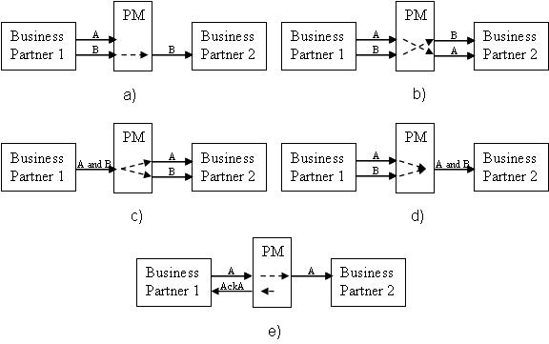
Process Mediation – Addressed Mismatches

Slide 80
Unsolvable Mismatches
PM
A
Business Partner1
Business Partner2
?
B
PM
A
Business Partner1
Business Partner2
A
?
B
A
PM
Business Partner1
Business Partner2
Ack
?

Slide 81
Process Mediation Example
Processes Mediator
origin
itinerary[origin,
destination, date]
destination
S
E
R
V
I
C
E
R
E
Q
U
E
S
T
itinerary[origin,
destination]
time
date
price
itinerary [route,
date, time, price]

Slide 82
Process Mediation Example
Processes Mediator
origin
itinerary[origin,
destination, date]
destination
S
E
R
V
I
C
E
R
E
Q
U
E
S
T
itinerary[origin,
destination]
time
date
price
itinerary [route,
date, time, price]

Slide 83
Process Mediation Example
Processes Mediator
origin
itinerary[origin,
destination, date]
destination
S
E
R
V
I
C
E
R
E
Q
U
E
S
T
itinerary[origin,
destination]
time
date
price
itinerary [route,
date, time, price]

Slide 84
Process Mediation Example
Processes Mediator
origin
itinerary[origin,
destination, date]
destination
S
E
R
V
I
C
E
R
E
Q
U
E
S
T
itinerary[origin,
destination]
time
date
price
itinerary [route,
date, time, price]

Slide 85
Process Mediation Example
Processes Mediator
origin
itinerary[origin,
destination, date]
destination
S
E
R
V
I
C
E
R
E
Q
U
E
S
T
itinerary[origin,
destination]
time
date
price
itinerary [route,
date, time, price]

Slide 86
Agenda
E-Banking Use Case
Maciej Zaremba

Slide 87
Overview
Overall goal
Prototype requirements
Example scenarios
Benefits of using SWS in eBanking
Necessary steps for SWS integration via WSMX
Prototype architecture
Conclusions

Slide 88
Overall Goal
Create portfolio management system that aggregates data offered by the banks and compose their base services in customer tailored scenarios.
Using natural language user should be able to:
  Consult stock market various statistical data on which certain requirements can be imposed using rules
  Invoke operations on the stock market that might involve composition of existing primitive services

Slide 89
Prototype Requirements
A client describes in a textbox its goals by typing it in natural language
A natural language recognition system (NRLS) filters the text and extracts the more relevant informations
Once the client question is understood the system builds a WSMO Goal and sends it to WSMX
If specified, user’s request can be re-executed multiple times until it succeeds
The client receives the result in natural language format

Slide 90
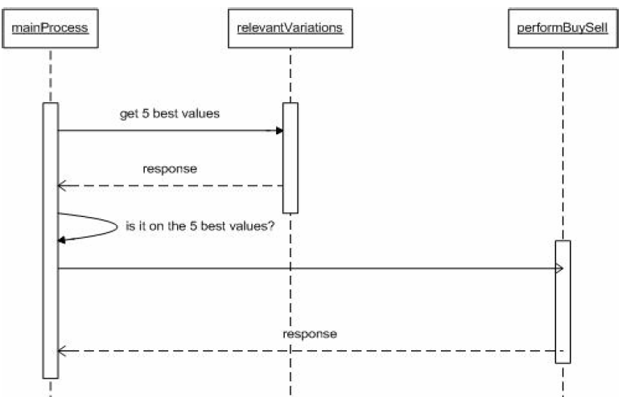
Example Scenarios
If the stock value belongs to the top five variations, then the system executes certain action (BUY, SELL, ALERT).

Slide 91
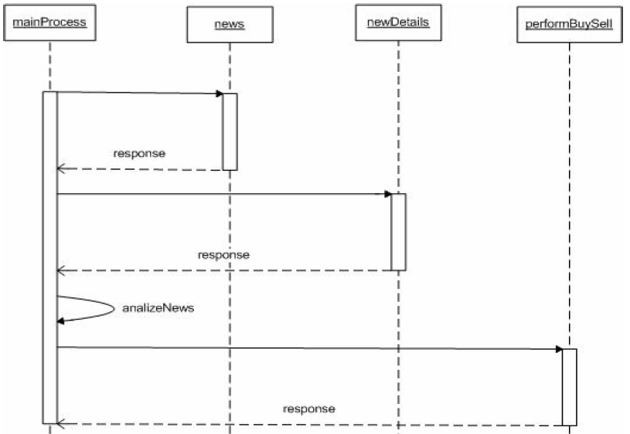
Example Scenarios
If the advice of several/all/some/specific brokers/banks is BUY/SELL then execute the action

Slide 92
Benefits of SWS in eBanking
For user:
  User do not have to visit multiple web sites, but can use one portal that aggregates multiple services and can be extended with new ones.
For providers:
  Integration - support for data and process heterogeneity (mediation)
  Easiness in adding/modyfing services
  Support for the discovery
  Foundation for logic reasoning about service description and behaviors

Slide 93
Necessary steps for SWS integration via WSMX
Creating WSMO Goals. The client has to express its requirements and behavior using WSMO Goal. Template approach, after natural language analysis Goals are populated with values.
Creating WSMO Web service. Providing semantic descriptions. Lifting arbitrary XML messages to the upper, semantic level by the ontology conceptualization and describing message exchange patterns
WSDL grounding to WSML. Bidirectional mappings between XML and WSML.
Ontology mapping. Bidirectional mappings between the ontologies Currently, WSMX takes a semi-automatic, mappings are created offline and executed during the run-time.

Slide 94
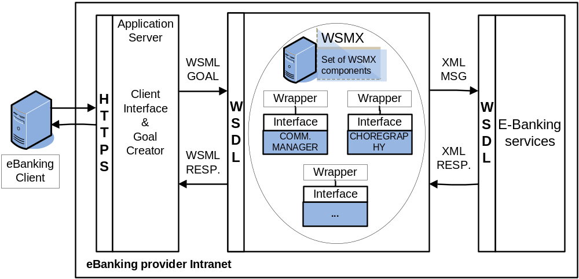
Prototype Architecture

Slide 95
Conclusions
System allows to express Goals by the user in natural language that in turn are mapped to WSML what allows to execute them on WSMX
User do not have to visit multiple web sites, but can use one portal that aggregates multiple services and can be extended with new ones
Semantic infrastructure is in the place giving foundation for the mediation, composition, and discovery

