Slide 1

Pan-European E-Government Services on the Semantic Web Services Technology
Tomas Vitvar, Adrian Mocan, Arnold van Overeem, Vassilios Peristeras, Konstantinos Tarabanis
Tomas Vitvar
tomas.vitvar@deri.org
E-Government: Bariers and Opportunities – World Wide Web 2006 Conference
May 23–26 2006, Edinburgh, UK

Slide 2
Overview
SemanticGov project
Background: IDABC, WSMOLX
Pan-European E-Government on SWS
Conclusion

Slide 3
SemanticGov Project
EU FP6 Project
Start: January 2006, End: December 2008 (3 years)
Goal
  Build National and Pan-European E-Government System based on SWS technology and PA Service Model and being compliant with IDABC efforts
Partners
  Research: DERI Galway (Ireland), DERI Innsbruck (Austria), CERTH (Greece), University of Roma (Italy)
  Industry: CapGemini (Netherlands), Software AG (Germany), ALTEC (Greece), OntoText (Bulgaria)
  User: City of Torino (Italy), Ministry of Interior for Central Macedonia (Greece)

Slide 4
IDABC
IDABC – Interoperable Delivery of European e-Government Services to Public Administrations, Businesses and Citizens
Former IDA (promote interoperability between administrations in EU)
Sector Projects (e.g. integration of IS in transport, health, …)
Horizontal Activities
  On-line Front-office services (portals)
  Infrastructure Services (European Interoperability Framework, PEGS Architecture)

Slide 5
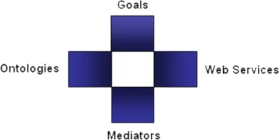
Semantic Web Services in DERI
Semantic Web Services
  (semi) automate discovery, selection, composition, mediation, invocation of services
  DERI: WSMO, WSML, WSMX Working Groups
  (other: OWL-S, WSDL-S/METEOR-S)
  Projects: DIP, KW, SEKT, SWWS, ASG, …
  New Projects in areas of e-government, e-health, BPM
Web Service Modelling…
… Ontology -> WSMO
  Conceptual model for SWS:
  goal, ontologies, mediators, services
… Language -> WSML
  Ontology Language for SWS
  WSML Variants: WSML Core, WSML DL, WSML Rule, WSML Full
… Execution Environment and Architecture -> WSMX
  Middle-ware platform for SWS
  Now in OASIS SEE TC

Slide 6
Pan-European E-Government and SWS
PA
Service Model
WSMO
Service Model
WSMO-PA
IDABC–PEGS
SWS
Architecture
Semantic PEGS
Architecture

Slide 7
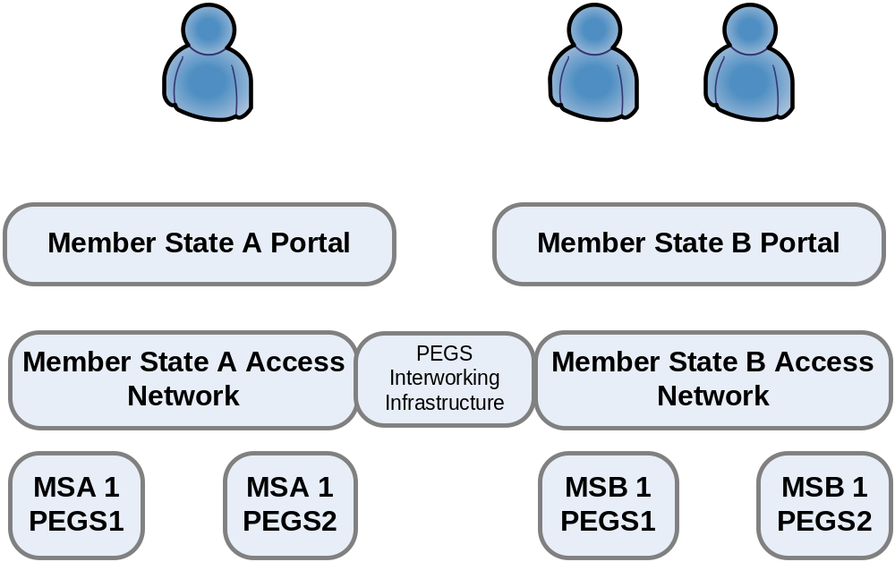
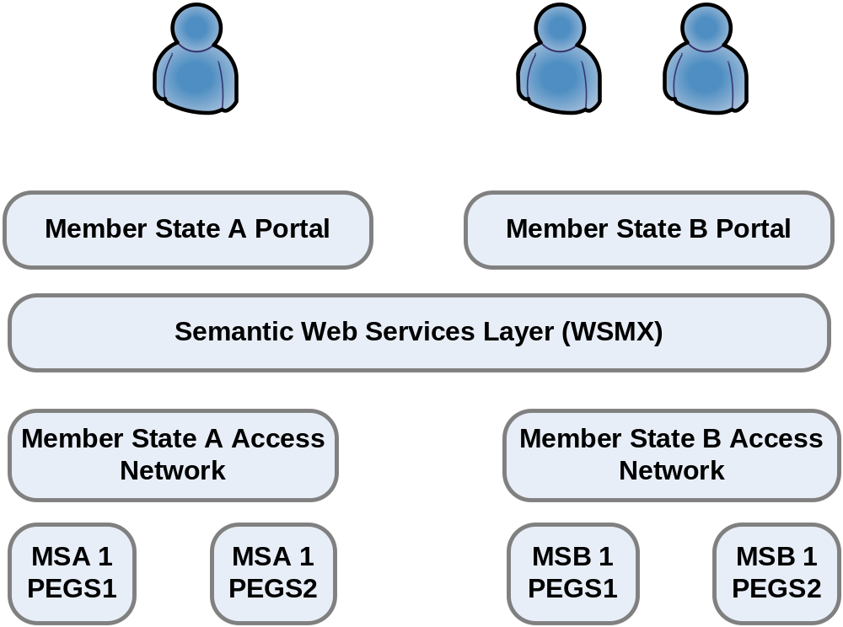
PEGS and Semantic Web Services

Slide 8
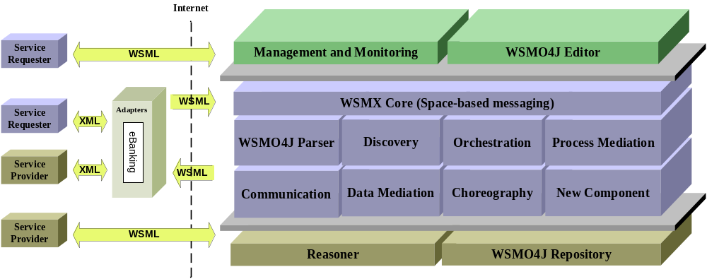
WSMX Architecture

Slide 9
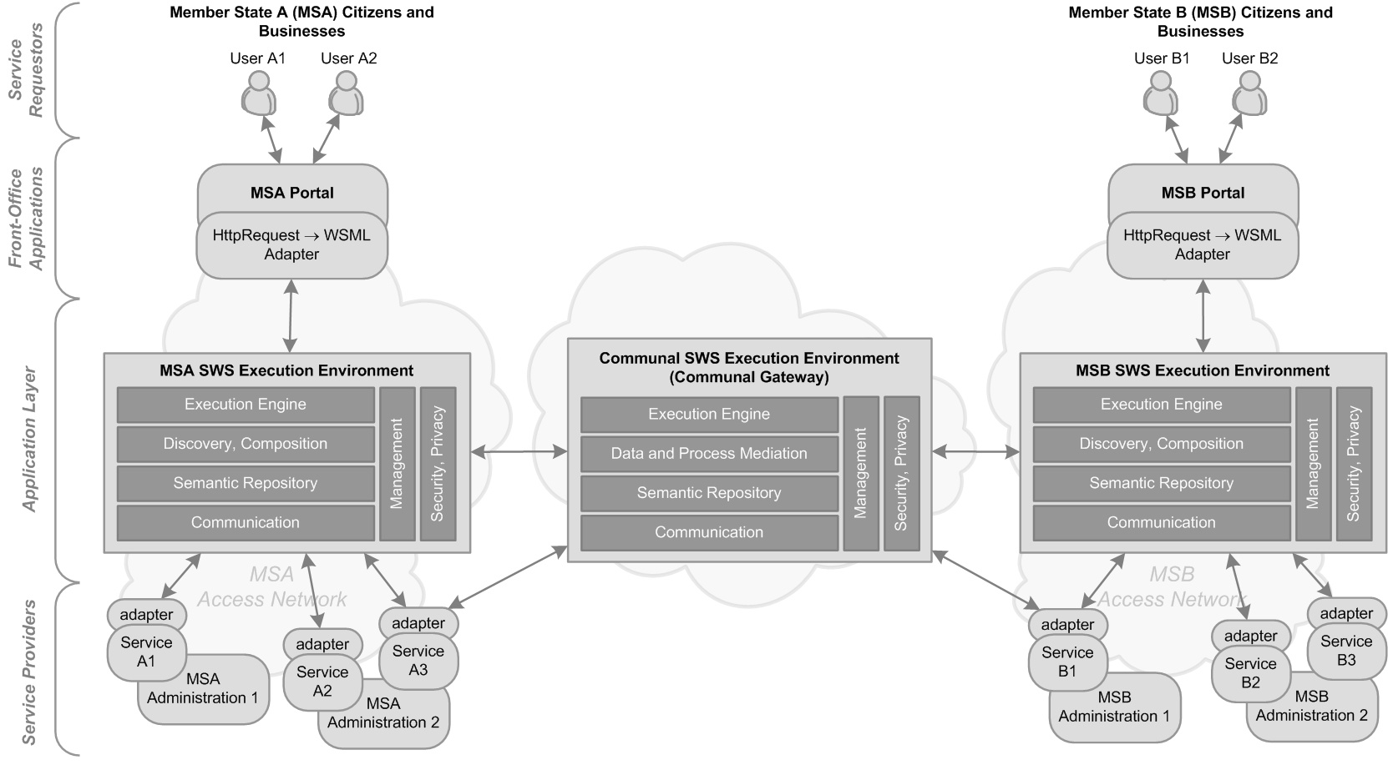
PEGS and Semantic Web Services

Slide 10
NEGS SemanticGov Architecture Components
Needs2Services (N2S) Facilitator
  Level of front-office application
    Part of Member State Portal
  “Transforming” client’s needs to services
  On result -> WSMO Goal
  Next: discovery and composition to find actual services satisfying goal

Slide 11
NEGS SemanticGov Architecture Components
Discovery, Composition, Service Registry
  Central/Common registry at National Level
  One registry at Public Administration Level
    Distributed discovery across PA service registries
    Requester requires service from another member state
PA2
Discovery request
Discovery
PA1
Discovery request
Discovery
Discovery request
PA4
Discovery
Discovery request
PA3
Discovery
Discovery request

Slide 12
NEGS SemanticGov Architecture Components
Service Creation
  Semantic PA service creation using WSMO-PA
  Ontologizing of non-semantic messages
  (e.g. XSD Schema)
    Manual creation of ontologies (integration/domain ontology)
Adapters
    Transformation from non-semantic messages (e.g. XSD schema) to ontological level
      Rules for lifting and lowering
    Technical interoperability: Interoperability at the level of communication protocols (e.g. ftp, http, soap, …)

Slide 13
NEGS SemanticGov Architecture Components
Data and Process Mediation
  No need at national level
    Data/process interoperability achieved through
    common standards
    e.g. birth certificate is the same throughout the country but not across countries
  Communal Level
    Communal Gateway
      Data Mediation
        Interoperability achieved through mapping of ontologies and executing mapping rules and conversions
      Process Mediation?
        Processes should be compatible
        SemanticGov will not deal with “procedural interoperability”
        Compatible processes could need process mediation (process mediation is possible whereas if procedural interoperability is not achieved, process mediation might not be possible)

Slide 14
Conclusion
IDABC and SWS – WSMO, WSML, WSMX
Formalize PA service model using WSMO and WSML
Build PEGS Infrastructure on SWS (WSMOLX)
  Apply and develop WSMX to facilitate PEGS architecture according to the IDABC specifications
  Interoperability in cross-country e-gov services (data, process, technical)
  Discovery, composition of services
  Communal Gateway – data/semantic interoperability

