Slide 1


Semantic Web Services enabled B2B Integration
Kotinurmi,Vitvar, Haller, Richardson and Boran
Contact author: Paavo.Kotinurmi@tkk.fi
Data Engineering Issues in E-Commerce and Services
June 26, 2006
Notes:
Good afternoon everybody,
My name is Paavo Kotinurmi and I will present our paper on semantic web services enabled B2B integration.
This is joint work with many colleagues.
I myself am from Helsinki University of Technology, in Finland. For the past 7,5 months I have been visiting researcher in DERI Galway.
The colleagues Tomas Vitvar, Armin Haller from DERI and Ray Richardson and Aidan Boran have also contributed to this work.

Slide 2
Outline
Motivation
Interoperability scenario
Integration set-up and run-time phases
B2B Integration Process execution
Conclusions
Notes:
The outline of my presentation today is as follows.
I first motivate briefly the SWS approach.
I start by going through our use case scenario of Supply chain integration.
The integration itself is divided to integration setup and integration run-time phases. I go those through.
Then I go through B2B integration process run-time behaviour
Finally draw up conclusions made.

Slide 3
Motivation
Current integrations are very rigid
  Little or no flexibility
  It takes even 6 months to get everything working with standard
  Negotiation on details take time and is manual
There is business needs for more flexible behaviour
  Current integrations lead to non-optimal business behaviour, e.g. always shipments using one carries
Semantic Web Services have been proposed to facilitate fast integrations – even automated ones.
  Mediation, discovery, composition and selection capabilities
Notes:
Why integration using SWS technologies…
The current technologies used have serious limitations. They are very rigid and offer little flexibility.
The setup can take months due to inflexibility and rigidness to changes. This negotiation is also very manual process.
At the same time the current integrations do not serve business as they should. E.g. always same integrated partner is used and the competition with suppliers happen only couple of times a year, not e.g. case-to-case basis.
SWS has been proposed as a technology to help in this. The wildest vision even automate at run-time..
Mediation of data and processes, discovery, composition and selection are all supported by SW technologies.

Slide 4
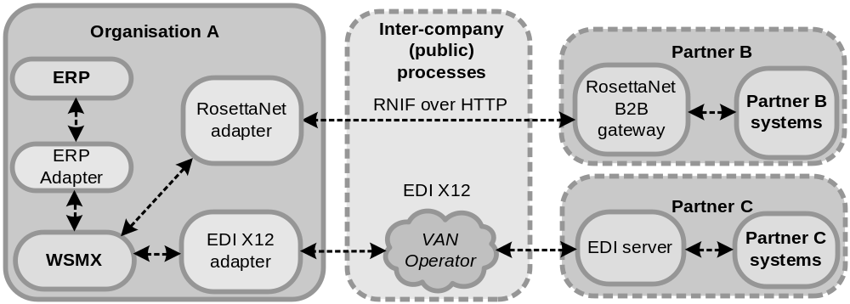
Use Case
Communication level – interoperation
Message level – interoperation
Business Process level – interoperation
Notes:
We do not go to directly SWS as they are not used in companies.
They have considerable investments in place and the existing systems e.g. handle well the internet security.
The existing SWS systems also lack in security etc…We use WSMX system developed in DERI.
WSMX is a systems developed in DERI for execution environment for semantic web services.
So we build our solution on proven technologies. Bridging the gap to using additional semantics do demonstrate the benefits of this approach.
In this picture the basic approach is presented. There are partners with RosettaNet and EDI connections. So logically same conversations are carried out with different standards. To enable maximum reuse here, WSMX acts as a intelligent EAI system. Adapters are needed in WSMX to lift syntactic messages to WSML semantic formal ontology language.
The partners differ in all 3 interoperability levels related to B2B integrations.
Communication level uses different methods. Operator vs. secured Internet…
sHTTP
Message/data level is most heterogeneous because EDI and RosettaNet has totally different messages and enumerations for lower level elements.. So in RosettaNet in this case PIPS 3A1 and 3A4 are used. EDI x12 has own corresponding transactions sets to conduct same conversations.
In process level, RosettaNet defines basic response times and certain exception handling behavior. In EDI this is not as straightforward but is more how is agreed.

Slide 5
Semantic Web Services and B2B
Integration Process
Integration Set-up Phase
  B2B standards used, agreements on messages
  Design and Implementation of integration
  Ontologising the business messages, rules for data mediation
  Registrations
Integration Run-time Phase
  Execution process and behaviour
Notes:
The process to integrate with SWS environment is still not fully automated.
There needs to be set-up first. And only after that the runtime behaviour is ready….
In the setup B2B standards used and how they are used. Here particularly optional elements are agreed upon. Includes designing and implementing necessary adapters etc..
Ontologising the messages needs to be done once. This includes how e.g. RosettaNet PiP 3A1 is lifted to ontology and lowered to XML.
Also registering necessary details for messaging, products supplied, standards supported etc for the SWS infrastructure.
When setup is done and run-time happen. We go later through the example scenarios execution behavior.

Slide 6
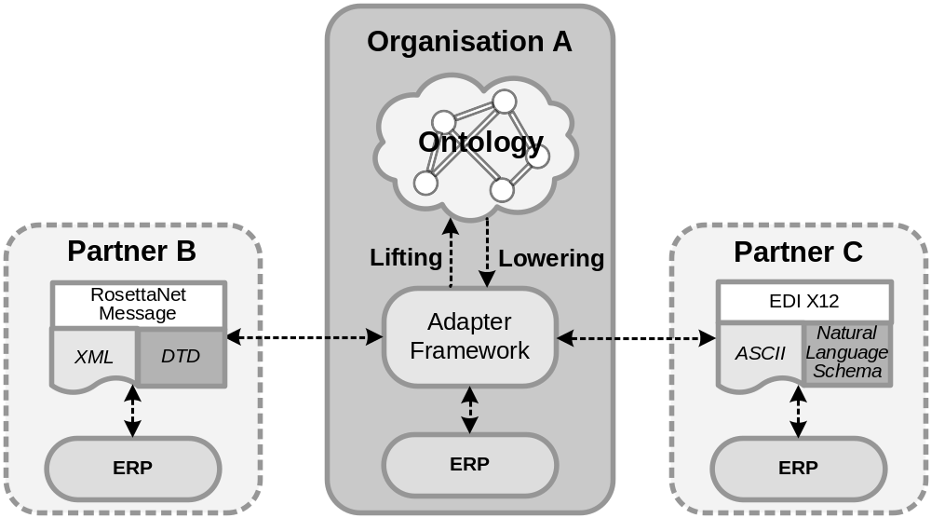

Message ontologising
Extract of RosettaNet PIP in DTD
<!ELEMENT ProductIdentification
(GlobalProductIdentifier?,
PartnerProductIdentification*)>
...
Message Guidelines add natural language contraint “Constraint: One instance of either "GlobalProductIdentifier" or "PartnerProductIdentification" is mandatory.”
The limitations of current RosettaNet schema languages can be bridged using stronger language (WSML in our case)
Lifting demonstrated using XSLT
Similarly EDI information can be lifted to ontology
Notes:
The use of stronger language enables representing also currently constraints that are currently presented in natural language.
E.g. without this valid document could be without id.
This is due to poor power of DTD. Some latest PIPs use XMl Schema but the element names differ. So again logically same informations displayed differently.
XSLT is used for lifting. Example in the paper.

Slide 7
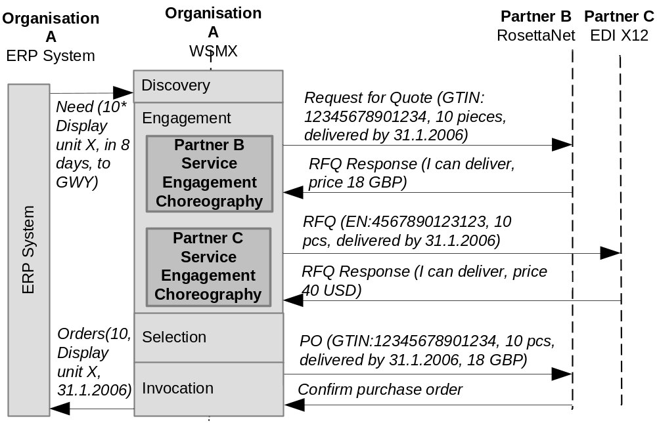
B2B integration Process Run-time behavior
Notes:
Differences… logically same information can be sent differently…
We have gone to details especially with RosettaNet.
The product information can be used as partners expect it, the dates, prices etc. can be mediated. Also selected.
Currently these processes are very manual. The back-end interface expensive and essentially there is no deal to deal based
A colleague has also done a lot on EDI X12, ontologysing the basic messages.

Slide 8
Conclusion
Our scenario the buyer can accept more heterogeneity to integrations thanks to added semantics (e.g. product identifiers, measurement units)
Combining existing e-business frameworks with WSMX semantic web service solution
  Adapter solution, Security etc. tackled by existing RosettaNet solutions
  Lifting and lowering messages from XML (edi) to ontology – partners can still use current standards
Better validation thanks to more expressive power of semantic web language
Notes:
Future work.
Implementation is SWS Challenge. Towards implementing the solutions

