Slide 1
Semantic Web Services
Research, Standardization and Applications
Tomas Vitvar
DERI Galway, Ireland
Tomas Vitvar
firstname.lastname@deri.org
Talk at Knowledge Engineering Group (KEG), University of Economics
12th April 2007, Prague, Czech Republic

Slide 2
Agenda
DERI Organization
Introduction to Semantic Web Services
Semantic Web Services in DERI
Standardizations and Applications

Slide 3
Agenda
DERI Organization
Introduction to Semantic Web Services
Semantic Web Services in DERI
Standardizations and Applications

Slide 4
DERI Organization – Vision and Focus
Vision:
„Make the Semantic Web and Semantic Web Services a reality and enabling fully flexible integration of information and services in both inter- and intra-enterprise integration settings“

Slide 5
DERI Organization – Structure
DERI Galway, Ireland
  National University of Ireland
  member of DERI International
DERI International
  Family of DERI Institutes
  DERI Institutes associated with Universities as legal entities
  Institutes:
    DERI Galway, Ireland (National University of Ireland)
    DERI Innsbruck, Austria (University of Innsbruck)
    DERI Stanford, USA (Stanford University)
    DERI Seoul, Korea (University of Seoul)
    DERI Milano, Italy (Milano University)

Slide 6
DERI Organization – DERI Galway
Research – Basic and Applied Research
  Semantic Web
  Semantic Web Services
  Distributed Systems and P2P Networks
Projects – Research and Development
  Science Foundation Ireland
  Enterprise Ireland
  EU FP6 -> FP7

Slide 7
DERI Organization – DERI Galway Projects
Semantic Web
  Semantic Desktop, Integration of Online Communities, Semantic Web Search Engine, Semantic WiKis, eLearning
Semantic Web Services
  Development of SWS Framework known as WSMO, WSML, WSMX
  Core SWS development
    Lion – Science Foundation Ireland
    KnowledgeWeb (FP6)
    DIP (FP6)
  Applications to:
    E-Government (SemanticGov project – FP6)
    E-Health (EI and FP6)
    E-Business and BPM (FP6)
    ...

Slide 8
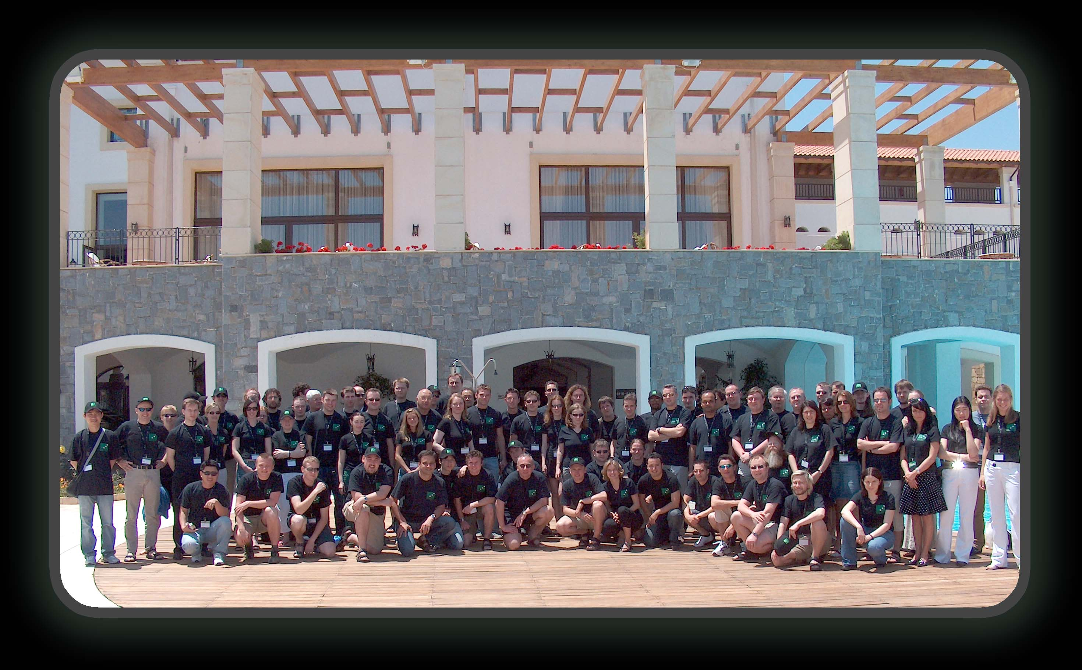
DERI Organization – DERI Team

Slide 9
Agenda
DERI Organization
Introduction to Semantic Web Services
Semantic Web Services in DERI
Standardizations and Applications

Slide 10
Semantic Web Services – Basis
Knowledge Representation
Semantic Web
Enterprise Computing
Web Services
Service-Oriented Computing

Slide 11
Semantic Web
The next generation of the WWW
Information has machine-processable and machine-understandable semantics
Not a separate Web but an augmentation of the current one
Ontologies as basic building block

Slide 12
Semantic Web – Ontology Definition
Formal, explicit specification of a shared conceptualization

Slide 13
Semantic Web – Ontology Technology
Ontology Languages:
  expressivity
  reasoning support
  web compliance
Ontology Dynamics and Management Techniques:
  editing and browsing
  storage and retrieval
  versioning and evolution Support
Ontology Heterogeneity:
  Ontology aligning, merging

Slide 14
Web Services
Loosely coupled, reusable components
Encapsulate discrete functionality
Accessible over standard internet protocols

Slide 15
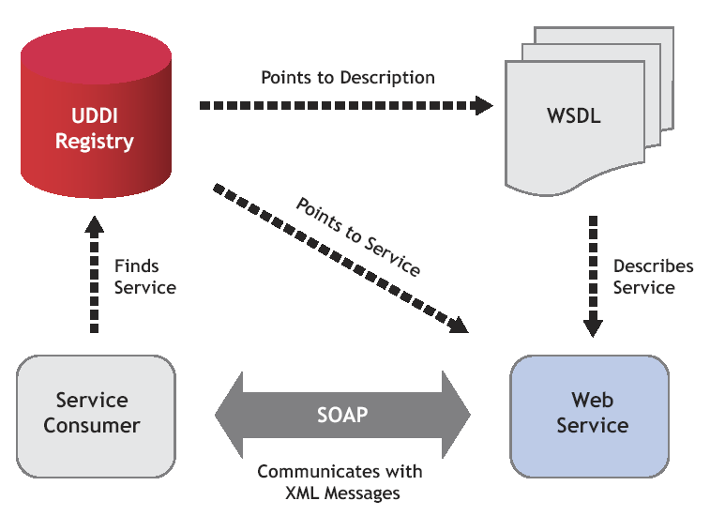
Web Services – Architecture

Slide 16
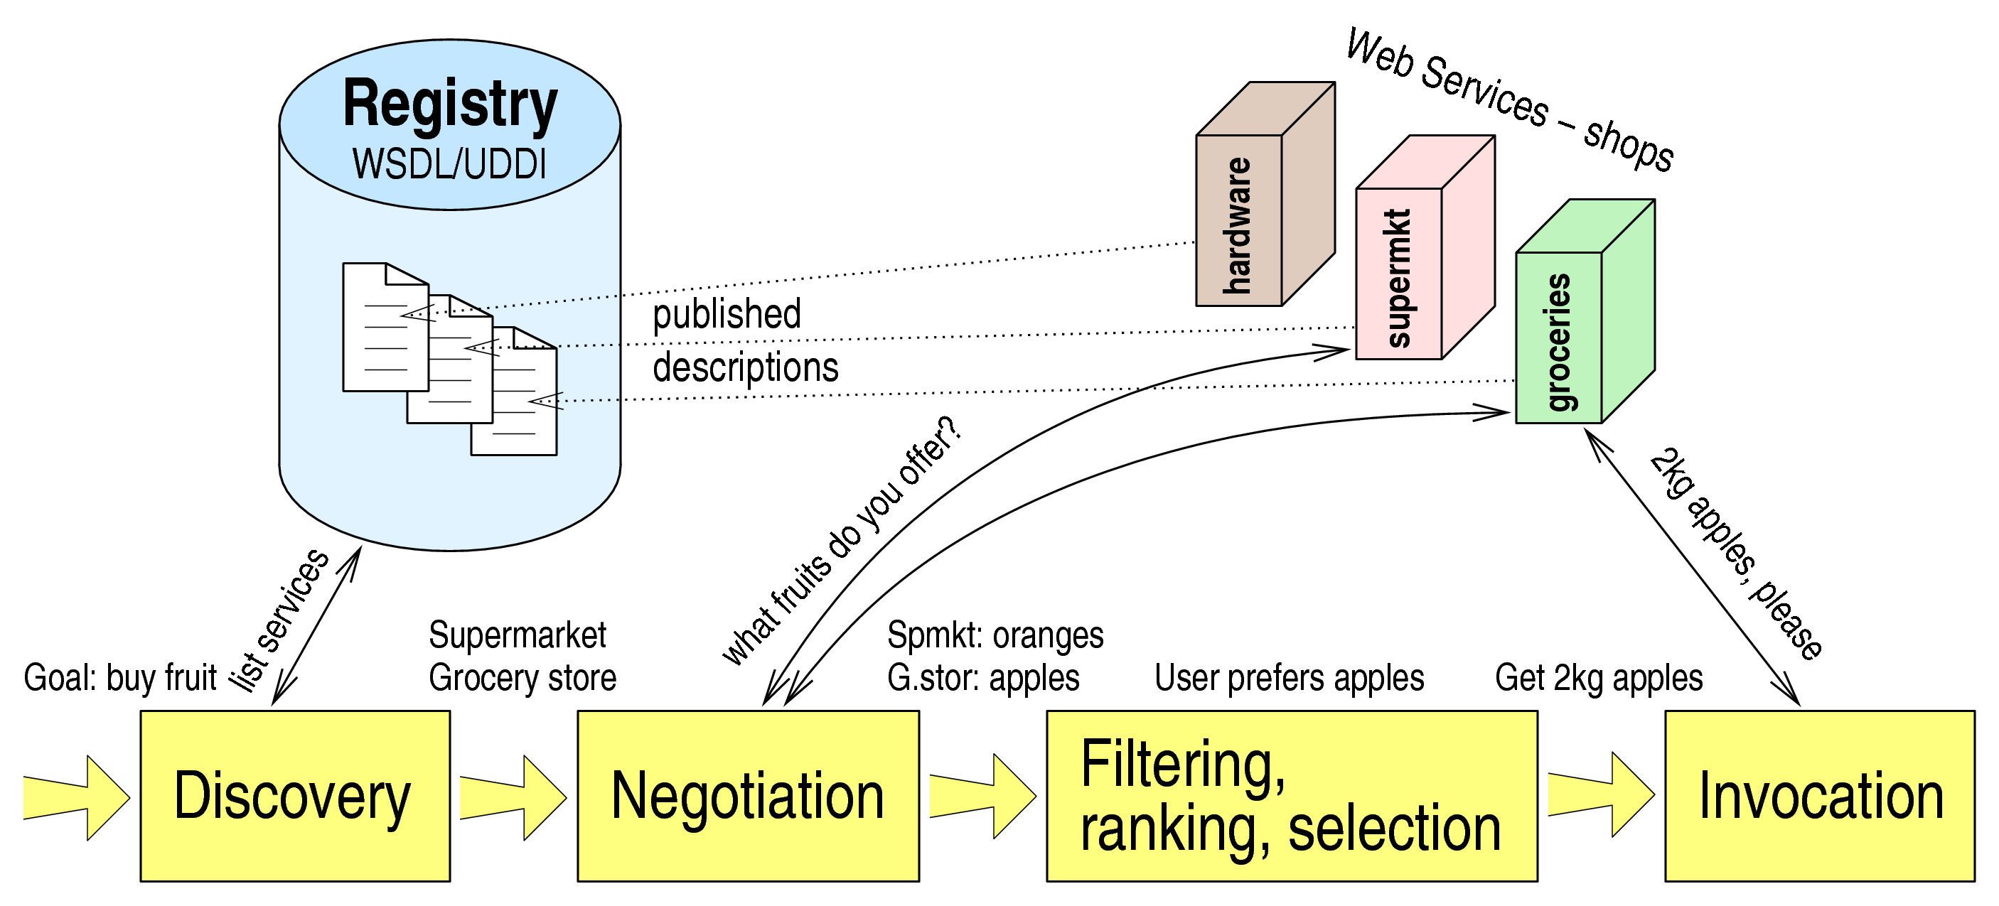
Web Services – Usage Process

Slide 17
Web Services – Difficulties
Only Syntactical Information Descriptions
  Syntactic support for discovery, composition and execution
  Web Service usage and integration needs to be supported manually
No Semantic mark-up for content and services
No support for Semantic Web

Slide 18
Semantic Web Services
Semantic Web Technology
+
Web Service Technology
allow machine supported data interpretation
ontologies as data model
messaging, invocation of services
security, etc.
=> Semantic Web Services as integrated solution for realizing the vision of the next generation of the Web

Slide 19
Semantic Web Services – New Layer
Knowledge
Representation
Semantic Web
Semantic Web Service Layer
WSMO
OWL-S
WSDL-S
…
grounding
Web Service Layer
WSDL
SOAP
UDDI
…

Slide 20
Semantic Web Services - Aspects
Service Model – framework for description of Web Services and related aspects (Service Ontology)
Ontologies as Information Model – support ontologies and make use of ontology languages for definition of underlying information model
Define semantically driven techniques for total or partial automation of the web service execution process

Slide 21
Agenda
DERI Organization
Introduction to Semantic Web Services
Semantic Web Services in DERI
  WSMO
Standardizations and Applications

Slide 22
WSMO – Scope
WSMO defines conceptual model for Semantic Web Services
  Ontology of core elements for Semantic Web Services
  Formally defined using WSML language
  Derived from the Web Service Modelling Framework (WSMF)
WSMO defines requirements for Web Service Modelling Language (WSML)
WSMO defines framework for architecture and execution environment (WSMX)
WSMO is developed as part of SWS Community in Europe

Slide 23




WSMO – Working Groups
A Conceptual Model for SWS
A Formal Language for WSMO
Execution Environment for WSMO
A Rule-based Language for SWS

Slide 24
WSMO – Design Principles
Web Compliance
Ontology-Based
Goal-driven
Centrality of Mediation
Execution Semantics

Slide 25
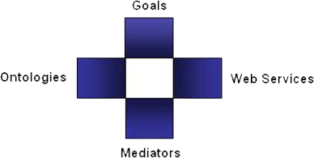
WSMO – Top Level Elements
Objectives that a client wants to
achieve by using Web Services
Provide the formally specified terminology
of the information used by all other components
Semantic description of Web Services:
Capability (functional)
Interfaces (usage)
Connectors between components with mediation facilities for handling heterogeneities
  WSMO D2, version 1.2, 13 April 2005 (W3C submission)

Slide 26
Non-Functional Properties
Every WSMO elements is described by properties that contain non-functional aspects of web services
Dublin Core Metadata Set
  Used for resource management
Versioning Information
  Evolution support
Quality of Service Information
  Availability of services, reliability
Other
  Owner, financial aspects, etc.

Slide 27
List of Non-functional Properties
Dublin Core Metadata
  Contributor
  Coverage
  Creator
  Description
  Format
  Identifier
  Language
  Publisher
  Relation
  Rights
  Source
  Subject
  Title
  Type
Quality of Service
  Accuracy
  NetworkRelatedQoS
  Performance
  Reliability
  Robustness
  Scalability
  Security
  Transactional
  Trust
Other
  Financial
  Owner
  TypeOfMatch
  Version

Slide 28
WSMO Ontologies
Objectives that a client wants to
achieve by using Web Services
Provide the formally specified terminology
of the information used by all other components
Semantic description of Web Services:
Capability (functional)
Interfaces (usage)
Connectors between components with mediation facilities for handling heterogeneities

Slide 29
WSMO Ontologies – usage and design principles
Ontologies are used as the ‘data model’ throughout WSMO
  all WSMO element descriptions rely on ontologies
  all data interchanged in Web Service usage are ontologies
  Ontology reasoning and semantic information processing
WSMO Ontology Language WSML
  conceptual syntax for describing WSMO elements
  logical language for axiomatic expressions (WSML Layering)
WSMO Ontology Design
  Modularization: import / re-using ontologies, modular approach for ontology design
  De-Coupling: heterogeneity handled by OO Mediators

Slide 30
WSMO Web Services
Objectives that a client wants to
achieve by using Web Services
Provide the formally specified terminology
of the information used by all other components
Semantic description of Web Services:
Capability (functional)
Interfaces (usage)
Connectors between components with mediation facilities for handling heterogeneities

Slide 31
WSMO Web Service Description
Complete item description
Quality aspects
Advertising of Web Service
Support for WS Discovery
Non-functional Properties
DC + QoS + Version + financial
Capability
functional description
client-service interaction interface for consuming WS
External Visible
Behavior
- Communication
Structure
- ‘Grounding’
realization of functionality by aggregating
other Web Services
functional
decomposition
interaction with
aggregated WS
Web Service
Implementation
(not of interest in Web Service Description)
WS
WS
WS
Choreography --- Service Interfaces ---
Orchestration

Slide 32
WSMO Web Service – Capability Specification
Non functional properties, Imported Ontologies, Used mediators
Preconditions
  what a web service expects in order to be able to provide its service (conditions over the input)
Assumptions
  conditions on the state of the world that has to hold before the Web Service can be executed
Postconditions
  Describes the result of the Web Service in relation to the input, and conditions on it
Effects
  conditions on the state of the world that hold after execution of the Web Service (i.e. changes in the state of the world)

Slide 33
WSMO Web Service – Interface Specification
Service Interface – consumption and interaction
  Choreography and Orchestration – described as sub-elements of WSMO Web Service Interface
  Formalism used: Abstract States Machines
  Grounding to WSDL
Choreography
  External Visible Behaviour of a Web Service
Orchestration
  Decomposition of Web Service functionality
  Interaction with aggregated web services

Slide 34
Choreography and Orchestration – Example
VTA example:
Choreography = how to interact with the service to consume its functionality
Orchestration = how service functionality is achieved by aggregating other Web Services
When the service is
requested
When the service
requests
Date, Time
Hotel Service
Date
VTA
Service
Hotel
Time
Flight, Hotel
Error
Error
Date, Time
Flight Service
Confirmation
Flight
Error

Slide 35
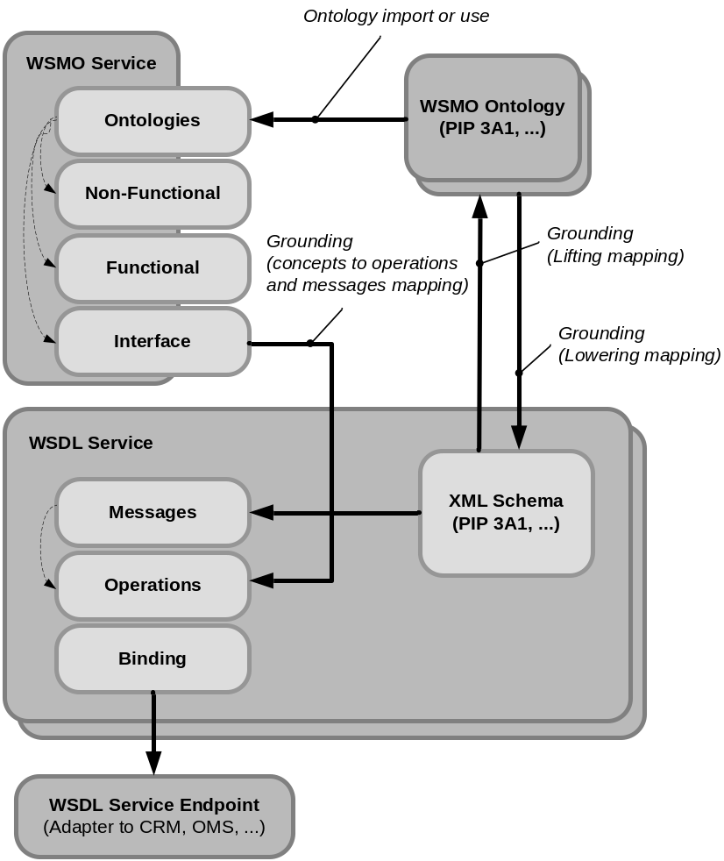
WSMO Service, WSMO Ontology and WSDL

Slide 36
WSMO Goals
Objectives that a client wants to
achieve by using Web Services
Provide the formally specified terminology
of the information used by all other components
Semantic description of Web Services:
Capability (functional)
Interfaces (usage)
Connectors between components with mediation facilities for handling heterogeneities

Slide 37
WSMO Goal
Basis for Goal-driven Architetcure
  requester formulates objective independently
  ‘intelligent’ mechanisms detect suitable services for solving the Goal
  allows re-use of Services for different purposes
Requests may in principle not be satisfiable
Derived from different AI-approaches for intelligent systems
  Intelligent Agents
  Problem Solving Methods

Slide 38
WSMO Goal Specification
Non functional properties, Imported Ontologies, Used mediators
Requested Capability
  describes service functionality expected to resolve the objective
Requested Interface
  describes communication behaviour supported by the requester for consuming a Web Service (Choreography)

Slide 39
WSMO Mediators
Objectives that a client wants to
achieve by using Web Services
Provide the formally specified terminology
of the information used by all other components
Semantic description of Web Services:
Capability (functional)
Interfaces (usage)
Connectors between components with mediation facilities for handling heterogeneities

Slide 40
WSMO Mediators
Heterogeneity …
  Mismatches on structural / semantic / process levels
  Occur between different components that shall interoperate
  Especially in distributed & open environments like the Internet
Concept of Mediation:
  Mediators as components that resolve mismatches
  Mediation cannot be always fully automated
  Several types of mediators defined by WSMO
    OOMediators, WWMediators, GGMediators, WGMediators

Slide 41
WSMO Mediators – General Approach
Source
Component
WSMO Mediator
uses a Mediation Service via
1
Target
Component
1 .. n
Source
Component
as a Goal
Mediation
Services

Slide 42
WSMO OO Mediator
Merging 2 ontologies
Train Connection
Ontology (s1)
OO Mediator
Mediation Service
Train Ticket
Purchase Ontology
Purchase
Ontology (s2)
Goal:
“merge s1, s2 and
s1.ticket subclassof s2.product”
Discovery
Mediation
Services

Slide 43
WSMO GG Mediator
Aim:
  Support specification of Goals by re-using existing Goals
  Allow definition of Goal Ontologies (collection of pre-defined Goals)
  Terminology mismatches handled by OO Mediators
Example: Goal Refinement
Source Goal
“Buy a ticket”
GG Mediator
Mediation Service
Target Goal
“Buy a Train Ticket”
postcondition:
“aTicket memberof trainticket”

Slide 44
Process Mediation (WWMediator)
internal business logic of Web Service
(not of interest in Service Interface Description)
internal business logic of Web Service
(not of interest in Service Interface Description)
WW Mediator
if a choreography does not exist, then find an appropriate WW Mediator that
  resolves possible mismatches to establish Information Compatibility (OO Mediator usage)
  resolves process / protocol level mismatches in to establish Communication Compatibility

Slide 45
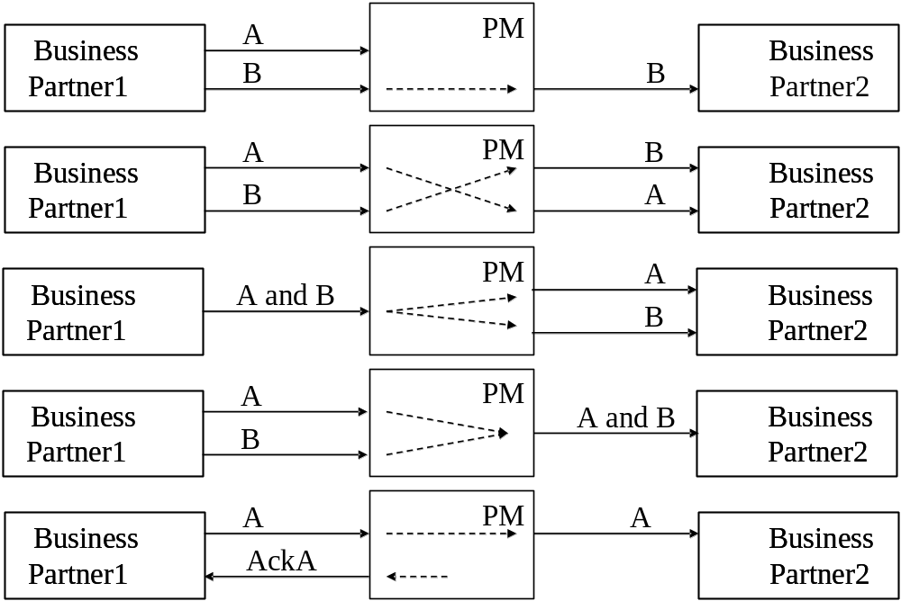
Process Mediator – Addressed mismatches

Slide 46
Agenda
DERI Organization
Introduction to Semantic Web Services
Semantic Web Services in DERI
  WSML
Standardizations and Applications

Slide 47
Web Service Modeling Language (WSML)
Aim – to provide a language (or a set of interoperable languages) for representing the elements of WSMO:
  Ontologies, Web services, Goals, Mediators
WSML provides a formal language for the conceptual elements of WSMO, based on:
  Description Logics
  Logic Programming

Slide 48
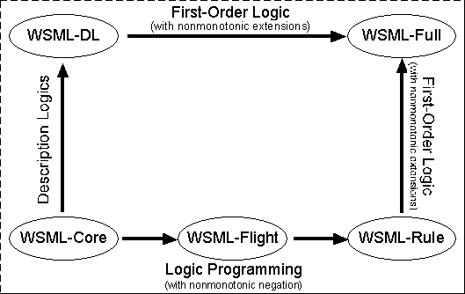
WSML Overview
Web Service Modeling Language
  Language to describe WSMO elements
  Variants: WSML Core, WSML DL, WSML Flight/Rule, WSML Full

Slide 49
Agenda
DERI Organization
Introduction to Semantic Web Services
Semantic Web Services in DERI
  WSMX
Standardizations and Applications

Slide 50
WSMX – Introduction
An execution environment for Semantic WS based on WSMO model
Foundation for OASIS Technical Committee on Semantic Execution Environments (OASIS SEE TC)
Integration Middleware based on Java Technology
  Operates on WSMO descriptions grounded to WSDL
Open source

Slide 51
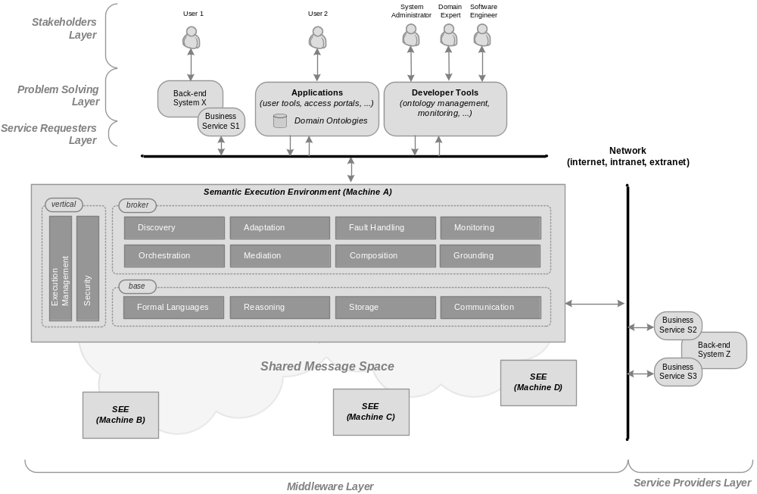
WSMX/SEE Middleware – SESA

Slide 52
WSMX/SEE – Middleware Services
Base
  Formal Languages, Reasoning, Storage, Communication
Broker
  Discovery, Adaptation, Fault Handling
  Monitoring, Orchestration, Composition
  Grounding
Vertical
  Execution Management, Security

Slide 53
Links
WSMX, WSMO home pages
  http://www.wsmx.org
  http://www.wsmo.org
Open source
  http://sourceforge.net/projects/wsmx
  http://wsmo4j.sourceforge.net
OASIS SEE TC
  http://www.oasis-open.org/apps/org/workgroup/semantic-ex

Slide 54
Agenda
DERI Organization
Introduction to Semantic Web Services
Semantic Web Services in DERI
Standardizations and Applications

Slide 55
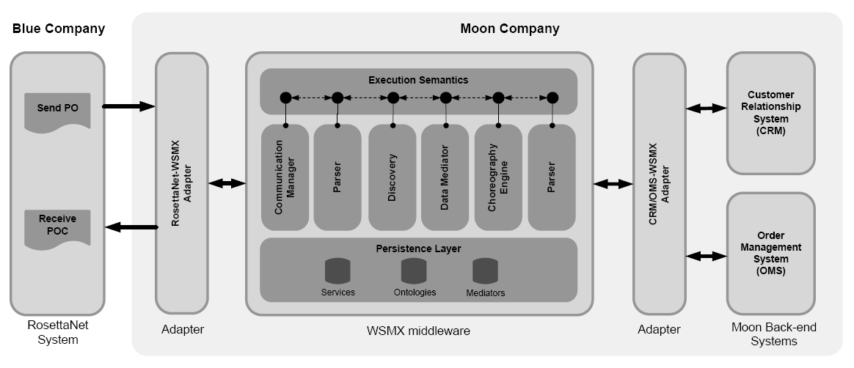
B2B Integration Scenario
Moon company wants to build B2B integration with Blue company
Blue – RosettaNet to be integrated with Moon back-end CRM and OMS
Integration builds on semantic technologies – WSMO/L/X

Slide 56
Scenario: Blue RosettaNet
PO[id, item1, item2, item3]
POC[confirmationID
Blue sends purchase order (customer id, and items to be ordered)
and expects order confirmation with confirmation id
Blue uses RosettaNet Standard PIP3A4 for Purchase Orders

Slide 57
Scenario: Moon Back-end Systems
id
cid
openOrder
addItem*
closeOrder
Internal customer id must be obtained from CRM system based on provided ID by Blue
Order must be opened in OMS system
Individual items are placed in OMS
Order is closed in OMS

Slide 58
Scenario: Interoperability Problems
Data
Interoperability
PO[id, item1, item2, item3]
Id’
cid
Process
Interoperability
POC[confirmationID
openOrder
addItem*
closeOrder
Interoperability Problems:
  Incompatible XML schemas for Blue’s and Moon’s messages
  Incompatible choreographies of Blue’s and Moon’s systems

Slide 59
Scenario: WSMX to Facilitate Integration
Modelling of information and
behaviour of standard
RosettaNet definitions
Modelling of information and
behaviour of proprietary
back-end systems

Slide 60
Scenario: What to model
RosettaNet
PIP 3A4
CRM, OMS
systems
WSMO
Ontology
WSMO
Ontology
Grounding
WSMO
Service
WSMO
Service
Grounding

Slide 61
Scenario: Deploy Models and Ontology Mappings
RosettaNet
PIP 3A4
CRM, OMS
systems
WSMO
Ontology
WSMO
Ontology
mapping rules
Grounding
WSMO
Service
WSMO
Service
Grounding

Slide 62
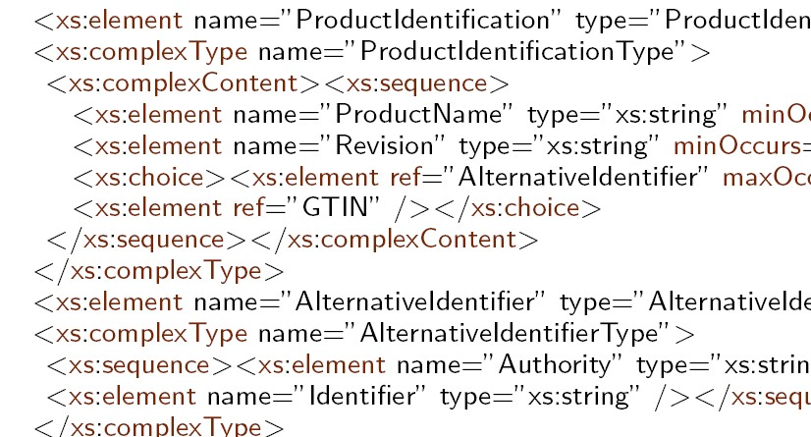
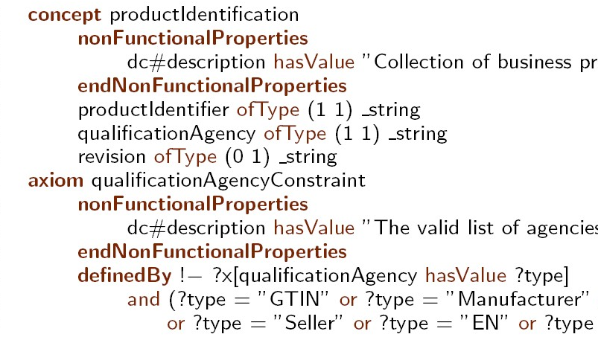
WSMO Ontology: Modelling of Information
Web
Service
RosettaNet
PIP 3A4
Lowering Schema Mapping
WSMO
Ontology
XML Schema
Lifting Schema Mapping
Lifting Rules in XSLT

Slide 63
WSMO Service: Modelling of Choreography, Grounding
WSDL Web Service Operations,
Input and output messages
Web
Service
WSMO Choreography and Grounding Definition
a
b
Abstract State Machine Rules
stateSignature
in a → wsdl.interfaceMessageReference …
out b → wsdl.interfaceMessageReference …
…
transitionRules
If a then add(b)
…
RosettaNet
PIP 3A4
If message A is in the memory, then
add message B to the memory
from invocation of related operation.

Slide 64
Conversation: Involved WSMX Components
Adapters (RN-Adapter, CRM/OMS Adapter)
  Lifting and lowering from xml schema, receiving messages from back-end systems and sending messages to WSMX middleware
Communication Engine
  Sends and receives messages from outside of middleware according to the grounding definitions of choreography
Choreography Engine
  Blue and Moon choreographies are loaded to Choreography Engine
  Drives the conversation by evaluating 2 choreographies and execution of rules
Process Mediator
  Decisions which data to put to which choreographies loaded in the chor. engine
  Decisions for necessity of data mediation
Data Mediator
  Performs data mediation of required data according to the mapping rules (available from design stage).

Slide 65
Conversation: Process and Data Mediation
WSMO
Ontology
(Blue-PIP3A4)
Mapping Rules
WSMO
Ontology
(Moon-CRM/OMS)
a ↔ o, b ↔ p, c ↔ q, d ↔ r
Data Mediator
Send PO
Process Mediator
GetCustomer
OpenOrder
Choreography
Engine
AddItem
Receive POC
CloseOrder

Slide 66
Conversation: Conversation Set-up
Data
Mediator
Comm.
Manager
Process
Mediator
Comm.
Manager
Processing
Memory
Processing
Memory
Rule Base
Rule Base
1: Blue and Moon choreographies are
loaded to the choreography engine.
{rule_{j}}
{rule_{i}}
Blue Choreography
Moon Choreography

Slide 67
Conversation: Communication with Blue
Data
Mediator
PO[id, item1, item2, item3]
Comm.
Manager
Process
Mediator
<empty>
id’, item1’,
Item2’, item3’
2: PO is received, process mediatior evaluates
the data should be mediated and added
to the Moon’s choreography memory.
{rule_{j}}
{rule_{i}}
Blue Choreography
Moon Choreography

Slide 68
Conversation: Communication with Moon
Data
Mediator
Comm.
Manager
Process
Mediator
cid
Comm.
Manager
<empty>
cid, id’, item1’,
Item2’, item3’
searchCustomerID(id’)
3: The rule 1 of the Moon choreography is evaluated:
- cid (Moon’s internal customer id) to be added
to the memory;
- According to the grounding definition of cid,
searchCustomerId is invoked, cid is obtained
and process mediator evaluates cid is added to the
Moon’s choreography memory.
1: If id’ then
add(cid),
remove(id’)
{rule_{j}}
{rule_{i}}
Blue Choreography
Moon Choreography

Slide 69
Conversation: Communication with Moon
Data
Mediator
Comm.
Manager
Process
Mediator
orderId
Comm.
Manager
<empty>
orderId, cid, item1’,
Item2’, item3’
createOrder(cid)
4: The rule 2 of Moon choreography is evaluated:
- orderId to be added to the memory;
- According to the grounding definition of orderId,
createOrder is invoked, orderId is obtained
and process mediator evaluates orderId is added
to the Moon’s choreography memory.
2: If cid then
add(orderId),
remove(cid)
{rule_{j}}
{rule_{i}}
Blue Choreography
Moon Choreography

Slide 70
Conversation: Communication with Moon
Data
Mediator
Comm.
Manager
Process
Mediator
response
Comm.
Manager
<empty>
response, orderId,
item1’, Item2’, item3’
addItem(orderId, item)
5: The rule 3 of Moon choreography is evaluated 3x:
- response of item order to be added to the memory;
- According to the grounding definition of response,
addItem is invoked, response is obtained…
3: If orderId, item
then
add(response),
remove(item)
{rule_{j}}
{rule_{i}}
Blue Choreography
Moon Choreography

Slide 71
Conversation: Communication with Moon
Data
Mediator
Comm.
Manager
Process
Mediator
OC
Comm.
Manager
<empty>
…, orderId
closeOrder(orderId)
6: The rule 3 of Moon choreography can be evaluated:
- order confirmation (OC) to be added to the memory;
- According to the grounding definition of result,
addItem is invoked, OC is obtained.
- Moon Choreography gets to the end of conversation
state (no other rule can be evaluated)
3: If orderId, !item
then
add(OC),
remove(orderId)
{rule_{j}}
{rule_{i}}
Blue Choreography
Moon Choreography

Slide 72
Conversation: Communication with Blue
Data
Mediator
POC
Comm.
Manager
Process
Mediator
OC
Comm.
Manager
OC’
<empty>
7: The process mediator evaluates the data should
be mediated and added to the Blue’s choreography
memory.
- The rule of Blue choreography is evaluated sending
POC back to the Blue system.
- Blue Choreography gets to the end of conversation
state (no other rule can be evaluated)
1: If OC’ then
add(OCresp),
remove(OC’)
{rule_{j}}
{rule_{i}}
Blue Choreography
Moon Choreography

Slide 73
Agenda
DERI Organization
Introduction to Semantic Web Services
Semantic Web Services in DERI
Standardizations and Applications

Slide 74
Overview
W3C Semantic Annotations for WSDL (W3C SAWSDL WG)
OASIS Semantic Execution Environment Technical Committee (OASIS SEE TC)

Slide 75
W3C SAWSDL WG
Started: April 2006
  After several W3C SWS submissions (WSMO, OWL-S, WSDL-S)
Currently: 10 months
Chair: Jacek Kopecky (UIBK DERI Innsbruck)
Members
  UIBK, NUIG, OU, IBM, ILOG, Wayne State University, University of Georgia, Telecom Italia, CA, Scapa Technologies
Notes:
SAWSDL is the first step towards semantic web services in W3C. It defines hooks in WSDL in order to annotate WSDL elements – schema types, interfaces, operations, services (it does not define any semantics but only hooks which can be used for annotation of WSDL elements). SAWSDL thus allows to link semantic information with non-semantic WSDL description, e.g. classification of a service from classification ontology, pre- and post- conditions on service interface or operation, behavioural semantics attached to interfaces or operations, etc.

Slide 76
SAWSDL Overview
SAWSDL is part of Web Service Activity in W3C
Charter at
  http://www.w3.org/2005/10/sa-ws-charter.html
Based on WSDL-S
  http://www.w3.org/Submission/WSDL-S/
Taking WSDL as basis for SWS description
  Adding hooks for (pointers to) semantics

Slide 77
SAWSDL Overview
Goal
  Introduce extensions to WSDL in order to annotate WSDL elements using semantic descriptions
  Enable automation of service discovery, mediation, selection, negotiation using semantic descriptions

Slide 78
SAWSDL Attribute Extensions
Attribute Extensions
  modelReference
    Linking WSDL elements with concepts from ontology (WSDL elements: XML Schema types, interfaces, operations, messages and services)
  loweringSchemaMapping and liftingSchemaMapping
    Transformations of XML data to/from ontology representation (only on XML Schema types)

Slide 79
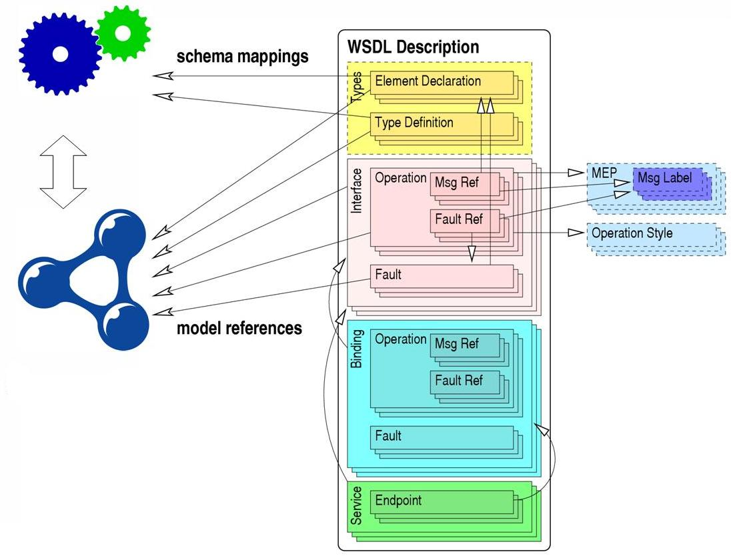
SAWSDL Attribute Extensions

Slide 80
SAWSDL Attribute Extensions
SAWSDL gives a flexibility
  Semantics: ontology concepts for discovery, selection, composition; lifting/lowering mapping for mediation, invocation; classifications for discovery; …
More specialized usage of SAWSDL could be specified as a follow up work
  e.g. WSMO Grounding using SAWSDL

Slide 81
Q & A

