Slide 1

DERI Galway
David O‘Sullivan, Tomas Vitvar, Hamish Cunningham
DERI International Meeting, Galway November 2005

Slide 2
Vision
DERI Galway’s vision is to develop new knowledge and disruptive technologies for the Internet
  Semantic Web Services
  Semantic Web
  Human Language Technology

Slide 3



Semantic Web Services
Web Services
UDDI, WSDL, SOAP
Semantic Web
Services
Dynamic
WWW
URI, HTML, HTTP
Semantic Web
RDF, RDF(S), OWL
Static

Slide 4
Semantic Web
②
Social
Connectivity
Blogs, OSNs, Wikis
Social
Semantic
Web
①

⓪
③

WWW
URI, HTML, HTTP
Semantic Web
RDF, RDF(S), OWL
①

Slide 5




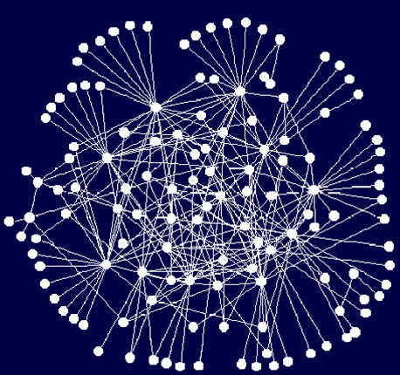
Human Language Technology
Phase 1
Phase 2
Phase 3
Desktop/
Wiki
Semantic Desktop
Social
Semantic Desktop
HLT
Semantic P2P
Ontology driven distributed
Social Networking
P2P networks
Semantic Web
Ontology driven Social Networking
Social Networking

Slide 6
Research Approach
Knowledge
  Push leading edge approaches
  Publish new Knowledge
Standards
  Semantic Web Services
  Social Semantic Collaboration
Industry Collaboration
  Applications
  Testing and Validation
Open source
  WSMX
  JeromeDL

Slide 7
Seed Funding
EU Funding (€7.5 M)
DIP (2 M)
ASG (0.5 M)
KW (0.5 M)
SWWS (200 K)
AMI-4-SME (330 K)
EastWeb (200 K)
Nepomuk (1.25 M)
SUPER (1.1 M)
Tripcom (0.6 M)
SemanticGov (332 K)
SWING (314 K)
RIDE (138 K)
Ecospace (700 K)
Industrial Partners (€4.2 M)
HPGL (4M)
HC-exchange (10K)
SAP (220K)
EI Funding (€2.4 M)
Terra Nua (9 K)
Storm (9 K)
SOAR (340 K)
SWORCA (40 K)
eLearning (2 M)
IRCHSS (€0.1 M)
Wiki Ireland (125 K)
SFI (9.9 M €)
Lion (9.6 M)
Supplemental Equipment (150 K)
M3PE (174K)
STARs (25 K)
SeDiTo (open)
italics: submitted

Slide 8
Summary
Generate new knowledge and disruptive technologies for the Internet
Focus
  Semantic Web
  Semantic Web Services
  Human Language Technology
Key Challenges
  Senior Appointments
  Management Structure
  DERI Intl Collaboration

Slide 9
Semantic Web

Slide 10
Current Research
Semantic Web Search Engine (SWSE)
  Semantic Ontology Repository (YARS)
  Semantic Digital Library (JeromeDL)
    Social Semantic Collaborative Filtering (FOAFRealm)
    Semantic Bibliographic Descriptions (MarcOnt)
  Semantically-Interlinked Online Communities (SIOC)
Social Semantic Desktop
  Semantic Blogs (semiBlog)
  Semantic Wikis (SemperWiki)
Semantic Innovation
  Semantic Innovation Management System (SIMS)
  Ambient Intelligence for Manufacturing (AmI)

Slide 11
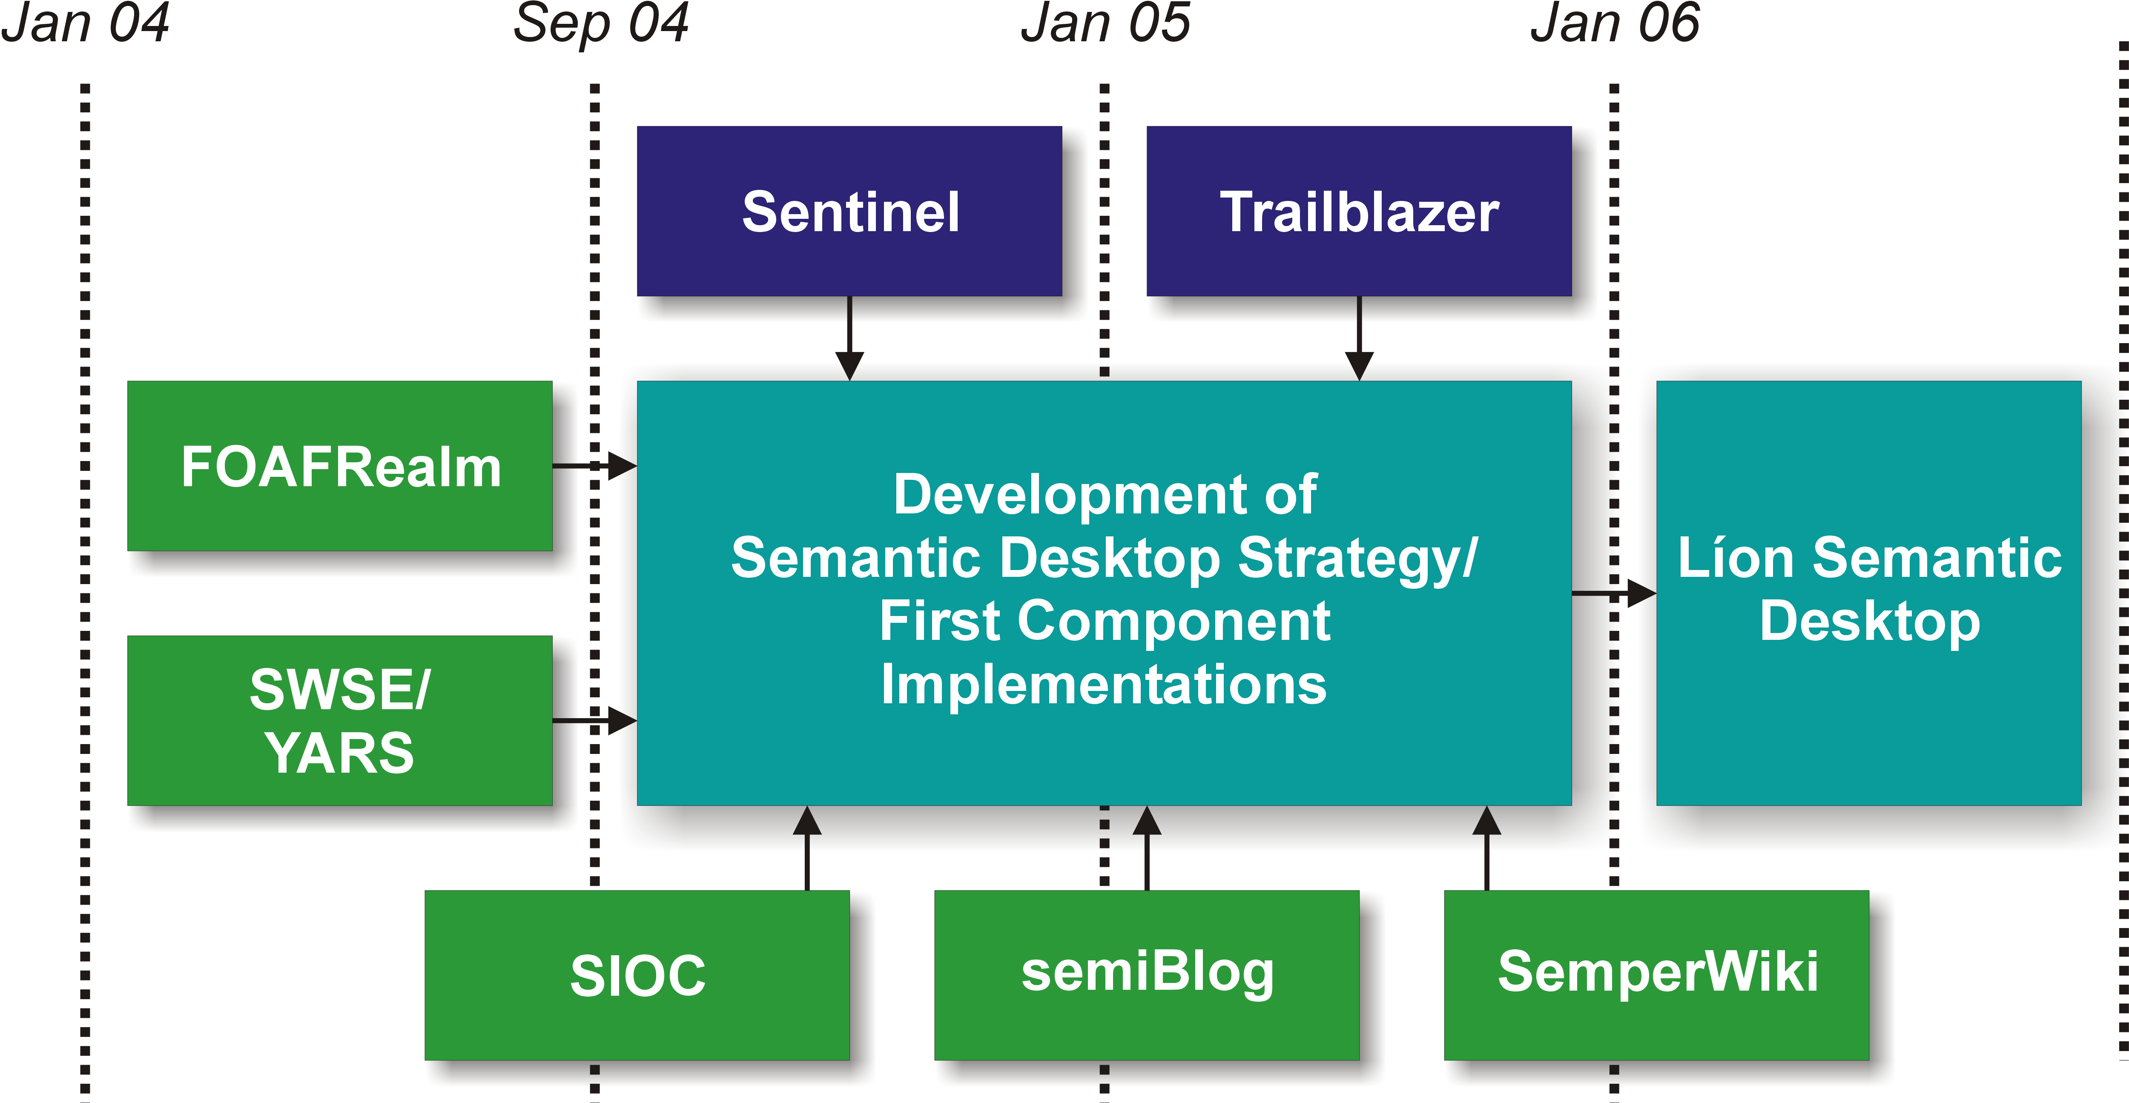
Business Development

Slide 12
Future Research
AnnoWiki
  Create personal information management workbench by integrating existing work lines
Social Semantic Desktop (NEPOMUK)
Semantic Digital Library
Semantic Interlinking of Online Community Sites
Ambient Intelligence for Manufacturing
eLearning
Skills Matching of Human Resources

Slide 13
DERI International Collaboration
DERI Innsbruck
DERI Korea
DERI Stanford

Slide 14
Summary
AnnoWiki, Nepomuk and eLearning are major research thrusts
Other minor thrusts e.g. AmI, Sioc, etc.
DERI Intl Collaboration
Key Challenges
  Recruitment of post-docs and PhD researchers

Slide 15
Semantic Web Services
Tomas Vitvar, Laurentiu Vassiliu, Michal Zaremba
<firstname.lastname>@deri.org
DERI International Meeting, Galway, November 2005

Slide 16
Current Research
Semantic Web Services
  WSMO, WSML, WSMX
  Ontologizing of EDI
  Multi-meta model process execution (m3pe)
WSMX: Execution Environment for the SWS
  Architecture: component-based, service oriented
  WSMX Execution Framework
  Data mediation, Process Mediation
  Management Tools (WSMT): Ontology Editor, Data Mapping Tool

Slide 17
Business Development
Bell Labs (telecommunications, e-business)
  Integration of voice, data and video services in the context of 3G networks
  Dynamic supply chain
Nortel Networks (telecommunications)
  Semantics in the call centre
Capgemini (e-government)
  SemanticGov project
  Semantic Interoperability for PEGS
STORM (e-business)
  E-procurement

Slide 18
Future Research
WSMX WG to be moved to DERI Innsbruck
SWS Focus for the future: Applied SWS
  apply, verify and align specifications around WSMO, WSML and WSMX according to the real world use case scenarios
  Contribution to WSMO, WSML and WSMX WG
  Strong Collaboration with DERI Innsbruck
Application Areas
  E-Health
  E-Government
  Telecommunications
  Business Process Management
  GeoSpatial Services
  E-Business

Slide 19
Research Projects
E-Health:
  SAOR (EI): Interoperability of medical information systems,
  RIDE (EU FP6): Road map for semantic interoperability in e-Health
E-Government:
  SemanticGov (EU FP6): Infrastructure for Pan-European E-Government Services based on SWS technology
BPM:
  SUPER (EU FP6): Semantic Utilised Process Management within and between Enterprises
GeoSpatial Services:
  SWING (EU FP6): annotation, discovery, composition, and invocation of geospatial web services

Slide 20
DERI International Collaboration
DERI Innsbruck
  WSMO, WSML, WSMX WG
DERI Korea
  E-Health
    workshop on e-health in summer 2006 to exchange ideas between projects on e-Health
  Telecommunications
    funding opportunities for joint project in semantic integration of services in the context of IMS networks

Slide 21
Summary
Past: SWS cluster: WSMX WG
Future: Applied SWS
  Application domains: e-health, e-government, telecom, e-business, …
  Industrial Partners: Bell, Nortel, Capgemini, Storm
DERI Intl Collaboration with Innsbruck and Korea
Key Challenges
  Recruitment of Professor, post-docs and PhD researchers

Slide 22
Human Language Technology
Hamish Cunningham
<firstname.lastname>@deri.org
DERI International Meeting, Galway, November 2005

Slide 23
Human Language Technology in DELTA
The opportunity
The problem
Some solutions
digital
enterprise
language
technology
applications

Slide 24
The Opportunity: a Knowledge Economy
Gartner, December 2002:
  taxonomic and hierarchical knowledge mapping and indexing will be prevalent in almost all information-rich applications
  through 2012 more than 95% of human-to-computer information input will involve textual language
IBM 2004: 80% of corporate data is unstructured
A contradiction: formal knowledge in semantics-based systems vs. ambiguous informal natural language
The opportunity: to reconcile these two opposing tendencies

Slide 25
The Problem: Deploying HLT Applications
Simple tasks: document clustering, full-text search, entities, simple descriptions
Complex tasks: relations and events, cross-document reference
Specific domains: chemical engineering job descriptions, football match reports
General domains:
all .ie news sites
general
100%
90%
acceptable
accuracy
80%
Domain
specificity
vs. task
complexity
specificity
Performance Level
30%
domain
specific
simple
complexity
complex
bag-of-words
entities
relations
events

Slide 26
Some solutions
AI’s image problem: when it succeeds, it’s not AI
Successfull businesses exist selling MT, KBS, ANNs, but they’re typically assistive
DELTA will look at 4 semi-automatic applications
Futures (1): Web-scale HLT and SWAN
Futures (2): literate modelling
Futures (3): redundant-source IE
Futures (4): contextual identity

