Slide 1

<WP3: Design of National and European Semantic Web Services Architecture>
Tomas Vitvar
firstname.lastname@deri.org
SemanticGov 3rd Planetary Meeting
10-11 July 2006, Galway, Ireland

Slide 2
Overview
Introduction
  Tasks and Deliverables, Dependencies
Progress to Date
Architecture
Work Plan

Slide 3
Overview
Design of Semantic Web Service architecture for National and Pan European eGovernment services.
  Conceptual and technical architecture for SemanticGov
Start: M6 (June 2006)
Finish: M16 (April 2007)
Total effort: 66MM
CERTH | NUIG | LFUI | UOR | CAPGEMINI | SOFTWARE AG | ONTO | ALTEC S.A. | MOI | RCM | Citta Di Torino
7 | 6 | 11 | 15 | 6 | 3 | 9 | 5 | 1 | 1 | 1

Slide 4
Tasks
Tasks 3.1/3.3: Application of WSMF to Semantic Government services
    WSMO/L/X for SemanticGov architecture
    … + softwareAG technology + WS, BPEL, Ontotext, UniRoma composition tools, IDABC PEGS Architecture, GEA PA model
Deliverables:
    SemanticGov Architecture version 1, total effort: 10MM
    SemanticGov Architecture version 2, total effort: 20MM
Milestones:
    M12 (December 2006): SemanticGov Architecture version 1
    M16 (April 2007): SemanticGov Architecture version 2

Slide 5
Tasks
Tasks 3.2/3.4: Development of Mediator Support
    Design of WSMO mediator to address the issue of interoperability in the overall framework.
      Technical – adapters, lifting on non-semantic messages to semantic level, integration with existing standards and systems
      Data – Data Mediator to achieve semantic interoperability
      Process level – Process Mediator to achieve interoperability of processes if different communication patterns are used (choreographies)
Deliverables:
    Analysis of Mediator Requirements and Mediator Implementation : 36MM
Milestones:
    M16: Analysis of Mediator Requirement and Mediator Implementation

Slide 6
SemanticGov Architecture Dependencies
Relations with other WPs
  WP1: Overall Conceptual Analysis
    SemanticGov architecture should be conceptually inline with WP1 results
    Infrastructure elements: N2S, common PA service directory, process orchestrator
  WP2: Requirements Analysis
    SemanticGov architecture should support requirements from WP2
Basis – technology, existing know-how and concepts
  DERI: WSMO, WSML, WSMX, SAWSDL
  Software AG: SOA technology, Web Services, BPEL, …
  OntoText: WSMO Studio, WSMO API, registry/repository
  UniRoma: Composition Tools
  CERTH: GEA model, GEA PA Service Model
  CapGemini: IDABC PEGS Architecture

Slide 7
SemanticGov Architecture Dependencies – technology, existing know-how and concepts
PA
Service Model
WSMO
Service Model
WP4: PA Domain Ontology
WSMO-PA
SAWSDL-
WSMO
IDABC–PEGS
Architecture
WSMX
Software AG
Technology
UniRoma
Composition
OntoText
(WSMO API,
registry)
SemanticGov
Architecture
WP3: SemanticGov Architecture

Slide 8
Overview
Introduction
Progress to Date
Architecture
Work Plan

Slide 9
Progress to Date
Conceptual Architecture
  Paper in SWEG symposium
Initial meeting with Software AG (June 2006)
  Overview of CrossVision Architecture
    CentraSite registry and repository
    Information Integrator
    Legacy Integrator
    Application Composer
  Discussion on possible use of CrossVision in the project
    Integration with WSMO-PA
    CentraSite repository
      Customized object stored in repository
      CentraSite accessed by JAXR API
    Discovery/composition in business process modeler

Slide 10
Overview
Introduction
Progress to Date
Architecture
Work Plan

Slide 11
Architecture Scope
Architecture
  Information/Data
    Information models, ontologies
  Functions/Processes
    Functions and processes provided by architecture
    addressing requirements
      execution semantics, middleware services
  Software Architecture
      Semantically-enabled SOA
  Hardware Architecture
      Not subject of SemanticGov
  Organizational Aspects
    Deployment, changes in environments, support of new technology?
Methodology
Security

Slide 12
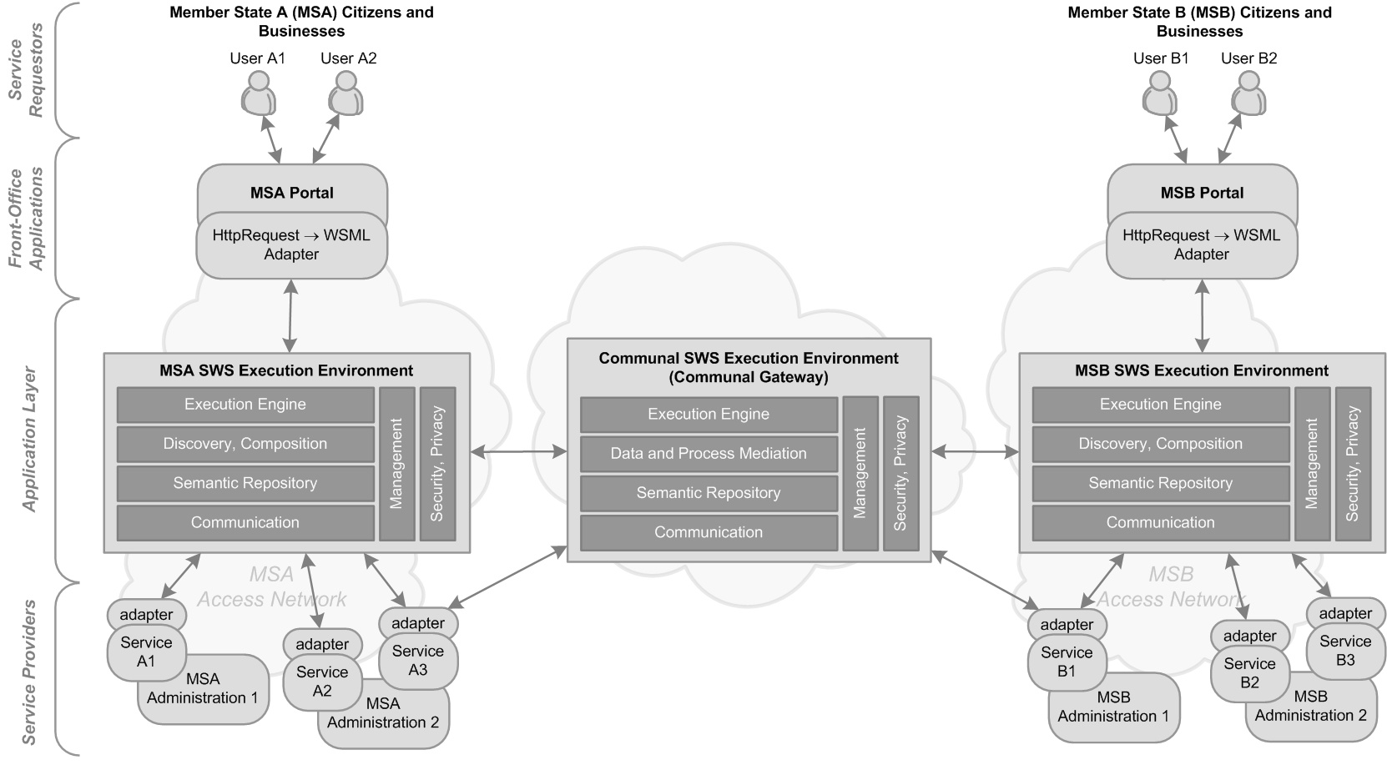
Global Architecture
(3) Needs2Services, Discovery,
Composition
(5) Execution Environment
(middleware)
(4) Data, Process Mediation
(2) Registry/Repository
(1) Semantic Services
(service creation)

Slide 13
Overview of components
…
Architecture Components
  Semantic Services (service creation)
  Registry/Repository
  Needs2Services, Discovery, Composition
  Mediation
  Execution Environment

Slide 14
Architecture Components – semantic services
Semantic Service Creation
  Creating services from existing applications
    Use case – detail technical specifications
    Legacy Integrator (Software AG) -> Web Services (WSDL)
  (1) Semantic Services - Semantic Annotations of WSDL
    WSDL -> SA-WSDL -> WSMO-PA
  (2) Semantic Services
    WSMO-PA -> grounding to WSDL

Slide 15
Architecture Components – semantic services
PA
Ontologies
PA
Ontologies
1. Creating PA Ontologies
(WSMO Studio, WSMT)
3. Creating WSMO-PA services
(annotating WSDL using SAWSDL
Or grounding WSMO-PA to WSDL)
(WSMO Studio, WSMT)
Registry/Repository
WSMO-PA
WSMO-PA
modelReference and schemaMapping (lifting/lowering)
WSDL
WSDL
2. Creating WSDL services from existing
Applications (Legacy Integrator)
Adapter
Existing e-government
Application

Slide 16
Architecture Components – semantic services – Partners Involved
Semantic Services
  Software AG
    Legacy integrator – wrappers for services
  DERI
    WSDL -> SA-WSDL -> WSMO-PA
  OntoText
    Tools to support SAWSDL
PA Ontologies -> dependant on WP4
  Ontotext + other partners involved in WP4

Slide 17
Overview of components
…
Architecture Components
  Semantic Services (service creation)
  Registry/Repository
  Needs2Services, Discovery, Composition
  Mediation
  Execution Environment

Slide 18
Architecture Components – registry/repository
Registry/Repository
  (1) Software AG CentraSite
    User defined object can be stored in the repository (WSMO-PA, PA ontology)
    Accessed through standard JAXR API
  (2) ORDI/OWLIM repository
    Storing ontologies (WSMO-PA)
    Stroing services description (WSDL + WSMO Service)

Slide 19
Architecture Components – registry/repository
Technology Option 1
Design-time and run-time
tools/components
Ontology Server (ORDI/OWLIM)
OntoText?
Service and Ontology
Editor
(WSMO Studio, WSMT)
Discovery/Composition
Tools
API
Ontology
WSDL
API
(JAXR)
WSMO-PA
CentraSite Registry/Repository
SoftwareAG?

Slide 20
Architecture Components – registry/repository
Technology Option 2
Design-time and run-time
tools/components
Service and Ontology
Editor
(WSMO Studio, WSMT)
Discovery/Composition
Tools
Ontology
API
WSDL
WSMO-PA
ORDI/OWLIM Registry/Repository
Or
CentraSite Registry/Repository

Slide 21
Architecture Components – distributed registry/repository
Different levels of registries/repositories
-> Requirements
Design-time and run-time
tools/components
Service and Ontology
Editor
(WSMO Studio, WSMT)
Discovery/Composition
Tools
Ontology
Access to distributed registry/
repository
WSDL
WSMO-PA

Slide 22
Architecture Components – registry/repository – Partners Involved
Ontology and Service Registry/Repository
  OntoText: ORDI/OWLIM -> WP4
  Software AG: CentraSite
    Storing user defined object, accessing objects using JAXR
Distributed registry/repository
  DERI: design of distributed registry/repository

Slide 23
Overview of components
…
Architecture Components
  Semantic Services (service creation)
  Registry/Repository
  Needs2Services, Discovery, Composition
  Mediation
  Execution Environment

Slide 24
Architecture Components – registry/repository
Needs2Services, Discovery
  Existing work of Sotiris
    Based on user profile, need is resolved to services
    Services are loaded from distributed registry/repositiory
  Front-office application -> discovery
Composition
  Set of services -> orchestration of services

Slide 25

Architecture Components – N2S, discovery, composition
Set of semantic services (WSMO-PA services)
Citizen
Need
Needs2Services
(Discovery)
Composition
(service capability
+ choreography int)
Access to distributed registry/
repository
Automatic or
semi-automatic?
Business Service
Orchestration + Choreography
(BPEL, state machine?)

Slide 26
Architecture Components – discovery, composition – Partners Involved
Needs2Services Facilitator
  CERTH: based on existing work of Sotiris
Access to distributed registry/repository (discovery)
  DERI (Innsbruck + Galway): based on existing work of discovery
Composition of semantic services
  UniRoma: BPEL?, State Machine?

Slide 27
Overview of components
…
Architecture Components
  Semantic Services (service creation)
  Registry/Repository
  Needs2Services, Discovery, Composition
  Mediation
  Execution Environment

Slide 28
Architecture Components - Mediation
Data and Process Mediation
No need at national level
  Data/process interoperability achieved through
  common standards
  e.g. birth certificate is the same throughout the country but not across countries

Slide 29
Architecture Components - Mediation
Communal Semantic Gateway
  Data Mediation
    Interoperability achieved through mapping of ontologies and executing mapping rules and conversions
  Process Mediation?
    Processes should be compatible
      SemanticGov will not deal with “procedural interoperability”
      Compatible processes could need process mediation (process mediation is possible whereas if procedural interoperability is not achieved, process mediation might not be possible)

Slide 30
Architecture Components – Mediation – Partners Involved
Data and Process Mediation
  Communal Semantic Gateway
    DERI Innsbruck: existing work on data and process mediation
    Separated deliverable on mediation
    UDEF? - CapGemini

Slide 31
Overview of components
…
Architecture Components
  Semantic Services (service creation)
  Registry/Repository
  Needs2Services, Discovery, Composition
  Mediation
  Execution Environment

Slide 32
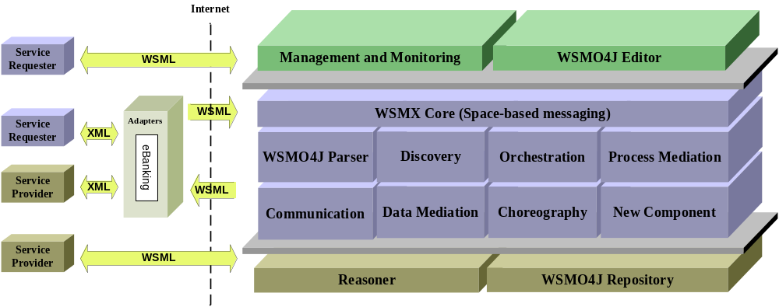
Architecture Components – Execution Environment
Execution Environment
  (1) WSMX – WSMO Orchestration (state machine)
  (2) CrossVision – service orchestrator, ESB (BPEL)

Slide 33
Overview
Introduction
Progress to Date
Architecture Components
Work Plan

Slide 34
Summary – work plan (1)
Architecture Document Scope, 10th September 2006
  Conceptual Architecture as basis (DERI Galway)
Semantic Service, 10th October 2006
  Service Creation – wrappers – Legacy Integrator (Software AG)
  SA-WSDL – WSMO-PA (DERI Galway)
  PA Ontologies –> WP4 (Ontotext)
Registry/Repository, 10th October 2006
  CentraSite/ORDI/both, technical specification (Software AG, Ontotext)
  Distributed registry/repository (DERI Galway)
Mediation, 10th November 2006
  DERI Innsbruck (separated deliverable?)

Slide 35
Summary – work plan (2)
Needs2Services, 10th November
  Needs2Services (CERTH)
Discovery, 10th November
  Distributed discovery (DERI Galway + DERI Innsbruck)
Composition, 10th November
  UniRoma

Slide 36
Summary – architecture meetings
Dedicated Architecture Meeting
  2nd half of September 2006
  Discussion the progress of work, components, etc.
  Participants: DERI (I+G), UniRoma, OntoText, SAG, …
4th Plenary
  End of October?

Slide 37
Summary – work plan (3)
SemanticGov Architecture – 1st version, 30th December
Mediatiors – 1st version, 30th December
SemanticGov Architecture – 2nd version
  Jan – Apr 2007
Mediators – 2nd version
  Jan – Apr 2007

