Slide 1

Dynamic B2B Integration on the Semantic Web Services: SWS Challenge Phase 2
Thomas Hasselwanter, Paavo Kotinurmi, Matthew Moran, Tomas Vitvar, Maciej Zaremba
Tomas Vitvar, Maciej Zaremba
tomas.vitvar@deri.org
SWS Challenge – Phase 2
June 15-16 2006, Budva, Montenegro (co-located with Knowledge Web GA)

Slide 2
Overview
SWS: WSMO, WSML, WSMX
Contributions and Design of the Solution
Implementation and Demonstration
Conclusion

Slide 3
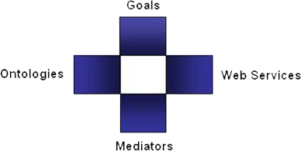
SWS: WSMO, WSML, WSMX
Semantic Web Services
  (semi) automate discovery, selection, composition, mediation, invocation of services
  DERI: WSMO, WSML, WSMX Working Groups
  (other: OWL-S, WSDL-S/METEOR-S)
  Projects: DIP, KW, SEKT, SWWS, ASG, …
  New Projects in areas of e-government, e-health, BPM
Web Service Modelling…
… Ontology -> WSMO
  Conceptual model for SWS:
  goal, ontologies, mediators, services
… Language -> WSML
  Ontology Language for SWS
  WSML Variants: WSML Core, WSML DL, WSML Rule, WSML Full
… Execution Environment and Architecture -> WSMX
  Middle-ware platform for SWS
  Now in OASIS SEE TC

Slide 4
SWS: WSMX Overview
middleware for Semantic Web Services
  integration of services
Provide a reference implementation for WSMO
  Eat our own cake
Provide an environment for goal based service discovery and invocation
  Run-time binding of service requester and provider
Provide a flexible Service Oriented Architecture
  Add, update, remove components as needed
Keep open-source to encourage participation
  Developers are free to use in their own code
Define flexible execution semantics (execution scenarios)
  system behaviour

Slide 5
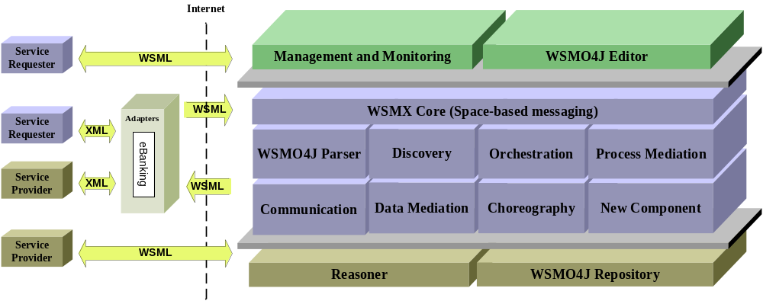
SWS: WSMX Architecture

Slide 6
Overview
SWS: WSMO, WSML, WSMX
Contributions and Design of the Solution
Implementation and Demonstration
Conclusion

Slide 7
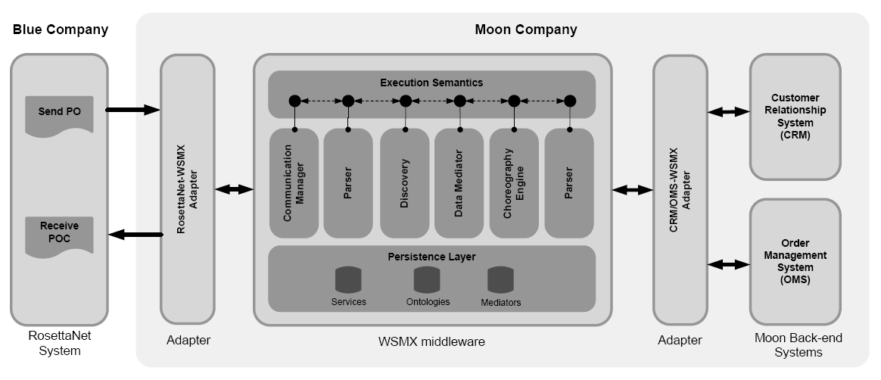

Scenario
WSMO Goal
Description
WSMO Service
Description

Slide 8
Contributions
Description of RN, CRM and OMS services as semantic WSMO services
  Ontologies, Capability, Interface – chorepgraphy
Transformation of XML Schema to WSML
  XSLT for RosettaNet Purchase Order and schemas of OMS and CRM systems
Conversation between services facilitated by the WSMX middleware
Data and process mediation between services during conversation

Slide 9
Solution: Overview of Integration Stages
1 – Sending Request
  Blue sends PO request
2 – Discovery and Conversation Setup
  Discovery of service, setup of conversation
3 – Conversation with Requester
  Blue RosettaNet System: accepting purchase order request
4 – Conversation with Provider
  CRM and OMS systems: opening order, adding line items, closing order
5 – Conversation with Requester
  order confirmation, end of conversation

Slide 10
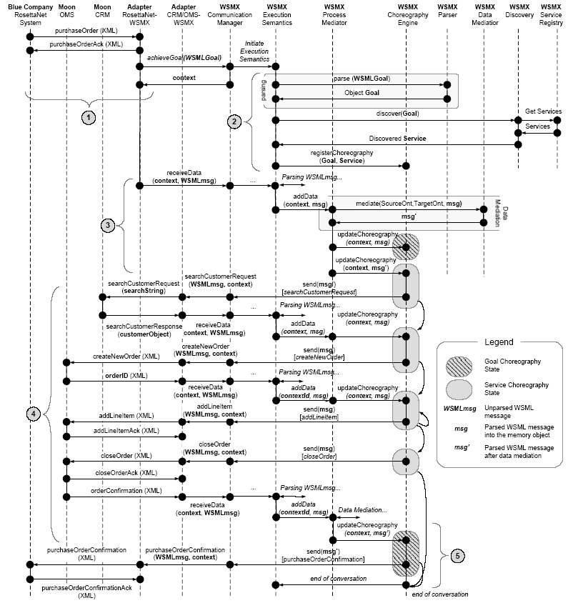
Solution: Overview of Integration Stages
1 – Sending Request
2 – Discovery and Conversation Setup
3 – Conversation with Requester
4 – Conversation with Provider
5 – Conversation with Requester

Slide 11
Solution: Overview of Integration Stages
1 – Sending Request
2 – Discovery and Conversation Setup
3 – Conversation with Requester
4 – Conversation with Provider
5 – Conversation with Requester

Slide 12
Stage 1: Sending Request
1 – Sending Request

Slide 13
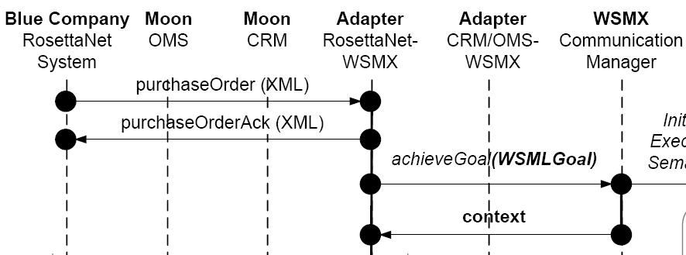
Stage 1: Sending Request
PurchaseOrder in XML is sent to Moon (RN-WSMX adapter)
RN-WSMX accepts the message
RN-WSMX send acknowledgement
XML message is transformed to WSML (using XSLT lifting rules)
WSMO Goal is created
WSMO Goal is sent to WSMX (AchieveGoal entrypoint) and context is received

Slide 14
Stage 2: Discovery and Conversation Setup
1 – Sending Request
2 – Discovery and Conversation Setup

Slide 15
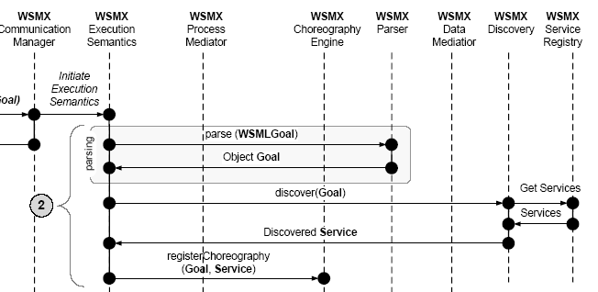
Stage 2: Discovery and Conversation Setup
CM initiates the execution semantics
ES invokes parser to parse WSMO Goal into the memory object
ES invokes discovery(Goal)
  Discovery matches goal capability with possible service capability
On return: service and goal
ES registeres Goal and Service choreography with Choreography Engine
CE waits for incoming messages

Slide 16
Stage 3: Conversation with Requester
1 – Sending Request
2 – Discovery and Conversation Setup
3 – Conversation with Requester

Slide 17
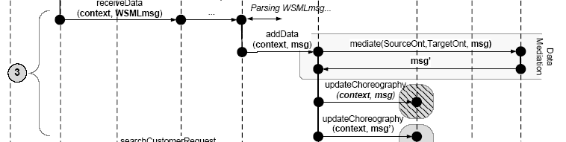
Stage 3: Conversation with Requester
RN-WSMX adapter sends data of PO in WSML through receiveData entrypoint
ES invokes parser to parse data into memory object
ES invokes Process Mediator (PM) to add data to choreography
PM invokes data mediation to transform data to providers ontology
PM updates choreography (adds data to provider‘s choreography and flags requester‘s choreography that the message has been received

Slide 18
Stage 4: Conversation with Provider
1 – Sending Request
2 – Discovery and Conversation Setup
3 – Conversation with Requester
4 – Conversation with Provider

Slide 19
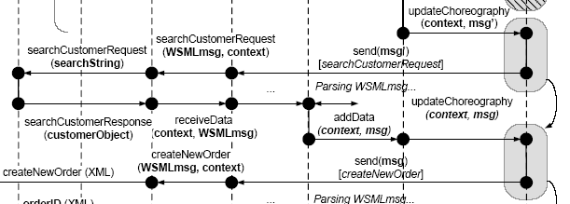
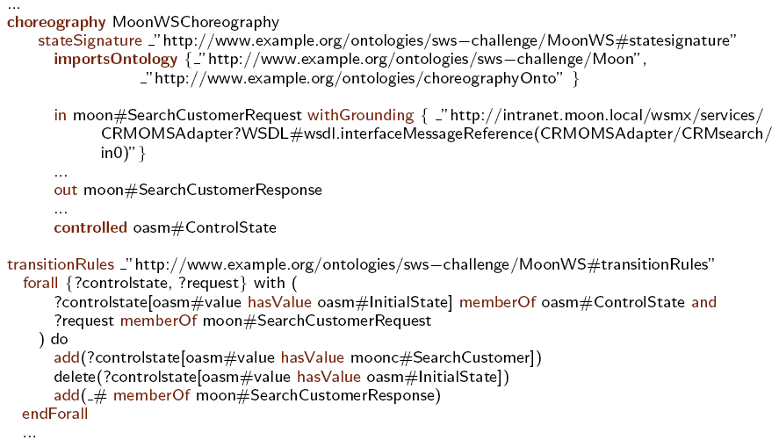
Stage 4: Conversation with Provider (1)
After data has been updated, a rule from provider‘s choreography is fired to send SearchCustomerRequest and receive searchCustomerResponse

Slide 20
Stage 4: Conversation with Provider (2)
CE notifes CM to send the message
CM invokes CRM/OMS adapter entrypoint (defined in grounding of the choreography)
CRM/OMS adapter invokes original service at CRM system
CRM/OMS adapter accepts searchCustomerResponse
CRM/OMS adapter performs Lifting to WSML
CRM/OMS adapter invokes receiveData entrypoint
ES invokes parser to parse data into memory object
ES invokes PM to add data to apropriet choreography
PM adds data to provider‘s choreography

Slide 21
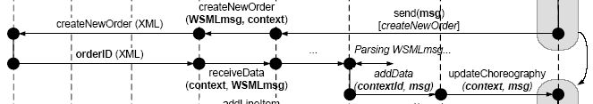
Stage 4: Conversation with Provider (3)
Next, CE fires rule to send CreateNewOrder
Message is passed through CM, CRM/OMS Adapter, OMS
OMS returns OrderID in response and finaly PM adds the result to provider‘s choreography

Slide 22

Stage 4: Conversation with Provider (4)
Next, CE fires rule to send addLineItem
This rule is fired for every lineItem in the provider‘s choreography
These line items were previously added to the choreography after the date mediation in stage 3
Acknowledgement is „stopped“ at CRM/OMS Adapter

Slide 23

Stage 4: Conversation with Provider (5)
When there is no line item in the choreography, CE fires the rule to send CloseOrder

Slide 24
Stage 5: Conversation with Requester
1 – Sending Request
2 – Discovery and Conversation Setup
3 – Conversation with Requester
4 – Conversation with Provider
5 – Conversation with Requester

Slide 25
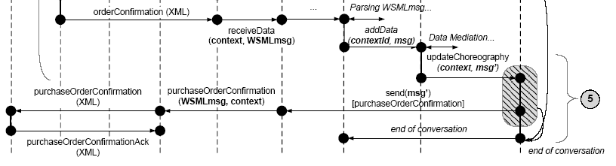
Stage 5: Conversation with Requester
In response, after order was closed, order confirmation is sent from OMS system
PM evaluates this data is added to CE
CE fires the rule of requester‘s choreography to send POC to Blue‘s RosettaNet System
No more rules to be fired in both choreographies -> conversation is ended

Slide 26
Overview
SWS: WSMO, WSML, WSMX
Contributions and Design of the Solution
Implementation and Demonstration
Conclusion

Slide 27
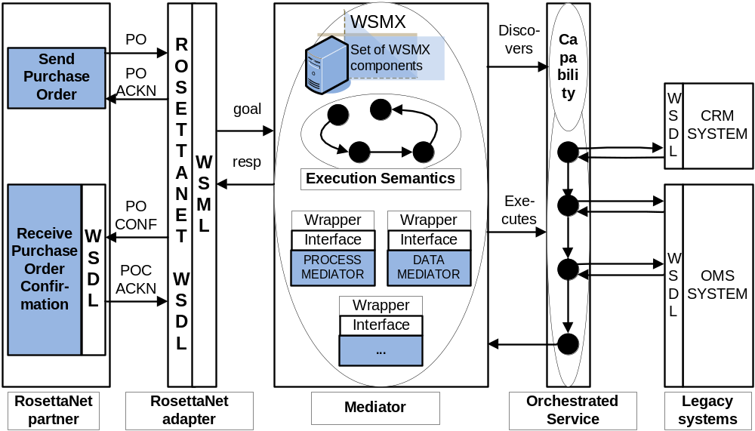
Implementation & Demonstration

Slide 28
Implementation & Demonstration
  Steps necessary to integrate Blue with Moon:
  defining ontologies for RosettaNet Blue and proprietary Moon
  providing adapters for XML->WSML (XSLTs) and WSML->XML (code)
  semantic descriptions of the partners:
    - WSMO Goal description of Blue (capability + choreography)
    WSMO Web service description of Orchestrated Moon services (capability + orchestration)
  defining ontology mappings to ensure Data level interoperability (in general approach using Data Mediation design tool – due to technical issues in current version code based Data Mediation)
  Service requester choreography due to its simplicity has been captured in the adapter entrypoint (extension possible)

Slide 29
Implementation & Demonstration
  Data Mediation – Ontology to Ontology mediation
    design time aspect – defining mappings
    run-time aspect – mappings execution on the instance level
    current implementation – code, due to the technical issues with reasoner
  Examples:
    PO.fromRole -> SearchCustomer
    PO.fromRole -> CreateOrderRequest
    PO. AddLineItem(s) -> multiple AddLineItemRequest(s)
    others (CloseOrder)

Slide 30
Implementation & Demonstration
  Process Mediation – run-time mediation based on partners, internally executable Choreography/Orchestration descriptions defined in Ontologized ASM formalism
PO
Search
Blue
Details
Moon CRM
ACK
PO_CONF
Create Order
ACK
orderId
...
Moon
OMS
...

Slide 31
Implementation & Demonstration
  Extensions necessary for mediation v.2:
  Declarative:
  Providing new Blue Goal
  Providing new Moon Web serivce
  extending Blue RosettaNet ontology with shipTo concept on ProductLineItem level
  new XML->WSML xstls for the adapter
  Code:
  providing new Web service mediator entrypoint

Slide 32
Overview
SWS: WSMO, WSML, WSMX
Contributions and Design of the Solution
Implementation and Demonstration
Conclusion

Slide 33
Conclusion and future work
  Fully operational implementation for SWS-Challenge mediation task
  Main emphasize on Data and Process Mediation issue
  Future steps:
  Generic XML Schema/WSML mapping mechnism
  Integration of generic Data Mediation component
  Integration of elaborate, semantic discovery
  Possible use of design time Process Mediation approach
  Exception handling in WSMO Choreography, visual tool support for Choregraphy/Orchestration modelling

Slide 34
Presentation Wrap-up
Q&A

