Slide 1


WP03 – Design of Semantic Web Service Architecture for National and Pan-European e-Government services
Tomas Vitvar
SemanticGov Review
20 February 2007, Brussels, Belgium

Slide 2

Overview
Objectives
Work Plan
Background concepts
Architecture and Components
Future Work

Slide 3
Objectives
Objective 1: Application of WSMF to Semantic Government services
  Design of architecture for national and Pan-European e-Government (conceptual and technical)
Objective 2: Development of Mediator Support
  Design of mediators to address the issue of interoperability in the overall architecture.
  Aligned interoperability problems in PEGS

Slide 4
Workplan
Start: M6 (June 2006)
Finish: M16 (April 2007)
Total effort: 66MM
Deliverables
  SemanticGov Architecture version 1, total effort: 10MM
    Delivered M12 (December 2006)
  SemanticGov Architecture version 2, total effort: 20MM
    Will be delivered M16 (April 2007)
  Analysis of Mediator Requirements and Mediator Implementation total effort: 36MM
    Will be delivered M16 (April 2007)
CERTH | NUIG | LFUI | UOR | CAPGEMINI | SOFTWARE AG | ONTO | ALTEC S.A. | MOI | RCM | Citta Di Torino
7 | 6 | 11 | 15 | 6 | 3 | 9 | 5 | 1 | 1 | 1

Slide 5
Methodology – overview
WP1: Overall conceptual analysis
WP2: Requirement Analysis for NEGS & PEGS
Conceptual Design Phase (requirements analysis)
WP3: Design of National and European Semantic Web Services Architecture
Conceptual/Technical Design Phase
WP5: Development of SWS Execution Environment For NEGS & PEGS
Technical/Implementation Phase

Slide 6
Methodology – Dependencies (technology, existing know-how and concepts)
PA
Service Model
WSMO
Service Model
WP4: PA Domain Ontology
WSMO-PA
Architecture
from WP2
DERI
SEE (WSMX)
Software AG, UniRoma,
Ontotext technology
SemanticGov
Architecture
WP3: SemanticGov Architecture

Slide 7
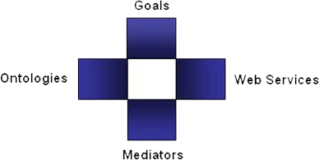
Background Concepts: WSMO, WSML, WSMX
Semantic Web Services in DERI
  SWS: WSMO, WSML, WSMX
    community Effort driven by DERI
    EU FP6 and national funding
Web Service Modelling…
… Ontology -> WSMO
  Conceptual model for SWS:
  goal, ontologies, mediators, services
… Language -> WSML
  Ontology Language for SWS
  WSML Variants: (description logic and logic programming based knowledge representation formalisms)
… Execution Environment and Architecture -> WSMX
  Middleware platform for SWS
  Now in OASIS Semantic Execution Environment Technical Committee

Slide 8
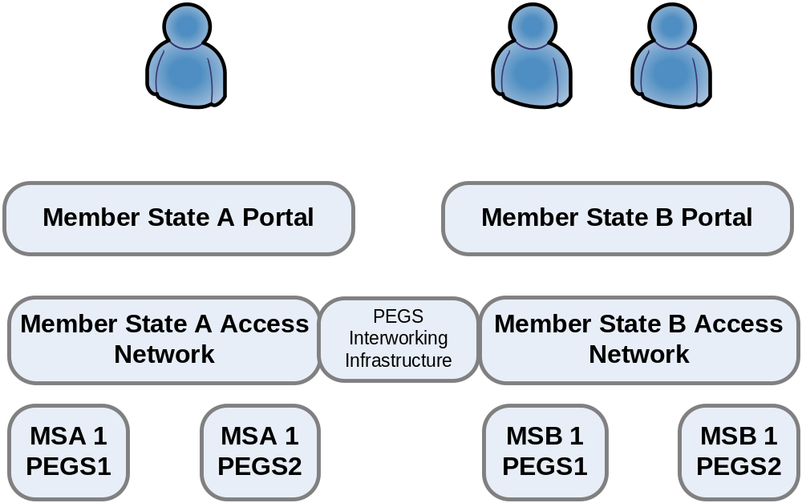
SemanticGov Architecture – conceptual

Slide 9
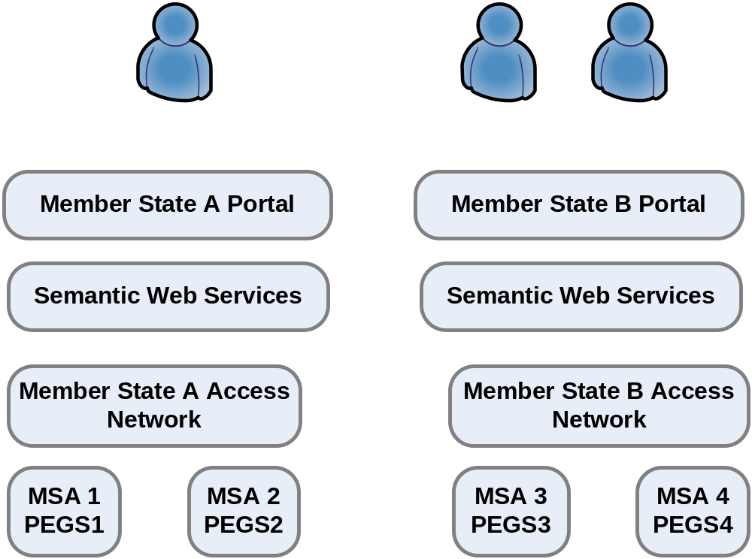
SemanticGov Architecture – conceptual

Slide 10
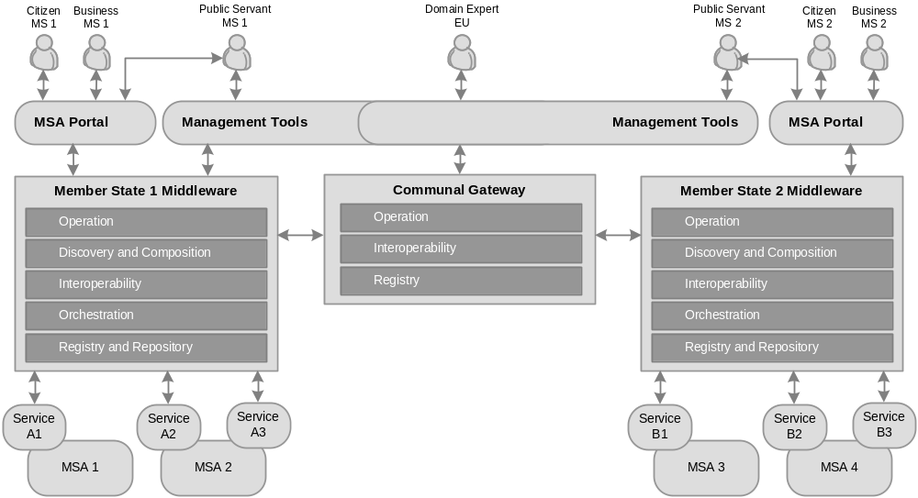
Results – Global view on Architecture

Slide 11
Services
Client Services
  Member State Portal
  Management
Middleware Services
  Operation, Discovery, Interoperability, Composition, Registry/Repository, Orchestration, Reasoning, Communication
Public Administration Services (Business Services)
  WSMO-PA -> WP4

Slide 12
Distributed Registry/Repository
Distributed Repository
  Domain specific repositories (a number of repositories will exist in member states - e.g. repository for transportation, construction, etc.)
  Registry for each MS with information on the location of domain repositories (tuples: domain repositories and their locations)
  Discovery first locates the domain repository and then performs discovery of services in the repository.
  CentraSite will be used as a registry,
  ORDI will be used as a repository.
REGISTRY
(Member State)
REPOSITORY
(Domain)
Member State A
Query Processor
Query Processor
Member State B
JAXR, WebDAV
Light-weight reasoner
(WSML Core)
Member State C
CentraSite
ORDI
WSML Reasoner
(DL, LP)

Slide 13

Discovery and Composition: Design time
choreography
request
Discovery
Composition
(service capability
+ choreography int)
Public Servant
Access to distributed registry/
repository
Set of semantic services
(WSMO-PA services)
Business Service
Orchestration
(state machine)

Slide 14
Interoperability
Data Mediation
  Identify the technical requirements for the semantic interoperability conflicts (D1.3) – type of interoperability conflicts
    Data Level Conflicts
      Data Value Conflict
      Data Representation Conflicts
      Data Unit Conflict
      Data Precision Conflict
      Granularity of the Information Unit
    Schema Level Conflicts
      Naming Conflicts
      Entity Identifier Conflict
      Schema Isomorphism Conflict
      Generalization Conflict
      Aggregation Conflict

Slide 15
PA Services
PA
Ontologies
PA
Ontologies
PA Ontologies
WSMO-PA services
(grounding WSMO-PA to WSDL)
Semantic Repository
WSMO-PA
WSMO-PA
Grounding
WSDL
WSDL
WSDL services from existing
Applications
Existing PA
Application
Repository (UDDI)

Slide 16
Future Work
Final version of the SemanticGov architecture
  April 2007
  Finalize interfaces for middleware services
  Design of member state portal for SemanticGov
  Define middleware processes
    Execution semantics for the architecture
Mediator support for PEGS
  April 2007
  Based on technical requirements for the semantic interoperability conflicts (D1.3)

Slide 17
  Thanks!

Slide 18
  Backup Slides

Slide 19
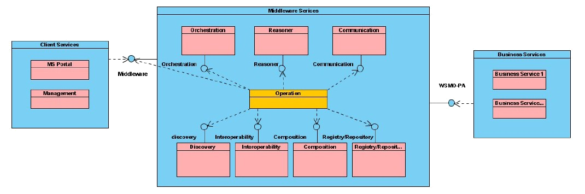
Services

Slide 20
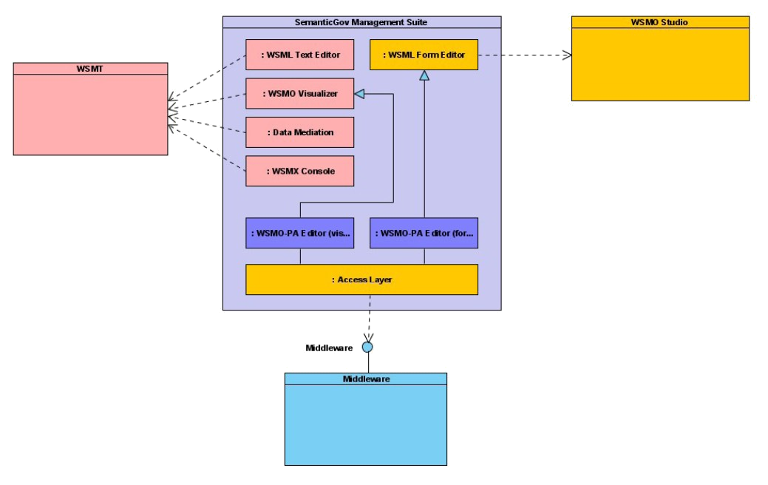
Management Tools (client services)

Slide 21
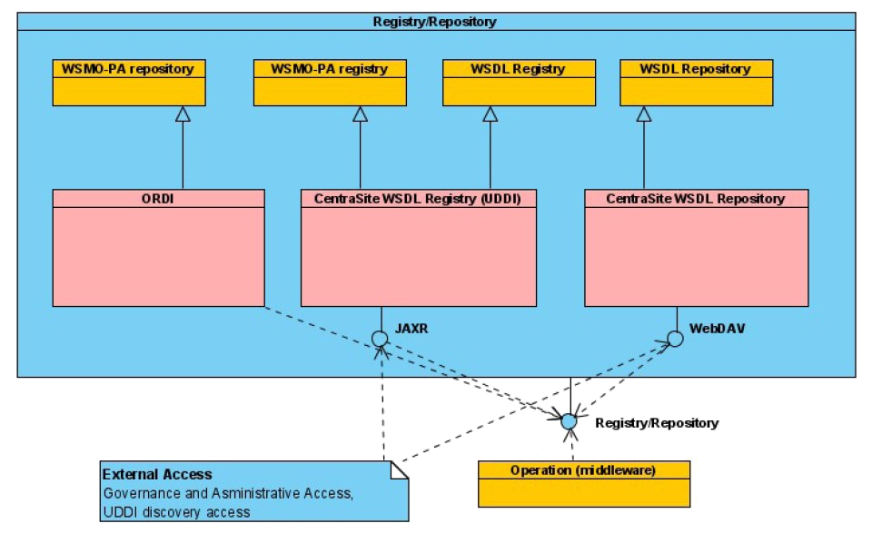
Registry/Repository

Slide 22
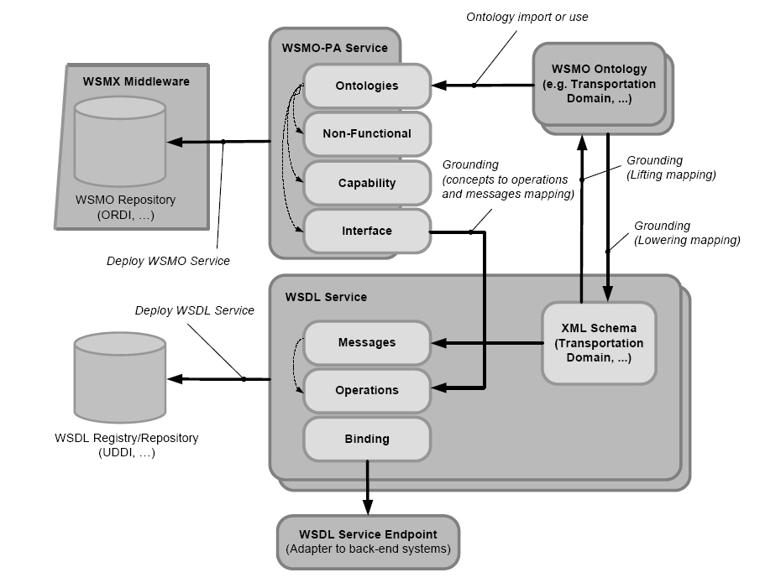
Public Administration Services

Slide 23
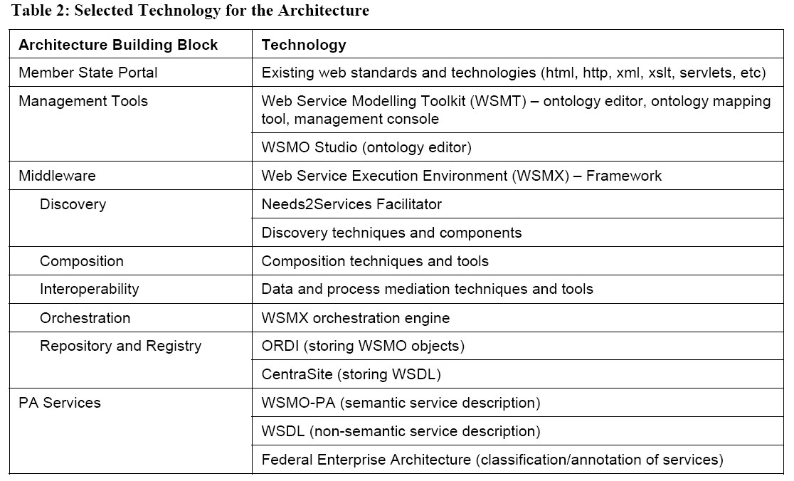
Results – Technology

Slide 24
Interoperability
National Level
  Data interoperability achieved through
  common standards
  e.g. birth certificate is the same throughout the country but not across countries
Pan-European Level – Communal Semantic Gateway
  Data Mediation
    Interoperability achieved through mapping of ontologies and executing mapping rules and conversions

Slide 25
Processes
Middleware processes – defined by execution semantics
Support for business process modelling (run by domain experts) (design-time)
  Discovery, composition (+mediation)
  Result Business Process will be deployed to the architecture
Support for service usage (run-time)
  Discovery, invocation of PA services (+mediation)

