Slide 1

Infrastructure for the Semantic Pan-European
E-Government Services
Tomas Vitvar, Mick Kerrigan, Arnold van Overeem, Vassilios Peristeras, Konstantinos Tarabanis
Tomas Vitvar
tomas.vitvar@deri.org
Semantic Web Meets E-Government (SWEG), AAAI Spring Symposium
27-29 March, Stanford, USA

Slide 2
Overview
Background: IDABC, WSMOLX
Pan-European E-Government on SWS
Conclusion

Slide 3
IDABC
IDABC – Interoperable Delivery of European e-Government Services to Public Administrations, Businesses and Citizens
Former IDA (promote interoperability between administrations in EU)
Sector Projects (e.g. integration of IS in transport, health, …)
Horizontal Activities
  On-line Front-office services (portals)
  Infrastructure Services (European Interoperability Framework, PEGS Architecture)

Slide 4
Pan-European E-Government Services
Existing National Interoperability Frameworks
  Guidelines to provide interoperability in Member States
  (data interoperability standards, methodology, etc.)
Types of Services
  National – provided to citizens/businesses at national level
  Communal – provided to citizens/business by EC
  Interworking – bridge differences in national services

Slide 5
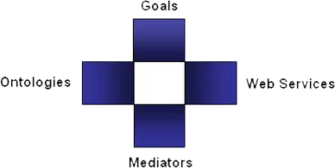
Semantic Web Services in DERI
Semantic Web Services
  (semi) automate discovery, selection, composition, mediation, invocation of semantic web services
  DERI: WSMO, WSML, WSMX Working Groups
  Projects: DIP, KW, SEKT, SWWS, ASG, …
  New Projects in areas of e-government, e-health, BPM
Web Service Modelling…
… Ontology -> WSMO
  Conceptual model for SWS:
  goal, ontologies, mediators, services
… Language -> WSML
  Ontology Language for SWS
  WSML Variants: WSML Core, WSML DL, WSML Rule, WSML Full
… Execution Environment and Architecture -> WSMX
  Middle-ware platform for SWS
  Now in OASIS SEE TC

Slide 6
Pan-European E-Government and SWS
PA
Service Model
WSMO
Service Model
WSMO-PA
IDABC–PEGS
WSMX
Semantic PEGS
Architecture

Slide 7
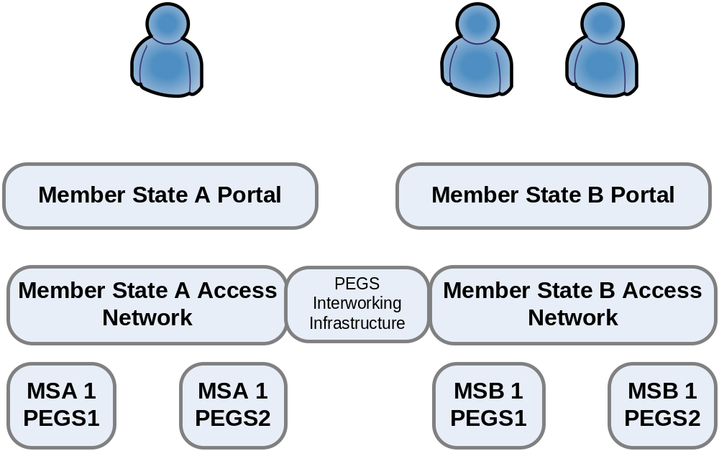
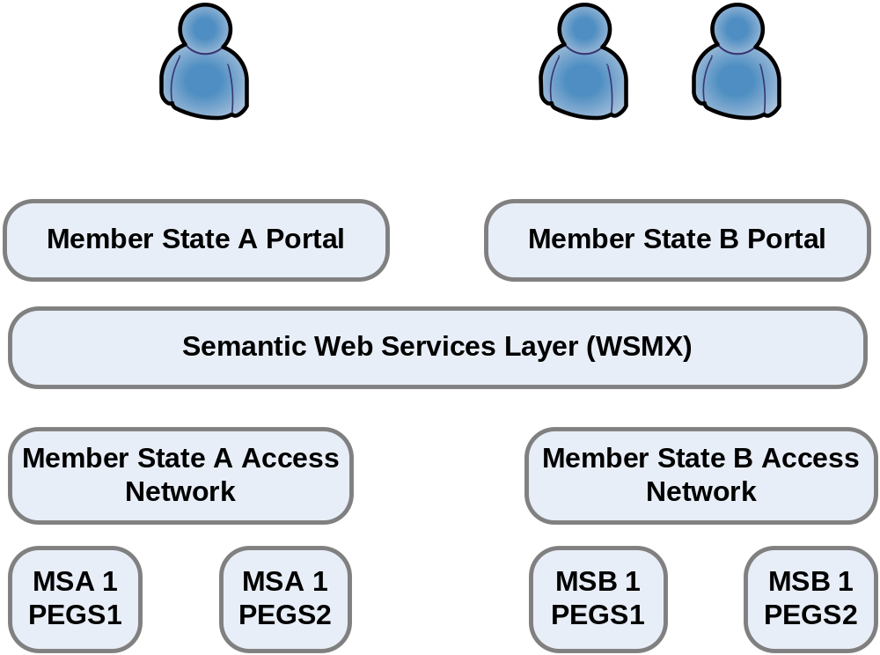
PEGS and Semantic Web Services

Slide 8
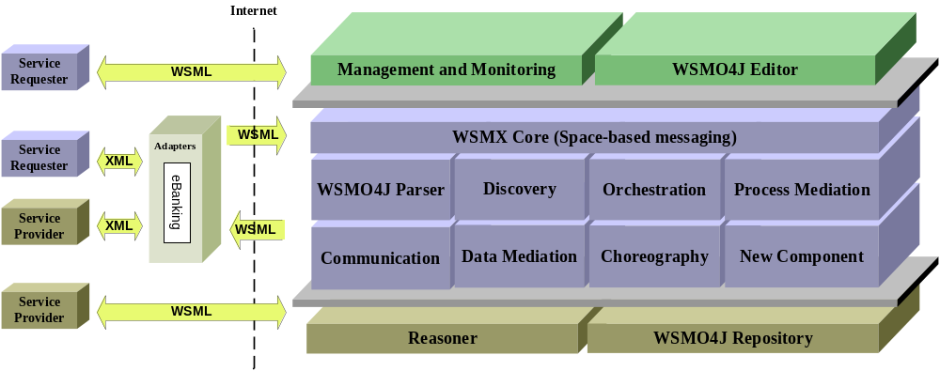
WSMX

Slide 9
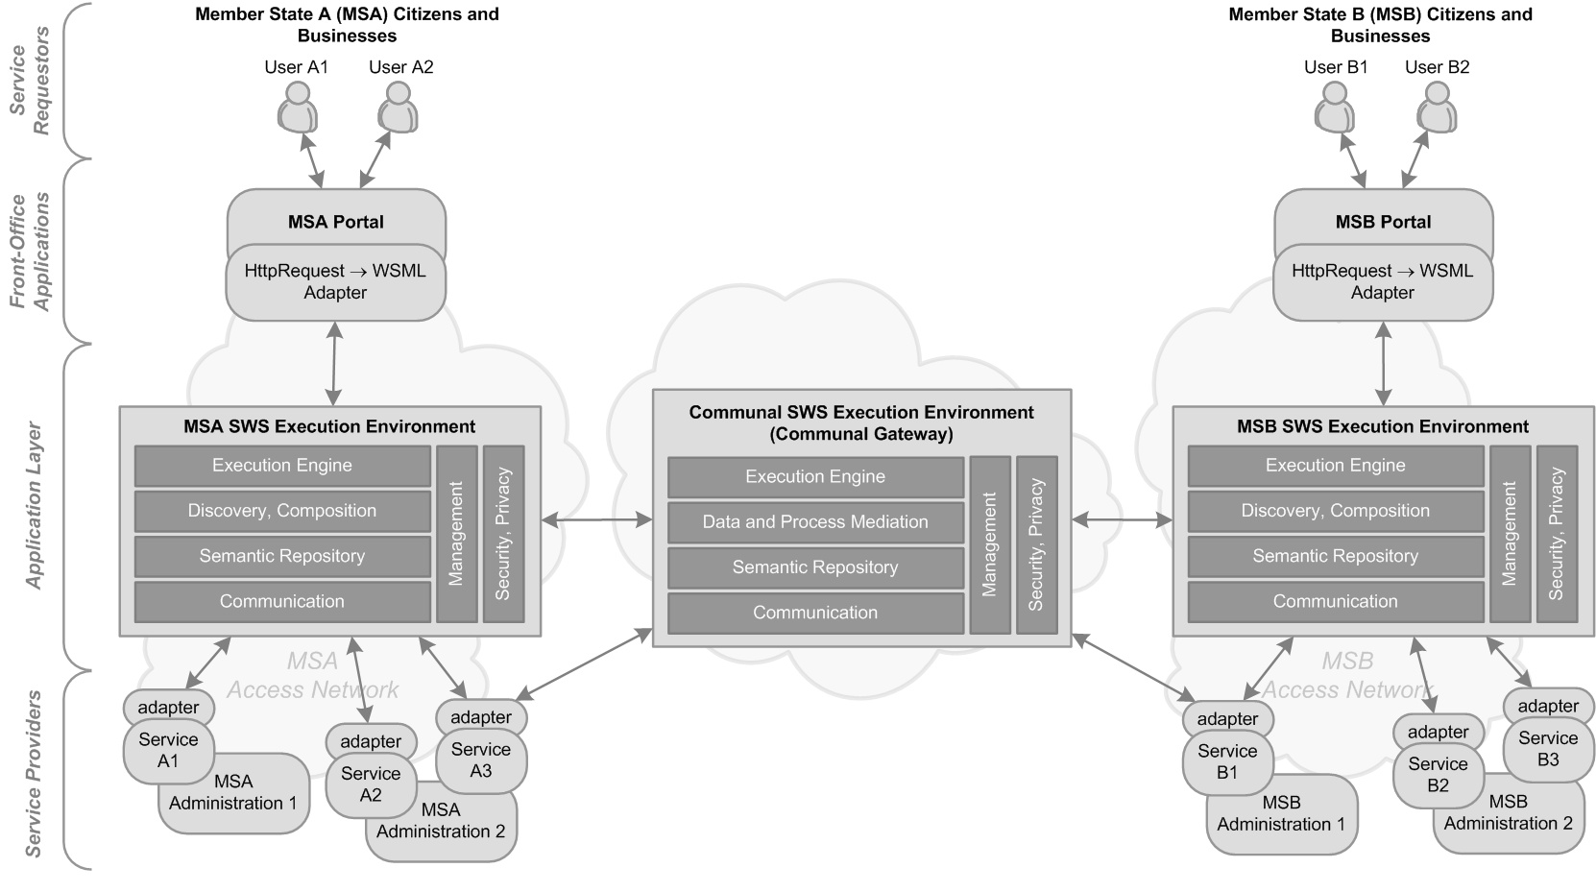
PEGS and Semantic Web Services

Slide 10
Conclusion
IDABC and SWS – WSMO, WSML, WSMX
Formalize PA service model using WSMO and WSML
Build PEGS Infrastructure on SWS (WSMOLX)
  Apply and develop WSMX to facilitate PEGS architecture according to the IDABC specifications
  Interoperability in cross-country e-gov services (data, process, technical)
  Discovery, composition of services

