Slide 1

WSMO-PA: Formal Specification of Public Administration Service Model on Semantic Web Service Ontology
Xia Wang, Tomas Vitvar, Vassilios Peristeras, Adrian Mocan,
Sotirios Goudos, Konstantinos Tarabanis
Tomas Vitvar
tomas.vitvar@deri.org
40th Hawaii International Conference on System Sciences
January 4-6, 2007, Hawaii, U.S.A.

Slide 2
Overview
Objectives and Requirements
Background Concepts: WSMO, GEA PA Service Model
WSMO-PA: WSMO + GEA PA Service Model
Semantic Government Architecture
Conclusion

Slide 3
Objectives and Requirements
Goal: Develop Integration Architecture for e-Government Services Based on Semantic Technology
  E-government services are subject of integration
  Model for e-government services needs to be:
    Semantic Aware (formal semantics)
    Public Administration Aware
Underlying Concepts:
  WSMO: Semantic Service Model (led by DERI)
  GEA: Service Model for Public Administration (led by CERTH)
⇒ WSMO-PA: Semantic and Formal Model for E-Government Services

Slide 4
Objectives and Requirements
Benefits of Semantics for e-Government
  Increasing Automation of Integration of e-government services (both run-time and design-time)
    E-government service usage process
  Service Identification
    Finding approapriate services for clients‘ needs
  Service Discovery and Composition
    Which Administrative Levels and which PA provide the service?
  Service Execution
    Complex workflows spanning accross multiple PAs to be executed and monitored
  Service Interoperability
    Interoperability issues in cross-country or cross-region integration

Slide 5
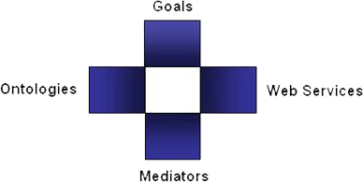
Background Concepts: WSMO, WSML, WSMX
Semantic Web Services in DERI
  SWS: WSMO, WSML, WSMX
    community Effort driven by DERI
    EU FP6 and national funding
Web Service Modelling…
… Ontology -> WSMO
  Conceptual model for SWS:
  goal, ontologies, mediators, services
… Language -> WSML
  Ontology Language for SWS
  WSML Variants: WSML Core, WSML DL, WSML Rule, WSML Full
… Execution Environment and Architecture -> WSMX
  Middleware platform for SWS
  Now in OASIS SEE TC

Slide 6
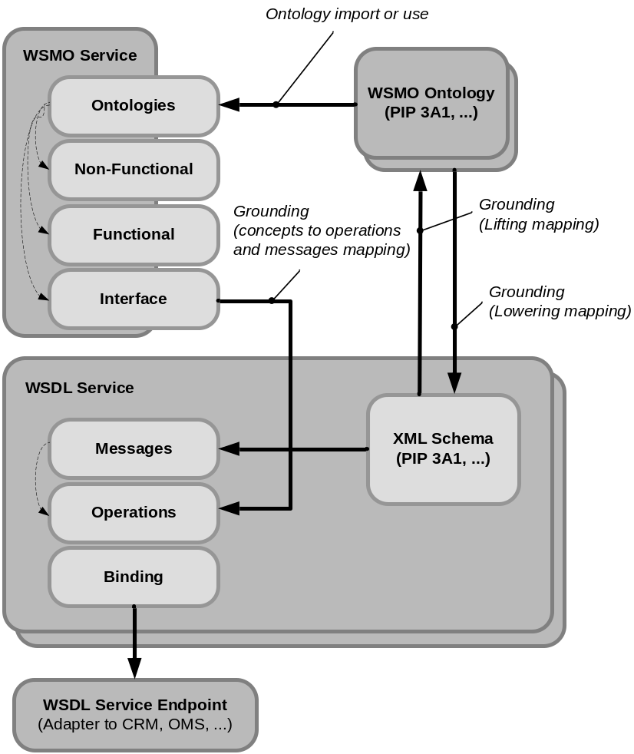
WSMO Service, WSMO Ontology and WSDL

Slide 7
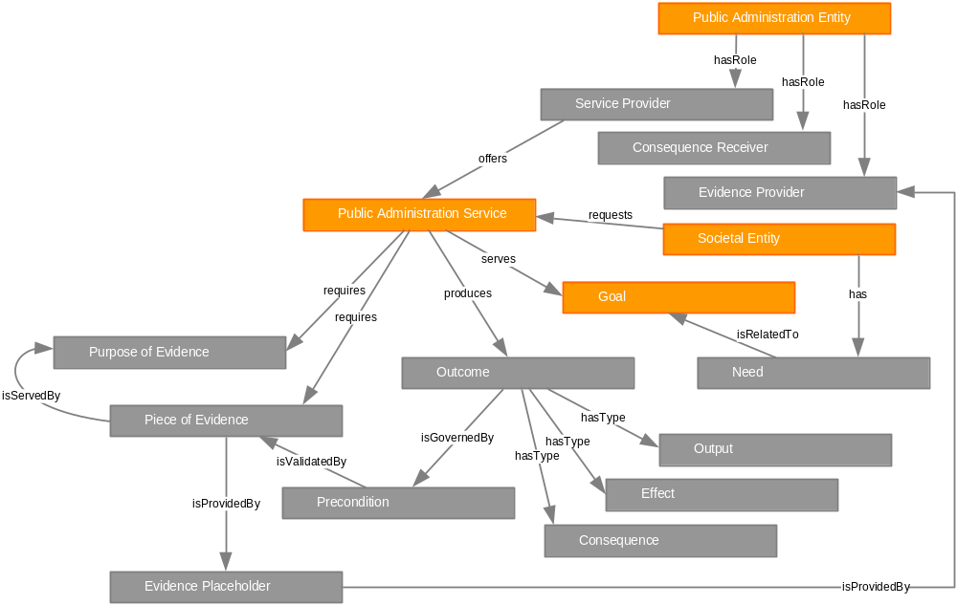
Background Concepts: GEA PA Service Model

Slide 8
WSMO-PA Overview
GEA PA Service Model
WSMO
WSMO-PA Specification
Ontologies, Services, Goals, Mediators
(specification + top level ontologies)
WSMO-PA Instance
Ontologies, Services, Goals, Mediators
(concrete definitions for particular scenarios)

Slide 9
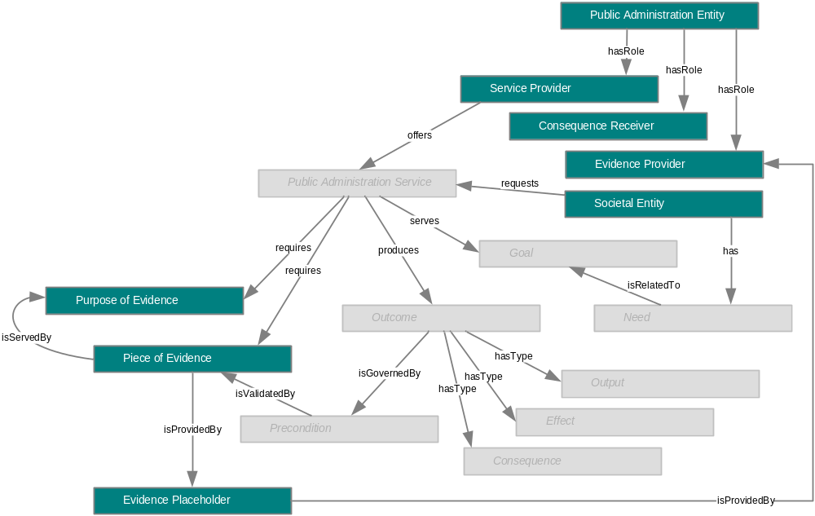
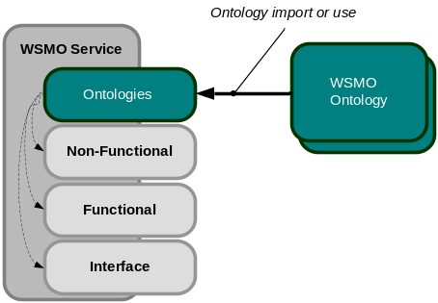
WSMO Ontology
Modelling of…
  PA Entities and their roles (e.g. classification
  ontology for PA entities)
  Societal Entities (citizens, businesses)
  Evidences (purposes, evidence placeholders)
Idea is to have an abstract ontology
  Modelling of specialized concepts
  for particular scenario

Slide 10
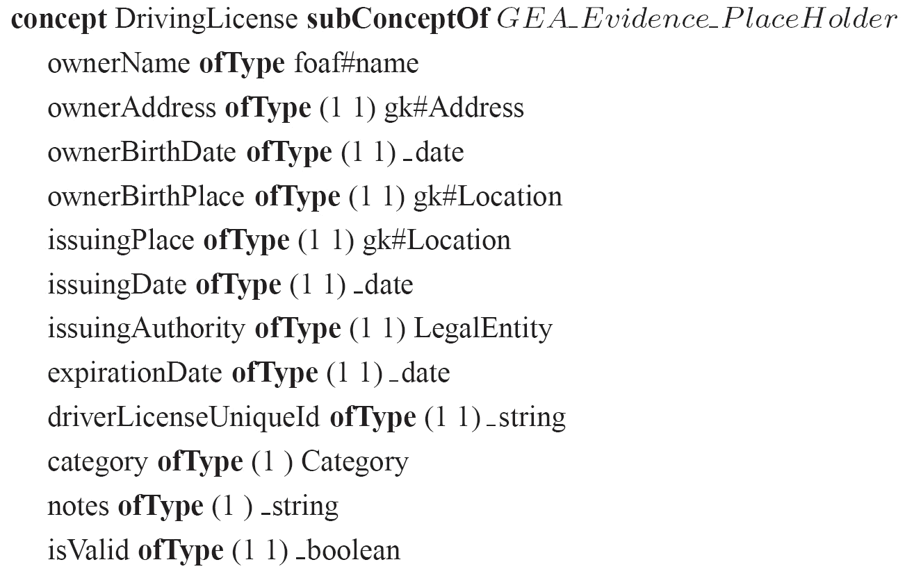
WSMO Ontology – Example
Example of a Driving Licence Evidence Placeholder Concept

Slide 11
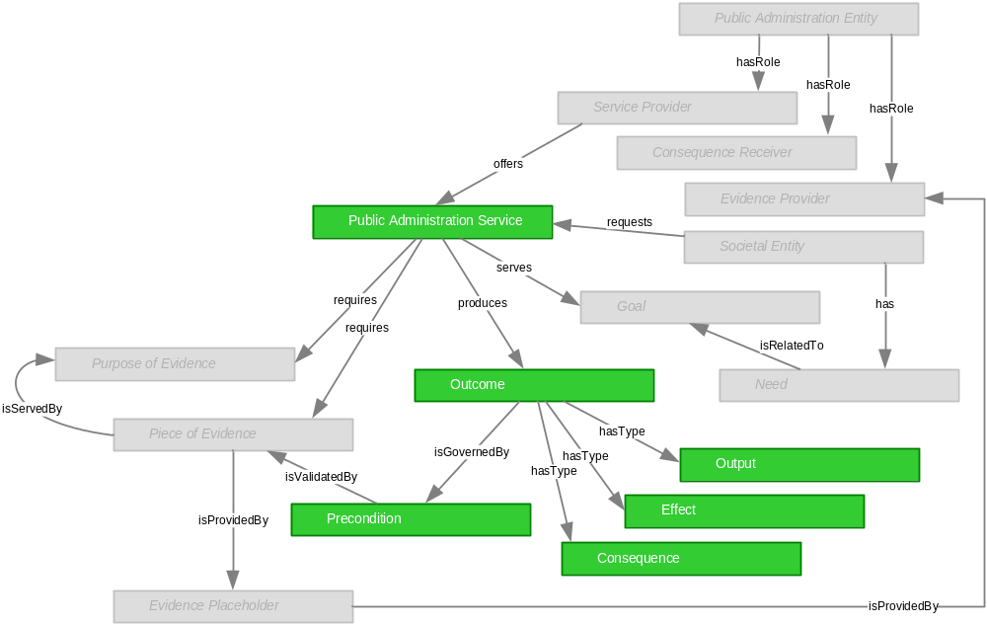
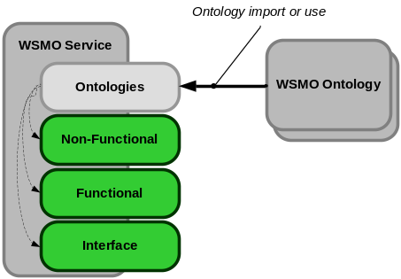
WSMO Service
WSMO Service modelled as PA Service
  Capabilities modelled using preconditions, outputs
  effects
  Interfaces
    Choreography – Communication Pattern for
    consuming PA service
    Orchestration
      Verification, Execution,
      Consequence

Slide 12
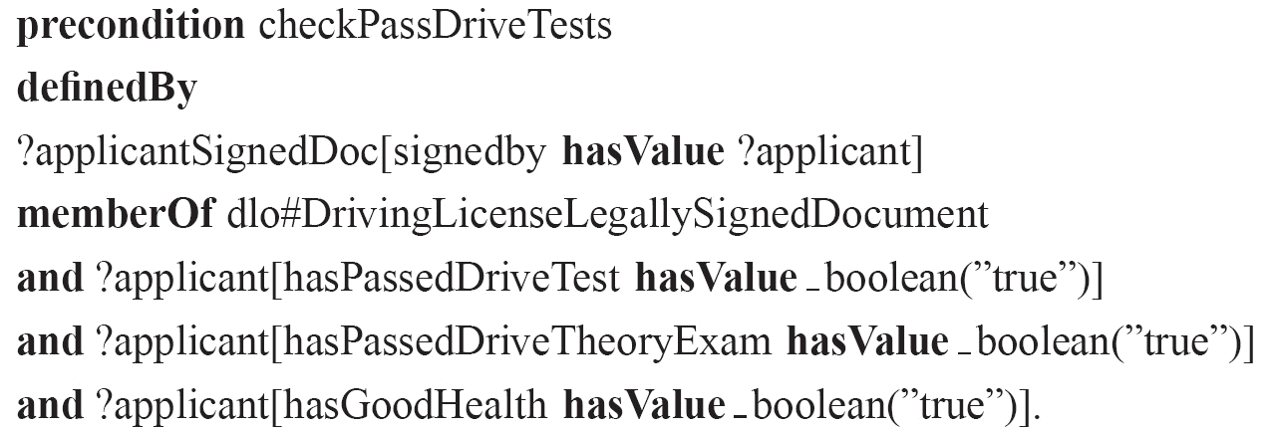
WSMO Service – Example
Example of a precondition for a Driving License Service

Slide 13
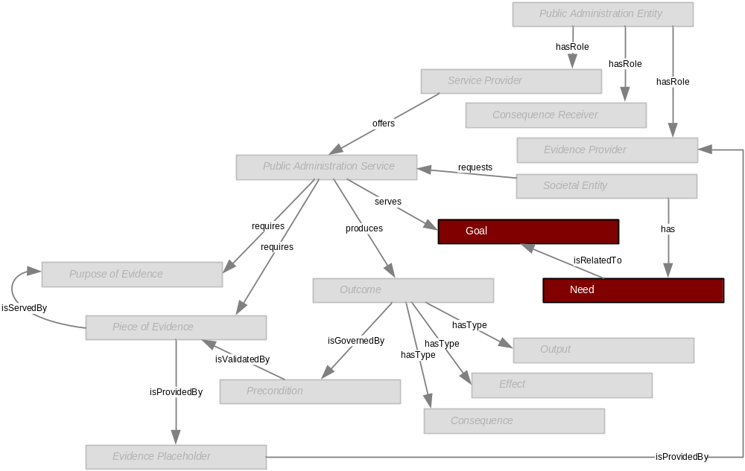
WSMO Goal
WSMO Goal modelled as Goal from PA Service Model
  Informal needs to be transformed to formal WSMO Goals

Slide 14
WSMO Mediator
No corresponding concepts in GEA PA Service Model
Mediators used to overcome interoperability issues
  Data Interoperability (OOMediator)
  Process Interoperability (WWMediator)

Slide 15
Semantic E-Government Services Creation
PA
Ontologies
WSMO-PA
Ontologies
1. Creating PA Ontologies
(WSMO Studio, WSMT)
3. Creating WSMO-PA services
(grounding WSMO-PA to WSDL)
(WSMO Studio, WSMT)
Registry/Repository
WSMO-PA
Service
WSMO-PA
Service
modelReference and schemaMapping (lifting/lowering)
WSDL
WSDL
2. Creating WSDL services from existing
Applications (Legacy Integrator)
Adapter
Existing e-government
Application

Slide 16
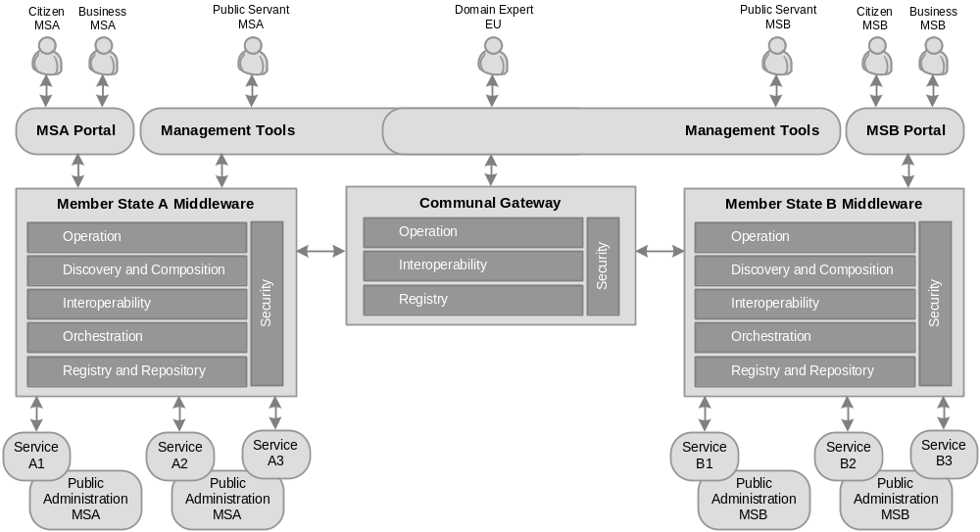
Global View on SemanticGov Architecture
WSMO-PA
Service
WSMO-PA
Service
WSMO-PA
Service
WSMO-PA
Service
WSMO-PA
Service
WSMO-PA
Service

Slide 17
Conclusion and Future Work
WSMO-PA – underlying specification for the architecture for e-government systems based on semantic technologies
Based on concepts of GEA PA Service Model and WSMO
Develop/customize tools for WSMO-PA editors
  Text, visualization tools (based on WSMT)
Develop the SemanticGov Architecture

