Slide 1
WP3 and WP5 Session
Architecture
T omas V itvar
tomas .vitvar @ deri.org
SemanticGov Plennary
3–4 J uly 2007, Darmstadt, Germany

Slide 2
Underlying Principles
Service Oriented Principle
  Services: middleware services and PA services (business services)
Semantic Principle
  Semantic description of business services
Problem Solving Principle
  Separation of user goal and the service

Slide 3
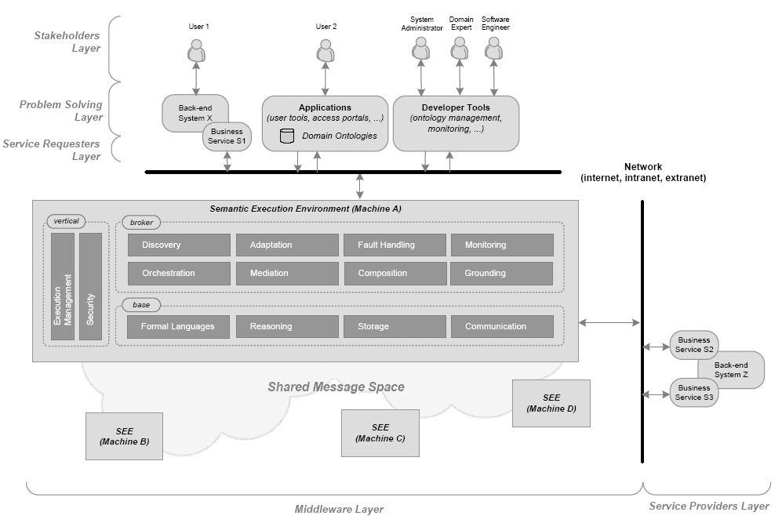
Global View

Slide 4
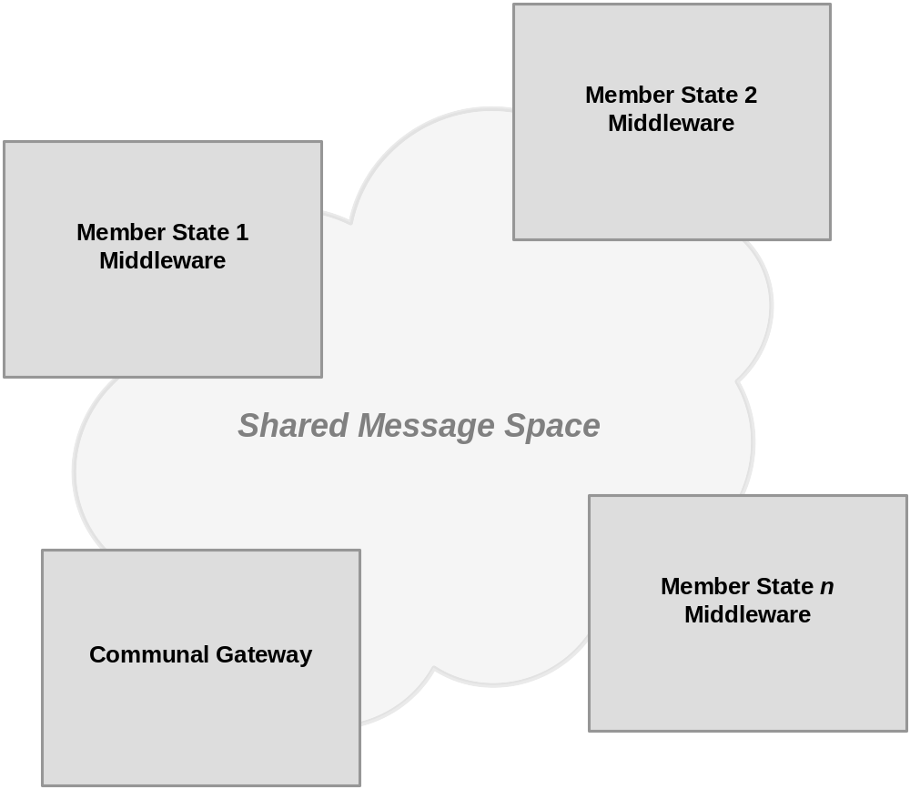
Distribution

Slide 5
Components
Discovery (NUIG)
  Discovers services based on formal user goal
Registry, Repository (NUIG)
  Distribution of repositories
Composition (UniRoma)
  Design-time composition
Member State Portal (CERTH)
  Getting input data from users and generating formal goal
Management Tools (Ontotext)
  Engineering of service and ontology descriptions, data mappings

Slide 6
Components
Orchestration (LFUI)
  Conversation
Data Mediation (LFUI)
  Resolving heterogeneity issues
  Communal Gateway

Slide 7
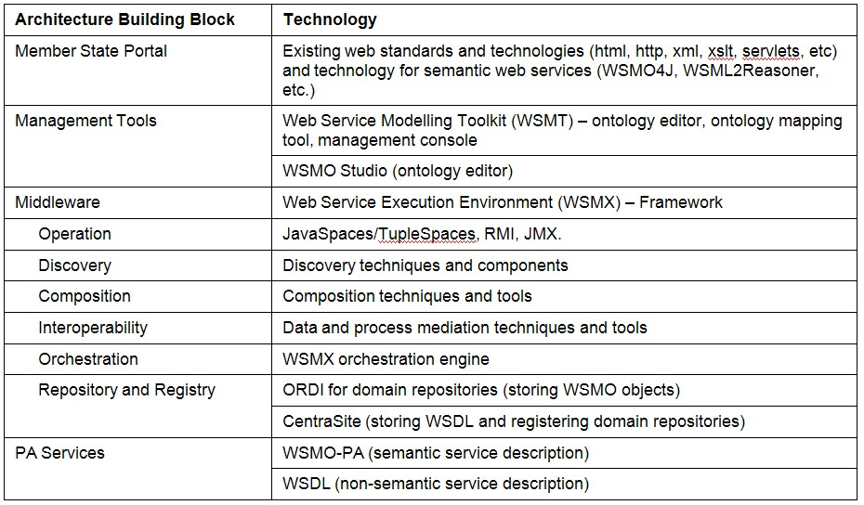
Technology

Slide 8
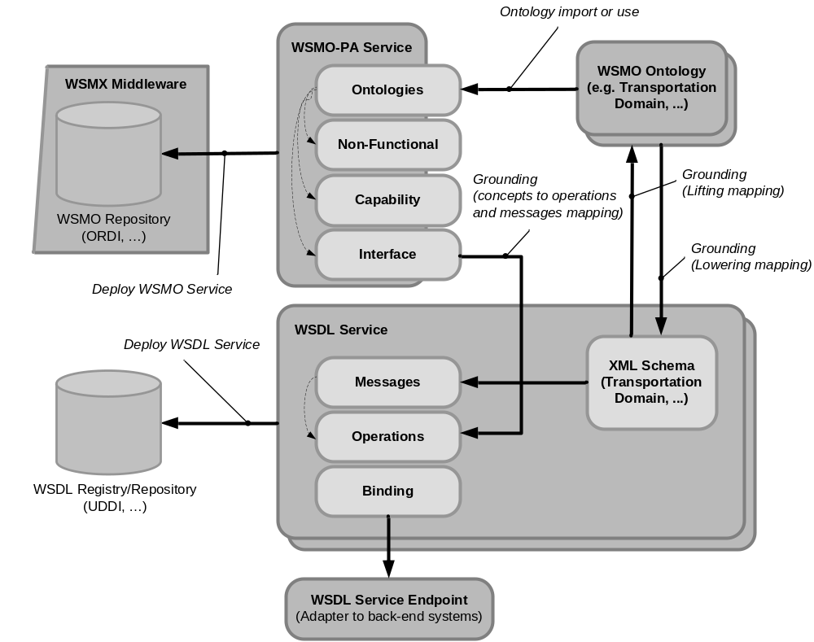
PA Services Anatomy (WSMO-PA – WP4)

Slide 9
Methodology
Two versions of the architecture
  1st version – 31/10/2007 (15/12/2007) (D3.1)
  2nd version – 31/4/2007 (20/6/2007) (D3.2)
Link to WP1, WP2 (conceptual analysis and requirements)
  Requirements addressed by the architecture (appending in D3.2)
Link to WP4, WP5, …
  Tight collaboration between WP3 and others
  Results should be documented as updated version of the architecture
    Another version of the architecture?
    Architecture as one of the main assets of the project

