Slide 1

Semantic Web Services: Hype of Reality?
ECOWS2005 Panel Discussions
Tomas Vitvar
tomas.vitvar@deri.org
IEEE European Conference on Web Services Vaxjo, Sweden, November 2005

Slide 2




Semantic Web and Web Services
500 million user
more than 3 billion pages
WWW
URI, HTML, HTTP
Static

Slide 3

Semantic Web and Web Services
  Serious Problems in
  information finding,
  information extracting,
  Information representing,
  information interpreting and information maintaining.
WWW
URI, HTML, HTTP
Semantic Web
RDF, RDF(S), OWL
Static

Slide 4

Semantic Web and Web Services
Web Services
UDDI, WSDL, SOAP
Dynamic
  Bringing the computer back as a device for computation
WWW
URI, HTML, HTTP
Semantic Web
RDF, RDF(S), OWL
Static

Slide 5
Semantic Web and Web Services
  Bringing the Web to its full potential
Web Services
UDDI, WSDL, SOAP
Intelligent Web
Services
Dynamic
WWW
URI, HTML, HTTP
Semantic Web
RDF, RDF(S), OWL
Static

Slide 6
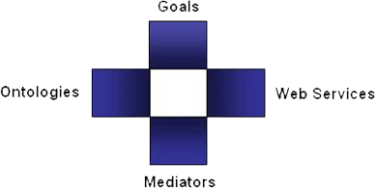
Semantic Web Services in DERI
Semantic Web Services
  DERI: WSMO, WSML, WSMX Working Groups
  Projects: DIP, KW, SEKT, SWWS, ASG, …
  New Projects in areas of e-government, e-health, BPM
Web Service Modelling…
… Ontology -> WSMO
  Conceptual model for SWS:
  goal, ontologies, mediators, services
… Language -> WSML
  Ontology Language for SWS
  WSML Variants: WSML DL, WSML Rule, WSML Core, WSML Full
… Execution Environment -> WSMX
  Execution Environment and Architecture for SWS
  Now in OASIS SEE TC
Notes:
Web service modelling … ontology, language, execution env.
Wsml variants – too detailed

Slide 7
Semantic Web Services in DERI
SWS aims to
  (semi) automate discovery, composition, mediation, negotiation, invocation of semantic web services
SWS grounds
  SOA
  Semantic Web
  Web Services
  Artificial Intelligence, Logics, Deductive Databases
SOA Evolution
  SOA -> Semantic-empowered Service Oriented Architecture (SESA) -> Problem-oriented Architectures

Slide 8
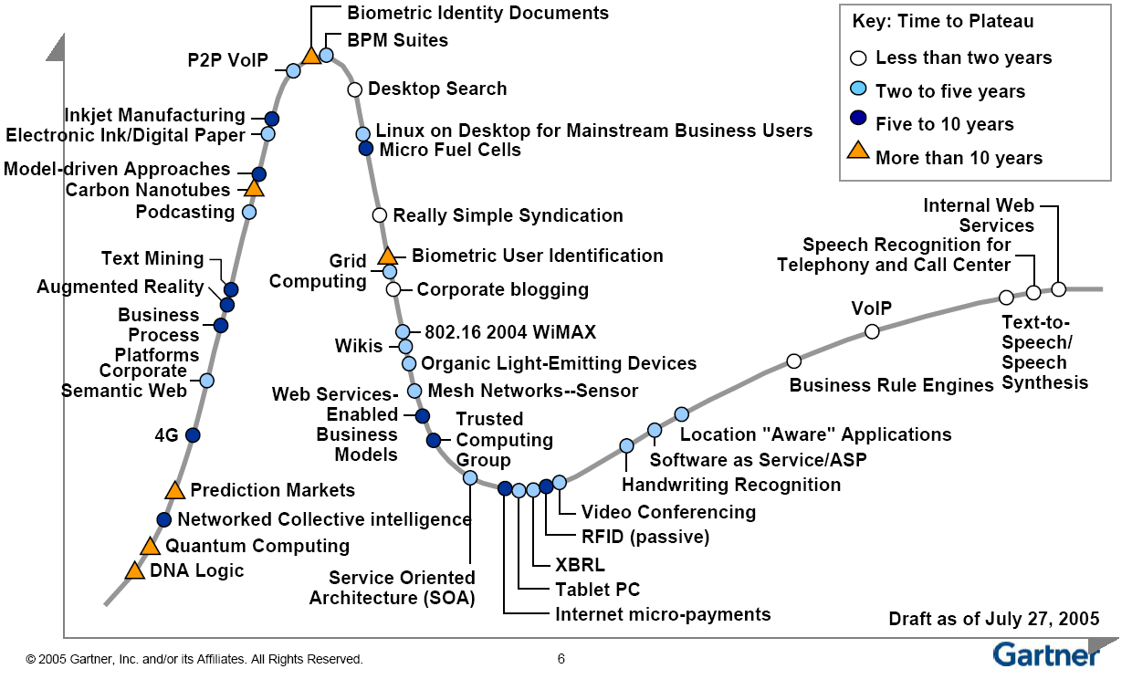
Emerging Technologies Hype Cycle
Notes:
We can’t talk about reality in regards to the SWS but SWS will definitely become of interest to industry within the next 5 to 10 years.

