Slide 1
WP2.4 Semantic Web Services
Knowledge Web Review
9-10 March, 2006
Innsbruck, Austria

Slide 2
Overview
Conceptual and Formal Framework for SWS
Use Case – Interoperation, link to Industry
Relationships with other EU projects
Management Report

Slide 3
Conceptual and Formal Framework for SWS
Uwe Keller

Slide 4
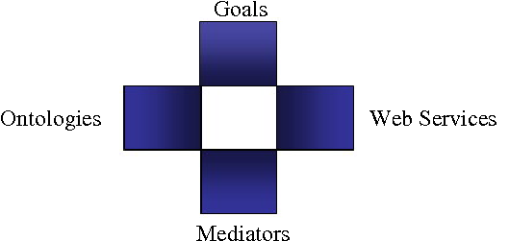
WSMO
Conceptual Framework for Web Services

Slide 5
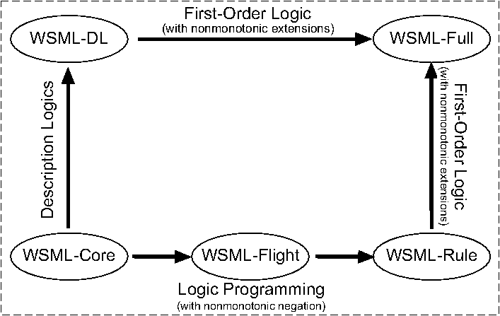
WSML
Concrete Language for representing the conceptual Framework

Slide 6
Functional Specification of
Web Services
Major addition in version 2 of the deliverable
Defines: Semantics for Capability Descriptions
  Functional perspective on a WS: What is provided / what does it do?
    Pre / Post style of modeling used in WSMO
  Survey of related work in Software Specification
  Achievement: Definition of a Language Neutral Framework for Capability Description and Semantics
    Provide a mathematically precise model of a the functionality of a WS on a detailed level
    Usable for defining semantics of Capability Descr. in various languages (WSML variants)
    Minimal assumptions on the language used for describing Precondition, Assumption, Postcondition and Effects
    Focusing on the dynamics added by WS to a static world
    Model integratable with behavioural model of WS (Choreography) of WSMO
Application to: Semantic Analysis of WS (Capability) Descriptions
  Formal definition of notions of Realizability and Refinement
  Useful for precise understanding Web service Discovery

Slide 7
Web Service vs. Service
Service
  A provision of value in some domain (not necessarily monetary, indepent of how service provider and requestor interact)
Web Service
  Computational entity accessible over the Internet (using Web Service Standards & Protocols), provides access to (concrete) services for the clients.
Relation between these notions
  Service corresponds to a concrete execution of a web service (with given input values)
  Web Service provides a set of services to ist client; one service for each possible input value tuple

Slide 8
Formal Semantics for Description Languages
Approach in Mathematical Logic / Algebra
  Model-theoretic approach
Description D
Syntax: description expressions
D
WS Capability
Conformance with D
Interpretation I
Web Services
Mathematical Structure I(D)
Models(D)
Semantics: Well-defined (unambiguous) structure

Slide 9
Summary:
How to consider a Web Service?
What? (Syntactically)
No explicit structure &
no machine processable semantics
{Keyword}
What? (Semantic „Light“)
  What does WS provide,
  in terms of atomic objects with properties
  (not under which circumstances)
Level of Detail / Abstraction
Atomic Services
What & When? (Semantic „Detailed“)
  Pre/Post-Cond,
  takes „before-after“ relationship
  & client-side requirements into account
Complex Services
What we consider here

Slide 10
Web Service Description:
Bank Transfer Web Service (I)
DBTWebService =
{Domestic Bank Transfer, Hypo Tirol Bank,
to Branch of Austrian Bank,
European Currencies only,
not more than 100.000 Euros}
{Keyword}
{25-15-13-04 [ AJZ69300201 ] }
eClass classifier for „Account Management“
WS
Level of Detail / Abstraction

Slide 11
Web Service Description:
Bank Transfer Web Service (II)
DBTWebService(?t) =
?t instanceOf BankTransfer
and exists ?F , ?T, ?A, ?C (
?t[
fromAcc hasValue ?F, toAcc hasValue ?T
amount hasValue ?A, currency hasValue ?C]
and ?A < convertCurrency(100000, ?C, Euro)
and ?F.bank hasValue HypoTirolBank
and ?F.branch.locatedIn hasValue Austria
and ?T.branch.locatedIn hasValue Austria
and isEuropeanCurrency(?C) ).
{Keyword}
WS
Level of Detail / Abstraction

Slide 12
Web Service Description:
Bank Transfer Web Service (III)
DBTWebService(?F, ?T, ?A, ?C)
pre:
?F.bank hasValue HypoTirolBank
and ?F.branch.locatedIn hasValue Austria
and ?T.branch.locatedIn hasValue Austria
and ?A < convertCurrency(100000, ?C, Euro)
and isEuropeanCurrency(?C)
post:
?F.balance = ?F.balance_{pre} - ?A
and ?T.balance = ?T.balance_{pre} + ?A
{Keyword}
WS
Level of Detail / Abstraction

Slide 13
Web Service Description:
Application in Discovery
Provider (Web Service)
Client (Goal)
Common keywords
Syntactic
{Keyword}
W1 … WL
K1 … Kn
Set-theoretic
relationship
Semantic („Light“)
WS
x
Level of Abstraction
Adequate (common)
execution/
state-transition
Semantic („Detailed“)
Match determined by

Slide 14
Formal Model
A changing world:
  world as an entity that changes over time
  each point in time, the world is in one particular state that determines how the world is perceived
  State corresponds to an interpretation (in a logical sense)
Assuming Signature of some language L
  Σ ⊇ {isAccount/1,balance/1, ¸, 0, 1, 2, ...}
  Symbols with Fixed Meaning (e.g. (¸, 0,))
  Dynamic Symbols (e.g. balance(¢))

Slide 15
Formal Model (cont’d)
Ontologies as background knowledge
  ∀ ?x . (isAccount(?x) → balance(?x) ¸ 0)
Example States:
  s₀: balance(acc₁) = 10 ∧ balance(acc₂) = 100
  s_{n}: balance(acc₁) = 30 ∧ balance(acc₂) = 80
Allows Intermediate States:
  s₁: balance(acc₁) = 10 ∧ balance(acc₂) = 80

Slide 16
Formal Model (cont’d)
Information Space
  Captures outputs given by the WS during execution
  ∅ = IS₀ ⊆ IS₁ ⊆ … ⊆ IS_{k}
  (outputs can be received successively, but all are known in post state (monotonic))
  Example
    ack(20051202,msgid23) ∧ confirm(acc₁acc₂20) ∈ IS_{k}

Slide 17
Model Summary
Abstract State Space
S₁ ≈ W(i₁, … , i_{n})
Information
Space
S₂ ≈ W(i‘₁, … , i‘_{n})
State of
the world
S₃ ≈ W(i‘‘₁, … , i‘‘_{n})
Web Service W

Slide 18
Applying Model:
Semantic Analysis
We used a model-theoretic Approach
  Natural question: What happens if we consider standard notions in mathematical logic (defined in terms of models) under our class of models
  Satisfiability, Validity, Logical Entailment …
Example: “Realizability” of Functional Description
  Equivalent notion to “Satisfiability” in Logics: There is a WS which can satisfy the functional description (for all inputs)
  Example (Ω |= ∀ ?x.(isAccount(?x) →balance(?x) ¸ 0)
    φ^{pre}: ?amount ¸ 0
    φ^{post}: balance(?acc) = balance_{pre}(?acc) - ?amount
  Not obvious: Description not realizable with respect to Ω
  Fix the description: Need to extend precondition
    φ^{pre}: 0 · ?amount · balance(?acc)

Slide 19
Conclusion
Abstract state spaces as means for defining a mathematical model for Web Services and the world they act in
  sufficiently rich, flexible and language-independent
Based on Abstract State Spaces: Model-theoretic Semantic of Capabilities
  Definition of the Semantics of Functional Descriptions of Web Services
  Concise and formal definitions for all concepts involved
Basic Model for Pre/Post State-based Descriptions of SWS
Application of the formal model to Semantic Analysis of Functional Descriptions: Realizability, Functional Refinement, Omnipotence
Future Work
  Instantiate the model with concrete languages: WSML-Rule, WSML-DL, …
  Integration with Choreograhy Descriptions
  Complete vs. Incomplete Descriptions
  Include Execution Invariants

Slide 20
Backup
Why this Level of Abstraction in the Model?

Slide 21
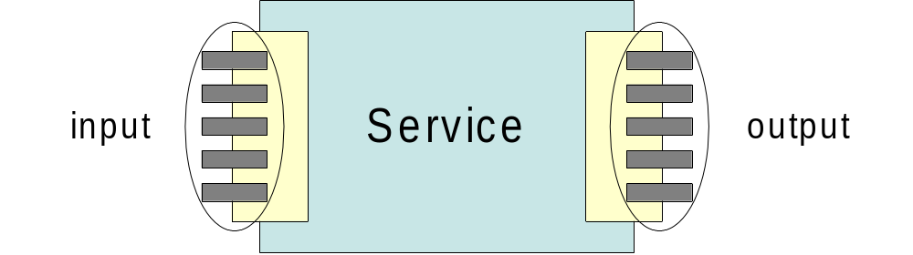
Separate Pre / Post sets
No relation between concrete pre and post states
Pre and Post states are expressed in logically separate descriptions

Slide 22
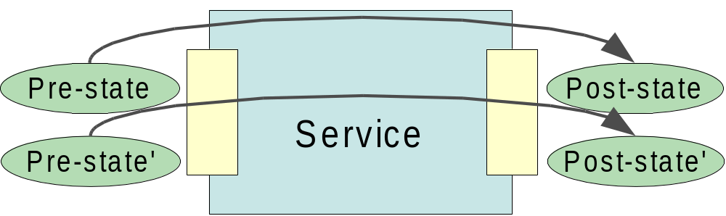
Including State Transition
Model describes transition function and allows to calculate post state given a concrete pre sate

Slide 23
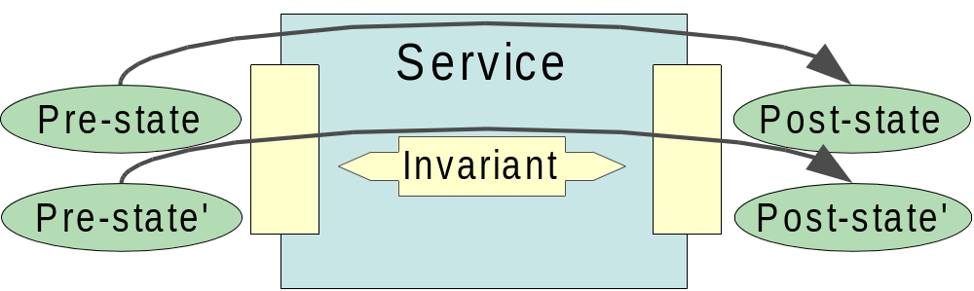
Adding Invariants
Invariants must hold during complete execution
Invariants, pre and post state expressed using “static” language

Slide 24
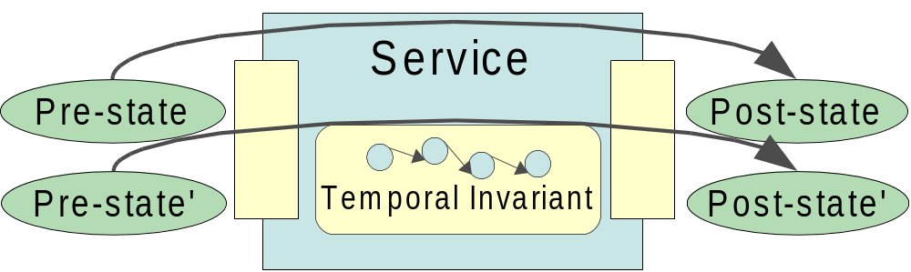
Adding Temporal Invariants
Expressing “product must have been send before credit card is charged”
Needs assertion language that is aware of state transition

Slide 25
Use Case – Interoperation and Invocation of WS, link to Industry
Paavo Kotinurmi, Tomas Vitvar

Slide 26
Interoperation and Invocation of Web Services – Overview
Introduction
Integration Scenario
Semantic Web Services and B2B Integration Process
Future work

Slide 27
Introduction
SWS – core concepts lie in interoperation
  Interoperation achieved by common domain ontology
  Interoperation achieved by mediation
Mediation Levels
  Technical Level – protocol, language syntax
  Data Mediation – semantics
  Process Mediation – mediation of process (choreographies)
Goal: guidelines for achieving interoperation and invocation of services in the inter-enterprise integration settings

Slide 28
Scope of Mediation
Semantic Web Services Architecture
  Services being integrated are using non-semantic languages (e.g. XML Schema)
  For data and process mediation – common WSML language is required
  SWS Architecture is built on ontology language (WSML)

Slide 29
Scope of Mediation
Technical Level
  happens outside of SWS architecture
  Facilitated by adapters
  Functions:
    Transformation of communication protocols (not of interest of this work)
    Lifting and Lowering – ontologizing
      Translation from non-semantic message to semantic level (lifting) (e.g. from XML to WSML)
      Translation from semantic level to non-semantic message (lowering) (e.g. WSML to XML)

Slide 30
Scope of Mediation
Data Level
  Design-time stage: mappings between source and target ontologies
  Run-time stage: mapping rules execution during SWS execution process when mediation is needed
  Data Mediation is not of interest of this deliverable, it is partially being solved in DIP
  Data Mediation and mapping language will be subject of collaboration with WP2.2 Heterogeneity

Slide 31
Scope of Mediation
Process Level
  Services are using different choreographies (described in WSML)
  Mediation between choreographies
  Process Mediation is not of interest of this deliverable, it is solved in DIP

Slide 32
B2B Integration Scenario
Business partners
  Both using different B2B standards
  Differences in communication protocols, languages used, semantics and choreographies
  Goal: make interoperation possible when different B2B standards are used by partners
Focus of the deliverable within the scenario
  RosettaNet Request for Quote – PIP3A1
  RosettaNet Purchase Order – PIP3A4

Slide 33
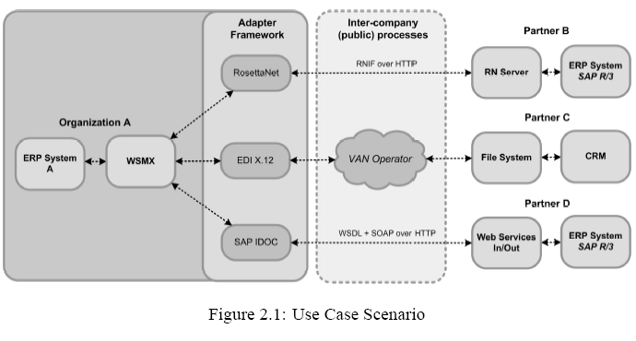
Integration Scenario

Slide 34
Integration Process
Phase I: Integration Set-up Phase
    (1) Semantic service creation (e.g. for RosettaNet messages) (ontology, capability, interface)
    (2) Registering of ontologies and services with SWS environment (WSMX)
    (3) Mappings between new ontologies and existing ontologies
Phase II: Integration Run-time Phase
    SWS Execution Process (execution semantics)

Slide 35
Semantic Service Creation – Steps
For each PIP used:
  Ontologizing and rules for lifting/lowering
  Description of Service Capabilities in WSML
  Description of Service Interface in WSML
Design of Adapter Web Service Interface with WSMX
Design of Interface for Partner using RosettaNet

Slide 36
Semantic Service
Web Service Interface
with WSMX
Registration Interface
for RN Partner
PIP xyz
PIP xyz
WSMX
PIP xyz
RosettaNet
Partner
Ontologies +
rules
capability
Interface
Communication Interface
with RN Partner

Slide 37
Set-up: (1) Semantic Service Creation
Ontologizing and rules for lifting/lowering
  Semi-automated process
  Creation of WSML ontology for RosettaNet messages
  Creation of transformation rules from PIP3Ax XML to WSML Ontology
  Introducing more semantics into the message

Slide 38
Set-up: (1) Semantic Service Creation
Creation of service capabilities in WSML
  Based on WSML Ontology (for RosettaNet message)
  Description of precondition, assumptions, postconditions and effects
Creation of service interfaces in WSML
  Choreography and Orchestration

Slide 39
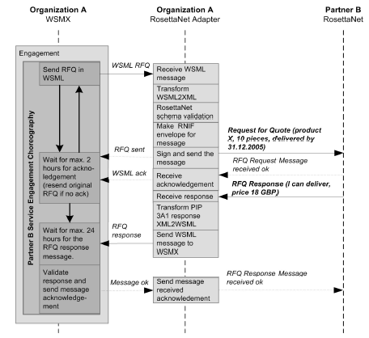
Integration Scenario – RosettaNet
Choreography interface of RosettaNet Service

Slide 40
Set-up: (1) Semantic Service Creation
Design of Web Service Interface with WSMX
  Adapter – wrapper for Semantic Service
  Technical-level Integration between WSMX and “semantic service”
  Web Service WSDL interface
  Service Choreography grounded to this WSDL specification

Slide 41
Set-up: (1) Semantic Service Creation
Design of Interface for Partner using RosettaNet
  Registration Interface
    Pip1, pip2, …, pipN – PIPs used by the partner
    Role – Role of the partner (buyer, seller)
    Additional information: endpoint, certificate
  Communication Interface
    Built according to RosettaNet Implementation Framework for secure communication – could be integrated to commercial B2B Gateway (e.g. BizTalk)

Slide 42
Set-up: other steps
(2) Registering of ontologies with WSMX
  New ontologies are registered in Ontology Repository
(3) Mappings between new ontologies and existing ontologies
  Mappings for data mediation

Slide 43
Run-time Phase: SWS Process
(1) Partner B registers using registration interface
  publication of partner’s service in repository
  e.g. register(pip3A1, pip3A2, seller, endpoint, certificate)
  WSML Service is created out of WSML capability and interface descriptions for each PIP used.
  WSML Service is registered with WSMX

Slide 44
Run-time Phase: SWS Process
(2) Organization A from ERP system sends request to WSMX as WSML goal
  e.g. Buy 10pcs of device X and deliver them to Innsbruck
(3) Available services are discovered
(4) Engagement (contracting) is done through engagement choreography interface
  i.e. Grounding to WSDL and transformation to RN Request for Quote
(5) Selection of services based on concrete values
(6) Invocation of selected service is done through invocation choreography interface
  i.e. Grounding to WSDL and transformation to RN Purchase Order
(7) Result is sent back to ERP system

Slide 45
Future work
Building a prototype and extend existing WSMX
Implementation of the RosettaNet adapter
Ontologizing other B2B standards
SWS Challenge – major part of contribution

Slide 46



Relationships with TRIPCOM, SUPER and DIP
Francisco Martin-Recuerda, Tomas Vitvar

Slide 47
General Overview
Identify common goals and coordinate efforts is an expensive and complex task
Relevant achievements:
  WSMO/L/X is the reference framework for SWS in DIP, KW and SUPER
  Common Abstract Mapping Language for SEKT, KW and DIP (working progress)
  Joint vision of Discovery framework in DIP and KW
  SESA (Semantically Empowered Service oriented Architecture) in the future

Slide 48
General Overview
The presentation is divided in 3 main blocks:
    KW vs TRIPCOM
    KW vs SUPER
    KW vs DIP
Each part include:
  Overview of the related project
  Description of related efforts

Slide 49
KW vs. TRIPCOM
Francisco Martin-Recuerda, Tomas Vitvar

Slide 50





Space based computing
application
application
application
application
application
Notes:
One to One communication. Message flow overload

Slide 51

Space based computing
application
application
application
application
application
application
application
application
application
application
Notes:
Reduced message flow
Asynchronous communication mechanism
Improve reliability and facilitate the integration of security and trust mechanisms

Slide 52
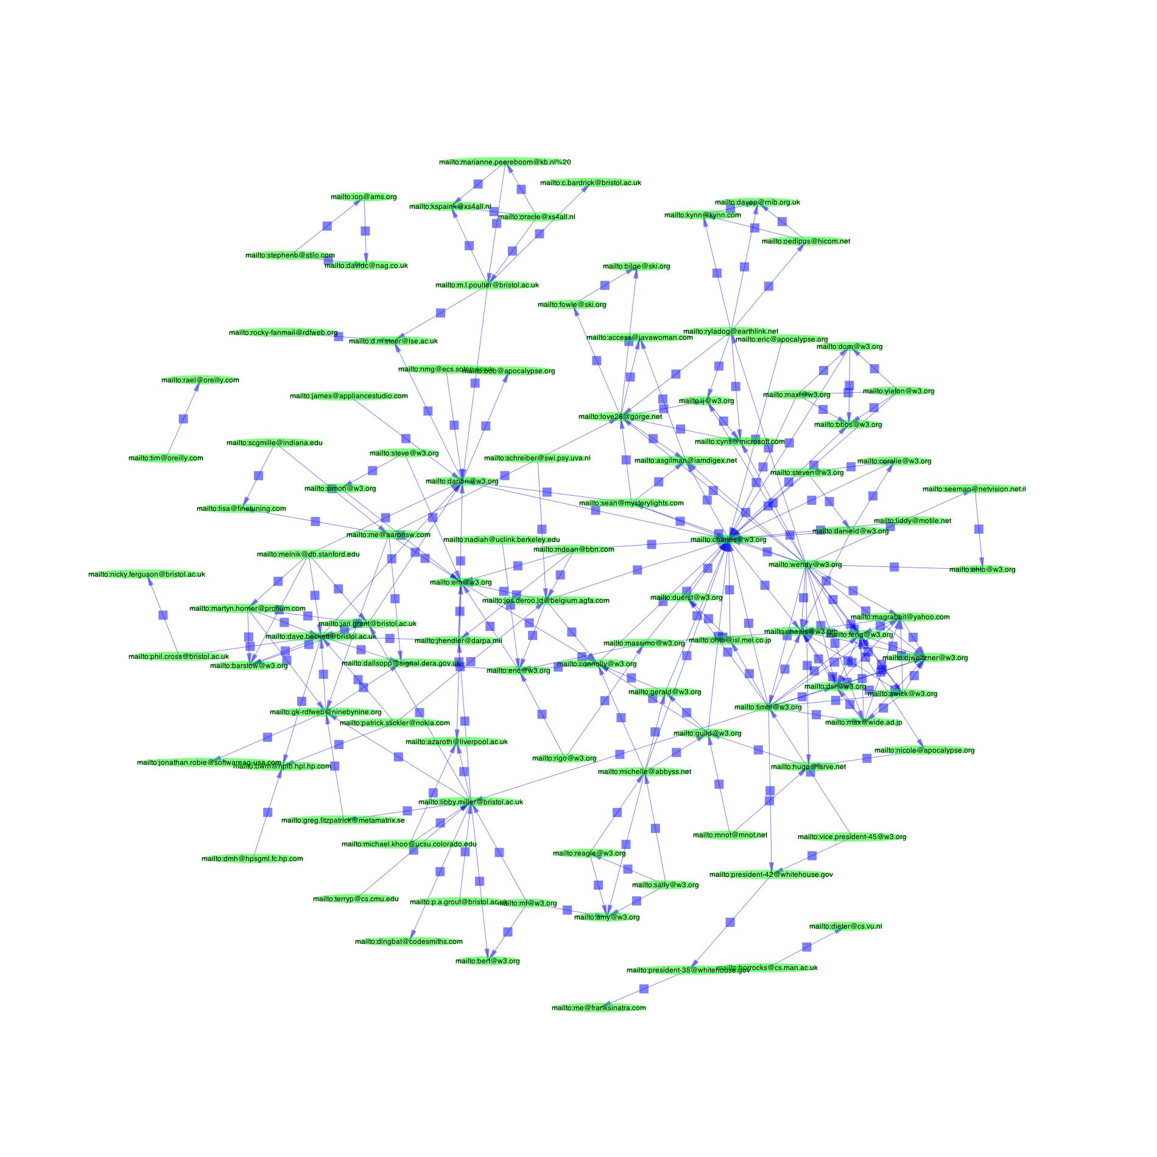
Space based computing
application
application
application
application
application
application
application
application
application
application
Notes:
Include the pictures of message passing and shared space

Slide 53
TripCom overview
Start April 2006 (3 years duration)
Common partners: UIBK, NUIG and FU-Berlin
“Transform the Semantic Web in a global persistent space for application integration and coordination”
Communication infrastructure for SESA
The outcome of the project will be the implementation of the Triple Space Computing infrastructure

Slide 54
Goals of TripCom
RDF substitute the tuple datamodel
  Scalable and distributed RDF repository
Reuse Web infrastructure (REST model)
  URI to identify resources
  Resources are stateless
  Client-server architecture
Query engine for RDF (support read operations)
Security and Trust Management
Proof of concept based on real use cases
Notes:
REST (Representational State Transfer) [Fielding, 2000] that is defined as a set of constraints (client-server architecture, stateless, cache, uniform interface, layered system, and code-on demand). The fundamental principle of REST is that resources are stateless and identified by URIs.

Slide 55
KW D2.4.8.1
Analysis and evaluation of 4 proposals in KW:
  sTuples (NOKIA)
  Semantic Web Spaces (FU Berlin)
  Triple Space Computing (UIBK-NUIG)
  CSpaces (UIBK)
Notes:
Example: planning the building of a house
we can decompose the intended final layout, separately building the components and then putting them together
we can assign a special task to each available agent, aiming at exploiting each (specialist) agent in parallel given a list of building phases, or
we can try to parallelize the building process

Slide 56
KW D2.4.8.1
KW promotes following extensions of TripCom:
  integration of publish-subscription and tuplespace computing coordination models
  super-peer architecture model (P2P + client-server)
  Not only a communication middleware but also a distributed knowledge management system.
  Use richer semantic representation formalisms than RDF
  Deal with heterogeneity problems

Slide 57
KW D2.4.8.1
Not enough resources to provide a reference implementation!
  Only some features will be tested.
Inputs from TripCom will be considered in KW and vice versa

Slide 58
KW vs. SUPER
Francisco Martin-Recuerda, Tomas Vitvar

Slide 59
SUPER overview: some definitions
Business process: describe a set of tasks, the order to be executed, the participants and resources involved, the data used to achieve a goal
Workflow: is the representation of a business process. Two main approaches:
  Constraint based: define a set of tasks and rule/constraints.
  Task flow based: define a set of tasks and transitions between tasks
Workflow Levels:
  Behaviour Level: define tasks and the order of execution (or constraints)
  Data Level: specify the data that is transferred between tasks
  Operational Level: define performative operations for each task
  Organizational Level: specify which organizational entities performs each task
Workflow Management: create, manage and execute workflows

Slide 60
SUPER Overview
Start April 2006 (3 years duration)
Common partners: UIBK, NUIG, SAP and OU
Main goals:
  Annotated Business Processes with machine processable semantics
  Development of specific ontologies for annotating business processes
  Definition of query techniques and representation formalisms for Business Processes
  Creation of mediators components for business process integration
  Integration with SW and SWS technologies (WSMO/L/X)

Slide 61

KW vs. SUPER
BEHAVIOUR LEVEL
DATA LEVEL
OPERATIONAL LEVEL
ORGANIZATIONAL LEVEL
Notes:
BEHAVIOR LEVEL: WSMO defines behavior level in terms of rule/constraint based model. SUPER may be have to provide a task flow based model
OPERATIONAL LEVEL: WSMO defines operational level in terms of grounding to Web Services only

Slide 62
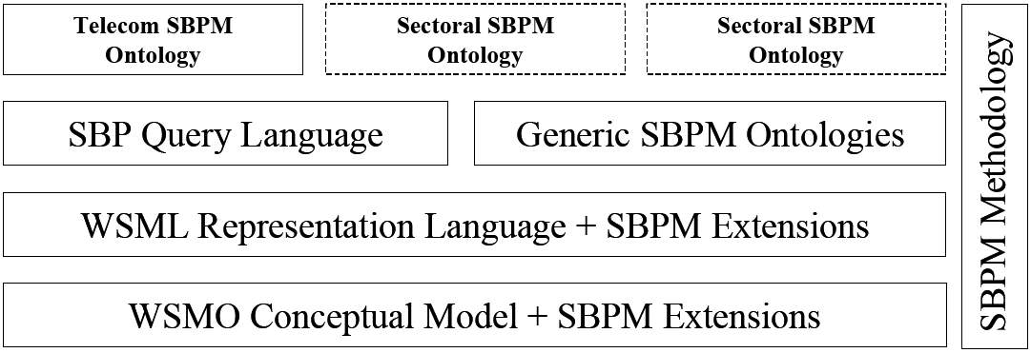
KW vs. SUPER

Slide 63
KW vs. DIP
Francisco Martin-Recuerda, Tomas Vitvar

Slide 64
DIP Overview
Started January 2004 (3 years duration)
Common partners: UIBK, NUIG, EPFL, OU and VUB
Contribute in the development of the SW
Combine SW and WS towards SWS
Apply SWS in real scenarios:
  eGoverment
  eBanking
  B2B in Telecom markets

Slide 65










DIP Overview
WP10 Case Study
eBanking
WP5 Service Mediation
ontologies and
WP15
Management
WP9 Case Study
eGovernment
WP3 Service
WP4 Service Usage
WP14 Training
Ontologies and
Service Description
WP8 Case
WP13 IPR
B2B Telecom
Activities
WP1 Ontology
WP2 Ontology
Reasoning and
Management
Querying
WP12 Market
Observation
WP7
WP11
Technology
WP6 Interoperability and Architecture
Dissemination
Watch and
Standardization

Slide 66
KW vs. DIP: Service model
DIP: D3.2 Service Description Framework
  Finished: June 2004
  Partners: UIBK, NUIG, OntoText, OU, FZI and SAP
  Main contributions:
    Requirements specification and broad overview of a Semantic Description Framework.
    Grounding for OWL-S and WSMO is provided
KW: D2.4.5 Conceptual and formal framework for SWS
  Finished: December 2005
  Partners: UIBK, NUIG, UniTn and UoM
  Main contributions:
    Revision of WSMO/L framework
    Functional specification of Web Services

Slide 67
KW vs. DIP: Discovery
DIP: D4.8 Discovery Specification
  Partners: FZI and SAP
  Finished: December 2005
  Main contributions:
    Object Based Service Description
    Abstract services as a set of concepts and their properties
KW:
  D2.4.5 Conceptual and formal framework for SWS and
  D2.4.6 Theoretical integration of Discovery and Composition
  Partners: UIBK, UniTn, EPFL
  Finished: December 2005
  Main contributions:
    Transition state based Service Description
    Abstract services as a set of transition states
Notes:
DIP
Abstract Service “objects to be delivered“
Travel Service concept: ticket (properties from (value Karlsruhe) to (value Innsbruck) vehicle (value Train))
Domestic Bank Transfer concept: transfer (properties Account1, Branch1(value Austrian Branch), Account2, Branch2 (value Austrian Branch), Amount (value <100.000), Currency (value Euros))
KW
Domestic Transfer (Account1, Branch1, Account2, Branch2, Amount, Currency)
Pre: Branch1: Austrian Branch
Branch2: Austrian Branch
Amount < balance(Account1)
Pos: balance(Account1) = balance@pre(Account1) – Amount
balance(Account2) = balance@pre(Account2) + Amount
Where pre is state 1 and pos is state 2 (only 2 states are considered in WSMO)

Slide 68
KW vs. DIP: Discovery
→ Syntactic capability
{Keyword}
→ Semantic “light“ capability
WS
Level of Abstraction
→ Semantic “heavy“ capability
Notes:
Joint vision of web services description
DIP and KW investigate different aspects (levels)

Slide 69
KW vs. DIP: Composition
DIP: D4.9 and D4.12
  Partners: ILOG
  Finished: December 2005
  Main contributions:
    configuration based workflow composition
    Prototype based on ILOG JConfigurator and WSMO 4J
KW: D2.4.6 WS Discovery and Composition
  Partners: UniTn, EPFL, UIBK
  Finished: December 2005 (prototype in June 2006)
  Main contributions:
    UniTn approach called "process-level composition" based on "planning as model checking“
    EPFL approach “functional-level composition“ is based on “forward chaining”
Notes:
In DIP:
ILOG is working on composition
ILOG is not in KW
ILOG’s approach is based on configuration based workflow composition.
For ILOG workflow composition is the process of connecting input and output message flows (choreographies are not considered) to preexisting or added workflow items, like fork, join nodes or auxiliary user input handling actions.
A configuration task consists in building (a simulation of) a complex product from components picked from a catalog of types.
Components are subject to relations, and their types are subject to inheritance. Constraints (also called well-formedness rules) generically define all the valid products. A configurator expects as input a fragment of a target object structure, and expands it to a solution of the configuration problem, if any. This problem is semi-decidable in the general case.
A configuration program is well described using a constrained object model in the form of a standard class diagram, together with wellformedness rules or constraints (UML/OCL)
Configuration emerges as an AI technique with applications in many different areas, where the problem can be formulated as the production of a finite instance of an object model subject to constraints. Reasoning about workflows falls into this category, because a workflow description is an instance of a given metamodel (as is the UML metamodel for activity diagrams [1]). Composing workflows is a configuration problem in that in so doing, one must introduce an arbitrary number of previously non existent transitions (fork, join, split, merge, transformations, pre-defined user-interactions sequences), and interconnect input and output message pins provided they have compatible types. The user of a composition system provides:
a list of potentially usable workflows, implemented in the form of partially defined instances of the workflow metamodel used, (e.g. a producer for some good, a shipper, a payment service, etc.)
the ontologies for the data types linked to the input/output messages present in the workflows (e.g. types of journeys: by train, plane, etc. , methods of payment: cheque, credit card, cash etc.)
a goal to be satisfied by the result composition (e.g. a train ticket reservation),
a list of the data input he can provide (e.g. simple “yes/no” answers, credit card number, expiry date, selected item etc.)
In KW:
Trento is working on composition.
Trento is not working in DIP, ILOG is not workin in KW.
The functional level composition and process-level composition techniques developed by Trento are not part of DIP. These techniques are state-of-the-art, as shown by the large number of publications on this topic. Trento is not developing these techniques in KW, but extending them in 2 directions:
extending them so that they can deal with semantically annotated web services;
interating them in a broader composition process, that includes service discovery and functional level composition.
The only European project funding these two activities is KW.

Slide 70
KW Composition: Functional-level vs. process-level
Web services are described at two abstraction levels:
  functional (or capability) level
    the focus is on the service inputs,
    outputs, preconditions, and effects
    WSMO capability model
    Iteratively aggregates services in order to provide a required set of capabilities
  process level
    the Web service is defined by an
    activity flow or an interaction protocol
    WSMO interface model (choreography)
    The goal is to obtain the executable code that invokes a set of Web services (orchestration).
input
Web
Service
output
protocol
Web
Service

Slide 71
KW vs. DIP: Mediation
DIP: D2.6, D5.3, D5.4, D5.5
  Partners: UIBK, NUIG, SAP, SIRMA, OU and EPFL
  Finished: June 2005 (data mediation), December 2005 (process mediation)
  Work concentrated on data, process mediation without any context of B2B integration standards
KW: D2.4.7 Interoperation and Invocation of Web Services
  Partners: NUIG
  Finished: December 2005
  Reuse of data and process mediation and particular focus on integration of RosettaNet and SWS (lifting/lowering of messages, design of WSMX-RN adapter)
Notes:
In DIP
DERI Galway and DERI Innsbruck is working on mediation
They deal with data and process mediation and definition of general adapter framework
No context of B2B integration is taken into account
In KW
DERI Galway is working on this
DERI reuses data and process mediation from DIP and concentrates on integration of RosettaNet with WSMX (ontologizing of RosettaNet message, lifting, lowering, technical interoperability)

Slide 72
KW vs. DIP: Trust
DIP: D3.6 Trading partner management and trust
  Partners: OU and SAP
  Finished: December 2005
  Main contributions:
    Credential and Policy-based trust management
    Web Service Trust management Ontology (WSTO) for expressing policies
    Used for trust-based SWS selection
KW: D2.4.7 Reputation Mechanism
  Partners: EPFL
  Finished: December 2005
  Main contribution
    Reputation-based trust management
    Reputation mechanisms as incentives for honest behavior.
    Used for trust-based SWS selection
Notes:
The primary goal of credential and policy-based trust management systems is to enable access control. In such systems, peers use credential verification to establish a trust relationship with other peers.
Reputation-based trust management systems on the other hand focus on trust computation models capable to estimate the degree of trust that can be invested in a certain party based on the history of its past behavior. The main issues of such systems are how to model and compute trust, and how to manage reputation data.

Slide 73
Management Report
Dieter Fensel, Tomas Vitvar

Slide 74
Activities within the network
Link to Research
  Bilateral meetings with Research WPs
  WP2.5 Languages – joint work on Web Rule Language
  WP2.2 Heterogeneity – Joint work on ontology mapping language
    Results in D2.4.13 Data Mediation in SWS
Link to Industry
  Use Case: Dynamic B2B Integration
    Integration of B2B Standards with SWS technology
Link to Education
  Providing education materials (WSMO Tutorial)
  Knowledge Web PhD symposium
Notes:
Link to Research
Collaboration between WP2.4 and WP2.5 Languages is going on. As a result, participants of these WP made a joint W3C submission on Web Rule Language. Apart from that, a number of bilateral meetings with research work packages took place during general assemblies in Hanover and Crete. As a result from these meetings, we concluded that the most appropriate collaboration we need to concentrate on now is collaboration with WP2.4 Heterogeneity. Heterogeneity is the key aspect of the SWS concepts and WSMO in particular. From this reason we aim to strengthen data mediation concepts and tools in SWS by working on ontology mapping language with WP2.2. Results of this work will be documented in deliverable D2.4.13 Data Mediation in SWS.
Link to Industry
A number of use cases has been proposed by Industry area. During GA meeting in Crete, joint workshop between industry and research areas took place with aim to present use cases proposed by industry area. It has been pointed out, that none of proposed use cases takes into account service oriented integration scenarios. From this reason we agreed with industry area, that in collaboratio with industrial partners we propose use case from area of B2B integration where service-oriented aspects play the core role. This use case is reflected in the deliverable interoperation and invocation of WS.
Link to Education
WP2.4 contributes to the cooperation among doctoral students as part of Knowledge Web PhD symposium. WP2.4 leader is the member of the scientific board of this symposium and WP2.4 members will participate in this symposium in order to facilitate discussions and provide feedbacks in the areas of semantic service-oriented integration based on the SWS concepts and technology.

Slide 75
Cross Work Package Relationship
Use Case on B2B Integration (part of SWS challenge)
Collaboration on Web Rule Language (D2.4.13)
Alignment of mapping language for SWS mediation
Providing education materials and contributing to Knowledge Web PhD symposium (PC)
Modularize SWS
Approximate SWS
discovery
Benchmarking SWS
industry
WP2.1
WP2.2
WP2.4
WP2.3
WP2.5
education
Notes:
Link to Research
Collaboration between WP2.4 and WP2.5 Languages is going on. As a result, participants of these WP made a joint W3C submission on Web Rule Language. Apart from that, a number of bilateral meetings with research work packages took place during general assemblies in Hanover and Crete. As a result from these meetings, we concluded that the most appropriate collaboration we need to concentrate on now is collaboration with WP2.4 Heterogeneity. Heterogeneity is the key aspect of the SWS concepts and WSMO in particular. From this reason we aim to strengthen data mediation concepts and tools in SWS by working on ontology mapping language with WP2.2. Results of this work will be documented in deliverable D2.4.13 Data Mediation in SWS.
Link to Industry
A number of use cases has been proposed by Industry area. During GA meeting in Crete, joint workshop between industry and research areas took place with aim to present use cases proposed by industry area. It has been pointed out, that none of proposed use cases takes into account service oriented integration scenarios. From this reason we agreed with industry area, that in collaboratio with industrial partners we propose use case from area of B2B integration where service-oriented aspects play the core role. This use case is reflected in the deliverable interoperation and invocation of WS.
Link to Education
WP2.4 contributes to the cooperation among doctoral students as part of Knowledge Web PhD symposium. WP2.4 leader is the member of the scientific board of this symposium and WP2.4 members will participate in this symposium in order to facilitate discussions and provide feedbacks in the areas of semantic service-oriented integration based on the SWS concepts and technology.

Slide 76
Dissemination
Publications
  Conference papers: 13
  Journal articles: 3
  Workshop papers: 12
  Tutorials: 4
Standards & Working Groups:
  W3C Submission: WSMO, WSML, WSMX
  W3C Submission: Web Rule Language
  OASIS Semantic Execution Environment Technical Committee (aim to standardize architecture for SWS based on WSMX) – driven by DERI
    Started in November 2005
SWS Challenge

Slide 77
SWS Challenge
Goal:
  Integration of legacy systems and existing B2B standard (RosettaNet) by means of emerging semantic technologies
  Address challenges for (semi) automation of mediation, choreography and discovery of Web Services using semantic annotations
  This use case is a driving use case for WP2.4
Two Phases
  Phase 1: 9-10 March, Stanford, USA
  Phase 2: 15-16 June, Budwa, Montenegro

Slide 78
SWS Challenge
Phase 1
  Presentations and discussions on emerging technologies which could address the challenge
  Challenge Refinement
  Participants
    DERI Galway, DERI Innsbruck, DERI Stanford,
    North Carolina State University,
    IBM,
    University of Georgia (LSDIS Lab),
    University of Karlsruhe,
    …

Slide 79
SWS Challenge
Phase 2
  Organized as part of Knowledge Web GA in Budwa, Montenegro
  Each participant will demonstrate on a working prototype how its technology address dynamic environment
    Integration with legacy systems and standards
    mediation
    choreography
    discovery of services
  participants will be asked to reconfigure their software to meet new requirements

Slide 80
PMs per Finished and Ongoing Deliverables
Total | UIBK | EPFL | FU Berlin | NUIG | LivUni | VUM | FT | UniTn | Total
Planned Spent | 15.00 7.50 | 11.56 9.50 | 3.00 1.00 | 7.00 3.25 | 3.43 1.50 | 2.45 1.00 | 2.00 1.00 | 2.42 1.20 | 46.86 21.00
D2.4.5 – Conceptual and formal framework for SWS (finished)
Planned Spent | 2.50 2.50 |  |  | 0.25 0.25 |  | 1.00 1.00 | 1.00 1.00 | 0.20 0.20 | 4.95 4.95
D2.4.7 – Invocation and Interoperation of WS (not finished)
Planned Spent |  |  |  | 4.00 3.00 | 1.00 0.50 |  |  |  | 7.00 3.50
D2.4.9 – Reputation Mechanism (finished)
Planned Spent |  | 4.00 4.00 |  |  |  |  |  |  | 4.00 4.00
D2.4.6 – Integration of WS discovery and composition (not finished)
Planned Spent | 2.00 2.00 | 5.40 4.50 |  |  | 1.00 1.00 |  |  | 1.00 1.00 | 10.40 8.50
D2.4.8 – Triple Space Computing (not finished)
Planned Spent | 6.00 3.00 | 1.00 1.00 | 2.00 1.00 |  |  |  |  |  | 9.00 5.00

Slide 81
Tasks and Deliverables
D2.4.5 Conceptual and Formal
Framework for SWS
D2.4.13 Data Mediation for SWS,
prototype for data mediation
D2.4.7 Web Service Invocation and Interoperation, prototype
D2.4.9 Reputation Mechanism
D2.4.11 Reputation-based Service
Level Agreements
D2.4.6 Integration of WS Discovery and Composition, prototype
D2.4.12 Decentralized orchestration
of composite Web Services
D2.4.8 Triple Space Computing
Semantic Space
Computing
Semantic Space
prototype
Guidelines for the
integration of
agent-based and WS
D2.4.10 Architecture and execution semantics for SWS
We are
here
M30 Demo
12
18
24
30
36
42
SWS challenge
Notes:
In M24, several deliverables have been finished in its first version and final version. In particular, these are
final version of Conceptual and formal framework for SWS as an extension of current WSMO specifications,
first version of web service invocation and interoperation,
final version of reputation mechanism for web services,
final version of integration of web service discovery and composition,
first version of triple space computing.
In M24, we have updated the JPA for months 25-42 based on inputs from all partners. As a result, a number of new tasks and deliverables as continuation of work in KW were defined:
Data Mediation for SWS including a prototype – this work will be the main bridge for collaboration with WP2.2 Heterogeneity with aim to work on joint mapping language for data mediation for SWS and ontology alignment. This work will also aim to specify and implement one of the types of WSMO mediators, i.e. OOMediator (DERI Galway).
Decentralized orchestration of composite web services as follow up on the integrated discovery and composition task, the goal of this deliverable is to investigate decentralized orchestration schemes in order to overcome the limitations of the centralized approach.
Reputation-based SLA as follow up on reputation mechanism - this task will investigate a new form of service level agreement where the price is determined by the QoS actually delivered. The goal is to make it optimal for the service provider to deliver the service at the promised quality. To allow efficient monitoring of the actual QoS, a reputation mechanism will be used.
Tuple space computing – The goal of this task will be to define a persistent communication mechanism for Semantic Web Services based on Semantic Web technologies and Tuple Space Computing paradigm (based on sTuples (NOKIA), Triple Space Computing (UIBK), CSpaces (UIBK) and Semantic Web Spaces (FU Berlin).
Architecture and execution semantics for SWS – Based on guidelines for the integration of agent-based and WS technologies and existing SWS architecture defined by WSMX, the goal of this work will be to define architecture with dynamic execution semantics with ability to adapt to changes outside of the system.

Slide 82
Thanks for your attention!

